Slide 1
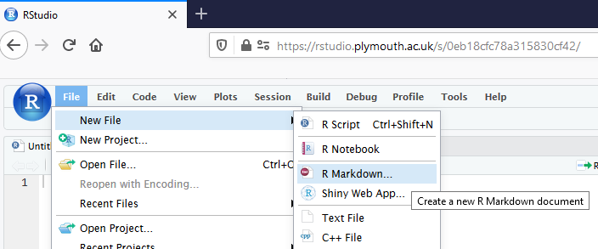
R Markdown files allow you to easily embed R code, tables, figures and text within a report
Go to File > New File > R Markdown
Using Rmd files. Chris Berry. Nov 2020

Slide 2
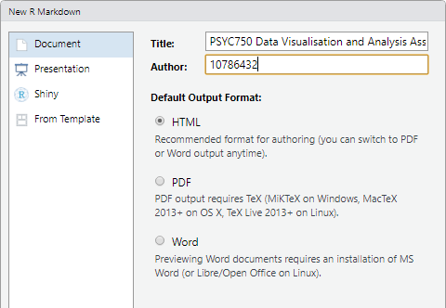
R Markdown files
Give your assignment a title
(you can change it later)
SRN
html
as output format (should be by default)

Slide 3
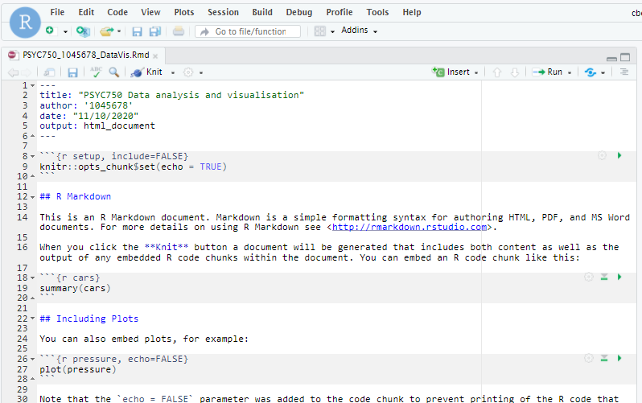
An Rmd document (text generated by default)

Slide 4
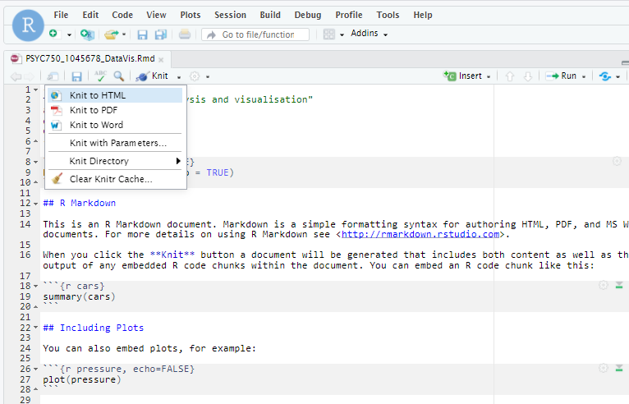
Click ‘Knit’ to generate an html report from the Rmd document
Check your code very carefully if you get an error

Slide 5
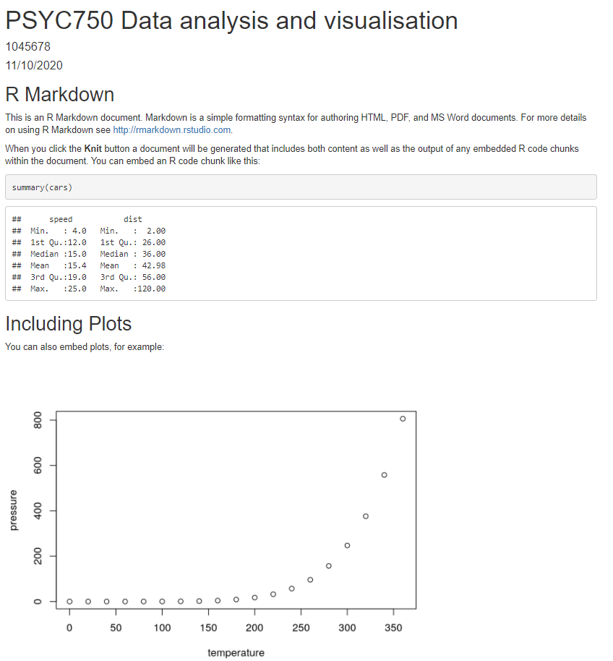
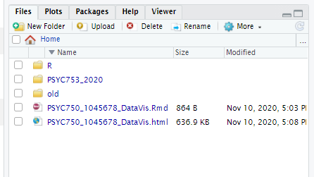
The html report will appear in the ‘Files’ panel of R studio
See how your html came out
Edit the Rmd
Repeat as required
Click on the html, select view in web browser

Slide 6
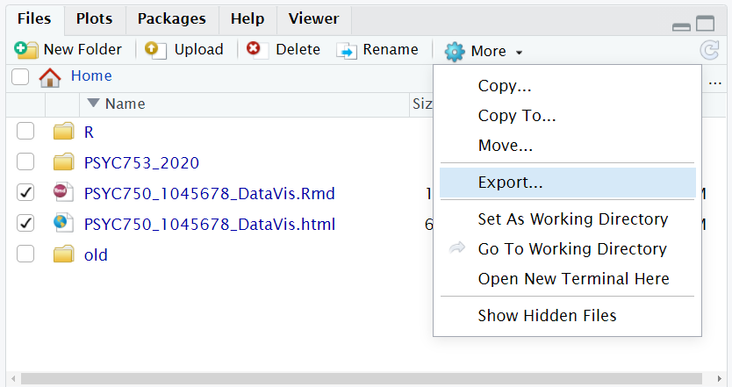
To submit to the DLE: Export the html file AND Rmd file from RStudio to your PC first
2
1
3
Once the files are on your hard drive, submit to the DLE as usual

Slide 7
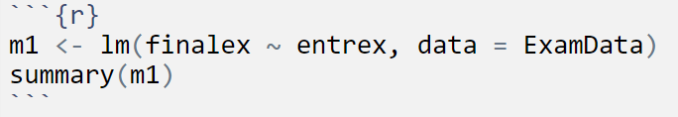
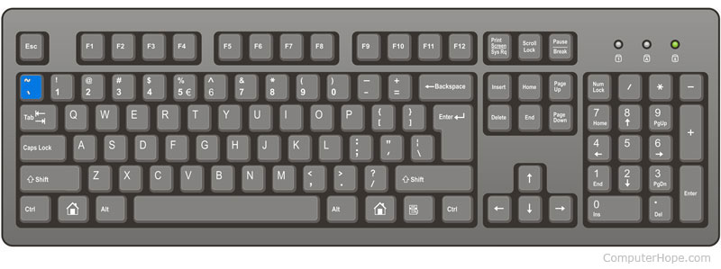
Tips on writing your Rmd file
R code is embedded in chunks:
The “backtick” symbol `
is the top left key of most keyboards

Slide 8
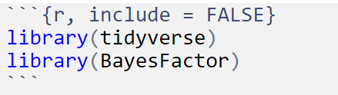
Tips on writing your Rmd file
Load up packages in a chunk at the start (you only have to load packages once), e.g.,
include = FALSE
means the code (and associated output) won’t appear in the PDF
Handy to hide unnecessary output in your report

Slide 9
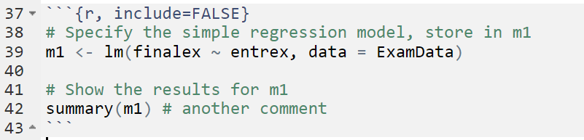
Tips on writing your Rmd file
You can add comments in chunks by using #

Slide 10
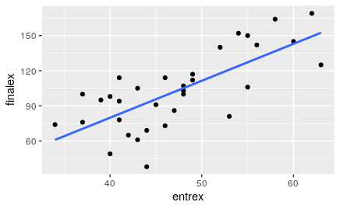
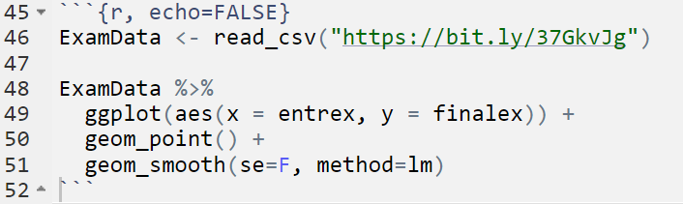
Tips on writing your Rmd file
Use echo = FALSE to show the output (e.g., a figure), but not the code in your report

Slide 11
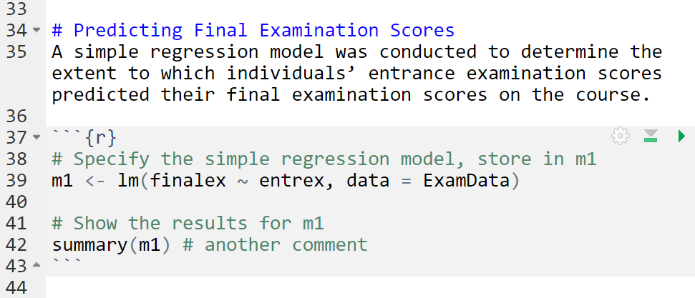
Tips on writing your Rmd file
Outside the code chunk: Write your text; use “#” to specify a heading.

Slide 12
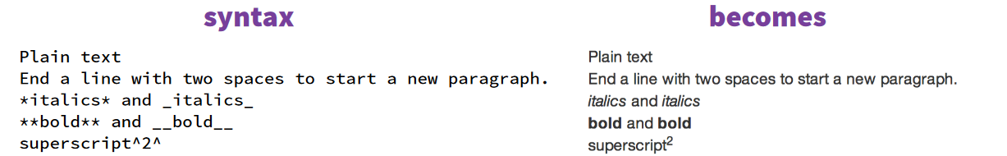
Tips on writing your Rmd file
_F_(1, 28) = 123.45, _p_ < .001
F(1, 28) = 123.45, p < .001
_R_^2^
R²

Slide 13
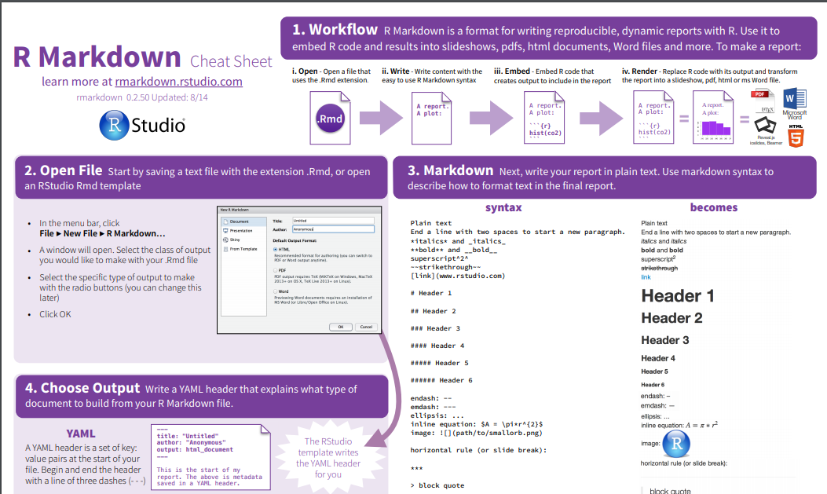
Useful R Markdown Cheatsheet
https://rstudio.com/wp-content/uploads/2015/02/rmarkdown-cheatsheet.pdf

Slide 14
Importantly
Start early
Play around
Persevere!

