Slide 1

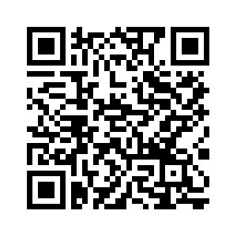
PSYC761
8: Mixed Models (an introduction)
Dr Chris Berry School of Psychology University of Plymouth PSQ B212 christopher.berry@plymouth.ac.uk
Book an office appointment:
Usually Tue and Fri 1-2pm
Scan QR code or click here
Check in code
**-**-**

Slide 2
Dependency in data
Dependencies often exist in psychological data
There may be multiple data points from different:
participants
classrooms
hospitals
items
Data within each of these groupings tends to be correlated
some participants may do better than others
some stimuli are easy/difficult
Technically, such dependencies violate the assumption of independence of data points in regression/ANOVA. A traditional approach is to average over data points prior to analysis (e.g., average RTs across items, then do a repeated measures ANOVA).

Slide 3
Mixed Models
Short for Linear Mixed Models (LMM)
A generalisation of multiple regression
Increasingly popular in psychology
Accounts for the dependencies between groupings in the data
Other known advantages
Provides more accurate and generalisable estimates of effects
Greater statistical power
Non-inflated Type I errors

Slide 4
Fixed vs. Random Effects
Fixed effect:
An effect thought to generalise to the population.
Usually a manipulated independent variable.
Random effect:
Explains variance in the outcome variable
but is usually treated as a ‘nuisance’ background variable
Sometimes referred to as a grouping factor.
Always a categorical variable, e.g.,
Participant
Item
Classroom
Hospital

Slide 5
Fixed vs. Random Effects
We usually want to know the fixed effect after accounting for any random effects.
e.g. what is the effect of difficulty, generalised across participants?
You can have several fixed and random effects
Repeated measures ANOVA is a special case of LMM where participant is a random effect.

Slide 6
Conceptual representation: Venn Diagram
The variance explained by the random effect (e.g., participant, item) is first accounted for.
Then the unique contribution of the fixed effect (e.g., Difficulty) is assessed.
The fixed effect explains a greater proportion of the remaining variance, compared to a model that does not include the random effect.
Therefore, there’s typically greater power to detect the fixed effect.
1
Participant
Item
2
Participant
Difficulty
Item
More →
Area of box = variance in DV to be explained.
Area outside circle = the remaining variance to be explained, also called the residual or error variance

Slide 7
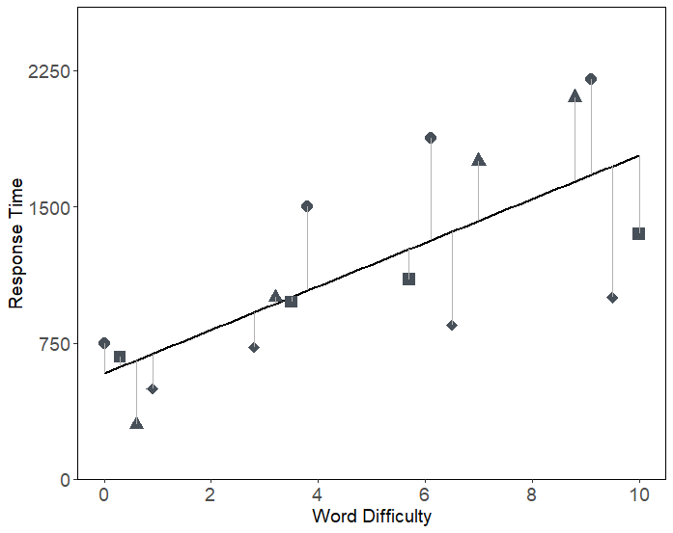
Conceptual representation: Regression Line Fixed effects model
Simple example:
The effects of word difficulty on RT
Each ppt represented by diff type symbol (,  etc.)
Large residual error (vertical distances)
Brown, V. A. (2021). An introduction to linear mixed-effects modeling in R. Advances in Methods and Practices in Psychological Science, 4(1), Article 2515245920960351. https://doi.org/10.1177/2515245920960351

Slide 8
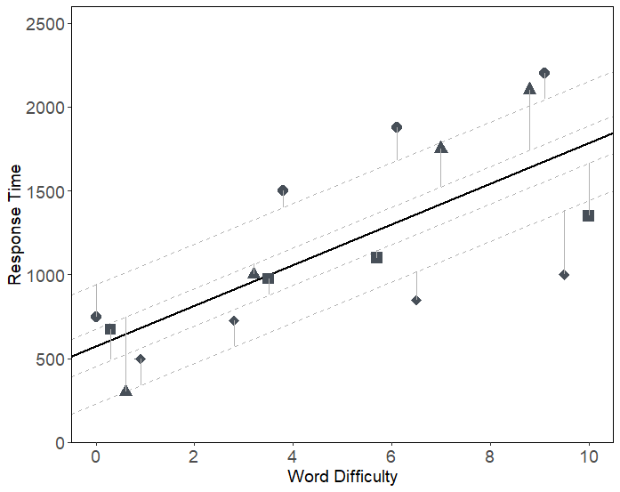
Conceptual representation: Regression Line + Random Intercepts
Each participant is now modelled as having their own regression line with its own intercept
The residual error decreases
Brown, V. A. (2021). An introduction to linear mixed-effects modeling in R. Advances in Methods and Practices in Psychological Science, 4(1), Article 2515245920960351. https://doi.org/10.1177/2515245920960351

Slide 9
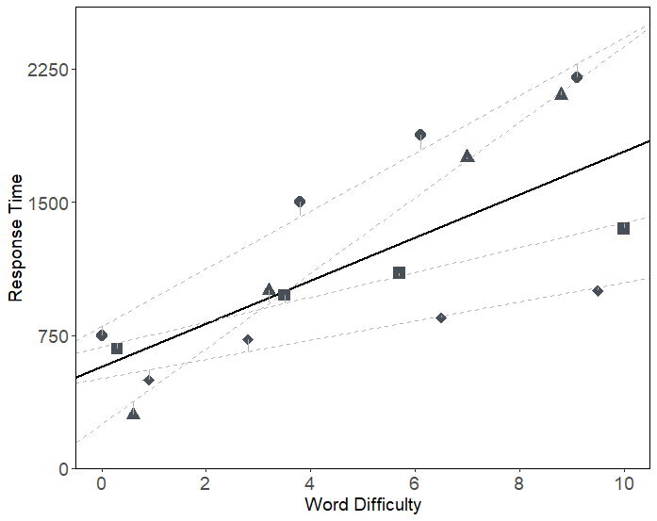
Conceptual representation: Regression Line + Random slopes
Each participant is now modelled as also having their own slope
The residual error decreases even more
“By-participant”
random intercepts and slopes
Brown, V. A. (2021). An introduction to linear mixed-effects modeling in R. Advances in Methods and Practices in Psychological Science, 4(1), Article 2515245920960351. https://doi.org/10.1177/2515245920960351

Slide 10
More on Random Intercepts and Slopes
Random Intercepts
Represent individual differences in the mean across all conditions. Can be
By-participant
By-item
Random slopes
Represent individual difference in the effect of a predictor
By-participant
By-item

Slide 11
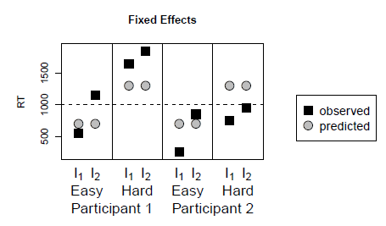
An example with items…
A reaction time (RT) experiment:
Conditions: Easy, Hard
Participants: 1, 2
Items: I₁, I₂
Trends in the data ( )
RTs tend to be:
slower in the hard condition
slower for participant 1
slower for item 2
What are the fixed and random effects?
Fixed: Condition (difficulty)
Random: Participants, Items
From:
Singmann, H., & Kellen, D. (2019). An Introduction to Mixed Models for Experimental Psychology. In D. H. Spieler & E. Schumacher (Eds.), New Methods in Cognitive Psychology (pp. 4–31). Psychology Press.

Slide 12
The Fixed Effects Model
Accounts for the difference in easy vs. hard () only
BUT ignores the dependencies within
Participant
Item
From:
Singmann, H., & Kellen, D. (2019). An Introduction to Mixed Models for Experimental Psychology. In D. H. Spieler & E. Schumacher (Eds.), New Methods in Cognitive Psychology (pp. 4–31). Psychology Press.

Slide 13
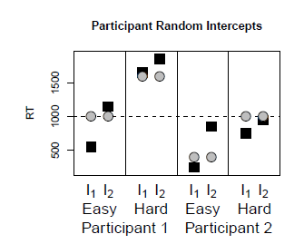

Random Intercepts Model (Participant)
Each participant also has their own mean RT
Participant 1 is slower
From:
Singmann, H., & Kellen, D. (2019). An Introduction to Mixed Models for Experimental Psychology. In D. H. Spieler & E. Schumacher (Eds.), New Methods in Cognitive Psychology (pp. 4–31). Psychology Press.

Slide 14
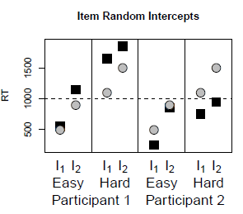
Random Intercepts Model (Item)
Each item now also has its own mean RT
RTs for Item 2 are slower
From:
Singmann, H., & Kellen, D. (2019). An Introduction to Mixed Models for Experimental Psychology. In D. H. Spieler & E. Schumacher (Eds.), New Methods in Cognitive Psychology (pp. 4–31). Psychology Press.

Slide 15
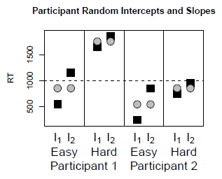
Random Intercepts and Slopes Model (Participant)
Random slopes
The fixed effect of difficulty can be different for each participant
e.g., smaller for Participant 2
From:
Singmann, H., & Kellen, D. (2019). An Introduction to Mixed Models for Experimental Psychology. In D. H. Spieler & E. Schumacher (Eds.), New Methods in Cognitive Psychology (pp. 4–31). Psychology Press.

Slide 16
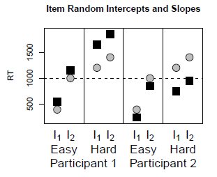
Random Intercepts and Slopes Model (Item)
Random slopes
The fixed effect of difficulty can be different for each item
e.g., smaller for Item 2
From:
Singmann, H., & Kellen, D. (2019). An Introduction to Mixed Models for Experimental Psychology. In D. H. Spieler & E. Schumacher (Eds.), New Methods in Cognitive Psychology (pp. 4–31). Psychology Press.

Slide 17
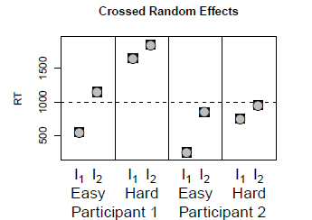
Crossed Random Effects Random Intercepts and Slopes Model (Participant AND Item)
The fixed effect of difficulty is different for each participant AND item
There are now too many parameters relative to data points necessary to identify them.
The model perfectly describes the data, but is said to be “non-identifiable”.
From:
Singmann, H., & Kellen, D. (2019). An Introduction to Mixed Models for Experimental Psychology. In D. H. Spieler & E. Schumacher (Eds.), New Methods in Cognitive Psychology (pp. 4–31). Psychology Press.

Slide 18
Random effects (intercepts and slopes) can be correlated.
e.g., slower participants have a larger difficulty effect.
The correlation can included or constrained to be zero
Not including random slopes can inflate the Type I error rate.
i.e., You are more likely to falsely find that a fixed effect is significant

Slide 19
Which model? Keep it maximal (Barr et al., 2013)
In general, greatest accuracy is achieved by adopting the maximal random effects structure justified by the design.
Include random intercepts, slopes, and their correlation for a given random effect as a starting point
Each random effect grouping variable must have at least 5 or 6 levels (Bolker, 2015).

Slide 20
Mixed Models in R
R package for mixed models:
lme4 (Bates et al., 2015).
The function for linear mixed model (LMM):
lmer()
Data needs to be in long format
In LMM, the outcome variable is continuous

Slide 21
Other Types of Mixed Models
For a binary outcome variables, e.g.,
Correct vs. incorrect
Success vs. failure
Attended vs. absent
the model is called a Generalised Linear Mixed effects Model (GLMM)
Use the glmer() function in lme4 package

Slide 22
Mixed models in the literature…
LMMs
Effects of difficulty and signal-to-noise ratio on RT after accounting for participant and item effects (Brown, 2021).
Predicting hallucinatory experiences from demographic variables (e.g., age, gender), and measures of cognitive performance (e.g., digit span), controlling for data-collection site (Moseley et al., 2021).
GLMMs
Effects of predictability and sequence position on a binary memory accuracy measure, controlling for participant (Gasser & Davachi, 2023)
Effects of experimental condition on binary accuracy measure, controlling for participant and trial (Bryant et al., 2018).

Slide 23
Activity: Remainder of Session
Start Worksheet 8 and Exercises using RStudio
Please ask me if you have any questions on the code or concepts.
Worksheet 8:
https://chrisjberry.github.io/datafluencyCB/
(or DLE)
Good luck in the assignment, don’t forget instructions on DLE and FAQ webpage ☺

