Slide 1
PSYC753: Data Fluency
Fitting Curves
Dr Chris Berry
School of Psychology
University of Plymouth
christopher.berry@plymouth.ac.uk
www.plymouth.ac.uk/staff/christopher-berry

Slide 2
Today
Overview:
- RMarkdown recap
- Polynomials
Workshop
Don’t forget!
- Supplementary sessions: Fri 1-2
- Data Analysis and Visualisation Assignment due 27 Feb 4pm

Slide 3
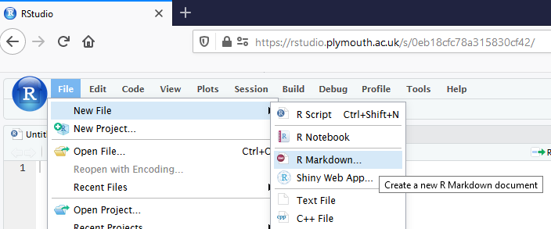
R Markdown files
Also covered previously in Ben’s sessions: https://benwhalley.github.io/datafluency/rmarkdown.html
File > New File > R Markdown

Slide 4
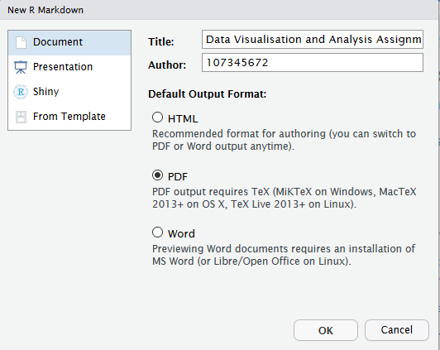
R Markdown files
Give your assignment a title
(you can change it later)
PDF
as output format

Slide 5
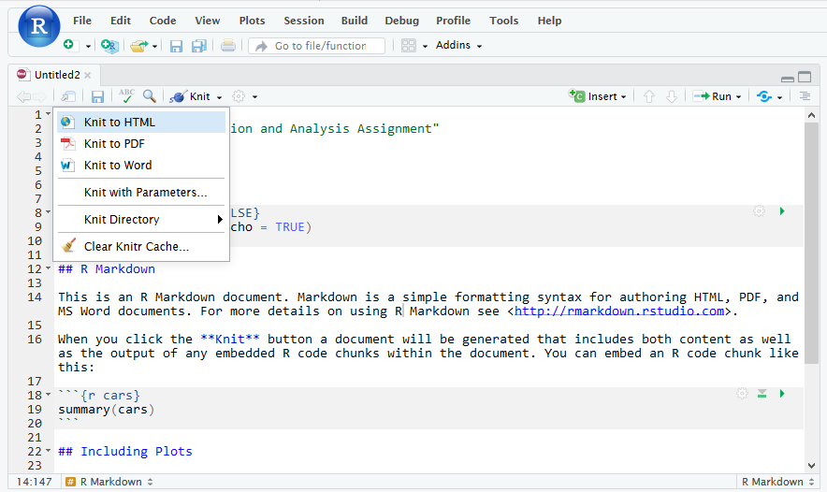
‘Knit’ the document to convert to PDF
Errors are likely at this stage!
- Check your code very carefully for errors
- Session > Restart R

Slide 6
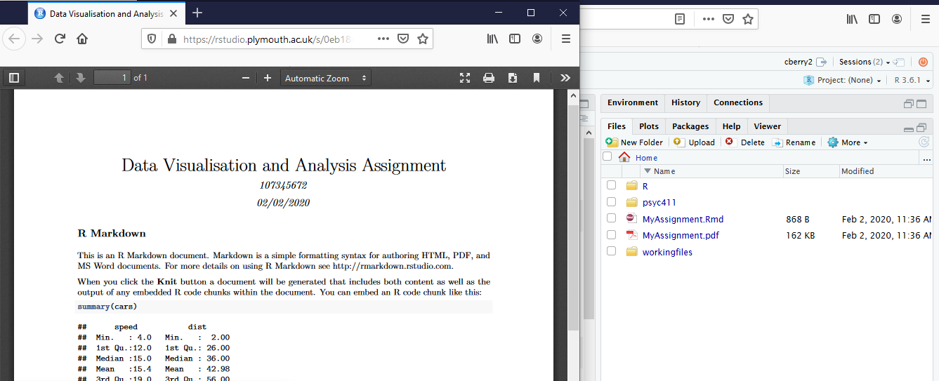
Saved files and the PDF appear in ‘Files’ pane of R studio
Click on the PDF to preview it
Check how your PDF came out.

Slide 7
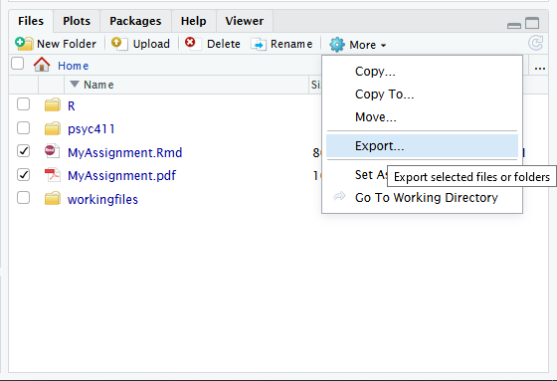
Export the PDF and Rmd from RStudio to your PC

Slide 8
Tips on getting started
Include r code in chunks:
```{r}
m1 <- lm(finalex ~ entrex, data = ExamData)
summary(m1)
```
The “backtick” symbol `
is the top left key of most keyboards

Slide 9
Tips on getting started
Load up packages at the start
(you only have to load packages once), e.g.,
```{r, include = FALSE}
library(tidyverse)
library(BayesFactor)
```
include = FALSE
Means the code (and associated output) won’t appear in the PDF

Slide 10
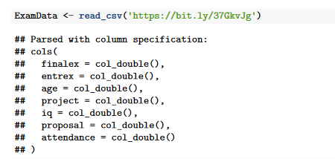
Tips on getting started
Use
eval = FALSE
to suppress cumbersome output appearing in your PDF
```{r, eval = FALSE}
# Load the data
ExamData <- read_csv('https://bit.ly/37GkvJg')
```
Stops this bit from appearing in your PDF:

Slide 11
Tips on getting started
You can add annotations by using #
```{r}
# Specify the simple regression model, store in m1
m1 <- lm(finalex ~ entrex, data = ExamData)
# Show the results for m1
summary(m1)
```

Slide 12
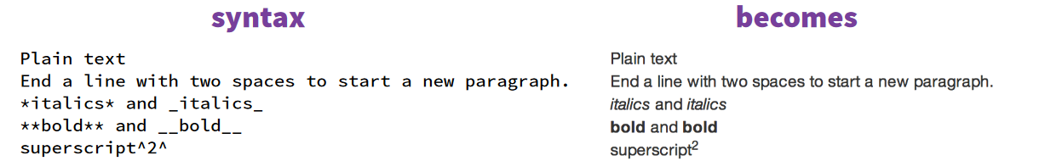
Tips on writing your answers in rmd
_F_(1, 28) = 123.45, _p_ < .001
F(1, 28) = 123.45, p < .001
_R_^2^
R²

Slide 13
Importantly
Start early
Experiment
Persevere!

Slide 14
Fitting Curves

Slide 15

Fitting Curves
So far, we’ve only fit linear models of the form:
Ŷ = a + b₁X₁ + b₂X₂
But, maybe non-linear relationships exist in the world!

Slide 16
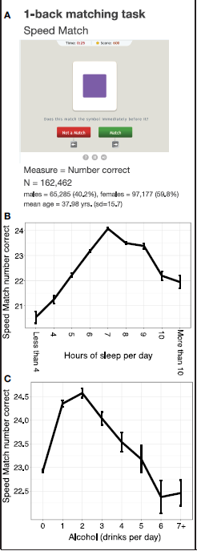
Sternberg et al. (2013)
Lifestyle factors and cognitive performance

Slide 17
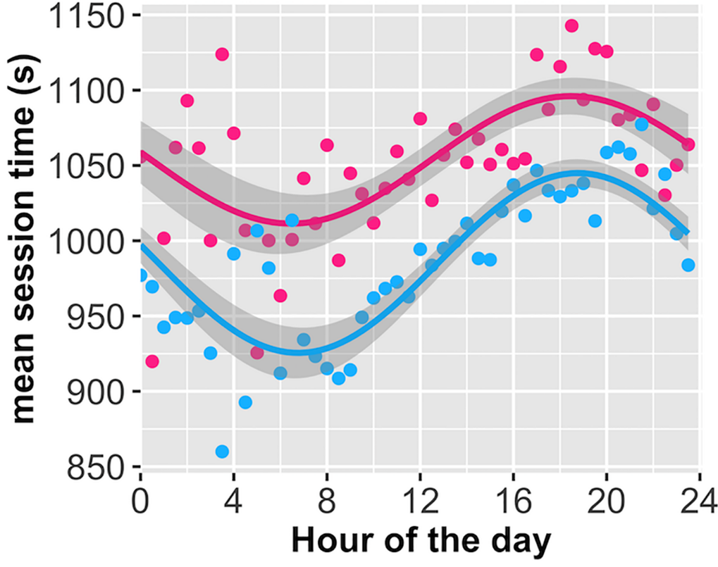
Randles et al. (2017)
Online session length vs. time of day

Slide 18
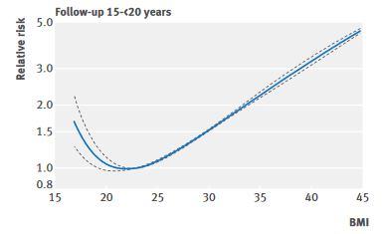
Aune et al. (2016)
BMI vs Mortality

Slide 19
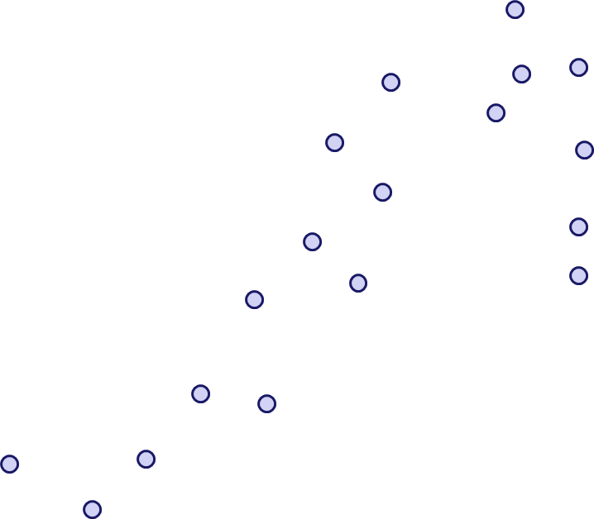
Fitting curves rather than straight lines
Ŷ =a + b₁x + b₂x² + b₃x³ + b₄x⁴ ...
Any curve can be fitted with a polynomial
We can think of a curve as being made up of these components…

Slide 20
y = 1
“Constant”
0

Slide 21
y = 0.5x
“Linear”
0

Slide 22
y = 1 + 0.5x
0
“Constant”
+ “Linear”

Slide 23
y = x²
“Quadratic”
0

Slide 24
y = -x²
0

Slide 25
y = 1 + 0.5x - x²
“Linear”
“Constant”
0
“Quadratic”

Slide 26
Using polynomials
Assess statistical significance using a hierarchical modelling approach
  ANOVA and Bayes Factors
anova()
lmBF()

Slide 27
Assessing statistical significance of polynomial components
Step 1: Enter the linear component, x, into the model
Step 2: Enter the quadratic component, x², into the model.
Step 3: Enter the cubic component, x³, into the model.
Test x² by seeing if change in variance explained is significant
(Model 2 vs Model 1)
Test x³ by seeing if change in variance explained is significant
(Model 3 vs Model 2)
Supplement with comparison of Bayes Factors

Slide 28
Some cautions
Be careful if extrapolating (making predictions) beyond the range of data.
  The same trend may not apply!
A complex model may fit the data very well, but could be overfitting and may not generalise to new data well.

Slide 29
Prevalence
0
Age
y = a + b₁x + b₂x² + b₃x³ + b₄x⁴

Slide 30
Don’t extrapolate outside range of data!
Prevalence
0
Age
y = a + b₁x + b₂x² + b₃x³ + b₄x⁴

Slide 31
Workshop
Go to PSYC753 DLE page
Locate link for my workshops
Today’s worksheet: “Fitting Curves”

