Slide 1
PSYC753: Data Fluency
Building Models 2
Comparing Models
Dr Chris Berry
School of Psychology
University of Plymouth
christopher.berry@plymouth.ac.uk
www.plymouth.ac.uk/staff/christopher-berry

Slide 2
Previous Session
Multiple regression
Simple regression
Entrance exam
Entrance exam
Final Exam
Project mark
Final Exam
IQ
- One predictor
- One outcome
- Multiple predictors
- One outcome

Slide 3
Evaluating the model:
Fundamental statistics
Outline shape:
- R²
- F-statistic
Total
Each crescent:
- t-test

Slide 4
Today
- Overview: comparing models
- Workshop
- Don’t forget!
Supplementary sessions: Fri 1-2

Slide 5
Simple regression model
Ŷ = a + bX
  Ŷ the predicted value of Y
  a the intercept
  b the slope (the coefficient for X)
e.g., Predicted Final Exam = -46.3 + 3.2*Entrance Exam

Slide 6
Multiple regression model
Ŷ = a + b₁X₁ + b₂X₂ + b₃X₃… b_{n}X_{n}
  Ŷ the predicted value of Y
  a the intercept
  X₁ predictor 1
  b₁ the coefficient for X₁
n number of predictors
e.g., Predicted Final Exam = -46.3 + 3.2*Entrance Exam + 2.1*age + 4.7*project

Slide 7
“Intercept only” model
Ŷ = a
Final
exam
mark
a
Entrance
Exam mark
Regression line is a flat line (slope = 0)
Intercept equals the mean of the outcome variable
The predictor variable predicts nothing!

Slide 8
“Intercept plus slope” model
Ŷ = a + b₁X₁
Final
exam
mark
Entrance
Exam mark
Slope of coefficient is non-zero
The F-statistic for this model can also be conceptualised as a test of the model against an intercept only model

Slide 9
“Intercept plus two predictors” model
Ŷ = a + b₁X₁ + b₂X₂
The F-statistic for this model can also be conceptualised as a test of the model against an intercept only model

Slide 10
Using the F-statistic (ANOVA)
to compare models
Model 1
Model 2
vs.
ANOVA asks: Is the increase in R² in model 2 significant?
This is called “hierarchical” or “sequential” regression

Slide 11
Can add several predictors in “one step”
Model 2
Model3
vs.
ANOVA asks:
Is the increase in R² from model 2 to model 3 significant?

Slide 12
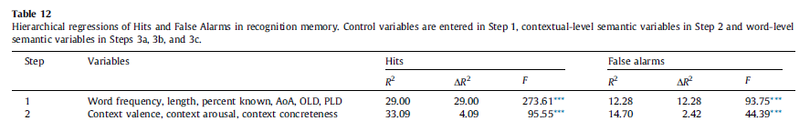
Example: Snefjella & Kuperman (2016)
Predicting recognition memory performance
Do contextual variables predict memory over an above established variables?
  Model 1 contains predictors known to explain memory
  Model 2 contains new predictors
Significant increase in R² from model 1 (29%) to model 2 (33%) revealed
by ANOVA (F statistic)

Slide 13
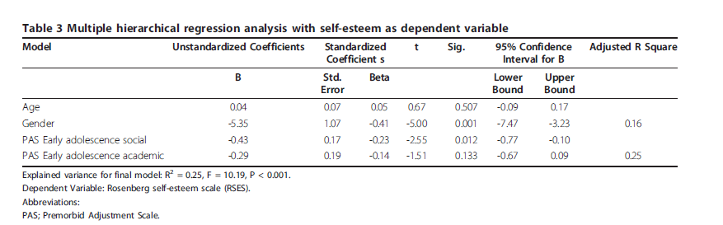
Example: Rom et al (2011)
Self-esteem is related to pre-morbid adjustment in early psychosis
Hierarchical regression used to:
Control influence of demographic factors before looking variables of interest
  Model 1: age, gender (16%)
  Model 2: premorbid adjustment (social and academic functioning prior to psychosis onset) (25%)

Slide 14
Bayesian Approach
Bayes factor
The probability of model 2 vs. model 1, given the data
  Model 2: more complex, less constrained model
  (e.g., alternative hypothesis)
  Model 1: more constrained model
  (e.g., null hypothesis)
A Bayes Factor = 9 means that model 2 is nine times more likely than model 1, given the data
A Bayes Factor = 0.5 means that model 2 is only half as likely than model 1, given the data

Slide 15
Why Bayes Factors?
  Allow us to quantify evidence for the null hypothesis (simpler model over the more complex one)
  Are another tool in your toolkit alongside classical statistics (useful given limitations of NHST)
  Are increasingly reported alongside classical statistics in articles (e.g., t-test, ANOVA).

Slide 16
Bayes Factors in R
The BayesFactor package:
library(BayesFactor)
lmBF()
Returns the Bayes Factor for a model vs. intercept alone
Model 1:
Final exam = a + entrance exam
E.g., “A model with entrance exam mark as a predictor is 8310 times more likely than a model with the intercept alone”

Slide 17
Compare Bayes Factors to compare models
  Model 1:
  Final exam = a + entrance exam
  Model 2:
  Final exam = a + entrance exam + age
  Comparing the Bayes Factor for Model 2 vs Model 1 tells us the probability of Model 2 vs Model 1, given the data.
  E.g., Model 2 is three times more likely than Model 1

Slide 18
Workshop
Go to PSYC753 DLE page
Locate link for my workshops
Today’s worksheet: “Building Models 2”

