Slide 1
ELC 470 Final Project: Sprite Animation
Shannon Chapter
Chris Jenson
Brian Worts

Slide 2
Our Project’s Goal
Starting with Krupa's basic sprite design, we will animate a sprite moving. Specifically, the team will alternate between two or more sprites to make the sprite appear to be running, and then horizontally shift the sprite across the screen.
Notes:
Chris

Slide 3
Challenging Ourselves
We wanted to make our program more reminiscent of old side scroller games. We gave the sprite three types of movement: right, left, and idle. Jumping was then added. The ability to move in those three ways and jumping while in any of those states made the program really feel like a game.
Notes:
Chris

Slide 4
Sprite Control Block Introduction
Inputs:
Outputs:
Name | Description
input jump_raw | Button Input
input right_raw | Button Input
input left_raw | Button Input
input stop_raw | Button Input
H_count_value, V_count_value | Used to increment sprite every new frame (When both are 0)
sprite1_vx_dir; sprite1_vy_dir; | Sprite 1 vertical and horizontal magnitude
sprite2_vx_dir; sprite2_vy_dir; | Sprite 2 vertical and horizontal magnitude
sprite3_vx_dir; sprite3_vy_dir; | Sprite 3 vertical and horizontal magnitude
sprite1_visible sprite2_visible sprite3_visible | The sprites visibility property
Notes:
Chris

Slide 5
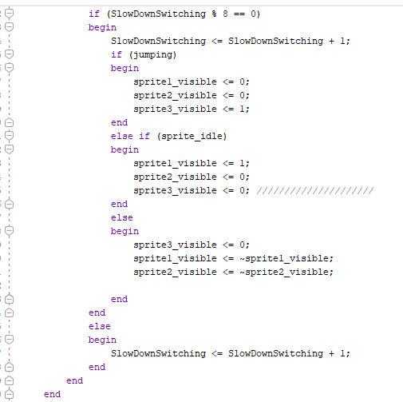
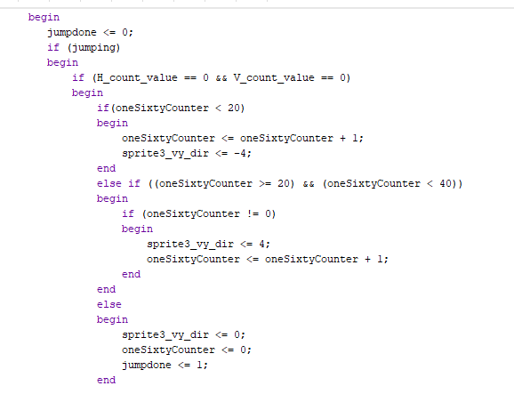
Interesting Aspects of Our Module
Switch displayed sprite every 8 Frames
If jumping, show Sprite 3
Every New Frame
Jump Up
If idle, show Sprite 1
If not idle or jumping, alternate sprites 1 and 2
Jump Down
Reset
Notes:
Brian

Slide 6
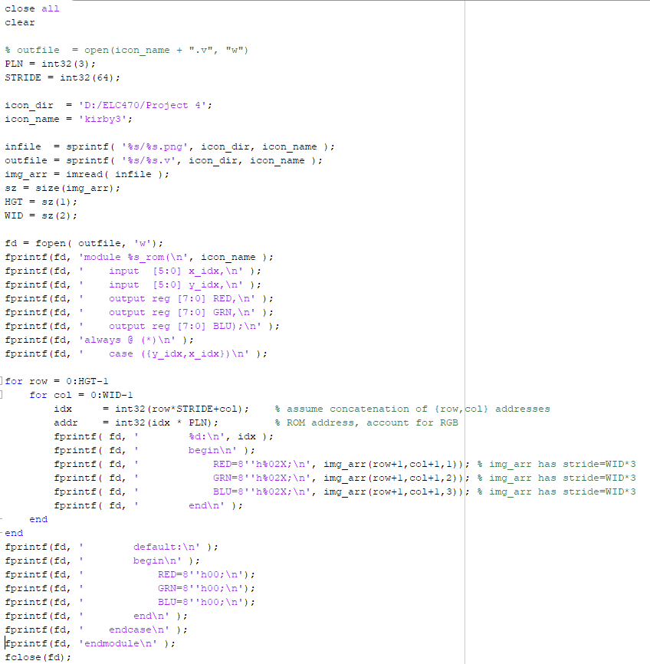
MATLAB Code
Notes:
Shannon- takes the rgb values of each pixel and generates verilog code for the sprite

Slide 7
Verification
A bug we experienced occured when animating the sprite. The sprites alternated properly before an initial jump but would synch up after a jump command. This happened because their visibilities were being improperly reset after a jump where they were set to the same value. Sprites 1 and 2 should never both be visible.
Verification was conducted through hardware. We had access to a board and a VGA capable monitor so we could program the board faster than we could simulate the code. LED’s were also driven by registers we wanted to test so that we could see what the FPGA was receiving, such as what state it was in.
Notes:
Brian

Slide 8



Images/Sprites
Idle/Moving Sprite 1 Moving Sprite 2 Jumping Sprite
Notes:
Shannon

Slide 9
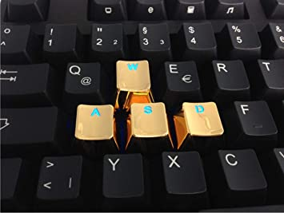
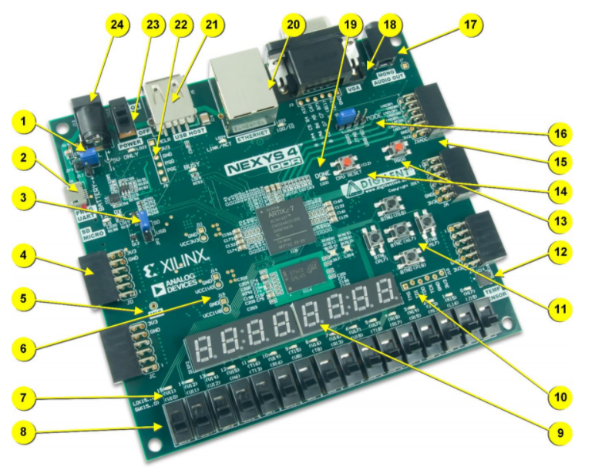
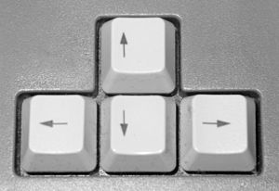
Controls
Notes:
Chris

Slide 10
Sprite States
Left
Idle
Right
Jumping (Left)
Jumping (Idle Down)
Jumping (Right)
Notes:
Chris

Slide 11
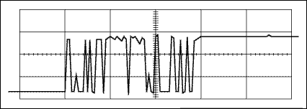
But what about Button Bouncing?
When pressing a button on the FPGA, a random stream of 1’s and 0’s will occur, called “bouncing”. Our sprite’s state (moving/jumping) is changed upon receiving a positive edge of a button input and any input from that button after the initial positive edge is irrelevant. Due to this, we did not have to account for button bouncing.

Slide 12

Right Motion
Notes:
Brian

Slide 13

Jumping
Notes:
Brian

Slide 14

Left & Right Motion, Idle State, and Jumping

Slide 15
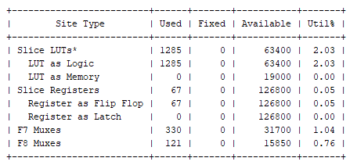
Synthesis Utilization

Slide 16
Future?
Add platforms for the sprite to jump to (Bresenham Line Drawing)
Other sprites as “enemies” to avoid
Collision with “enemy” sprites
Notes:
Shannon

Slide 17
Who Did What
Team Member | Coding | Debug | Analysis | Presentation
Shannon Chapter | 10 | 20 | 40 | 40
Chris Jenson | 40 | 40 | 30 | 30
Brian Worts | 50 | 40 | 30 | 30

Slide 18
Questions?

