Slide 1
Android Development
Getting Started
Christopher Jenkins
Developer - Mubaloo

Slide 2
Who am I? Chris Jenkins
Plymouth Graduate
  BSc (Hons) Computing
3 Years of Java Development
  C#, Objective-C, PHP, bash
  MySQL,PL/SQL, XML
  HTML,JavaScript, jQuery
  NodeJS
Android Developer 2 years+
Developed
Weather/Maps - MetOffice
Property
Finance
Retail
Gambling
@chrisjenx
+Chris Jenkins
Mubaloo - App Developer 2012
@mubaloo - http://mubaloo.com

Slide 3
Summary
Quick Start
What I wish I knew 2 years ago!
Designing for Android
Common Practice & Do’s
Demos and Examples

Slide 4
Quick Start
Notes:
How many have started android?
How many have an app?

Slide 5



Quick Start - What is Android
Android is built on linux
Its 4! (Born 20th of September 2008)
Runs a Java virtual machine (dalvikvm)
480M Android Devices (1.3M activated daily)*
Over 1400+ devices
Clopen source - but very open community
*As of 5th September 2012
Notes:
Know what I mean about Clopen source?

Slide 6
Quick Start -Android fundamentals
Some pros n’ cons:
Pros:
Background tasks (Services)
Intent system (Very Powerful)
Permission framework
Resource framework (Extremely useful!)
Cons:
Many devices (Phone’s, Tablet’s, TV’s, Embedded, Camera’s, etc..)
Differentiation of hardware/software
  Vendor Specific ‘Enhancements’
Notes:
Services - Work in the background without the user having to be in the app
Intents - Request actions across apps etc
Permissions - app only has access to what your user allows.
Resource framework - most powerful of all platforms

Slide 7
Quick Start - What you need/have (hopefully?)
        Java JDK
    Android SDK - (http://developer.android.com/sdk/index.html)
    Eclipse - (Recommend the Juno release)
    Android ADT (eclipse plug-in)
Windows, OSX and Linux
Getting started - http://developer.android.com/training/index.html
Notes:
Should hopefully have all of these

Slide 8
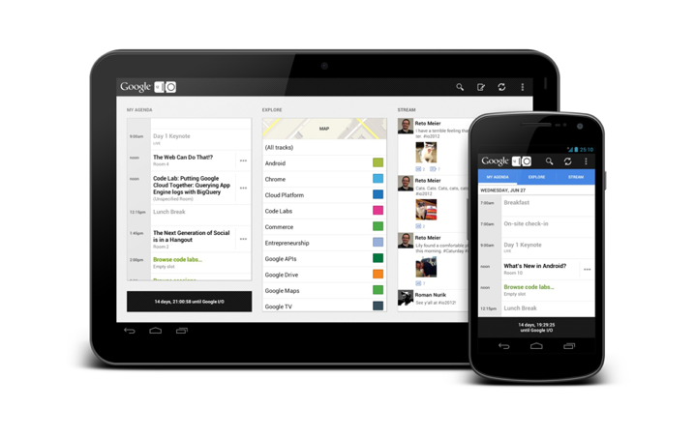
Quick Start - Forget your ruler...
Notes:
I’ll come back to this, start thinking about how these are laid out.

Slide 9
What I wish I knew 2 years ago!
Notes:
So this is what I wish I knew when I started, this is also things I would expect a good android developer to know and what we look for in recruits.

Slide 10
Have a plan
Who is your market?
  Young
  Adults
  Advanced
Why will they care?
  Whats unique?
How will you communicate with them?
Getting paid?
  In-App Purchases
  Ads
  Single Sale

Slide 11
How will you distribute
Direct download - http://mywebsite.com
Play store - http://play.google.com
Amazon - http://amazon.com/appstore
NOOK

Slide 12
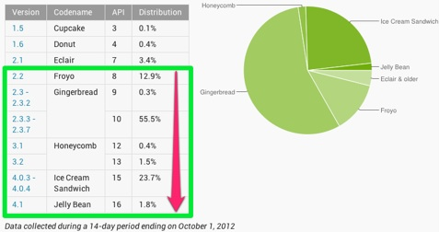
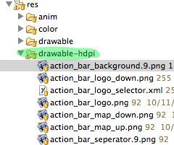
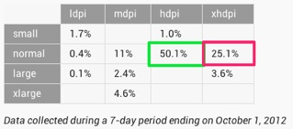
Target Devices
Keep watching Android Dashboards
http://developer.android.com/about/dashboards/index.html
Always Target/Build for Latest API (API 16)
Manifest.xml
<uses-sdk android:minSdkVersion="8" android:targetSdkVersion="16" />
normal - hdpi

Slide 13
Target Devices - cont.
Phone
  3” - 5” devices most common
  Gal S3/One X
Tablets?
  7” Amazon Fire/Nexus 7
Err ‘Phablets’?
Notes:
Think about what device you want to target, but the last slide should take most of that decision away.

Slide 14
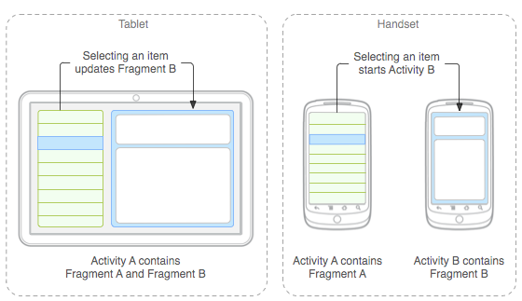
Fragments
Use them.
  Compatibility Library (if pre HoneyComb)
  https://developer.android.com/tools/extras/support-library.html
No really!
Demo later
Notes:
Use them

Slide 15
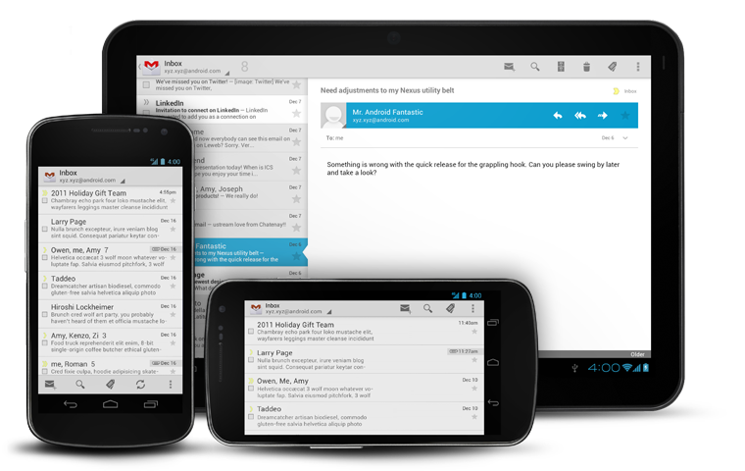
Action Bar
Best practice
Pre HoneyComb?
  ActionBarSherlock
    http://actionbarsherlock.com/
    ActionBar back to Android 2.1
Demo later
Notes:
Standard usage, use it, unless you reallly have a good reason not to.

Slide 16
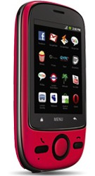
Make it look pretty
Graphics
  Ideally - Custom artwork
  Make do - Android Asset Studio
    http://android-ui-utils.googlecode.com/hg/asset-studio/dist/index.html
Themes
  Defacto as of ICS 4.0
    Light/DarkActionBar - @style/Theme.Holo.Light.DarkActionBar
    Light(Dark text) - @style/Theme.Holo.Light
    Dark (Light text), also the default - @style/Theme.Holo
Notes:
You have graphic students, if possible, bribe, ask, beg to help you.
Otherwise use the Asset studio to get a basic theme.
Default theme saves you from this pink monstrosity, you always have a default them.

Slide 17
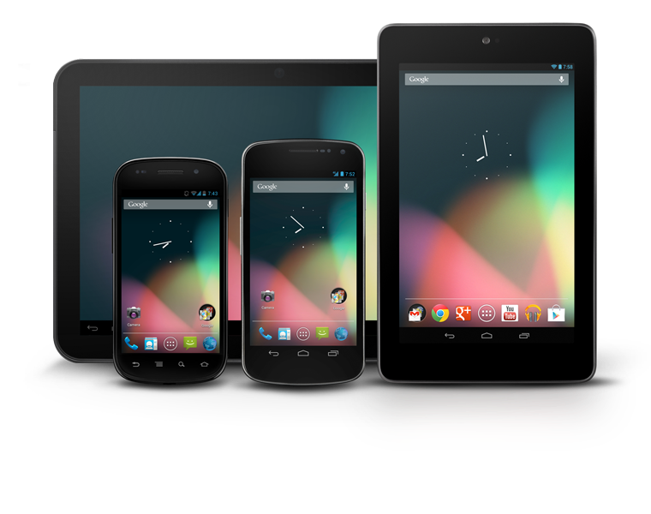
Follow UI Patterns
We now have guidelines
  Design site
  https://developer.android.com/design/index.html
  Follow them - but not religiously!
Best example preferences
If you don’t know the best way to do something - ask/google/examples/other apps etc
Notes:
Have a good undserstanding of android design

Slide 18
Sanity
Code validation
  ADT Lint - Tells you when your doing it wrong!
Testing
  Robolelectric
  Apkudo - online real device testing
  http://www.apkudo.com/
Notes:
ADT very helpful.
Robolelectic handy test framework
apkudo testing service, RoboTest -Testing the Top 30 devices only just covers 25% of the market.

Slide 19
Help!
Stack overflow - android tag
http://stackoverflow.com/questions/tagged/android
Android Developer Blog
http://android-developers.blogspot.co.uk/
Android Developer site
https://developer.android.com/guide/components/index.html
Android Developer Group
https://groups.google.com/forum/?fromgroups#!forum/android-developers
Github
https://github.com/
OpenIntents - Android Library Listing
http://www.openintents.org/en/libraries
Android Developer Meetups
http://android-developers.meetup.com/
Chrome Omni Extension
https://chrome.google.com/webstore/detail/android-sdk-reference-sea/hgcbffeicehlpmgmnhnkjbjoldkfhoin
Google!
Notes:
So probably the most important slide

Slide 20
Designing for Android

Slide 21
Notes:
ICS+ looks nice and has been standardised to provide a revised UI for you to work with.

Slide 22
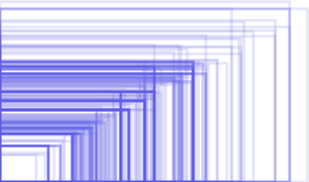
Design - It’s all relative
No fixed screen size
We work in “dips” density independent pixels
http://developer.android.com/training/multiscreen/screendensities.html
  Galaxy Nexus = 720 x 1280 = 360dp x 640dp
Notes:
Any idea of this image?
So you can’t fix your design size, never think in pixels

Slide 23
Design - dips
Should I need to worry?
  Yes - You will ONLY use them!
Calculate?
  32dip = 32pixels @ mdpi (~160dpi) - x1.0
  32dip = 48pixels @ hdpi (~240dpi) - x1.5
  32dip = 64pixels @ xhdpi (~320dpi) - x2.0
Example
Notes:
So why are they important?

Slide 24
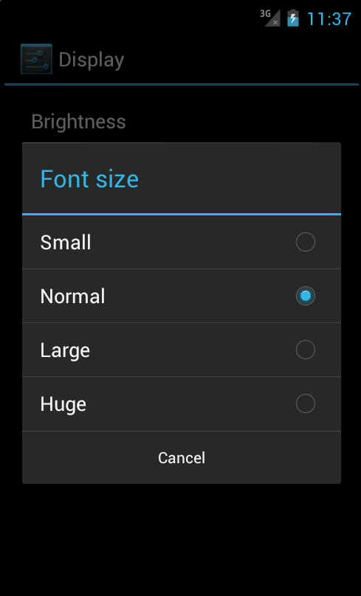
Design - scaled pixels
ScaledPixels?
  What happens when you change the device text size size?
Just like dips but multiplied by font size
1sp = 1dp at normal font size.
Notes:
Yes scaled pixels too! So what happens when change your text size?

Slide 25

Design - Layouts
Think Web!
Good:
  Frame Layout
  Relative Layouts
  LinearLayouts
    Careful with nesting, If you layout is more than 4 layers deep, maybe rethink your design.
  GridLayout (New API14+ or v7 acl)
DO NOT USE AbsoluteLayouts!
Read: http://developer.android.com/training/multiscreen/screensizes.html
Notes:
FrameLayout good for a container
Relative good for more complex layouts but can get fiddly
Linear good for wieghting content distributing content.
Examples?

Slide 26
Design - Styling
styles.xml
  <style name="Text.Small">
  <item name="android:textColor">@color/greyish</item>
  <item name="android:textSize">@dimen/text_size_normal</item>
  </style>
dimens.xml
  <dimen name="text_size_small">16sp</dimen>
colors.xml
  <color name="greyish">#111111</color>
More Reading
  https://developer.android.com/guide/topics/ui/themes.html
  http://stylingandroid.com/
Notes:
Use styles where possible. always define your styles in resources, that way you can define different looks for different sizes etc.

Slide 27
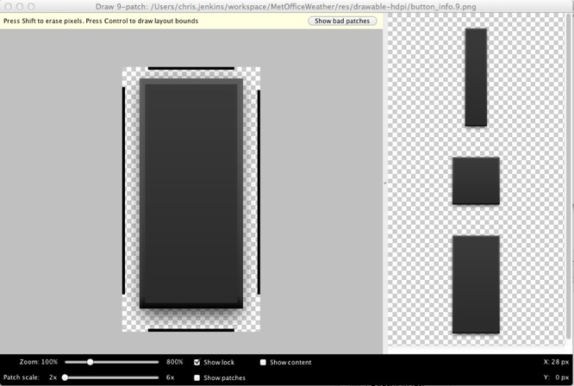
Design - 9 Patchs
Images
Definable stretchable regions
draw9patch tool
Notes:
Very useful.
Make it possible for images and content to stretch correctly.
Guide on the next page.
Not going to cover it as its a lecture unto its self.

Slide 28
Design - Pet peeves
Don’t port/copy from iOS!
Not using native ActionBar (Or ActionBarSherlock)
  Example of bad ActionBar implementation - Olympics 2012 Results App
No splash screen (well try to avoid it!)
Notes:
Please dont port from iOS.

Slide 29
Design - Resources
Android Design
http://developer.android.com/design/index.html
9-Patch
http://radleymarx.com/blog/simple-guide-to-9-patch/
UI Patterns
http://www.androiduipatterns.com/

Slide 30
Do’s n’ Don’ts

Slide 31

Threading - ANR
ANR?
  Activity Not Responding.
Do not work on the UI thread!
UI

Slide 32
Threading
Simplest use
  AsyncTask<Params, Progress, Result>
  Managed Thread pool
  doInBackground runs on a background thread.
  PreExecute & PostExecute run on the UI thread.
What should you thread?
  Web requests - Data/Images etc
  Database
  IO/Preferences etc

Slide 33
Threading - cont’d
ContentProviders
  Will listen to database changes and asynchronously update UI.
  https://developer.android.com/reference/android/content/ContentProvider.html
IntentService - Queued Background Threaded Service
WakeFullIntentService - Does work in the background service but will wake the device to do work
MarkMurphy - https://github.com/commonsguy/cwac-wakeful

Slide 34
Fragments
ModularUI
  Not just for Phone&Tablet apps
  Break up UI into manageable buckets/modules
  No Gargantuan Activities!
  Ideally don’t need to be linked, ContentProviders + Fragment lifecycle.
    Similar lifecycle to Activities.

Slide 35
Fragments - Cont’d
“If your not writing fragments, your writing legacy code” - Berry Drinkwater
Opens up new possibilities and API’s
  ActionBar + Tabs
  Transition Animations
  Automatic BackStack management
  ViewPager

Slide 36
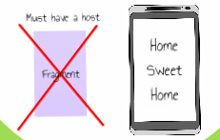
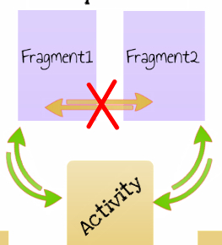
Fragment Idea
Sub-Activity?
Independent
Notes:
Fragments are separated out UI components, but, they still need to be within an activity
Fragments shouldn't need to talk to each other. But if they do, see the activity as a controller and handles fragments.

Slide 37
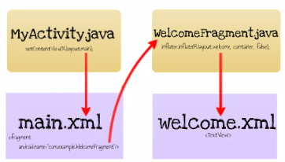
Fragments...
Simple Idea
MainActivity.java
  setContentView(R.layout.main);
main.xml
  <fragment
  android:name=”com.example.fragments.WelcomeFragment”/>
WelcomeFragment.java
  inflater.inflate(R.layout.frag_welcome, container, false);
frag_welcome.xml
  <TextView android:text=”Hello World” />
Example..

Slide 38
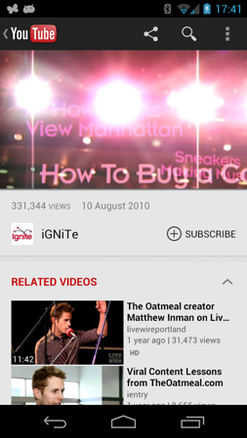
Fragments - Bigger Picture
Notes:
See how the you tube app is broken up.

Slide 39
Fragments - Dialog
DialogFragment
  Stop using Dialog!
DialogFragments maintain their lifecycle and modularise your code - win/win.
  Can convert your old Dialogs using:
    onDialogCreate() method.
http://prezi.com/fh2uslbr1xs3/the-fragment-transition/
https://developer.android.com/reference/android/app/DialogFragment.html

Slide 40
Performance
Background thread - of course...
  avoid - new Thread();
Don’t create objects unnecessarily
  Smaller device ~ Smaller Resources
  Less room to allocate memory - OOM Errors!
Static over Virtual
  About 15-20% faster invocation
  private static String staticRef = "SomeValue";
  private String virtualRef = "SomeValue";
Getters n’ Setters - Best Programming practice, but slower than accessing a field.
Notes:
new Thread is bad make sure you run threads in a pool.
any unessary object creation is bad, more so on mobile. Old GarbageColectors pause the main thread and will stutter the app.

Slide 41
Performance Cont.
For loops
  public void two() {
int sum = 0;
for (Foo a : mArray) {
sum += a.mSplat;
}
}
  Has the most efficient execution on pre/post JIT devices.
Avoid InnerClass to OuterClass Field access in high performance code spots.
https://developer.android.com/guide/practices/performance.html
Notes:
There are other forloop methods but this is the one recommend by google

Slide 42
Base Classes
MainActivity extends BaseActivity
ScoreFragment extends BaseFragment
What goes in their?
  protected final MyApplication mApp = MyApplication.get();
  protected final MyPrefs mPrefs = mApp.getPrefs();
  protected final DatabaseHelper mDB = mApp.getDatabase();
Singleton pattern is popular in Android.
  Careful not to hold reference to unneeded classes!

Slide 43
Any questions..?
Notes:
Any questions so far?

Slide 44
Examples and Demo’s

Slide 45

ActionBar
Standard UI/UX Experience
Play/Facebook/Twitter/Maps/Google+ etc..
ActionBarSherlock - Jake Wharton
http://actionbarsherlock.com/
Always use it (Unless 3.0+ only)
Solves menu deprecation issues
Example

Slide 46

Draggable Sort ListView
DragSortListView - Carl A. Bauer
https://github.com/bauerca/drag-sort-listview
Example..
Other
  cwac-touchlist - Mark Murphy
  https://github.com/commonsguy/cwac-touchlist
  Although Depreciated now

Slide 47

RoboSpice - async network lib
Async Done Right
Built of Google 2010 IO thought process
  Decoupling REST and UI components correctly
https://github.com/octo-online/robospice
https://play.google.com/store/apps/details?id=com.octo.android.robospice.motivations

Slide 48

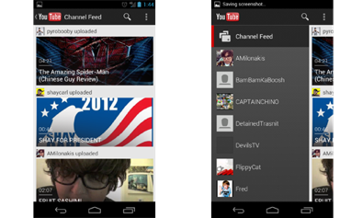
SlidingMenu
Creates a singular parallel user flow
Google Plus / You tube / Facebook
Plays nice with ActionBarSherlock
Jeremy Feinstein / SlidingMenu
https://github.com/jfeinstein10/SlidingMenu

Slide 49
Bluetooth example
SDK Sample

Slide 50
Books
http://commonsware.com/
Almost wrote the book on android... regularly updated and LOTs of smaller examples
http://www.amazon.co.uk/Professional-Android-Application-Development-Guides/dp/1118102274/ref=ntt_at_ep_dpt_1
Professional Android 2 App Development - By Reto Meier
One of the Android evangelists at google, knows his stuff.
http://www.amazon.co.uk/Smashing-Android-UI-Magazine-Book/dp/1118387287/ref=sr_1_1?s=books&ie=UTF8&qid=1351591674&sr=1-1
the ‘Smashing’ books are good too although a little less well established.

Slide 51
Thanks to
Presentation Ideas
  @mubaloo
  @scottyab
  @commonsguy
  @JakeWharton
  @corey_latislaw

Slide 52
Questions?

