Slide 1
Extensible Medical Image Processing Software Platform

Slide 2
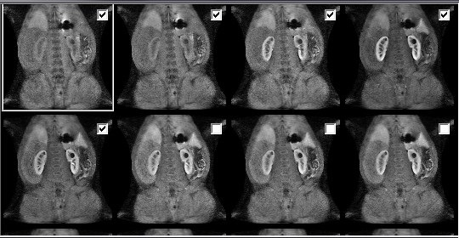
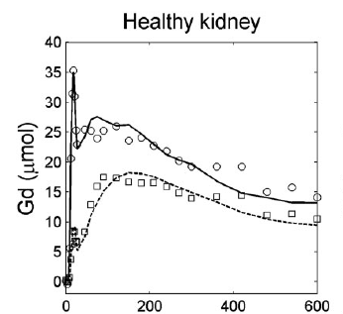
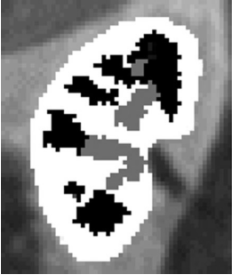
Background
Multiple Series
Time-Density Curve
Segmentation

Slide 3
Goal
1, Load DICOM folder s and divide DICOM files into different volume properly .
2, Image Display.
3, Segmentation, registration, and other algorithms.
4, Good extensibility.

Slide 4


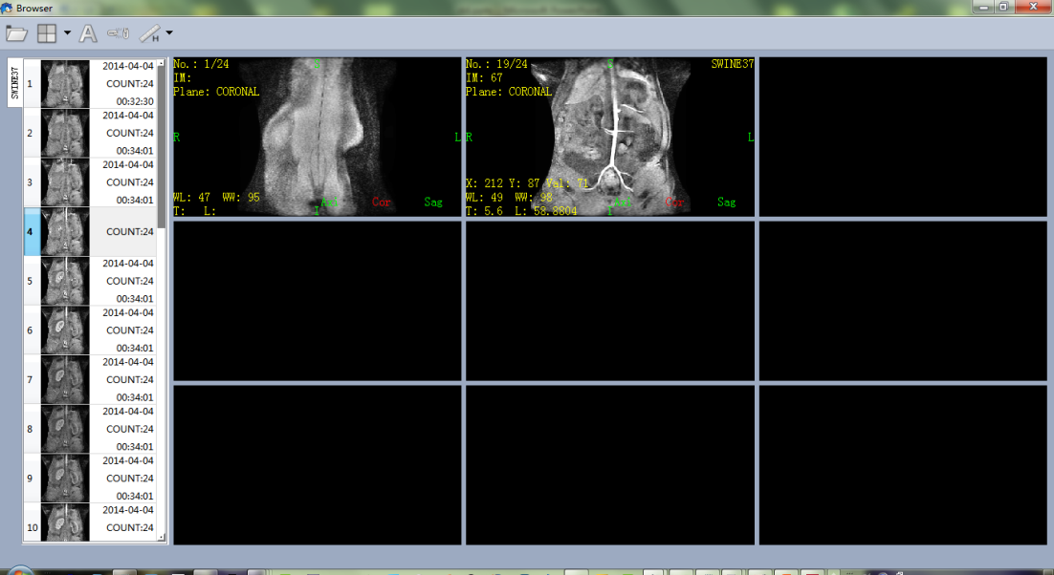
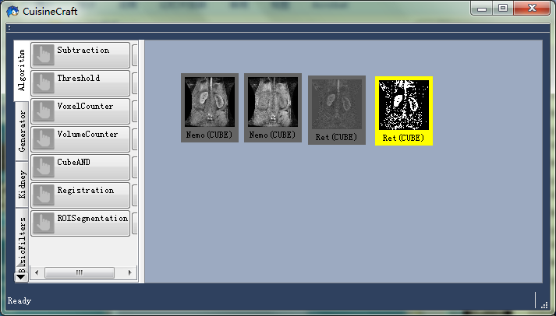
My software based on
Qt and ITK
Image Browser
Algorithm Desktop

Slide 5
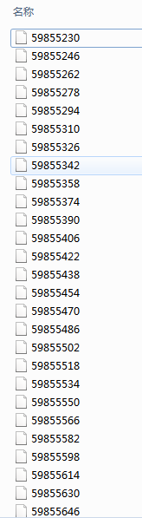
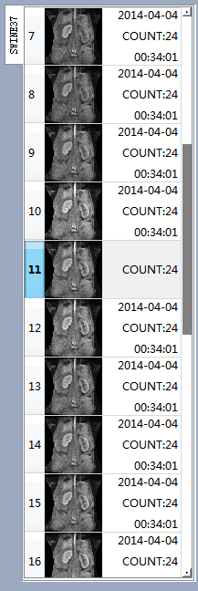
Features of Image Browser
Rearrange
according to
slice location,
slice thickness,
series id
and so on

Slide 6
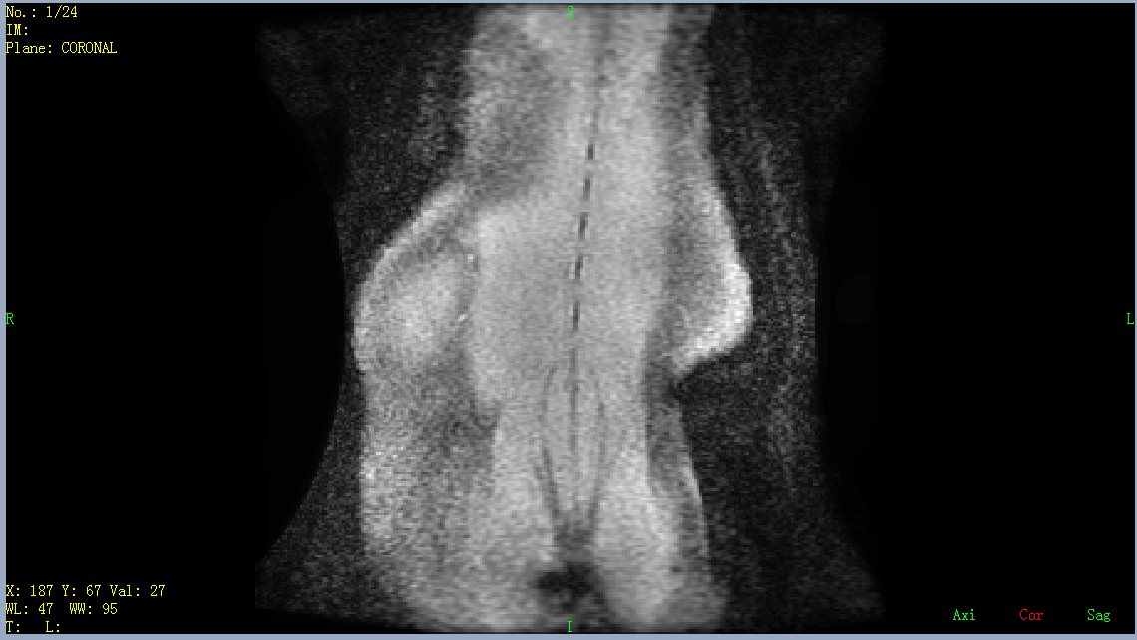
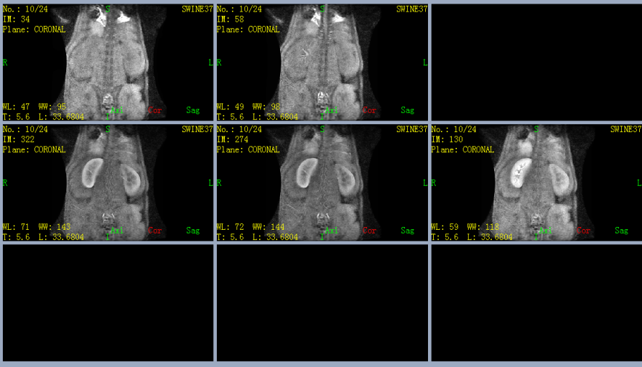
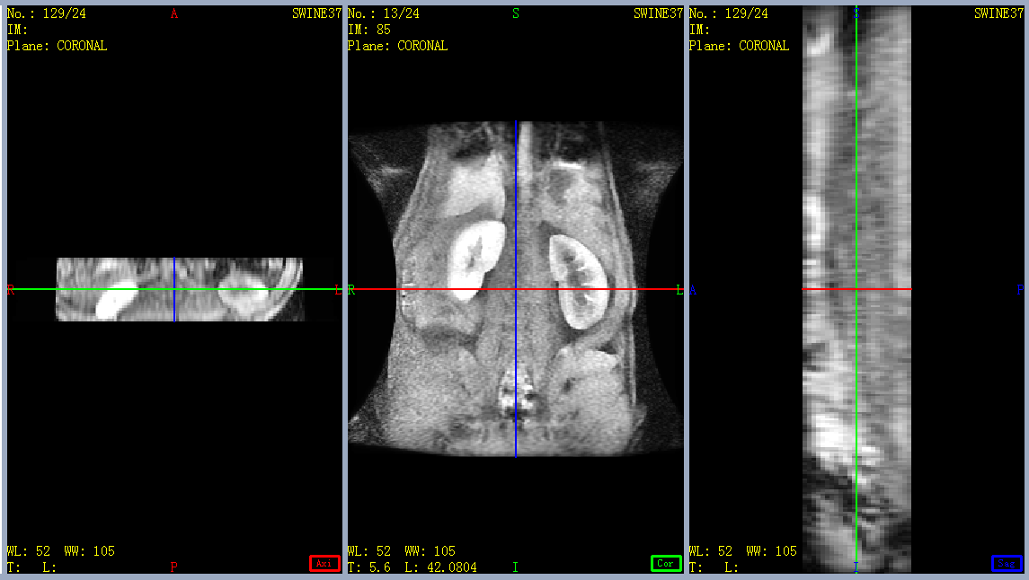
Features of Image Browser
Different view mode

Slide 7
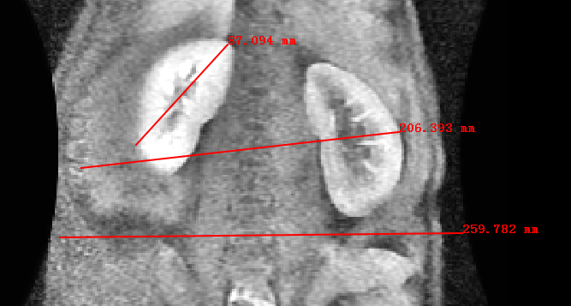
Features of Image Browser
Measurements

Slide 8
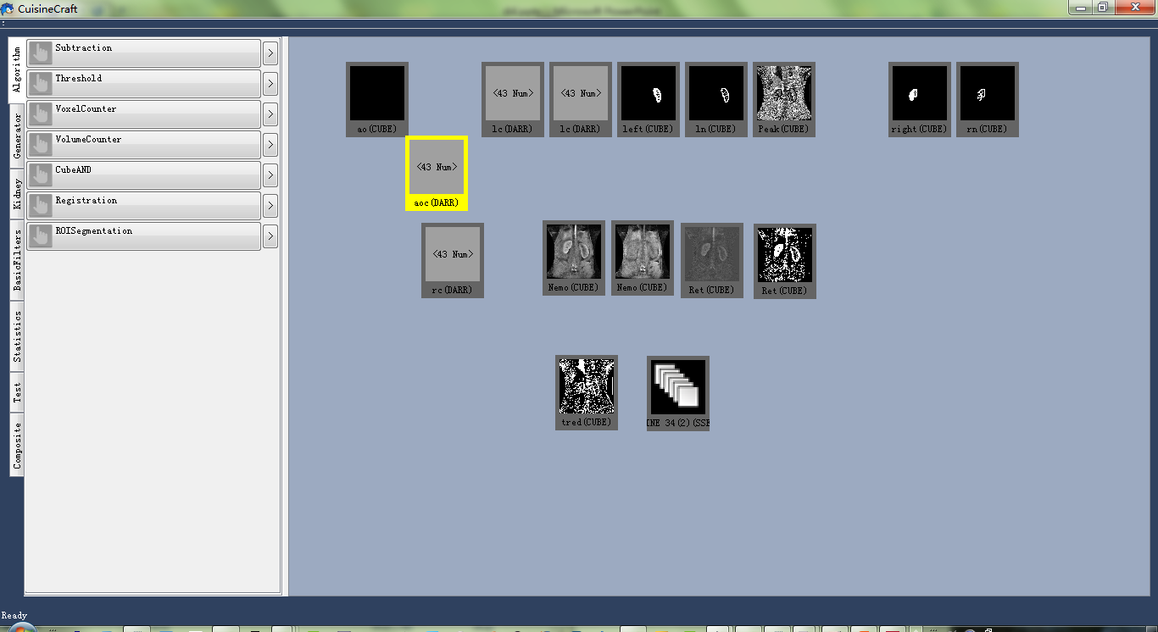
Features of algorithm desktop
Left part: algorithm button panel.
Right part: desktop that places tiles representing different data types
such as volumes, curves, multiple series and so on.

Slide 9
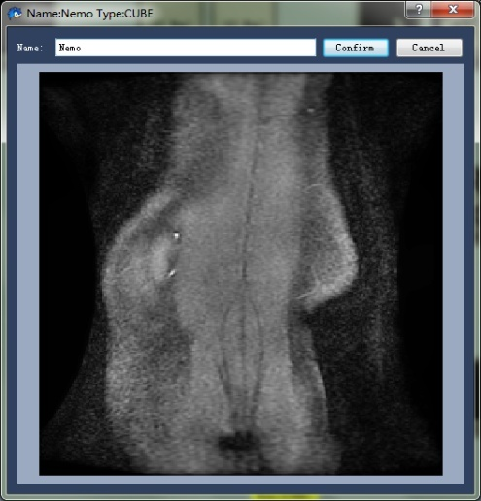
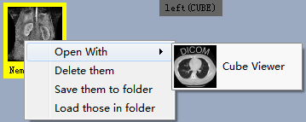
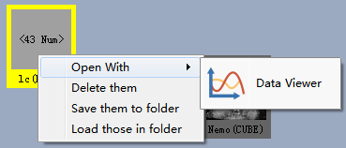
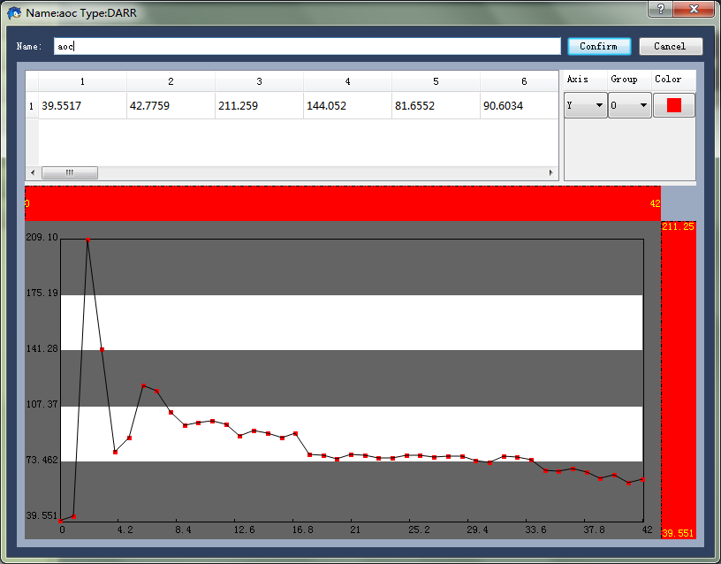
Features of algorithm desktop
Each tile has its own openwith menu, its own viewer. If you know how to open a jpg file on Windows, you know how to display a curve of your data on this software.

Slide 10
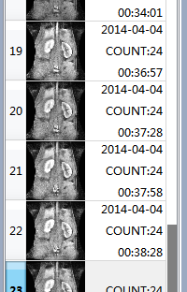
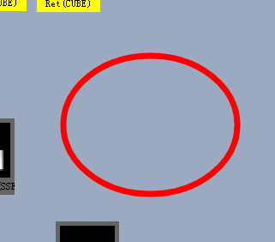
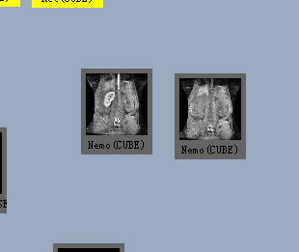
How to run an algorithm ?
STEP I:
Drag your inputs, for exmple two volumes , on to a blank area on algorthm desktop, you will get:

Slide 11
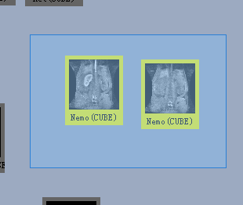
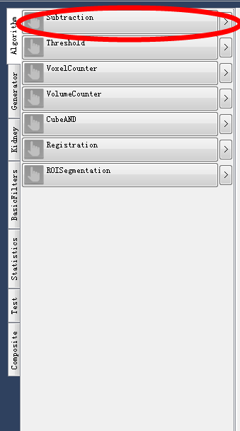
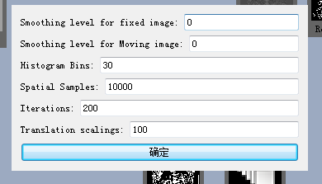
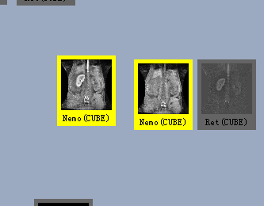
How to run an algorithm ?
STEP II:
STEP III:
STEP IV:
Results:
Fill out the argument table, if the algorithm needs you to.
Outputs are generated right beside your last input.
Use your mouse to select the two tiles.
Click an algorithm button for example subtraction

Slide 12

Extensibility
DLL plugin
Abstract algo base class
Classes in DLL are loaded by the main frame.
Your own class
-----------------------
void Run();
void CheckInputs();
Wrap the class into a DLL file

Slide 13
Extensibility
Scrypt plugin based on XML
This type of plugin is used to integrate algorithms in DLL files together.
<Test>
<version>1</version>
<name>KidneySeg</name>
<category>Kidney</category>
<algo>Subtraction</algo>
<algo>Gaussian</algo>
<algo>Threshold</algo>
<algo>Opening</algo>
<algo>LargestComponent</algo>
</Test>
This example shows how to integrate Subtraction, Gaussian, Threshold, Opening and LargestComponent into a new algorithm called KidneySeg. When you run KidneySeg, it’s equivalent to run those five algorithm one by one with one’s output as next one’s input.

Slide 14
Extensibility
Extensible modules :
1, Algorithm(inherites algorithm class).
2, Data type(inherites data factory class).
3, Data viewer(inherites viewer factory class, when browsing one tile, a corresponding viewer instance will be created by your class).

Slide 15
Thank You

