Slide 1
Arrakis: The Operating System is the Control Plane
Shikai Jin, Yuxuan Cui

Slide 2
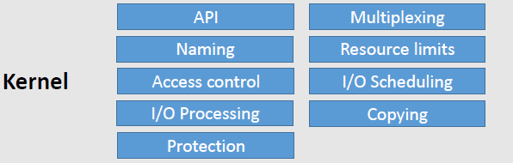
Why we need a new design for network operating system?
Server Application
Operations like
key-value queries
NIC or RAID storage

Slide 3
Why we need a new design for network operating system?
Server Application
Operations like
key-value queries
Kernel Mediation is too heavyweight!
NIC or RAID storage

Slide 4
Analysis of Overheads
Networking Stack overheads
Network Stack, Scheduler, Kernel Crossings, Copying
Nearly 70% of the total is spent on processing of Networking stacks.
Storage Stack Overheads
Historically, CPU writing overheads is insignificant compared to disk access time.
Recent hardware trends greatly reduce the disk access time. OS storage overheads become a major factor.
Application Overheads
Latency in socket operations upto 70%.

Slide 5
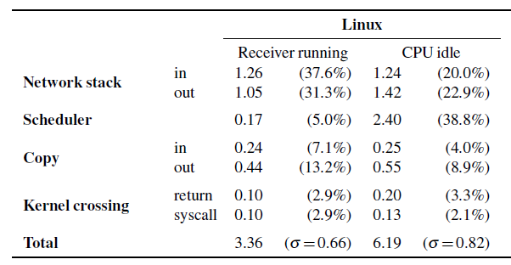
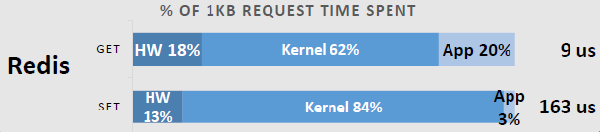
Analysis of Overheads
Networking Stack overheads
Network Stack, Scheduler, Kernel Crossings, Copying
Nearly 70% of the total is spent on processing of Networking stacks.
Storage Stack Overheads
Historically, CPU writing overheads is insignificant compared to disk access time.
Recent hardware trends greatly reduce the disk access time. OS storage overheads become a major factor.
Application Overheads
Latency in socket operations upto 70%.

Slide 6
Goal
Skip kernel & deliver I/O directly to applications
Reduce OS overhead
Keep classical server OS feature
Process protection
Resource limits
I/O protocol fexinility
Global naming
Hardware can help us!

Slide 7
Virtual machine
OS
VMM
VMM
OS
Hardware
Hardware
Type1
Type2

Slide 8
Hardware I/O virtualizaiton
Standard on NIC, emerging on RAID
Multipexing
Single Root I/O Virtualization: Virtual PCI devices
w/ own register, queues, INTs
Protecting
IOMMU:
Packet filters, logical disks: Only allow eligible I/O
I/O Scheduling
NIC rate limiter
Packet schedulers

Slide 9
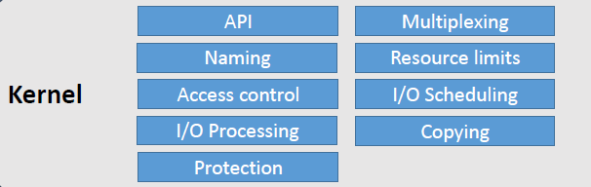
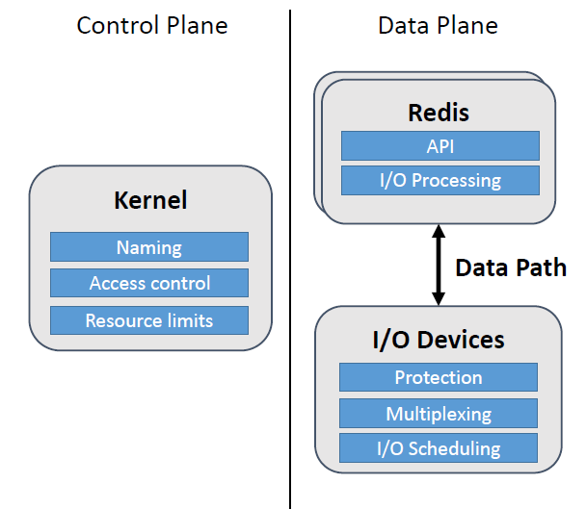
Hardware I/O virtualizaiton

Slide 10
Design and Implementation
Minimize kernel involvement for data-plane operations
I/O requests are routed to and from the application’s address space without the kernel involvement.
Transparency to the application programmer
Arrakis is designed for performance improvement without modification of applications written to POSIX API.
Appropriate OS/hardware abstractions
Arrakis’s abstraction should be sufficiently flexible to efficiently support a broad range of I/O patterns, scale well on multi-core systems, and support application requirements for locality and load balance.

Slide 11
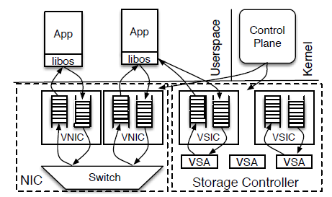
Architecture Overview
Based on hardware that can present multiple instances of itself, allowing the control plane to map each instance to application.
The hardware exports interface for control plane to create or destroy instances, allocate shared resources to different instances.
Once it’s all set, applications conduct I/O through its own protected instance without intervention of the kernel.
Applications have user-level I/O library to perform these operations.
The naming and protection mode is unchanged. A global naming system is provided by the control plane.

Slide 12
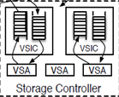
Hardware Model
DMA, direct memory access.
Virtual network interface cards (VNIC). Multiplex or demultiplex packets directly to user space, providing filters.
Virtual storage interface controllers (VSIC), providing virtual storage areas.
Each of VICs (including VNIC or VSIC) has queues and rate limiters.
Queues: each contains DMA queues for user-space send and receive. For VNICs, it supports hardware checksum and TCP segmentations.
Transmit and receive filters: check the header info of packets. Installation of these filters is the responsibilities of the control plane.
Virtual storage areas (VSA). Abstraction of physical storage devices. The control plane maps VSAs to VSICs.
Bandwith allocators, responsible for resource allocation such as rate limiters.

Slide 13
Control Plane interface
Interfaces available to user programs are VICs, doorbells, filters, VSAs and rate specifiers.
Doorbells are signals that can be associated with VICs, used to notify that VIC events occur, like packet arrival, etc.
Filters. Applications can use filters to control packet traffic at each VNIC.
Rate specifies are used to either control incoming traffic or pace outgoing packets and I/O requests. Applications can attach it to a VIC queue.

Slide 14
File Name Lookup
Applications have direct control of its VSA. An application can store metadata, directories and file data.
To allow other application access to its data. It has to implement some interfaces to export the data to the virtual file system of the control plane. To the rest of applications the data appears like a remote mount point like you use the SU drive.
Other applications can access to these files in three ways:
Applications exports file server interface. The interfaces can be host in standalone process and still be available when the application is down.
VSAs can be mapped into different processes. An application with permission can require

Slide 15
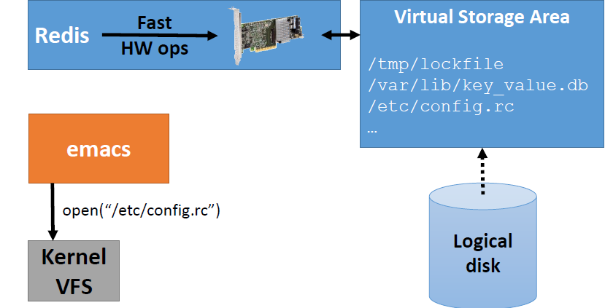
File Name Lookup

Slide 16
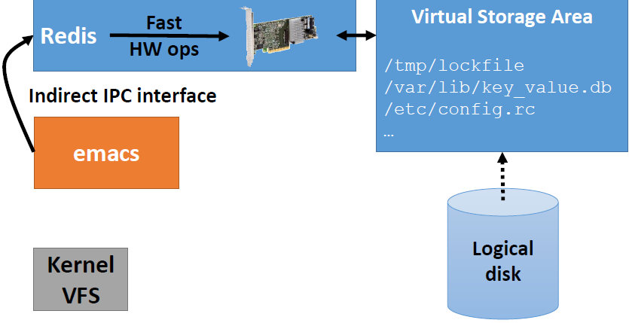
File Name Lookup

Slide 17
Network Data Plane interface
The network stack is implemented in the user space to maximize both latency and throughput.
The application transfer ownership of a packet to the network hardware by enqueueing a chain of buffers onto the hardware descriptor rings and receive a packet in a reverse process.
It handles asynchronous notification of events using doorbells associated with queues.

Slide 18
Storage Data Plane Interface
Low-level storage API provides a set if commands to asynchronously read, write and flush hardware caches at any offset and of arbitrary size in a VSA via a command queue.
Caladan, a library of persistent data structures.
Persist log and queue data structures with APIs including operations to open and close a log, create log entries, iterate through the log and trim the log.

Slide 19
Implementation
Based on a fork Barrelfish operating system. 33786 lines of code are added.
Extending Barrelfish with support for SR-IOV by implementing drivers for virtualization hardwares.
Implement a user-level network stack, Extaris.
Implement a storage API layer, Caladan.

Slide 20
Limitation and future work
The implementation of the virtual function driver does not currently support the “transmit descriptor head writeback” feature of the 82599, which reduces the number of PCI bus transactions necessary for transmit perations.
Due to the limited filtering support of the 82599 NIC,the implementation uses a different MAC address foreach VNIC, which we use to direct flows to applications and then do more fine-grain filtering in software, within applications.
The RS3 RAID controller we used in our experiments does not support SR-IOV or VSAs. Hence, we use its physical function, which provides one hardware queue, and we map a VSA to each logical disk provided by the controller

Slide 21
Evaluation
We evaluate Arrakis on four cloud application workloads:
A typical, read-heavy load pattern observed in many large deployments of the memcached distributed object caching system
A write-heavy load pattern to the Redis persistent NoSQL store
A workload consisting of a large number of individual client HTTP requests made to a farm of web servers via an HTTP load balancer
The same benchmark via an IP-layer middlebox.

Slide 22
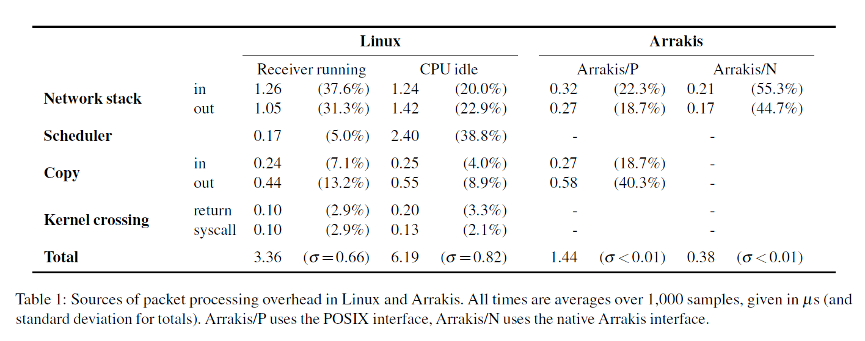
Server-side Packet Processing Performance

Slide 23
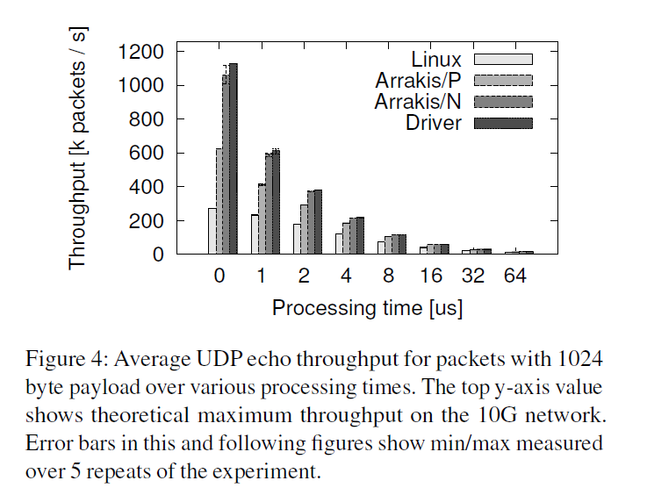
Server-side Packet Processing Performance

Slide 24
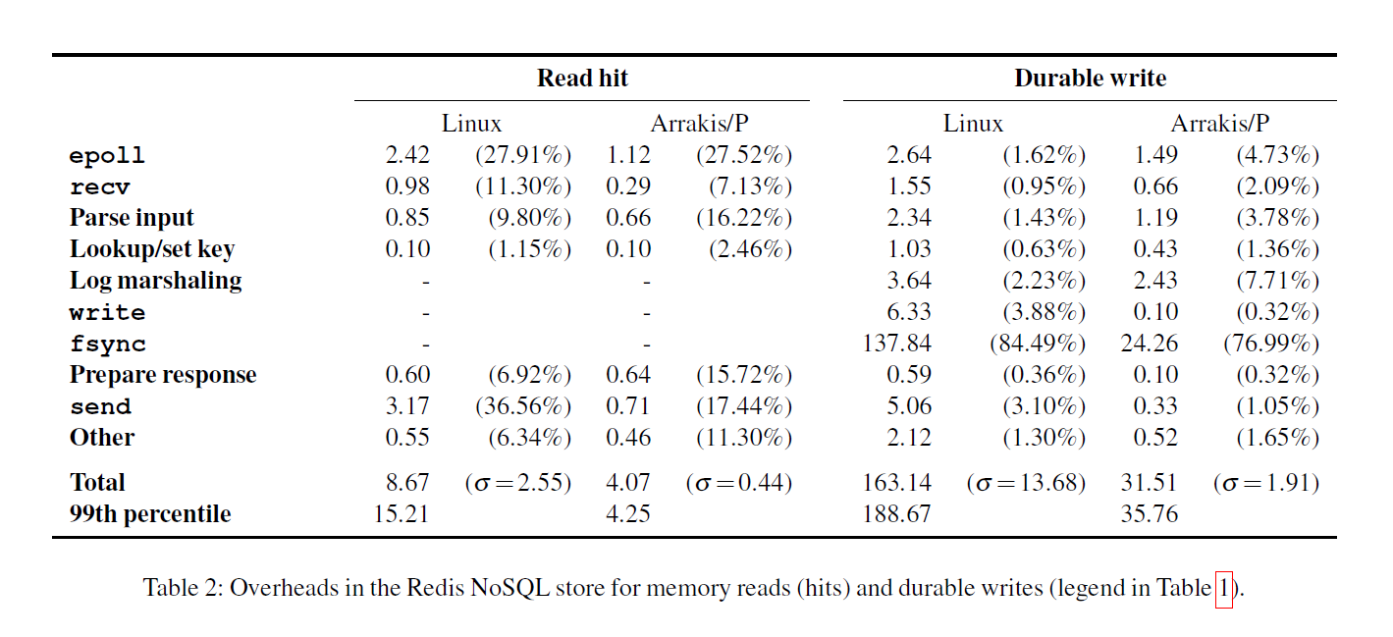
Redis NoSQL Store

Slide 25
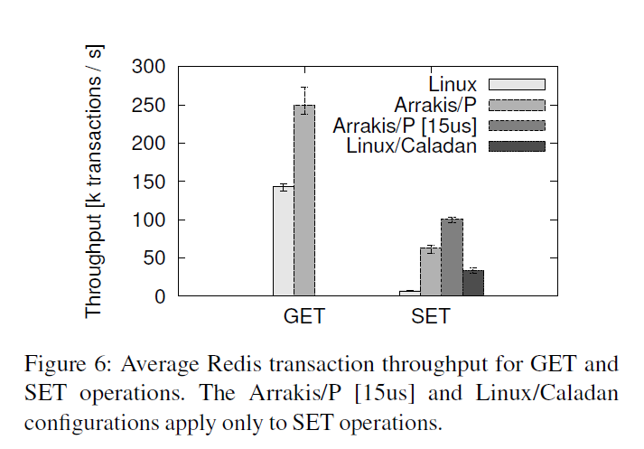
Redis NoSQL Store

Slide 26
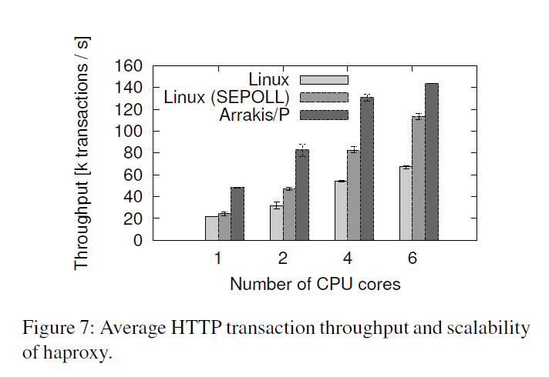
HTTP Load Balancer

Slide 27
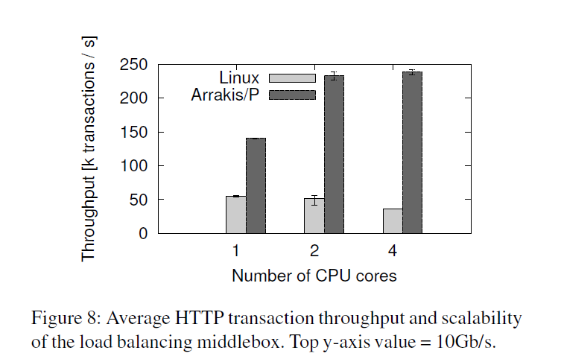
IP-layer Middlebox

Slide 28
Questions?

