Slide 1
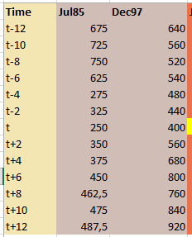
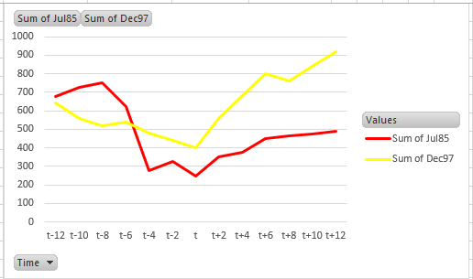
What is the goal of transforming quantitative data to start from 100 and how to
apply the right calculation
Suppose we have 2 data series and we would like to compare their trends, trying to compare the relative decrease and increase with respect to point in time t
Can you easily judge how t-12 and t+12 performed with respect to t in terms of %? And how Jul85 performed with respect to Dec97?

Slide 2
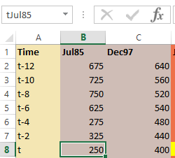
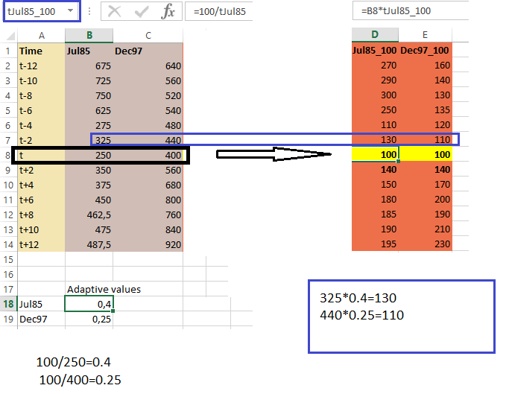
For a better comprehension we need to have a shared scale
What about we force t values to show 100 keeping other values to retain the same relationship with respect to t value?
For each t value we calculate 100/t value (name it adaptive value)
For all the values we multiply the value itself by the adaptive value
In this way we get a shared scale

Slide 3
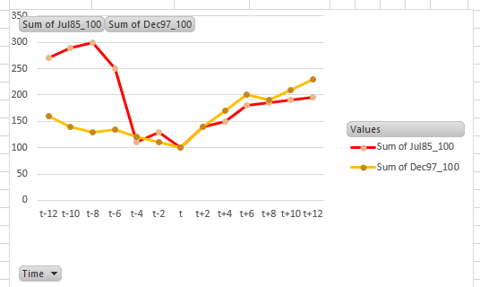
We compare chart with real values and chart with adapted values
Which representation gives us a better idea of relationship between numbers?
Normal
Adapted
We can easily see that Jul85 at t-8 was 3 times than t
We immediately see that at t+12 Jul85 and Dec97 got the same relative value respect to t
We also can see that at t-12 the relative values were quite different

