Slide 1
IMP-EGH: Interdisciplinary Master Program – Energy & Green Hydrogen Track 6: Systems Analysis for Green Hydrogen
3rd Semester | Heidi U. Heinrichs, Christoph Winkler
c.winkler@fz-juelich.de
Exercise Unit 4
March 2025

Slide 2
Exercise 4.1) Relevant Exclusions
Which exclusions do you think are most relevant for your countries, based on what you heard in the lecture? Brainstorm together.
(15 mins)
NOTE: This list does not need to be complete for the exercise context. Rather think about relevance.
Materials to be used:
Lecture slides

Slide 3
Exercise 4.2) Adapted Buffer Distances in your Country
What should be typical buffer distances for onshore wind turbines for the following exclusion features in your countries? Please brainstorm alone and write down your results. Especially think of why you chose this particular buffer value!
Human Settlements (optional subdivision into major and minor settlements)
Water courses
Bird protected areas
Forests
(15 mins)
NOTE: This is meant only for the context of the lecture/exercise. For later scientific assessments of land eligibility, the buffer distances must be based upon sound scientific or legal/political indications.
Materials to be used:
Lecture slides

Slide 4
Exercise 4.3) Comparing Various National Adapted Buffer Distances
In the former exercise sub task, you have determined wind onshore buffer values for your country for the following exclusion features. We will now compare your results with others and analyze differences all together.
Human Settlements (optional subdivision into major and minor settlements)
Water courses
Bird protected areas
Forests
(15 mins)
German example:
650/1000m
<50m
1000m (bird species!)
Not excluded per se!
Materials to be used:
Your notes from exercise 4.2)

Slide 5
Exercise 4.4) Understand Basic Functionality of GLAES
GLAES is our base tool for binary land eligibility analysis. Within the exercise Unit_4 folder, you will find a script 01_understand_basic_exclusions.ipynb that you may please execute and understand cell by cell.
Then, please exclude ONLY ‘tertiary’ and ‘tertiary_links’ roads in the same manner as shown before for the main roads, and save the result to a new file!
Work in pairs but make sure that the script works on both computers!
(30 mins)
Materials to be used:
Script SubTask_4_understand_basic_exclusions.ipynb
NOTE: There will be solution files for all the coming exercises in your exercises folder. In your own interest, you should not use them other than for checking if your approach is correct – if in doubt, rather discuss with each other and solve problems together!

Slide 6
Exercise 4.5) Understand Resample Algorithms
When excluding rastered data, it is crucial to understand how this data is processed within GLAES, based on the ‘resample algorithm’. It is also highly relevant for preprocessed raster data. Execute the sample script cell by cell and understand the background. Then, write down which resample algorithm you would use for our 100m x 100m analysis and the following input data:
Settlement raster, input resolution 10m x 10m
Slope raster, input resolution 30m x 30m
Landcover data, general, input resolution 30m x 30m
Landcover data, general, input resolution 250m x 250m
Please work alone, the results will be discussed in the whole group at the end! (20 mins)
Materials to be used:
Script SubTask_5_understand_resampleAlgorithms.ipynb
Some resampling algorithms available in gdal (underlying geospatial package in geokit/glaes): near: nearest neighbour resampling (default, fastest algorithm, worst interpolation quality). bilinear: bilinear resampling. average: average resampling, computes the weighted average of all non-NODATA contributing pixels. mode: mode resampling, selects the value which appears most often of all the sampled points. In the case of ties, the first value identified as the mode will be selected. max: maximum resampling, selects the maximum value from all non-NODATA contributing pixels. min: minimum resampling, selects the minimum value from all non-NODATA contributing pixels. med: median resampling, selects the median value of all non-NODATA contributing pixels. q1: first quartile resampling, selects the first quartile value of all non-NODATA contributing pixels. q3: third quartile resampling, selects the third quartile value of all non-NODATA contributing pixels. sum: compute the weighted sum of all non-NODATA contributing pixels (since GDAL 3.1)

Slide 7
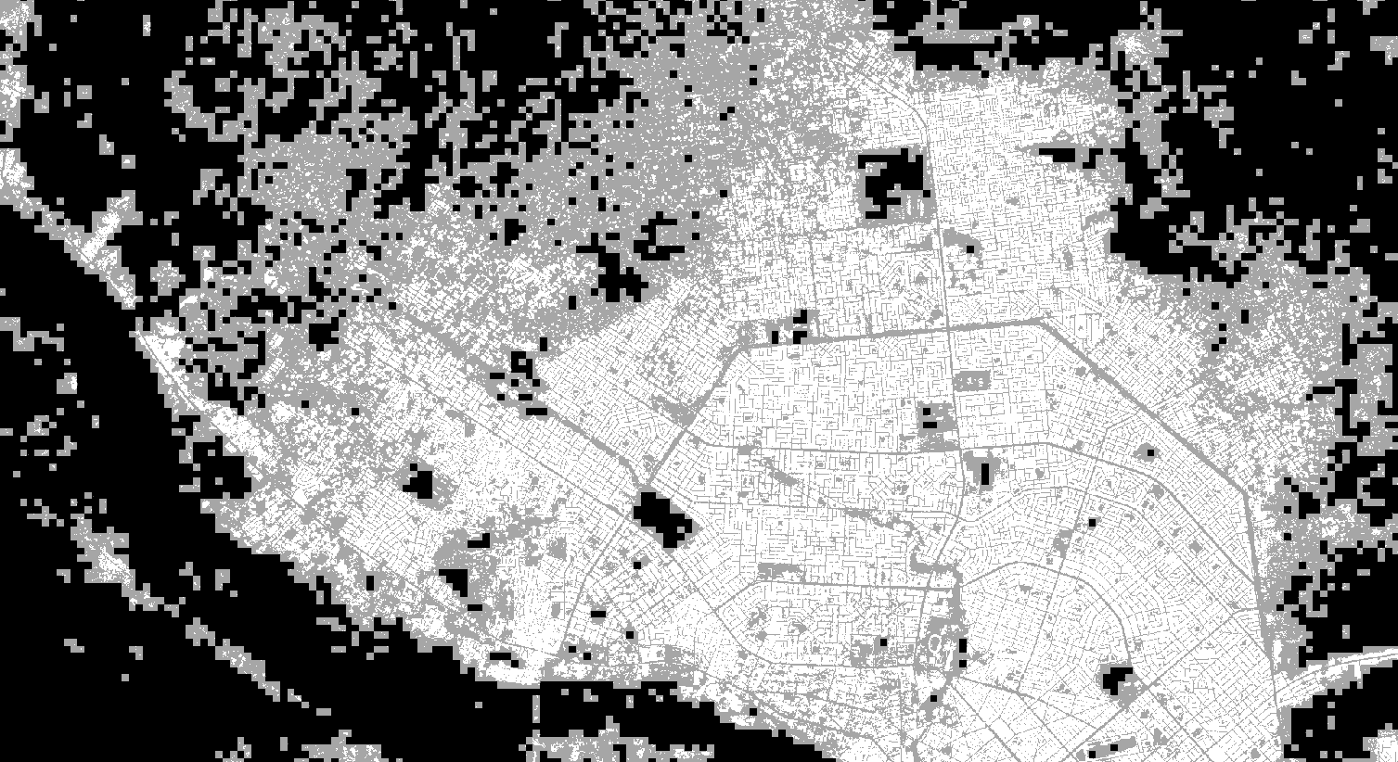
Comparison of Original and (max) Resampled Settlement Raster

Slide 8
Exercise 4.6) Apply a Set of Exclusions
Now we wish to apply GLAES for a set of exclusions. Understand the effect of exclusions applied individually and the difference when they are applied iteratively onto the same object.
Then, please exclude ‘water surfaces’ in addition to the exclusions that are already applied in the exercise script! You will find some hints at the end of the exercise script.
Work in pairs but make sure that the script works on both computers!
(30 mins)
Materials to be used:
Script SubTask_6_combine_exclusions.ipynb
CGLS landcover dataset manual

Slide 9
Exercise 4.7) Distribute Placements and Calculate Power Density
In this exercise, we will understand how placements can be distributed near optimally and how we can extract the results. Execute and understand the sample script first.
Then, please calculate the power density in MW/km² for our study region when only settlements are excluded with a buffer of 500m. Assume a spacing of 8 rotor diameters. Is the power density value high or low? What could be the reasons?
Work in pairs but make sure that the script works on both computers!
(30 mins)
Materials to be used:
Script SubTask_7_combine_exclusions.ipynb
Wind turbine type to assume: GE-158: 5.5 MW, rotor Ø 158 m, hub heights 101-161 m

Slide 10
Exercise 4.8) Calculate Exclusion Slopes over Buffer Variation
When the exclusion buffer is varied, the results change differently, depending on how fragemented the exclusion features are, what the default/reference buffer is etc. An understanding of the impacts of buffer changes for different criteria is very helpful for policy makers to show, where we must be careful with our decisions.
Execute and understand the script. Then calculate and plot the exclusion slope for a) human settlements, b) forests, c) water surfaces, d) main roads (at least 5 different buffer values each).
Work in pairs but make sure that the script works on both computers!
(45 mins)
Materials to be used:
Script SubTask_8_calculate_exclusion_slopes.ipynb
You may need to remember information from earlier sub tasks.

Slide 11
Exercise 4 – optional additional tasks)
Analyze the exclusion slope behaviour for other exclusion criteria as well
Compare it between different regions with very different structures (e.g. settlements, forests, protected areas etc.)
Apply the knowledge to the whole country – feel free to use your own country! The relevant data has been preprocessed for you.
Try to make your analysis „more complete“: Add exclusions, try to find datasets, and look for suitable buffer values.

