Slide 1
IMP-EGH: Interdisciplinary Master Program – Energy & Green Hydrogen Track 6: Systems Analysis for Green Hydrogen
3rd Semester | Heidi U. Heinrichs, ...
h.heinrichs@fz-juelich.de
Exercise Unit 07: Green Hydrogen Production
Nov. – Dec. 2022

Slide 2
Exercise 1: Scheme of Energy System Model
Electrolysis
Hydrogen demand
PV
Electricity demand
Lithium Battery

Slide 3
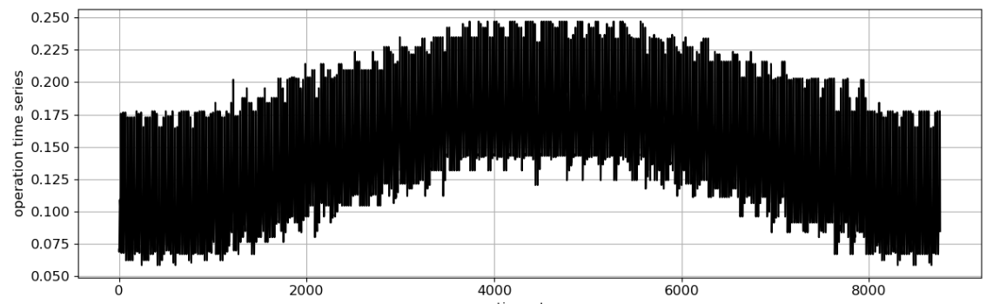
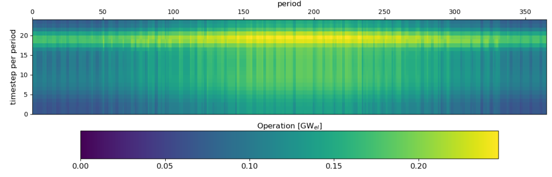
Hydrogen Demand and Electricity Demand are Equal in Both Scenarios
Electricity demand
electricity demand peaks in the evening hours and mid-year

Slide 4
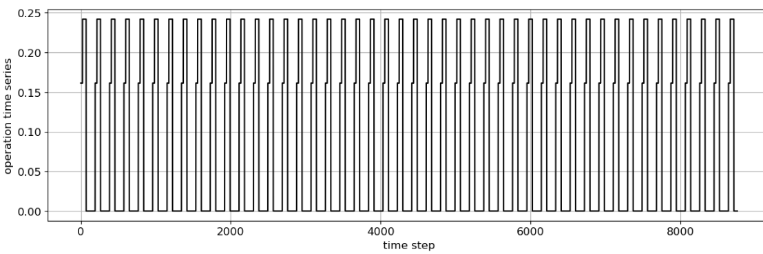
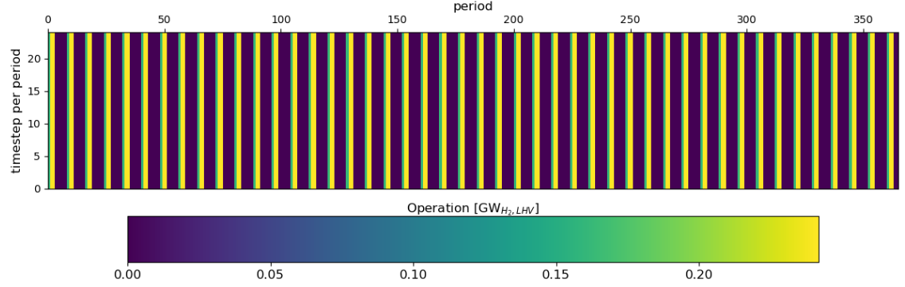
Hydrogen Demand and Electricity Demand are Equal in Both Scenarios
Hydrogen Demand
Hydrogen demand is cyclic and does not change its value
For many days of the year, there is no hydrogen demand at all
This is not a real time series

Slide 5
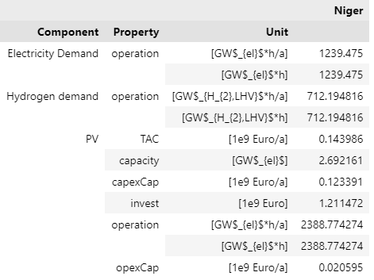
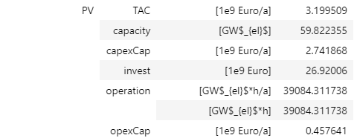
Only PV is Installed as a Source in Both Scenarios
Conversion Efficiency of 2%
Lower efficiency leads to:
Increase of Total annual Costs(TAC) of 3 bn EUR
Increase of installed PV capacity of 57 bn EUR
Due to lower conversion effciciency, more PV capacity must be installed to satisfy the required electricity input in conversion component
Conversion Efficiency of 70%

Slide 6
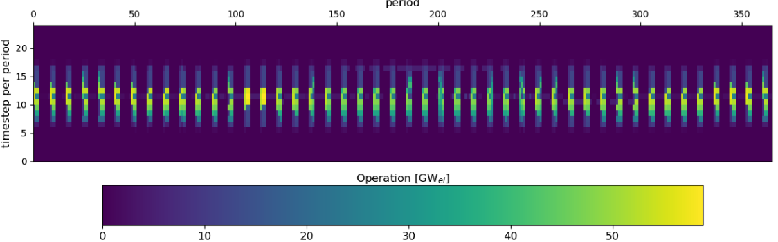
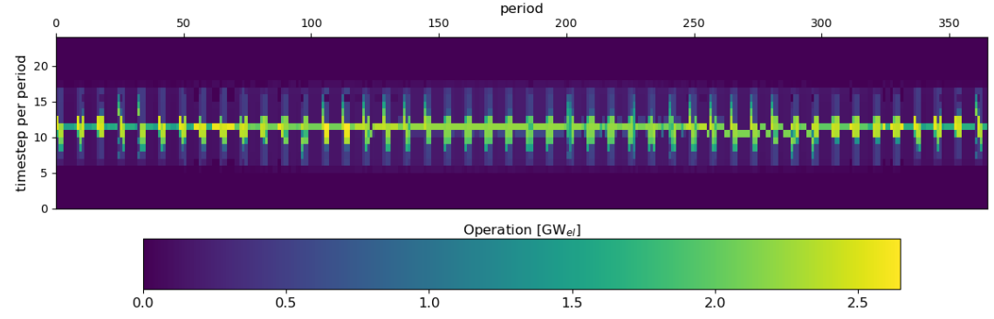
Higher Installed PV Capacity Leads to Operation Gap
Conversion Efficiency of 2%
Higher installed capacity in the 2% Scenario leads to operation stop on some days of the year
On sunny days, enough electricity is generated to fill Battery storages and apply this energy later (Lithium battery storages on next slide)
Conversion Efficiency of 70%

Slide 7
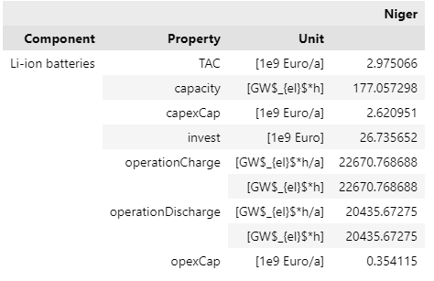
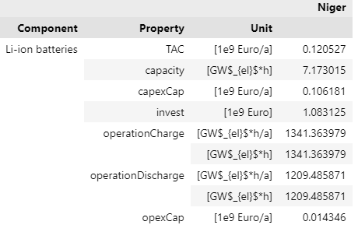
Battery Storages as a Source in Both Scenarios
Conversion Efficiency of 2%
Lower efficiency leads to:
Increase of Total annual costs of 2.85 bn EURO
An Increase of 177 GWH installed battery capacity
Different reasons are applicable:
PV had to be installed in the 2% scenario anyways to match the conversion input,
The exceeding energy vernation in periods with low hydrogen demand is stored in battery storages
Conversion Efficiency of 70%

Slide 8
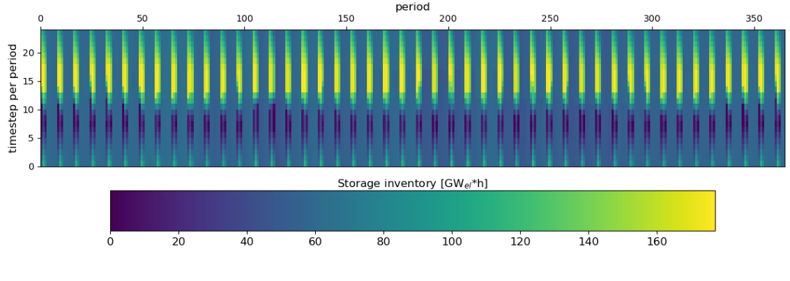
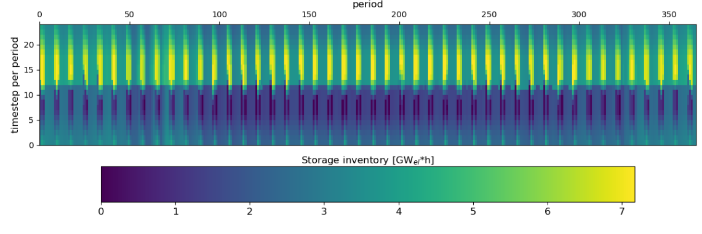
Battery Operation is similar
Conversion Efficiency of 2%
Peak operation times are similar, only the storage inventory changes drastically
Conversion Efficiency of 70%

Slide 9
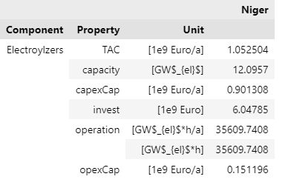
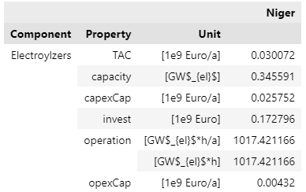
Installed Electrolysis Capacity Highly Dependent on Conversion Efficiency
Conversion Efficiency of 2%
Lower efficiency leads to:
Higher total annual costs of 1 bn Euro
Higher installed electrolyser capacity of 12 GW
Reason for the difference:
Due to lower efficiency, more capacity must be installed to match the hydrogen demand.
Thus, more electricity is needed.
A hydrogen storage may help to reduce the amount of installed capacity
Conversion Efficiency of 70%

Slide 10
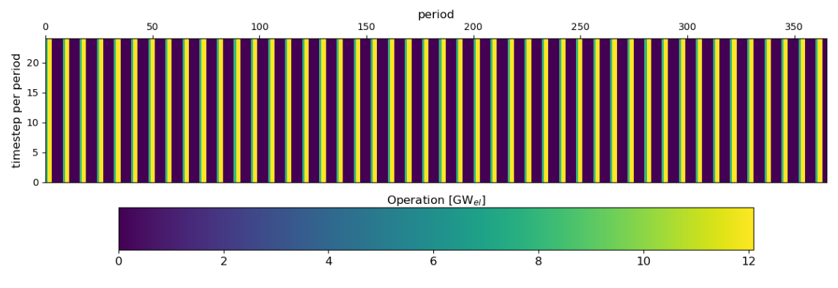
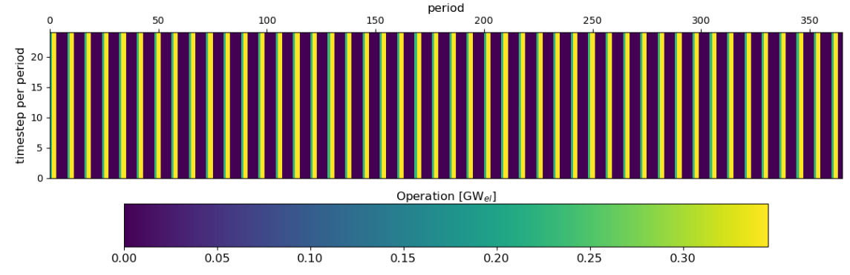
Conversion Operation Follows Hydrogen Demand
Conversion Efficiency of 2%
Operation of electrolysis must follow the hydrogen demand because there is no hydrogen storage applicable in the energy system model.
Only the applied power distinguish drastically (explanation on previous slide)
Conversion Efficiency of 70%

