Slide 1
IMP-EGH: Interdisciplinary Master Program – Energy & Green Hydrogen Track 6: Systems Analysis for Green Hydrogen
3rd Semester | Heidi U. Heinrichs, Arne Burdack
h.heinrichs@fz-juelich.de
Exercises 8: Electricity and Hydrogen Demand
Nov. – Dec. 2022

Slide 2
Exercise 1) Adding and changing electricity demands:
Open the Jupyter Notebook “Excercise_1-ElectricityDemand.ipynb” in “Unit_08_ElectricityAndHydrogenDemand”
a) Run it cell by cell. Name the class and the method that is used to add the electricity demand.
b) Check the resulting optimization summary and the plots:
Which region has high capacities of solar and wind energy, and which region not? Can you explain it?
Which could be a typical sector, leading to the shown electricity demand time line?
Materials to be used:
C:\Programming\GradSchool2022\wascal_graduate_school\student_files\exercises\Unit_08_ElectricityAndHydrogenDemand\Excercise_1-ElectricityDemand.ipynb

Slide 3
Exercise 1) Adding and changing electricity demands:
Imagine the Sustainable Development Goal 7 is reached in 2030 and Niger has 100% access to electricity. And further imagine, that this electricity is tried to be supplied by 100% of renewable energies. Building of industries, urbanisation and 100% electricity access fifolded the energy demand of the regions of Niger.
c)
Open Excercise_1-ElectricityDemand2030 from your explorer
There change the input path for the electricity demands to import the file: "electricity_dem2030_NER" and check the new results. Compare them to the former results. Especially check the demand of the SuperExpensiveElectricity-Source.
What problems arise due to the growing electricity demand?
Hint: What could that "SuperExpensiveElectricity-Source" be in reality?
Materials to be used:
C:\Programming\GradSchool2022\wascal_graduate_school\student_files\exercises\Unit_08_ElectricityAndHydrogenDemand\Excercise_1-ElectricityDemand2030.ipynb

Slide 4
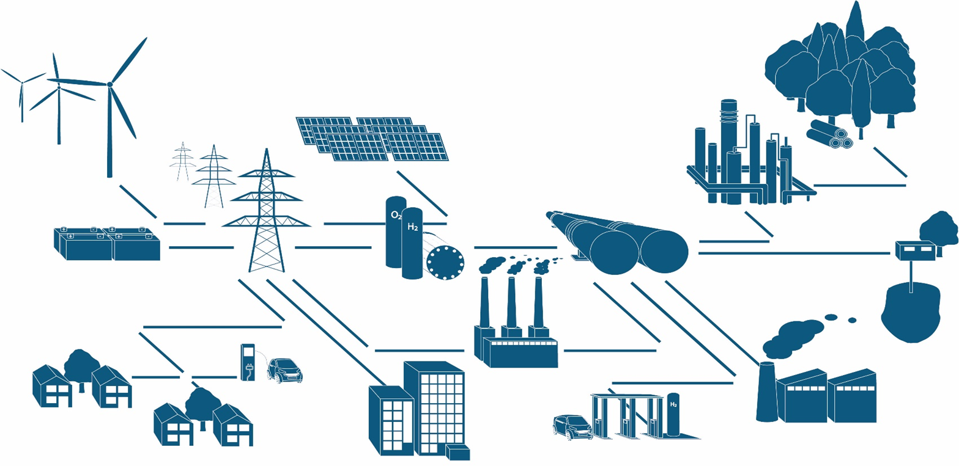
Exercise 2) Adding and changing electricity demands:
Based on the ESM of Execise 1.1 let us model an energy system where Niger's regions have seen the first industries using green hydrogen for fertilizer production, and the first pilot projects using hydrogen in the transportation sector are underway.

Slide 5
Exercise 2) Adding and changing electricity demands:
Open the Jupyter Notebook “Excercise_2-HydrogenDemand.ipynb” in “Unit_08_ElectricityAndHydrogenDemand”
Add the prepared hydrogen demand excel: "hydrogen_dem2030_NER.xlsx" as an input to the model
Finally adding the hydrogen demand as a "sink" something went wrong. Can you help to add the commodity that is missing?
Hint: You can find all commodities earlier in the code!
Run the model! What happens to the sources after adding hydrogen in comparison of before adding the hydrogen demand? Check the optimization summary and compare it to the optimizarion summary of Excercise_1-ElectricityDemand.ipynb.
Materials to be used:
C:\Programming\GradSchool2022\wascal_graduate_school\student_files\exercises\Unit_08_ElectricityAndHydrogenDemand\Excercise_2-HydrogenDemand.ipynb

