Slide 1
IMP-EGH: Interdisciplinary Master Program – Energy & Green Hydrogen Track 6: Systems Analysis for Green Hydrogen
3rd Semester | Heidi U. Heinrichs, Maximilian Stargardt
h.heinrichs@fz-juelich.de
Exercise Unit XYZ
March 2025

Slide 2

Content of This Exercise
What is FINE?
What can FINE be applied for?
Core Components of FINE
Build your own single-node energy system model
Unsplash.com

Slide 3
FINE as an Open Source Framework to Model Energy Systems
FINE is abbreviation for: Framework for Integrated Energy System assessment
generating energy system optimization models
Open-Source software
Easy handling for everyone
Finding answers to pressing questions in future energy systems
E.g.: (affordability, high share of renewable energy sources, low CO₂-emissions
Source
Sinks
Commodity c₁
Location XY
Storage
Transmission
Conversion
Location A
c₂
c₃

Slide 4
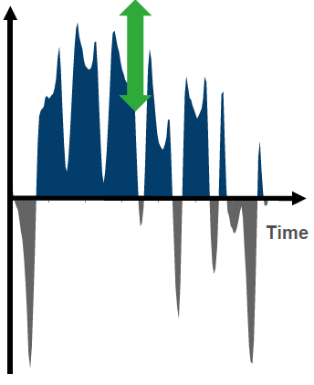
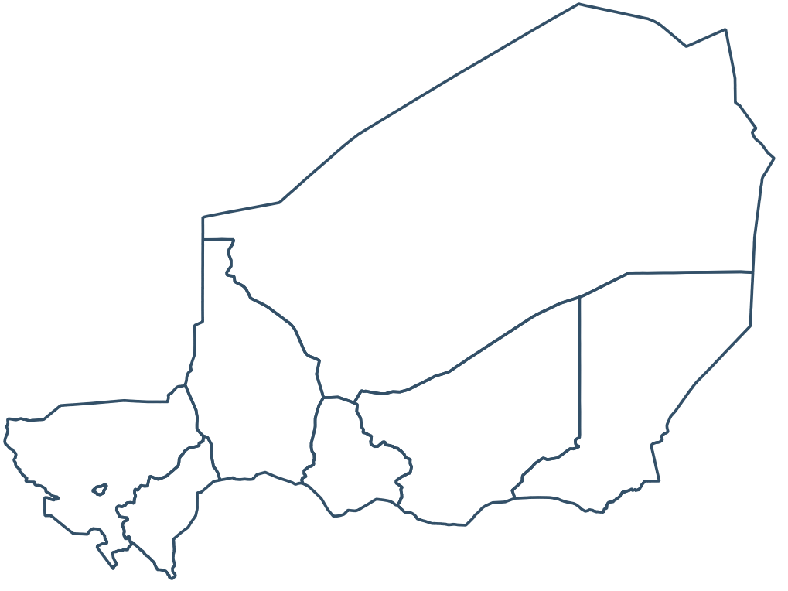
FINE Covers Three Basic Challenges for Energy Systems
Temporal
Spatial
Cross-linked Sectors and Commodities
Electricity
Residual Load
Time
Industry
Mobility
Service
Residential
Capture demand and renewable electricity production time series
Design storage adequately(from daily to seasonal storage)
Transmission infrastructure design and operation
More specific placements recommendations
Sector-coupling: connecting sectors to implement decarbonization strategies

Slide 5
N-Locations Connectable via n Transmission Lines Resulting in n-Node Model
Source
Sinks
Source
Sinks
Connecting 2 locations (2 nodes)
Commodity c₁
Commodity c₁
Storage
Transmission
Transmission
Storage
Conversion
Conversion
Location A
c₂
c₃
Location B
c₂
c₃
Locations (nodes) can be connected via transmission to exchange commodities
Increasing number of nodes leads to increasing complexity and computation times
Due to simplicity reasons, you will create a single-node model in FINE by applying jupyter notebook “”.

Slide 6
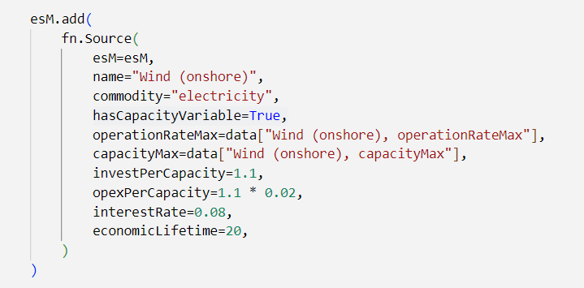
Explanation of Frequently Applied Parameters for the Component “Source” in FINE
Mandatory
Name of your plant
Generated commodity
Initialization of capacity variable
Maximum operation rate per timestep
Capacity dependent installation and operation costs
Maximum capacity ramp-up
Discount factor for calculating annual costs
Lifetime of the component in years
More information about potential parameters and a complete model description can be found here: https://vsa-fine.readthedocs.io/en/master/

Slide 7
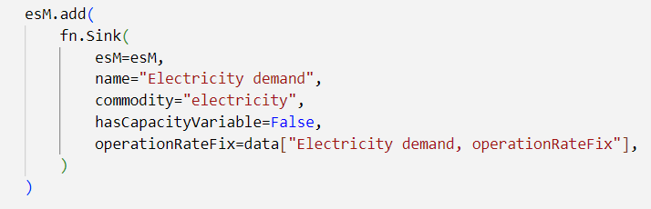
Explanation of Frequently Applied Parameters for the Component “Sink” in FINE
Mandatory
Name of the sink
Required commodity
Initialization of capacity variable
Required unit of the commodity per timestep for defined node
More information about potential parameters and a complete model description can be found here: https://vsa-fine.readthedocs.io/en/master/

Slide 8
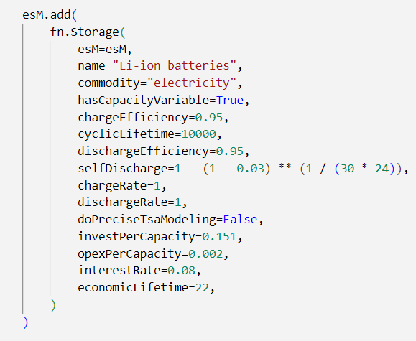
Explanation of Frequently Applied Parameters for the Component “Storage” in FINE
Mandatory
Name of the storage
Generated commodity
Defines the efficiency for d(dis-) charging the storage
Initialization of capacity variable
Ratio of maximum storage inflow to its capacity
Total number of full cycle equivalents
Capacity dependent installation and operation costs
Percentage of self-discharge for one hour
Discount factor for calculating annual costs
Lifetime of the component in years
More information about potential parameters and a complete model description can be found here: https://vsa-fine.readthedocs.io/en/master/

Slide 9
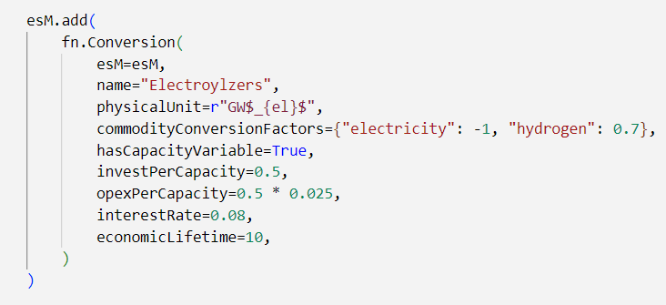
Explanation of Frequently Applied Parameters for the Component “Conversion” in FINE
Name of the storage
Mandatory
Physical units of the plant capacity limitations, cost parameter and timeseries refer to
Initialization of capacity variable
Factor with which commodities are converted into each other with one unit of operation
(1 unit electricity consumed, 0.7 units hydrogen produced)
Capacity dependent installation and operation costs
Discount factor for calculating annual costs
Lifetime of the component in years
More information about potential parameters and a complete model description can be found here: https://vsa-fine.readthedocs.io/en/master/

Slide 10
Exercise 1) Implementing a simple Single-Node Energy System Model
Task 1 (20 min)
Click through the notebook and try to understand the functionality of the energy system of Exercise Land.
Discuss in a group of 2-3 people: Why do you need two sources? How could you solve that issue?
Additional task: Do you have an idea where you can change the electricity demand? Which impact does a change of the demand have?
Materials to be used:
Jupyter-Notebook: Exercise_1.i.pynb
You do have two electricity sources, and one sink implemented in your model.
Sources
Sinks
electricity

Slide 11
Exercise 2) Extend Your Single-Node Model
Task 2 (20 min)
Open the related Exercise Folder and apply jupyter-notebook “Exercise_2.ipyb
Please discuss in groups of 2-3 people:
Compare this energy system to the system of exercise 1. What has change and what is the impact on the model results regarding the built components?
What is the utilization rate of the magic power source and why? Can you explain the operation peaks?
Source
Sinks
Materials to be used:
Jupyter-Notebook: Exercise_2.ipynb
Only one commodity is regarded “electricity)
The whole energy system is set up as a single node system
Commodity c₁
Storage

Slide 12
Exercise 3) Extend Your Single-Node Model with Additional Commodity
Task 3 (20 min)
Please discuss in groups of 2-3 people:
Compare this energy system to the system of exercise 2. What has changed and what is the impact on the model results regarding built technologies?
Which conversion ratio is assumed in the conversion component? What does this mean?
Source
Sinks
Materials to be used:
Jupyter-Notebook: Exercise_3.ipynb
Commodities electricity and hydrogen is considered
The whole energy system is set up as a single node system
c₂
Commodity c₁
Conversion
Storage

Slide 13
End of the Excercise

