Slide 1
IMP-EGH: Interdisciplinary Master Program – Energy & Green Hydrogen Track 6: Systems Analysis for Green Hydrogen
3rd Semester | Heidi U. Heinrichs, David Franzmann, Shuying Chen
s.chen@fz-juelich.de
Exercise Unit 5
March 2025

Slide 2
Renewable energy simulation Schedule
time | agenda
09:00 – 10:30 | Theory portion 1
10:30 – 10:45 | Break
10:45 – 12:00 | Theory portion 2
12:00 – 13:00 | Lunch break
13:00 – 15:00 | Code exercise, questions
Exercise resources download
Class examples: https://github.com/chrisjwin/IMP_EGH_ICE2
Further exploration in ECOWAS area: folder weather_data at https://fz-juelich.sciebo.de/s/1TbquCr9PD6Wh43

Slide 3
Renewable energy simulation Topics
Motivation General Workflow
Overview of weather data
Technologies: solar photovoltaics (PV) energy, Onshore wind energy
Physical principles
Workflow
Exemplary Results / H2 Africa application
Python session

Slide 4
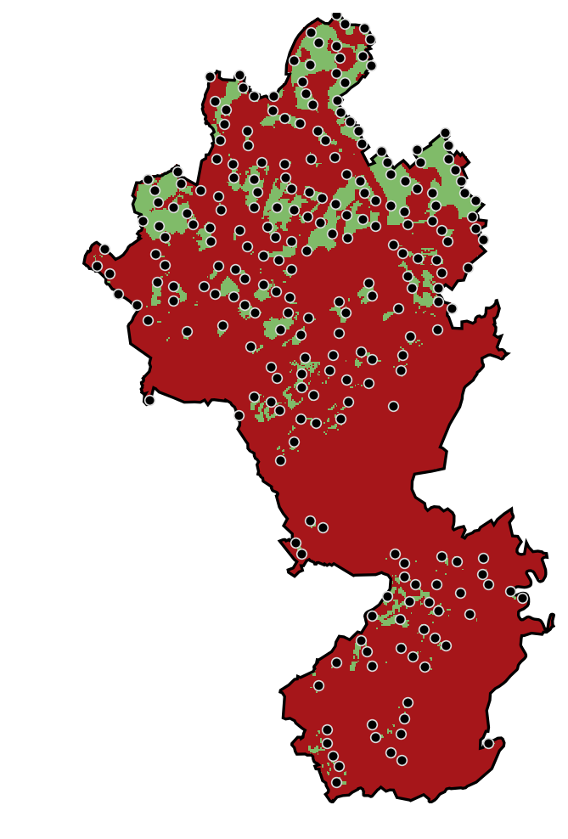
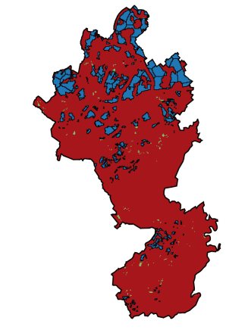
I/O of Renewables Simulation
Input from LEA
Output to Energy System Model
Simulation
No | Lon [°] | Lat[°] | Area [m²]
0 | 39.153 | -4.110 | 2814.98
1 | 39.288 | -4.066 | 2739.98
2 | 39.280 | -3.980 | 2444.98
3 | 39.345 | -4.056 | 2274.98
4 | 39.312 | -4.082 | 1979.98
5 | 39.336 | -4.084 | 944.99
… | 39.252 | -4.102 | 1654.98
n | 39.292 | -4.102 | 1794.98

Slide 5

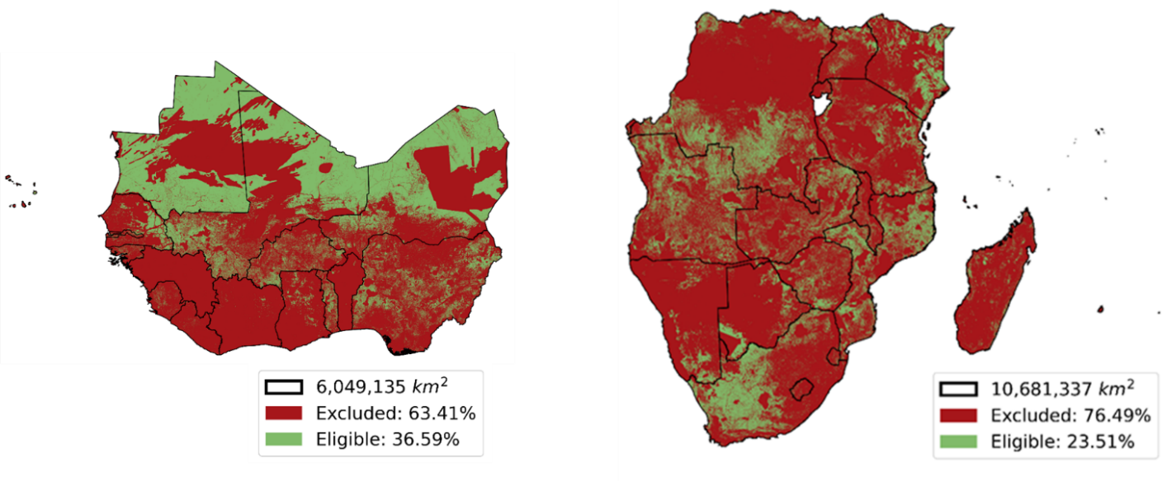
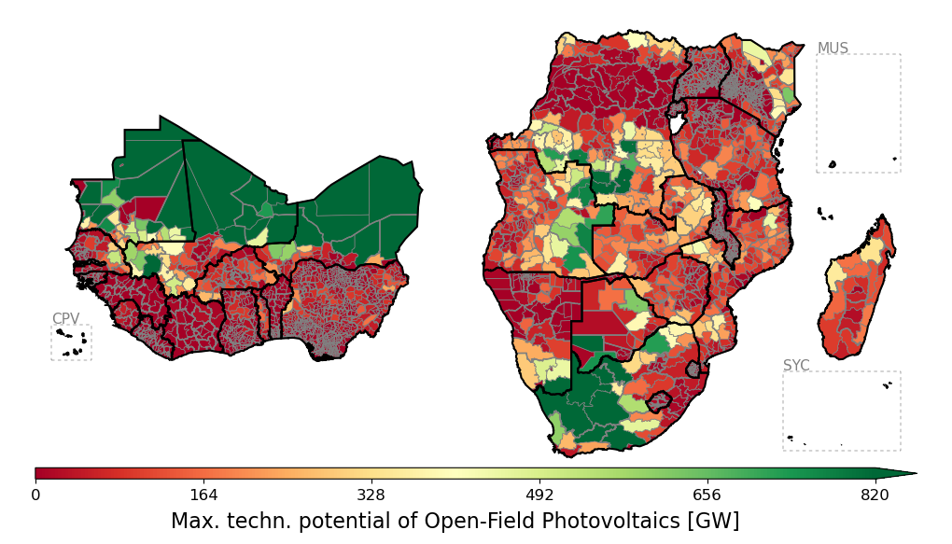
I/O of Renewables Simulation: Geographical Representation
Eligible land
Energy Potential
Renewable Simulation
[ref] Winkler, C. et al. Participatory mapping of local green hydrogen cost-potentials in Sub-Saharan Africa. International Journal of Hydrogen Energy 112, 289-321 (2025). https://doi.org:https://doi.org/10.1016/j.ijhydene.2025.02.015

Slide 6
RES Potentials: Requirements for Energy System
Resolution:
High spatial resolution
Hourly temporal resolution
Variables:
Capacity of each plant
Capacity factor time series of each plant
Cost parameters of each plant

Slide 7
Overview: General Workflow
Placements
at position x/y
Load all weather data
Process weather data
Simulate renewable energies

Slide 8
Overview: General Workflow
Placements
at position x/y
Load all weather data
Process weather data
Simulate renewable energies

Slide 9
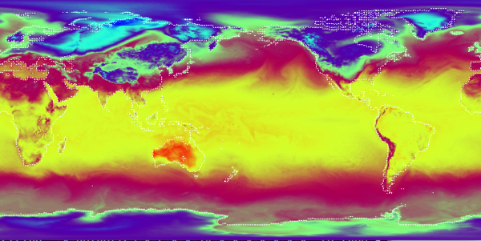
Weather Data
Usually, we want to simulate future energy systems, but we cannot forecast weather until 2050 (2100)
Use historic weather data and apply statistics
Historic weather data:
Measure data from ground stations
Measure data from satelites / weather balloons
Weather models
Weather data set
Global 2 m Temperature from ECMWF's ERA5 at 1st January 1979 0:00h. Copyright: UHH/CEN/AJB
[picture] https://www.cen.uni-hamburg.de/icdc/data/atmosphere/reanalysis-atmosphere/ecmwf-era5.html

Slide 10
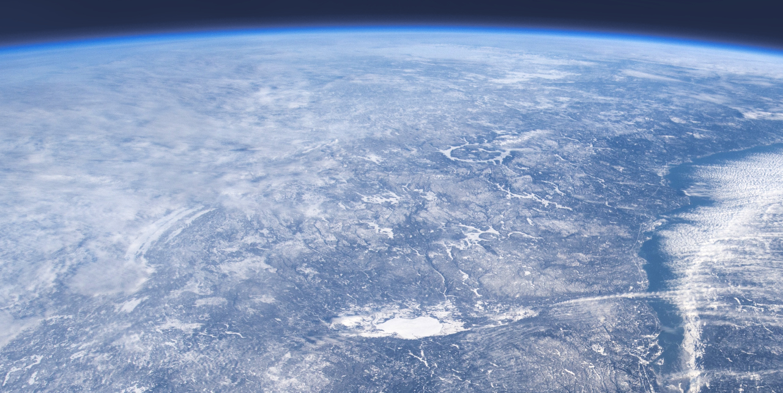
Different weather data
Dataset | Spatial resolution | Temporal resolution | Scope
ERA 5 | 0.25° x 0.25°, 1940 to present (-5 days) | 1h | Globally
MERRA 2 | 0.5° lat x 0.625° lon, | 1h | Globally
SAHRA 2 | 0.05°x0.05° | 30 min | Europe, Africa
Global Wind Atlas | 300mx300m | Only averages | Globally
Global Solar Atlas | 250mx250m | Only averages | Globally
[1] https://cds.climate.copernicus.eu/cdsapp#!/dataset/reanalysis-era5-single-levels?tab=overview
[2] https://gmao.gsfc.nasa.gov/reanalysis/MERRA-2/docs/ [3] https://navigator.eumetsat.int/product/EO:EUM:DAT:0863

Slide 11
ERA 5variables used
Varaible | Technology | Reason
Surface wind speed | PV | Temperature modelling
Surface pressure | PV | Temperature modelling
Surface air temp. | PV | Temperature modelling
Surface dew temperature | PV | Temperature modelling
Global horizontal irradiance | PV | Irradiance modelling
Direct horizontal irradiance | PV | Irradiance modelling

Slide 12
ERA 5variables used
Varaible | Technology | Reason
Elevated wind speed | Wind | Windspeed model
Surface pressure | Wind | Simulation
Surface air temp. | Wind | Simulation
Boundary layer height | Wind | Windspeed model

Slide 13
PV

Slide 14
Overview: General Workflow
Placements
at position x/y
Load all weather data
Get irradiances at time step and location
Process weather data
Get irradiances on module
Simulate renewable energies

Slide 15
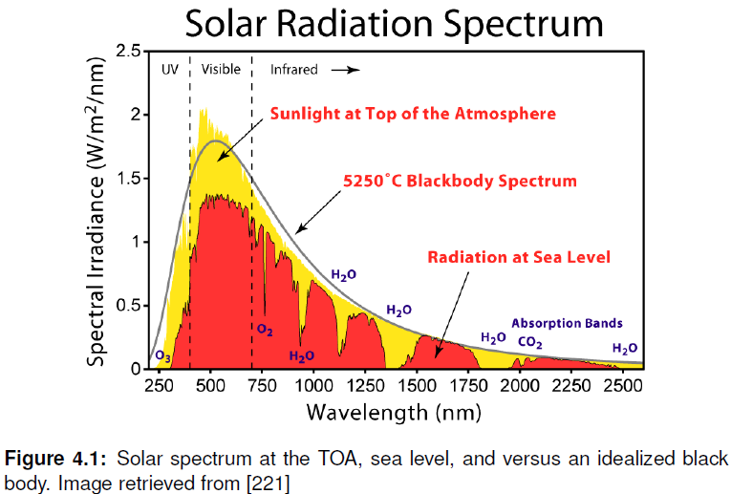
Background 1: Solar Irradiance
[1] Thesis Ryberg

Slide 16
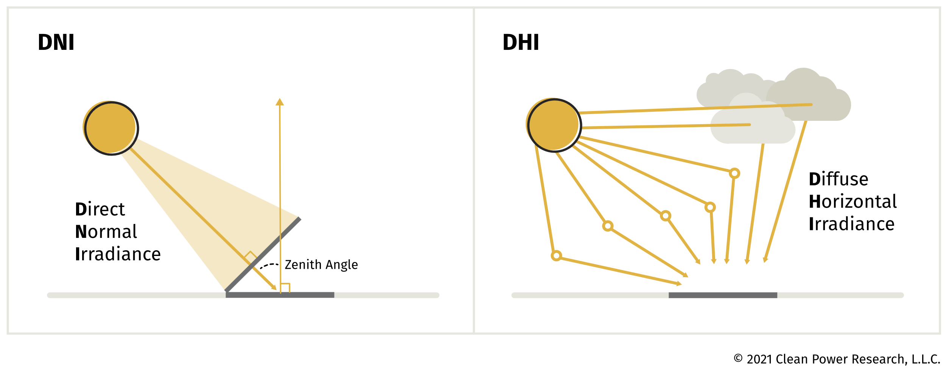
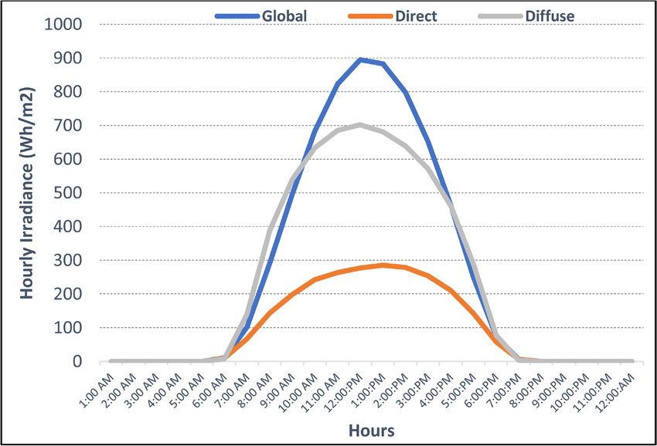
Background 2: Irradiances Types
Global horizontal irradiance:
„total irradiance on a horizontal surface plane“
GHI = DHI + DNI∗cos⁡(α_{zenith}​)
GHI: Global horizontal irradiance, DNI: Direct normal irradiance [1] https://www.solaranywhere.com/support/data-fields/definitions/ [2] https://www.researchgate.net/publication/335238562_Availability_Performance_and_Reliability_Evaluation_for_PV_Distributed_Generation/figures?lo=1&utm_source=google&utm_medium=organic

Slide 17
Irradiances Types with ERA5
Available:
Global horizontal irradiance (good!)
Direct horizontal irradiance (not good!)
Needed:
GHI (Global horizontal irradiance)
DNI (Direct normal irradiance)
DNI = Direct horizontal irradiance * 1/cos⁡(α_{zenith}​)
DHI (Diffuse horizontal irradiance)
DHI = GHI – DNI ∗ cos⁡(α_{zenith}​)
α_{zenith} needed: solar position and time series need to be matched
GHI: Global horizontal irradiance, DNI: Direct normal irradiance DHI: Diffuse horizontal irradiance [1] https://www.solaranywhere.com/support/data-fields/definitions

Slide 18

Long Run Averages (LRA)
ERA5: hourly resolution, but only 0,25° (20km at lat45°) resolution
Global solar atlas: resolution of 250m, but only 40-year average
Can this be combined?
High res
$$GHI_{LRA}(t)=GHI_{ERA5}(t)\frac{GHI_{Global solar atlas}}{GHI_{ERA5,average}}$$
Low res
High res + hourly
hourly
GHI: Global horizontal irradiance, DNI: Direct normal irradiance

Slide 19
Overview: General Workflow
Placements
at position x/y
Load all weather data
Get irradiances at time step and location
Process weather data
Get irradiances on module
Simulate renewable energies

Slide 20
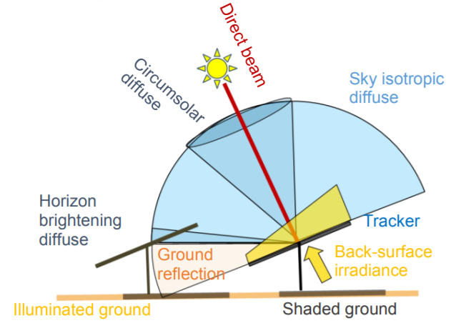
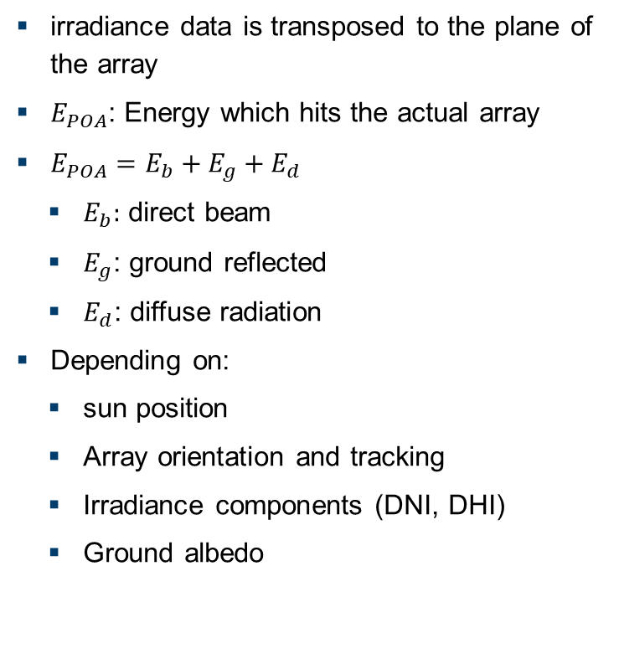
Plane of Array (POA)
irradiance data is transposed to the plane of the array
$E_{POA}$: Energy which hits the actual array
$E_{POA}=E_{b}+E_{g}+E_{d}$
$E_{b}:$ direct beam
$E_{g}$: ground reflected
$E_{d}$: diffuse radiation
Depending on:
sun position
Array orientation and tracking
Irradiance components (DNI, DHI)
Ground albedo
[1] https://pvpmc.sandia.gov/modeling-guide/1-weather-design-inputs/plane-of-array-poa-irradiance/

Slide 21
Overview: General Workflow
Placements
at position x/y
Load all weather data
Get irradiances at time step and location
Process weather data
Get irradiances on module
Simulate renewable energies

Slide 22
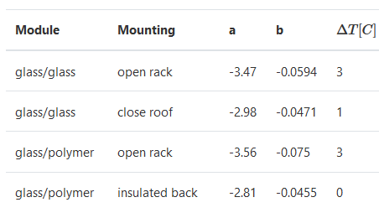
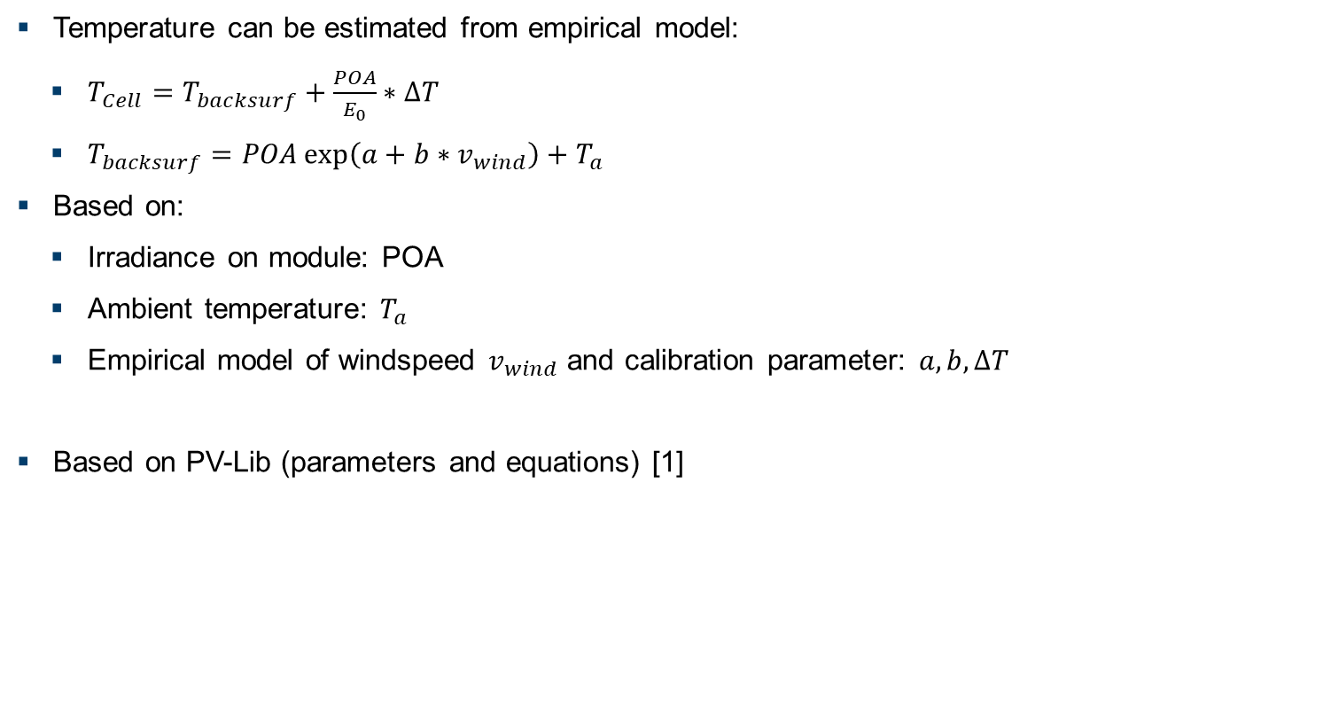
Simulation Step 1: Estimation of Cell Temperature
Temperature can be estimated from empirical model:
$T_{Cell}=T_{backsurf}+\frac{POA}{E_{0}}∗ΔT$
$T_{backsurf}=POA\exp\left(a+b∗v_{wind}\right)+T_{a}$
Based on:
Irradiance on module: POA
Ambient temperature: $T_{a}$
Empirical model of windspeed $v_{wind}$ and calibration parameter: $a, b, ΔT$
Based on PV-Lib (parameters and equations) [1]
[1] https://pvlib-python.readthedocs.io/en/stable/reference/generated/pvlib.temperature.sapm_cell.html?highlight=pvlib.temperature.sapm_cell

Slide 23
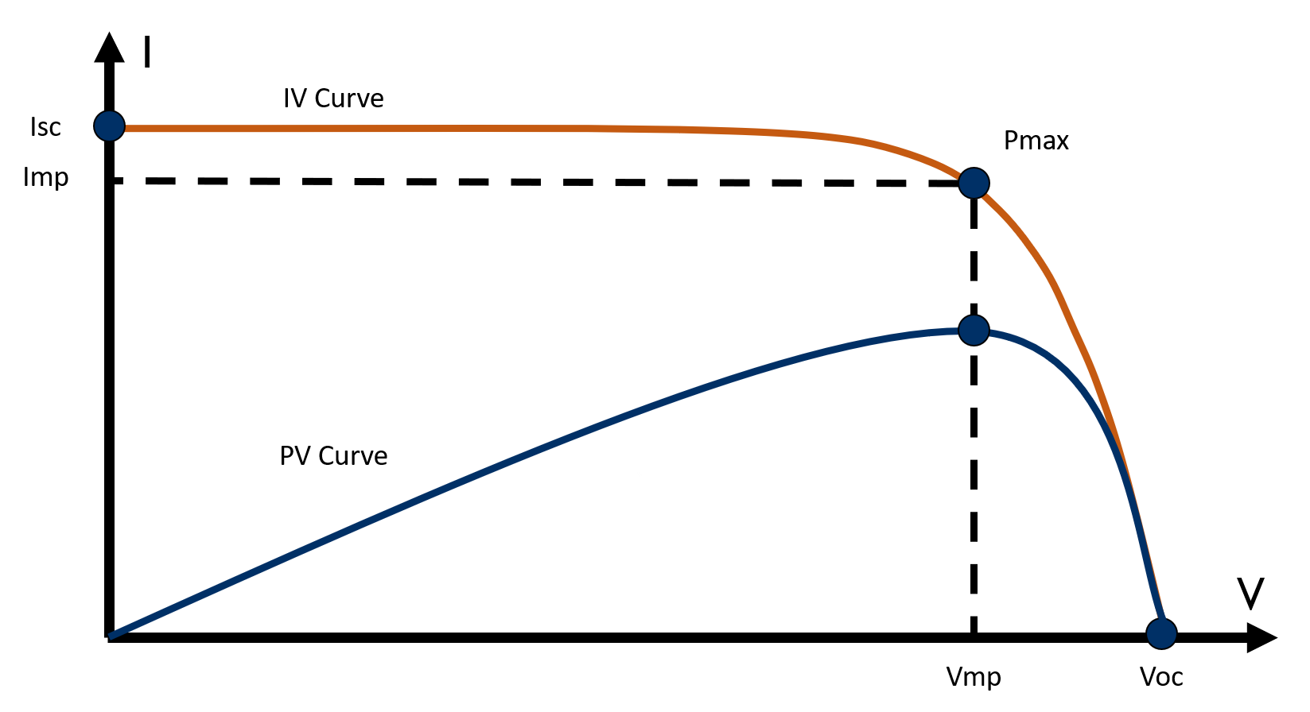
Simulation Step 2: Calculation of Power Output
Irradiance, temperature and electrical module params from PVlib database [2]
Calculation of the single diode equation from De Soto et al. [1]
Solve the single diode equation to obtain a photovoltaic IV curve [2]
[1] W. De Soto et al., “Improvement and validation of a model for photovoltaic array performance”, Solar Energy, vol 80, pp. 78-88, 2006. [2] https://pvlib-python.readthedocs.io [fig] https://www.atonometrics.com/applications/what-is-a-pv-module-iv-curve/

Slide 24
Result: PV Potentials
Apply this algrithm for each placement (up to millions) and different weather years to calculate average potential

Slide 25
Wind

Slide 26
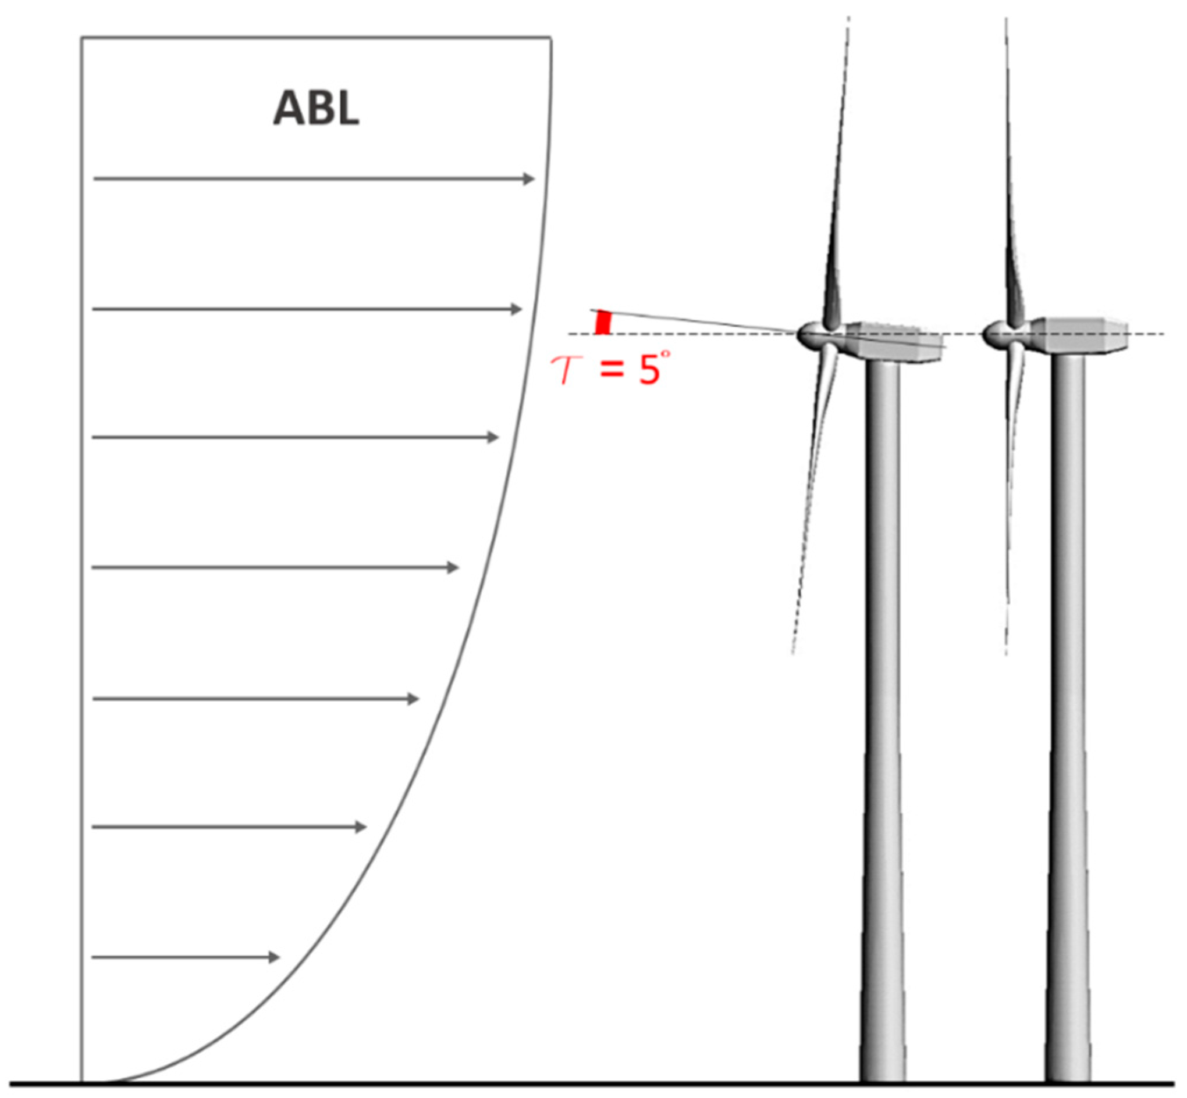
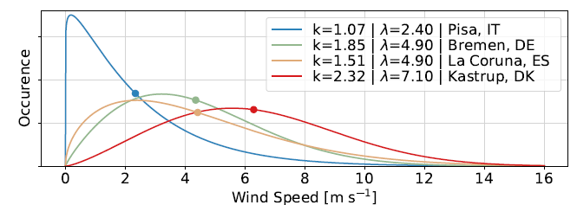

Background
Energy from wind:$P_{Wind}=A\frac{ρ}{2}v^{3}$
Maximal technical extractable power: $\frac{P_{max}}{P_{Wind}}=\text{16/27=0.593}$ (Betz law, not an efficiency)
Windspeed is intermittent. Therefore, distributions are often modelled as Weibull distributions
Wind creates a boundary layer above the surface
[fig left] https://doi.org/10.3390/en12071208 [fig right] Thesis Ryberg

Slide 27
Overview: General Workflow
Placements
at position x/y
Load all weather data
Get wind speed at time step and location
Process weather data
Model wind speed at turbine height
Simulate renewable energies

Slide 28
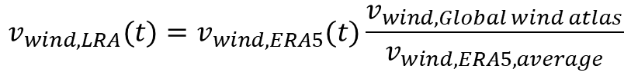
Long Run Averages (LRA)
ERA5: hourly resolution, but only 0,25° (20km at lat45°) resolution
Global wind atlas: resolution of 250m, but only 40-year average
Can this be combined?
High res
$$v_{wind,LRA}(t)=v_{wind,ERA5}(t)\frac{v_{wind,Global wind atlas}}{v_{wind, ERA5,average}}$$
Low res
High res + hourly
hourly
GHI: Global horizontal irradiance, DNI: Direct normal irradiance

Slide 29
Overview: General Workflow
Placements
at position x/y
Load all weather data
Get wind speed at time step and location
Process weather data
Model wind speed at turbine height
Simulate renewable energies

Slide 30
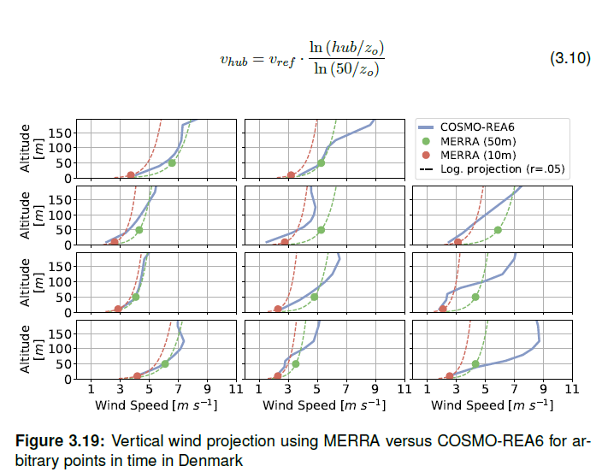
Projection to Wind Speed

Slide 31
Overview: General Workflow
Placements
at position x/y
Load all weather data
Get wind speed at time step and location
Process weather data
Model wind speed at turbine height
Simulate renewable energies

Slide 32
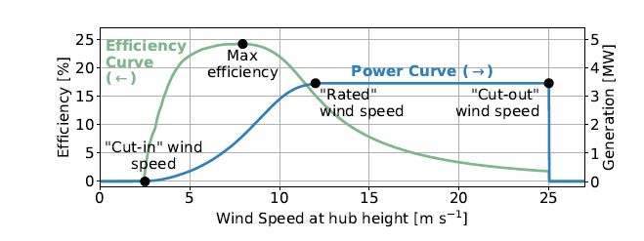
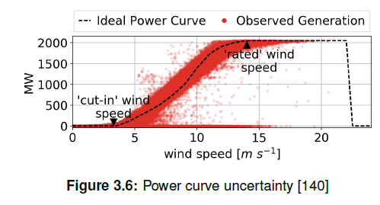
Power Curve
Power curve: electrical power determined by the wind speed
Real generation is distrubuted around the ideal generation due to:
Dynamic effects
Wind shears
Wind speed estimations
Changing air density …

Slide 33
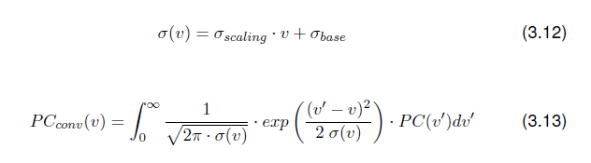
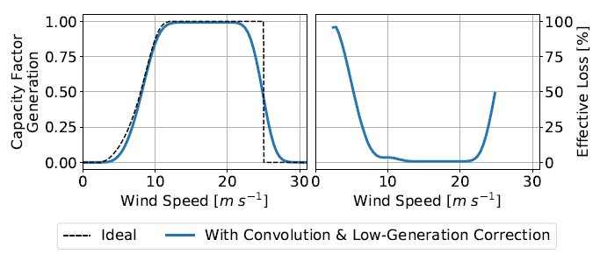
Power Curve
Convolution used as statistical measure to account for these effects

Slide 34
Result: Onshore Wind Potentials
Apply this algorithm for each placement (up to millions) and different weather years to calculate average potential

Slide 35
Cost model

Slide 36
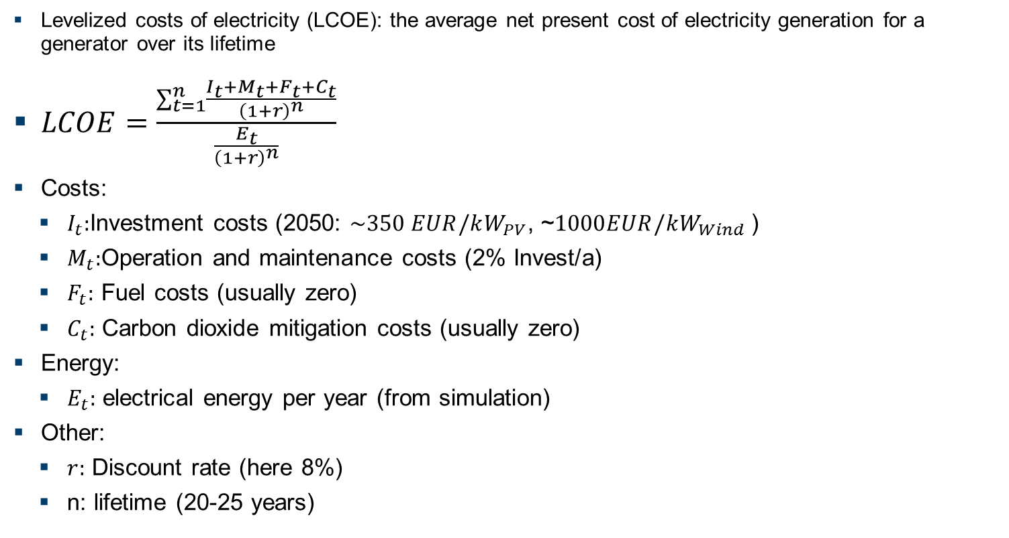
Determining the LCOE
Levelized costs of electricity (LCOE): the average net present cost of electricity generation for a generator over its lifetime
$LCOE=\frac{\sum_{t=1}^{n}{\frac{I_{t}+M_{t}+F_{t}+C_{t}}{{\left(1+r\right)}^{n}}}}{\frac{E_{t}}{{\left(1+r\right)}^{n}}}$
Costs:
$I_{t}:$Investment costs (2050: $\sim 350 EUR/kW_{PV}$, ~$1000EUR/kW_{Wind}$)
$M_{t}:$Operation and maintenance costs (2% Invest/a)
$F_{t}:$ Fuel costs (usually zero)
$C_{t}:$ Carbon dioxide mitigation costs (usually zero)
Energy:
$E_{t}:$ electrical energy per year (from simulation)
Other:
$r:$ Discount rate (here 8%)
n: lifetime (20-25 years)
Notes:
Discount rate accounts for the time value of money - the idea that money today is worth more than the same amount in the future. (to consider inflation in the project costs calculation)
The higher discount rate, the higher LCOE and make the project less attractive (the future revenue is worth less).

Slide 37
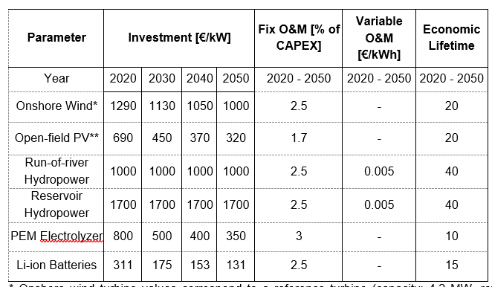
Cost assumptions
[1] Stolten et al.; KSG2045; 2023
Notes:
Operation and Maintenance (O&M) Costs, shown as percentage of Capital Expenditure (CAPEX)

Slide 38
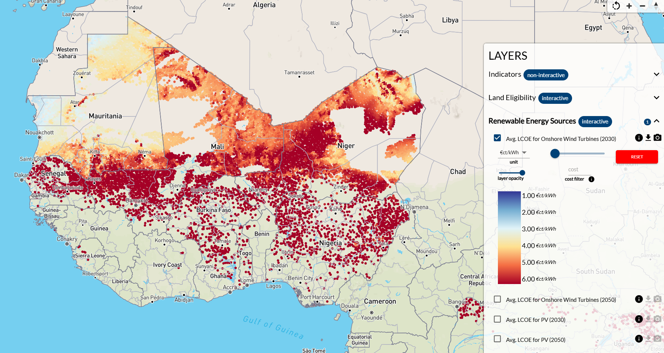
Cost Potential of Renewable Energies
H2Atlas project: https://africa.h2atlas.de/africa

Slide 39
Python Implementation:
IEK-3 developed Python-tool. ETHOS.RESkit

Slide 40
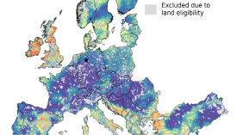
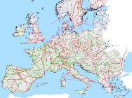

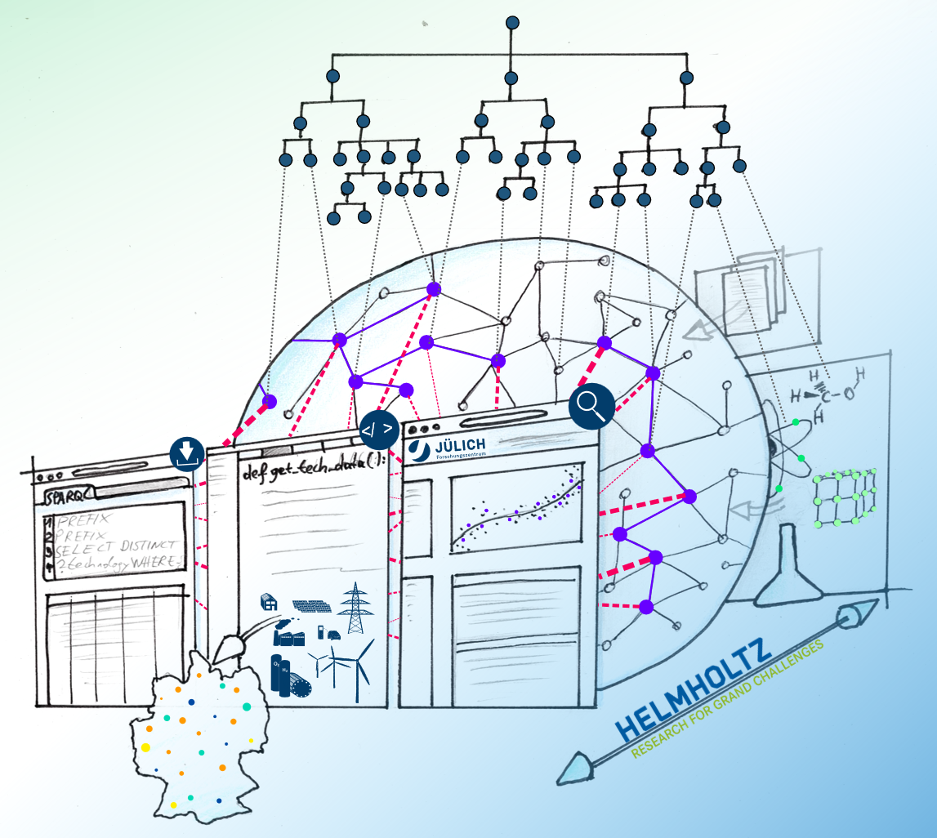
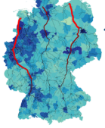
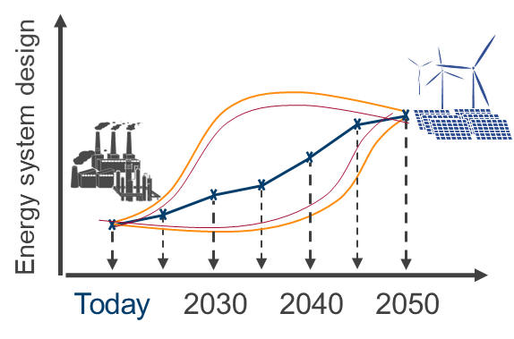
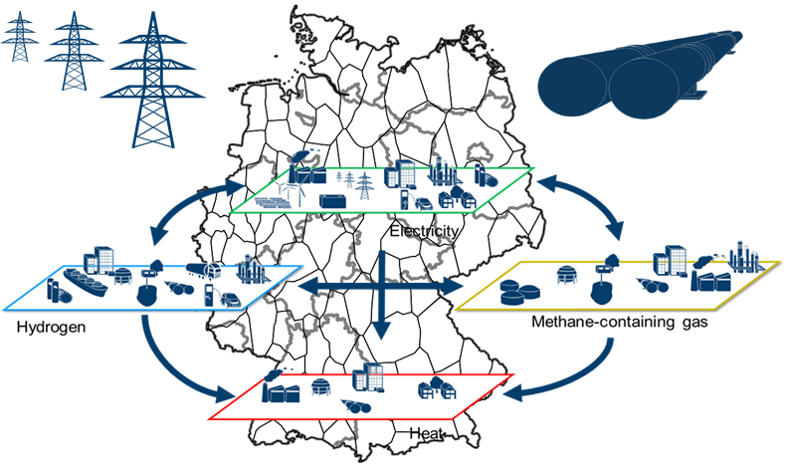



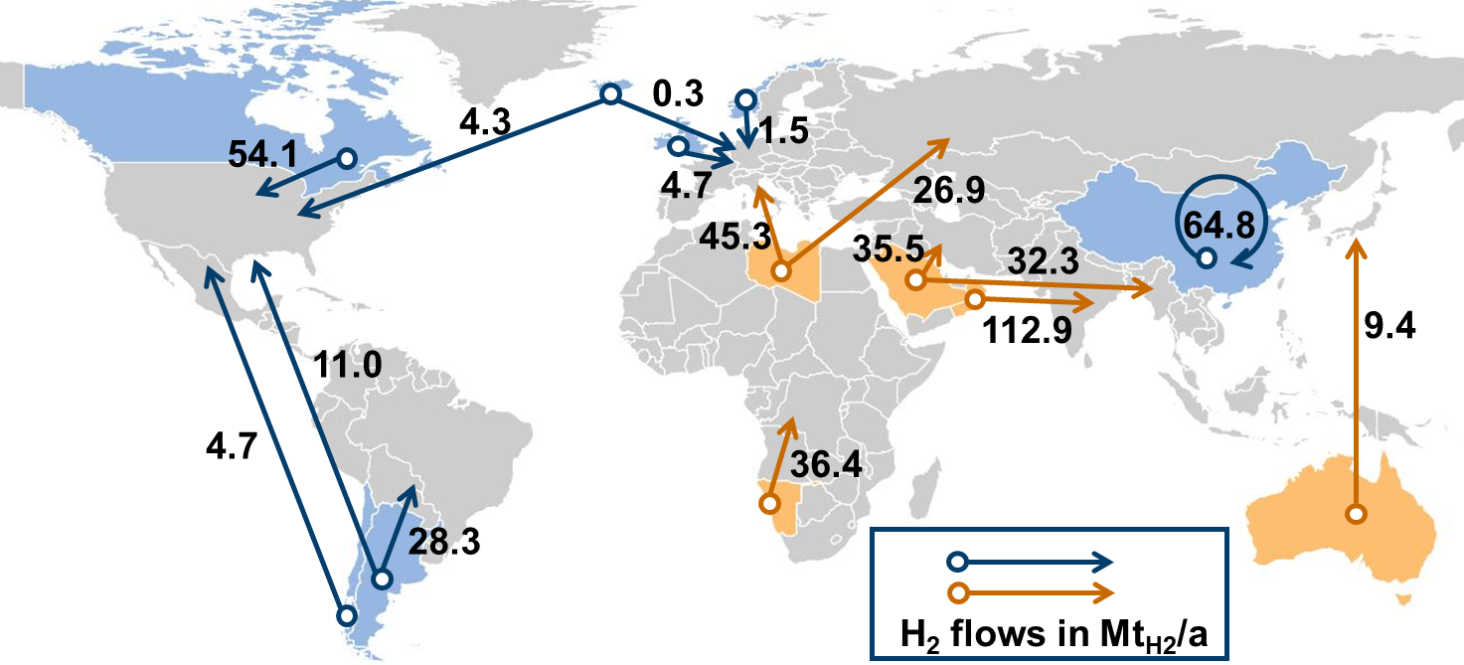
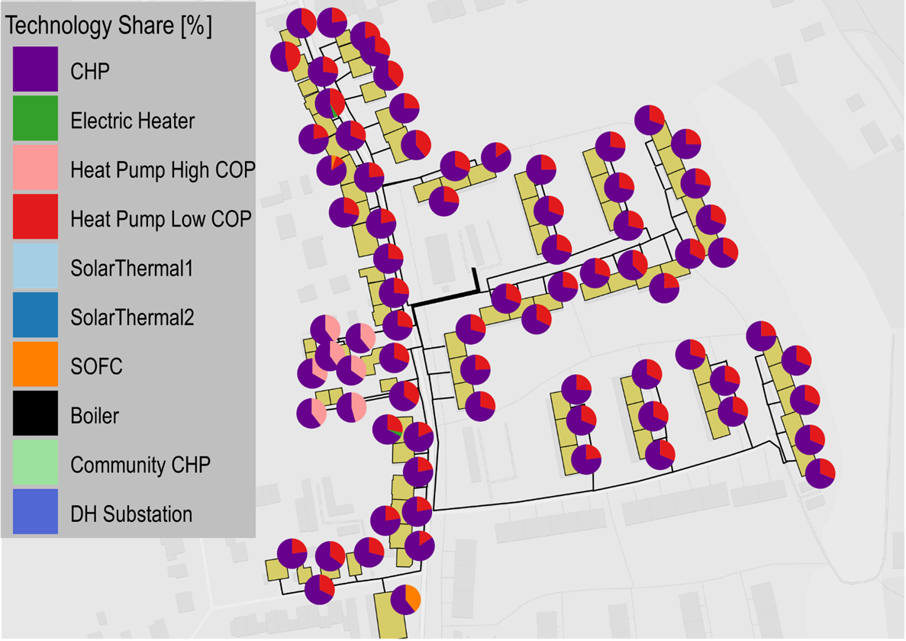

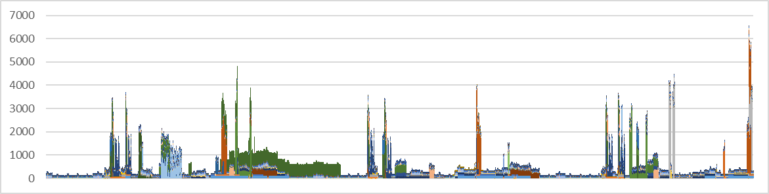









ETHOS: Energy Transformation PatHway Optimization Suite
Renewable Energy
Resources
Electricity transmission & distribution grids
Societal feasibility
Gas transmission grid
Integrated Hourly Optimization
Technology Database
Single-node
< 400 nodes
H₂ and PtX
Infrastructure
Macro-economics*
Life Cycle Assessment*
Buildings
Cost optimized energy systems
Regionalized via local demand and
infrastructure
H₂ global
Districts
Activity-based transport demand
From demand to load profile
Transport sector
Passenger
Freight

Slide 41
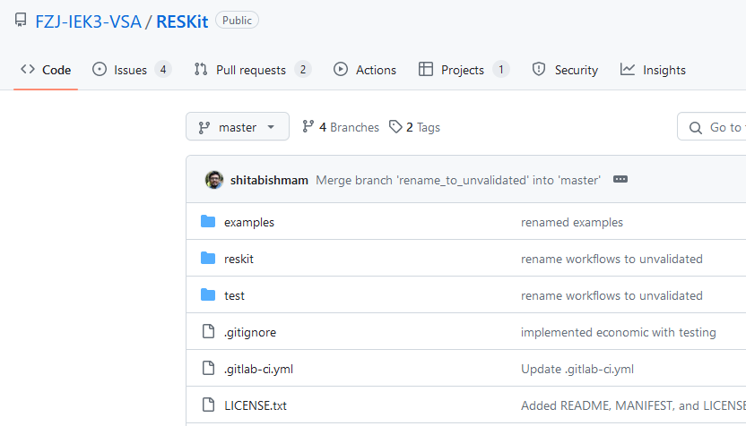
Python Implementation:
IEK-3 developed Python-tool. ETHOS.RESkit
Publicly available at:
https://github.com/FZJ-IEK3-VSA/RESKit/tree/master

Slide 42
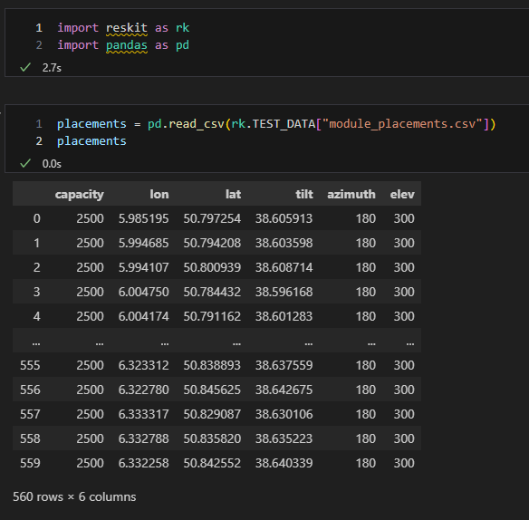
Simulation of PV: Placements as Input Data

Slide 43
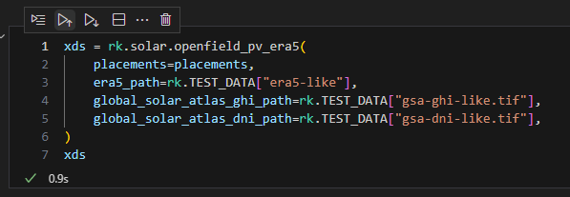
PV Simulation
Output: Placements with results
Input: Placements from results
Input: Path to ERA-5 data
Input: Path to GSA (GHI/DNI)

Slide 44
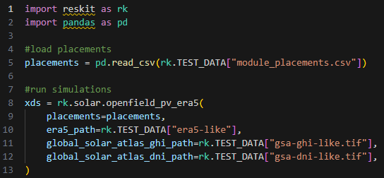
Whole Code for PV:

Slide 45
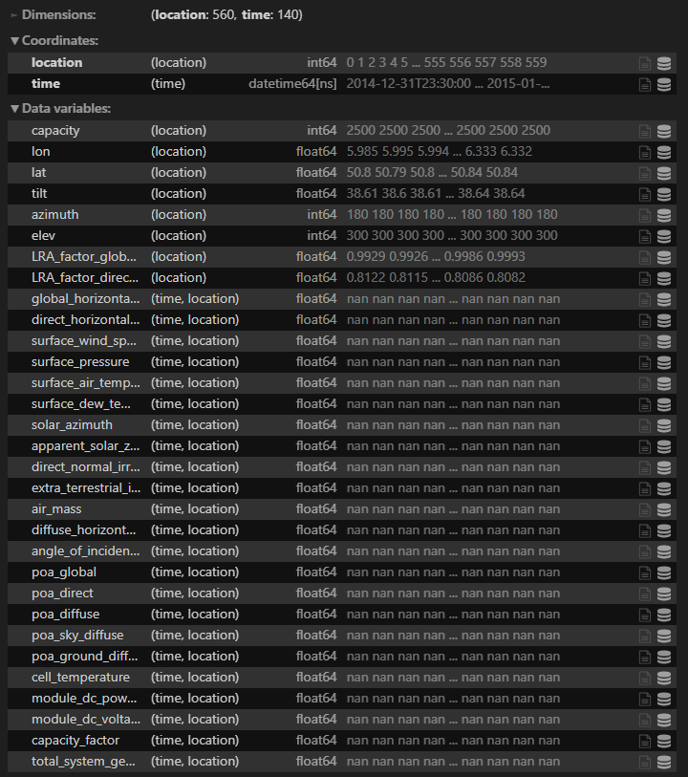
Simulation of PV: Results are Different Variables as Time Series

Slide 46
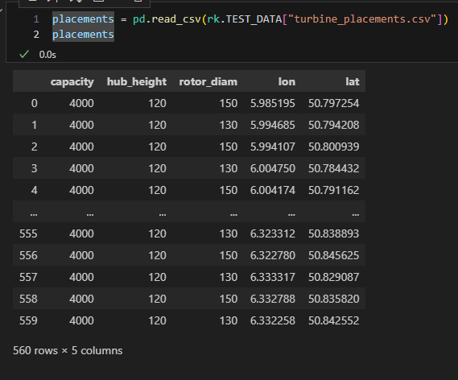
Simulation of Wind: Placements as Input Data

Slide 47
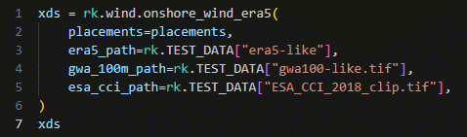
Wind Simulation
Output: Placements with results
Input: Placements from results
Input: Path to ERA-5 data
Input: path to global wind atlas
Input: path to land cover dataset

Slide 48
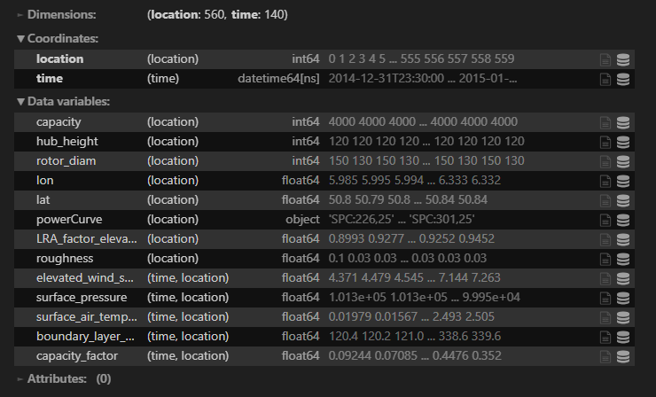
Simulation of Wind: Results are Different Variables as Time Series

