Slide 1
Diabetes Overview, Impact and Predictive Analysis
Christopher Kalfas, Joshua Otten, Thomas McCann

Slide 2
Objectives
With survey information from the National Health and Nutrition Examination Survey we aim to provide predictive analysis of the likelihood of Diabetic diagnosis.
We examine the participants of the diabetes survey along with a record of their nutritional intake to understand the correlation between diet and diabetes.
Develop a model to predict the onset of diabetes based on nutritional intake.
Demographics also contribute to the onset of diabetes. To a lesser extent we examine this relationship.

Slide 3
Technologies Implemented
Extract Transfer Load
Machine Learning/Visuals
SAS
Glob
SQL Server
MySQL
CSV
NumPy
Jupyter Notebook
Python Pandas
Flask
SQL Server
Scikit-Learn
Matplotlib
Html
Javascript
Tableau

Slide 4
Scope of Work
Survey information converted from SAS to CSV through SQL.
Large amount of data cleaned in Excel and SQL.
Clean database created in SQL Server.
Flask App built in Jupyter.
Model and training performed through Scikit-Learn
Visualizations created through Matplotlib and Tableau
Output collected and demonstrated through Flask and HTML.

Slide 5
Challenges
…opportunity for growth
The data was in SAS, so the first challenge was working with a new format.
We used a very large dataset. Starting with 3 separate sets the scope encompassed more than 10,000,000 data points.
Column headers were indecipherable without reference.
Without much intelligence on the data, we needed to select what we thought would be most prevalent to support our objective and make the data more workable.
This was survey and nutritional data which led to a large amount of NaN. Because we did not want to drop a majority of the data we converted NaN to 0.
Another unexpected challenge was working with miniscule decimals. These disrupted progress so they were also converted.

Slide 6
Bias Data
Surveys may not be the most honest source of data. Particularly in a face to face interview regarding Health. We even lie in our food diaries, don’t we?
Another aspect not initially considered was the idea that the survey participants may have already altered their nutritional intake based on the notion that they thought they may have had diabetes or been diagnosed diabetic or prediabetic. I would stop eating sugar…right?
🤔
While the data set was immense the sample size was not exactly that with 9,500 participants.
A1C testing along with a micronutrient blood panel would provide a more supportive portrayal of indicators.

Slide 7
Machine Learning
Matplotlib
Numpy
Sklearn
Logistic Regression Model

Slide 8
Diabetes Overview
Type 2 Diabetes occurs when the body does not use insulin properly. The pancreas produces extra insulin to normalize blood glucose levels. Over time the functionality of the pancreas is depleted and rendered ineffective.
Health factors strongly associated with diabetes include; Obesity, Smoking, High Blood Pressure, High Blood Glucose and lack of Exercise.
Symptoms of Diabetes include; Constant hunger/thirst, Frequent urination, fatigue, blurry vision, numbness in extremities and slow to heal cuts.
Insulin intake, oral medication and lifestyle changes are required to live with Diabetes.
The need for Insulin can be waned through diet and exercise.

Slide 9
Diabetes Epidemic*
In 2015 nearly 10% of the American population had Diabetes. Roughly 4% was undiagnosed.
1.5 Million Americans are diagnosed every year.
25% of Seniors have diabetes.
84 million Americans age 18 and older had prediabetes.
Diabetes is the 7th leading cause of death in the US as the underlying cause in 80K deaths in 2015 and a contributing cause in over 250K.
These statistics may also be under reported as only 35-40% with diabetes who died had diabetes listed anywhere on the death certificate.
*CDC National Diabetes Statistics Report, 2017.

Slide 10
Diabetes Epidemic*
Cholesterol, age, obesity, blood pressure and smoking are among largest non-genetic contributors.
Vitmamin D deficiency is associated with diagnosis though may not have causation.
The danger of unknowingly living with Diabetes is immense and at least 1/3 of those affected are undiagnosed.
Kidney failure, vision impairment, nerve damage and amputation are among the threats.
Diabetes has become very easy to diagnose through A1C, which measures the average blood glucose for the past 2-3 months.
You can lower your risk by nearly 60% by losing 7% of your body weight and exercising moderately 30 minutes a day 5 days a week.
*CDC National Diabetes Statistics Report, 2017.

Slide 11
Economics of Diabetes
$327 billion: Total costs of diagnosed diabetes in the United States in 2017
$237 billion for direct medical costs
$90 billion in reduced productivity
After adjusting for population age and sex differences, average medical expenditures among people with diagnosed diabetes were 2.3 times higher than what expenditures would be in the absence of diabetes.
*Economic Costs of Diabetes in the U.S. in 2017
American Diabetes Association, Diabetes Care 2018 Mar; dci180007.

Slide 12
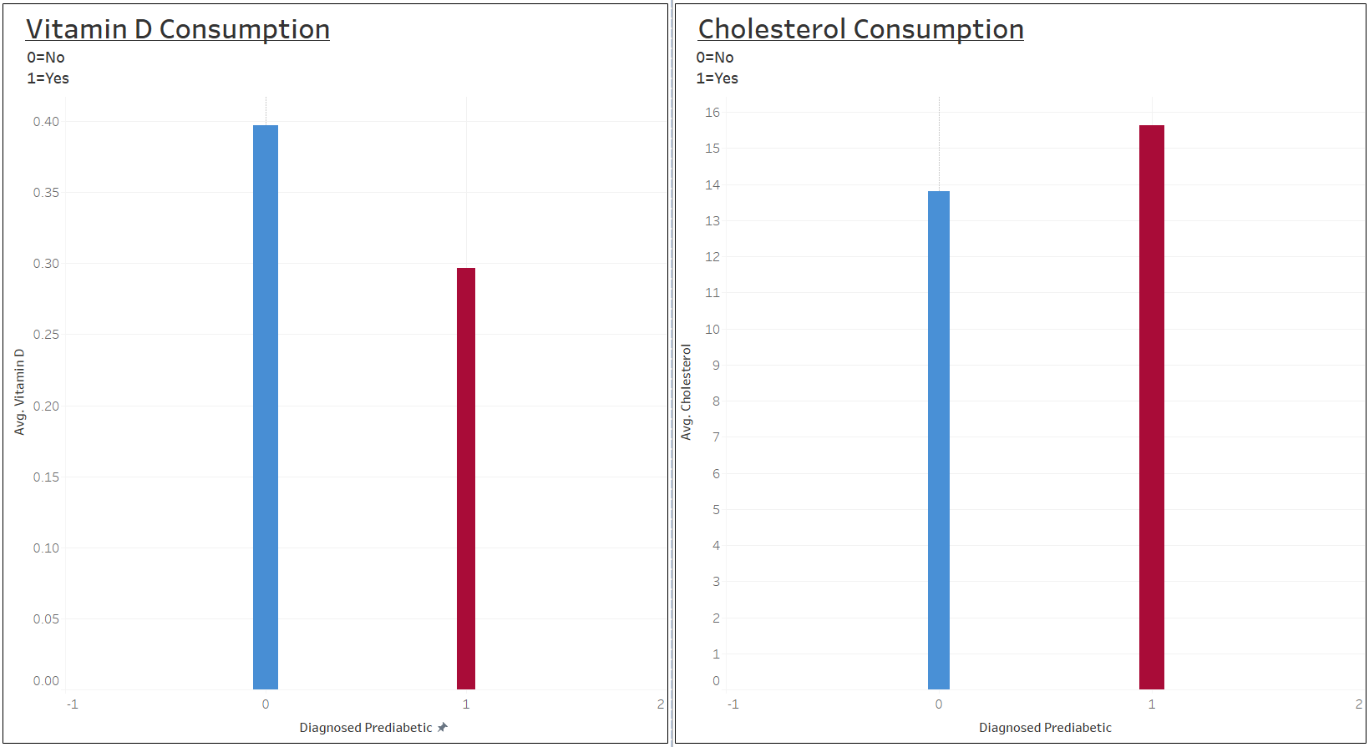

Slide 13
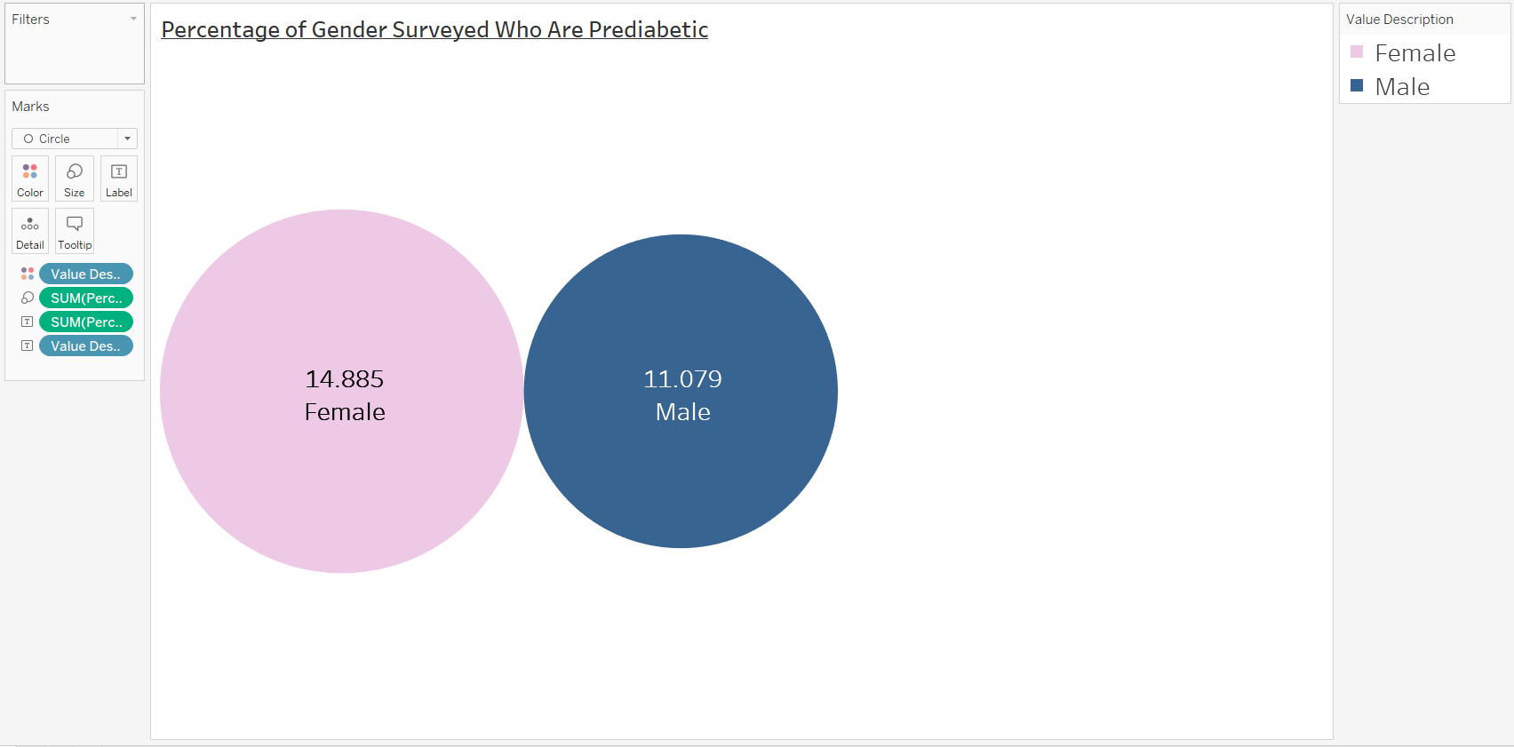

Slide 14
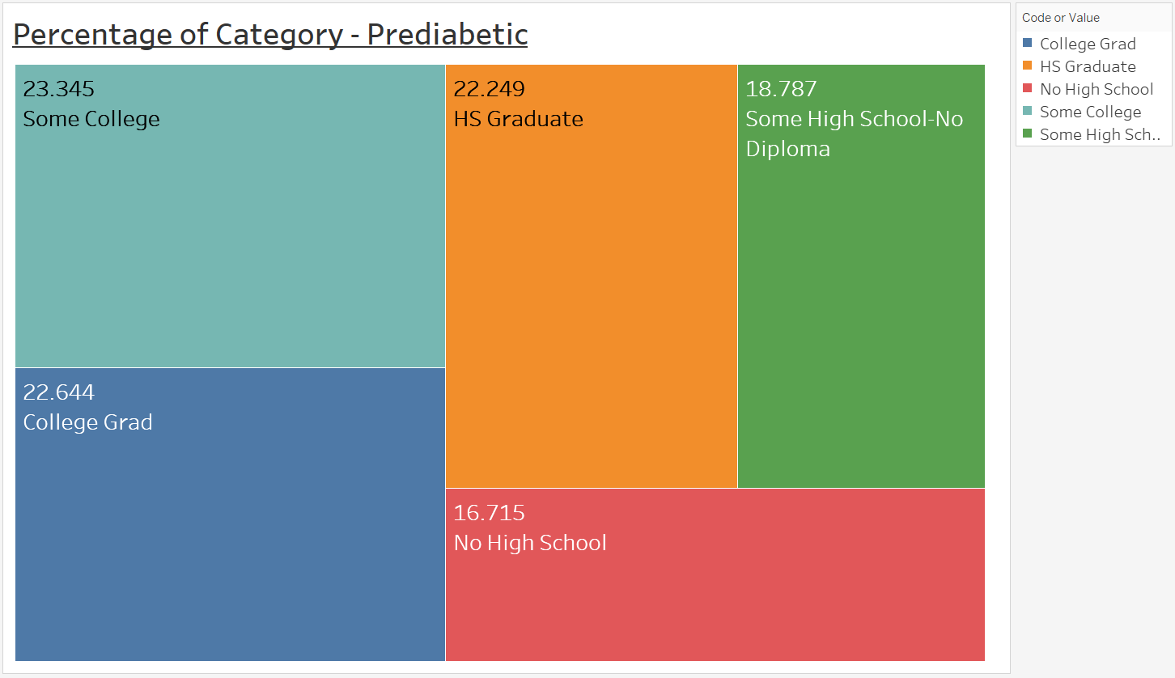

Slide 15
