Slide 1
Chapter 1

Slide 2
Java
Created in 1991
James Gosling
Canadian!
Sun Microsystems, Inc.
Publicly released in 1995

Slide 3
First program
//********************************************************************
// Lincoln.java Author: Lewis/Loftus
//
// Demonstrates the basic structure of a Java application.
//********************************************************************
public class Lincoln
{
//-----------------------------------------------------------------
// Prints a presidential quote.
//-----------------------------------------------------------------
public static void main (String[] args)
{
System.out.println ("A quote by Abraham Lincoln:");
System.out.println ("Whatever you are, be a good one.");
}
}

Slide 4
Output
A quote by Abraham Lincoln:
Whatever you are, be a good one.
//********************************************************************
// Lincoln.java Author: Lewis/Loftus
//
// Demonstrates the basic structure of a Java application.
//********************************************************************
public class Lincoln
{
//-----------------------------------------------------------------
// Prints a presidential quote.
//-----------------------------------------------------------------
public static void main (String[] args)
{
System.out.println ("A quote by Abraham Lincoln:");
System.out.println ("Whatever you are, be a good one.");
}
}

Slide 5
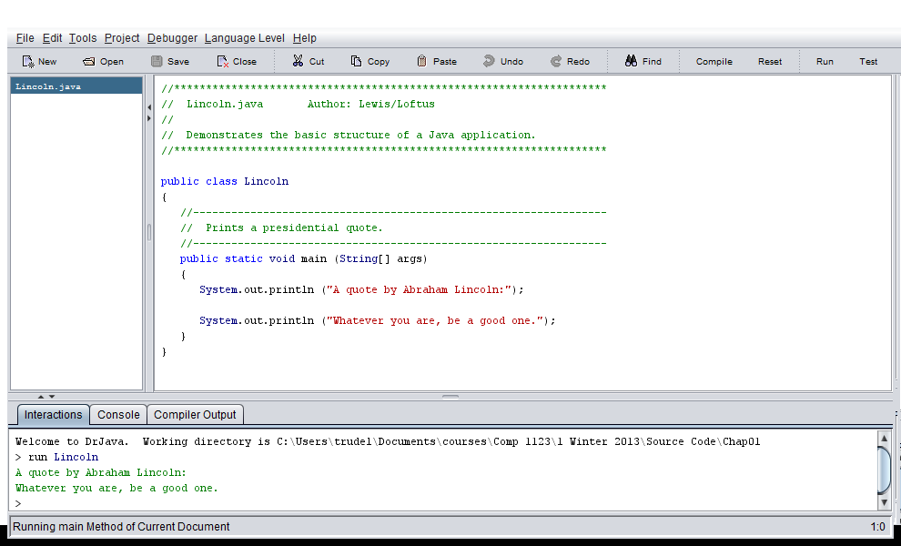
Open, Compile, then Run Lincoln.java in Dr Java

Slide 6
Exercise: Add another println to the code
Note what happens to the file name when the code is modified.
Remember to “Compile” before running the modified code.

Slide 7
Note that the file and class names are always identical

Slide 8
Exercise
Write a new program
HelloWorld.java
The name is always lower case except for the first letter of each word.
Include multiple println statements
Display a greeting
Check out the files that were saved on your hard drive

Slide 9
Comments
Comments should be included to explain the purpose of the program and describe processing steps
They do not affect how a program works
Java comments can take three forms:
// this comment runs to the end of the line
/* this comment runs to the terminating
symbol, even across line breaks */
/** this is a javadoc comment */

Slide 10
Always include a comment at the top of the class
//********************************************************************
// Lincoln.java Author: Lewis/Loftus
//
// Demonstrates the basic structure of a Java application.
//********************************************************************
public class Lincoln
{
//-----------------------------------------------------------------
// Prints a presidential quote.
//-----------------------------------------------------------------
public static void main (String[] args)
{
System.out.println ("A quote by Abraham Lincoln:");
System.out.println ("Whatever you are, be a good one.");
}
}

Slide 11
Always include a comment before each method
//********************************************************************
// Lincoln.java Author: Lewis/Loftus
//
// Demonstrates the basic structure of a Java application.
//********************************************************************
public class Lincoln
{
//-----------------------------------------------------------------
// Prints a presidential quote.
//-----------------------------------------------------------------
public static void main (String[] args)
{
System.out.println ("A quote by Abraham Lincoln:");
System.out.println ("Whatever you are, be a good one.");
}
}

Slide 12
Always include a comment before
A block of complicated/interesting code
The comment explains the code to the reader

Slide 13
TopHat Q1-Q2

