Slide 1
Chapter 2

Slide 2
Print and println

Slide 3
print and println
//********************************************************************
// Countdown.java Author: Lewis/Loftus
//
// Demonstrates the difference between print and println.
//********************************************************************
public class Countdown
{
//-----------------------------------------------------------------
// Prints two lines of output representing a rocket countdown.
//-----------------------------------------------------------------
public static void main (String[] args)
{
System.out.print ("Three... ");
System.out.print ("Two... ");
System.out.print ("One... ");
System.out.print ("Zero... ");
System.out.println ("Liftoff!"); // appears on first output line
System.out.println ("Houston, we have a problem.");
}
}

Slide 4
Output
Three... Two... One... Zero... Liftoff!
Houston, we have a problem.
//********************************************************************
// Countdown.java Author: Lewis/Loftus
//
// Demonstrates the difference between print and println.
//********************************************************************
public class Countdown
{
//-----------------------------------------------------------------
// Prints two lines of output representing a rocket countdown.
//-----------------------------------------------------------------
public static void main (String[] args)
{
System.out.print ("Three... ");
System.out.print ("Two... ");
System.out.print ("One... ");
System.out.print ("Zero... ");
System.out.println ("Liftoff!"); // appears on first output line
System.out.println ("Houston, we have a problem.");
}
}

Slide 5
String concatenation

Slide 6
String Concatenation
The string concatenation operator (+) is used to append one string to the end of another
"Peanut butter " + "and jelly"
It can also be used to append a number to a string

Slide 7
//********************************************************************
// Facts.java Author: Lewis/Loftus
//
// Demonstrates the use of the string concatenation operator and the
// automatic conversion of an integer to a string.
//********************************************************************
public class Facts
{
//-----------------------------------------------------------------
// Prints various facts.
//-----------------------------------------------------------------
public static void main (String[] args)
{
// Strings can be concatenated into one long string
System.out.println ("We present the following facts for your "
+ "extracurricular edification:");
System.out.println (); // Prints a blank line
// A string can contain numeric digits
System.out.println ("Letters in the Hawaiian alphabet: 12");
continue

Slide 8
continue
// A numeric value can be concatenated to a string
System.out.println ("Dialing code for Antarctica: " + 672);
System.out.println ("Year in which Leonardo da Vinci invented "
+ "the parachute: " + 1515);
System.out.println ("Speed of ketchup: " + 40 + " km per year");
}
}

Slide 9
Output
We present the following facts for your extracurricular edification:
Letters in the Hawaiian alphabet: 12
Dialing code for Antarctica: 672
Year in which Leonardo da Vinci invented the parachute: 1515
Speed of ketchup: 40 km per year
continue
// A numeric value can be concatenated to a string
System.out.println ("Dialing code for Antarctica: " + 672);
System.out.println ("Year in which Leonardo da Vinci invented "
+ "the parachute: " + 1515);
System.out.println ("Speed of ketchup: " + 40 + " km per year");
}
}

Slide 10
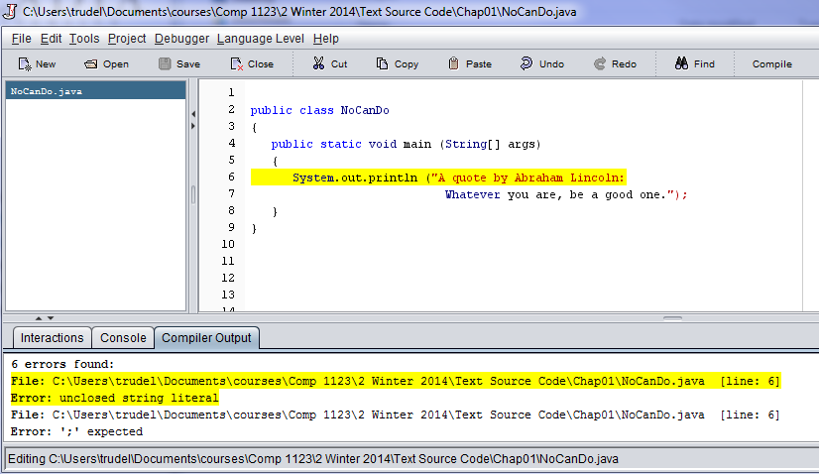
A string literal cannot be broken across two lines in a program

Slide 11
String Concatenation
The + operator is also used for arithmetic addition
The function that it performs depends on the type of the information on which it operates
string + string: string concatenation
string + integer: string concatenation
Recall that Python gives an error in this case…
integer + integer: addition

Slide 12
//********************************************************************
// Addition.java Author: Lewis/Loftus
//
// Demonstrates the difference between the addition and string
// concatenation operators.
//********************************************************************
public class Addition
{
//-----------------------------------------------------------------
// Concatenates and adds two numbers and prints the results.
//-----------------------------------------------------------------
public static void main (String[] args)
{
System.out.println ("24 and 45 concatenated: " + 24 + 45);
System.out.println ("24 and 45 added: " + (24 + 45));
}
}

Slide 13
Output
24 and 45 concatenated: 2445
24 and 45 added: 69
//********************************************************************
// Addition.java Author: Lewis/Loftus
//
// Demonstrates the difference between the addition and string
// concatenation operators.
//********************************************************************
public class Addition
{
//-----------------------------------------------------------------
// Concatenates and adds two numbers and prints the results.
//-----------------------------------------------------------------
public static void main (String[] args)
{
System.out.println ("24 and 45 concatenated: " + 24 + 45);
System.out.println ("24 and 45 added: " + (24 + 45));
}
}

Slide 14
TopHat Q1-5

Slide 15
Escape sequences
Recall \n from python

Slide 16
Escape Sequences
What if we wanted to print the double quote character?
The following line would confuse the compiler because it would interpret the second quote as the end of the string
System.out.println ("I said "Hello" to you.");
An escape sequence is a series of characters that represents a special character
An escape sequence begins with a backslash character (\)
System.out.println ("I said \"Hello\" to you.");

Slide 17
Escape Sequences
Some Java escape sequences:
Escape Sequence
\t
\n
\"
\'
\\
Meaning
tab
newline
double quote
single quote
backslash

Slide 18
//********************************************************************
// Roses.java Author: Lewis/Loftus
//
// Demonstrates the use of escape sequences.
//********************************************************************
public class Roses
{
//-----------------------------------------------------------------
// Prints a poem (of sorts) on multiple lines.
//-----------------------------------------------------------------
public static void main (String[] args)
{
System.out.println ("Roses are red,\n\tViolets are blue,\n" +
"Sugar is sweet,\n\tBut I have \"commitment issues\",\n\t" +
"So I'd rather just be friends\n\tAt this point in our " +
"relationship.");
}
}
OK to put a single quote inside a double quote

Slide 19
Output
Roses are red,
Violets are blue,
Sugar is sweet,
But I have "commitment issues",
So I'd rather just be friends
At this point in our relationship.
//********************************************************************
// Roses.java Author: Lewis/Loftus
//
// Demonstrates the use of escape sequences.
//********************************************************************
public class Roses
{
//-----------------------------------------------------------------
// Prints a poem (of sorts) on multiple lines.
//-----------------------------------------------------------------
public static void main (String[] args)
{
System.out.println ("Roses are red,\n\tViolets are blue,\n" +
"Sugar is sweet,\n\tBut I have \"commitment issues\",\n\t" +
"So I'd rather just be friends\n\tAt this point in our " +
"relationship.");
}
}
Note that 6 lines of text are output with a single println.

Slide 20
Top Hat Q5.1

Slide 21
variables

Slide 22
Variables
A variable declaration specifies the variable's name and the type of information that it will hold
data type
variable name
int total;
int count, temp, result;
Multiple variables can be created in one declaration

Slide 23
Variable Initialization
A variable can be given an initial value in the declaration
int sum = 0;
int base = 32, max = 149;
When a variable is referenced in a program, its current value is used

Slide 24
//********************************************************************
// PianoKeys.java Author: Lewis/Loftus
//
// Demonstrates the declaration, initialization, and use of an
// integer variable.
//********************************************************************
public class PianoKeys
{
//-----------------------------------------------------------------
// Prints the number of keys on a piano.
//-----------------------------------------------------------------
public static void main (String[] args)
{
int keys = 88;
System.out.println ("A piano has " + keys + " keys.");
}
}

Slide 25
Output
A piano has 88 keys.
//********************************************************************
// PianoKeys.java Author: Lewis/Loftus
//
// Demonstrates the declaration, initialization, and use of an
// integer variable.
//********************************************************************
public class PianoKeys
{
//-----------------------------------------------------------------
// Prints the number of keys on a piano.
//-----------------------------------------------------------------
public static void main (String[] args)
{
int keys = 88;
System.out.println ("A piano has " + keys + " keys.");
}
}

Slide 26
Assignment
An assignment statement changes the value of a variable
The assignment operator is the = sign
total = 55;
The value that was in total is overwritten
You can only assign a value to a variable that is consistent with the variable's declared type

Slide 27
//********************************************************************
// Geometry.java Author: Lewis/Loftus
//
// Demonstrates the use of an assignment statement to change the
// value stored in a variable.
//********************************************************************
public class Geometry
{
//-----------------------------------------------------------------
// Prints the number of sides of several geometric shapes.
//-----------------------------------------------------------------
public static void main (String[] args)
{
int sides = 7; // declaration with initialization
System.out.println ("A heptagon has " + sides + " sides.");
sides = 10; // assignment statement
System.out.println ("A decagon has " + sides + " sides.");
sides = 12;
System.out.println ("A dodecagon has " + sides + " sides.");
}
}

Slide 28
//********************************************************************
// Geometry.java Author: Lewis/Loftus
//
// Demonstrates the use of an assignment statement to change the
// value stored in a variable.
//********************************************************************
public class Geometry
{
//-----------------------------------------------------------------
// Prints the number of sides of several geometric shapes.
//-----------------------------------------------------------------
public static void main (String[] args)
{
int sides = 7; // declaration with initialization
System.out.println ("A heptagon has " + sides + " sides.");
sides = 10; // assignment statement
System.out.println ("A decagon has " + sides + " sides.");
sides = 12;
System.out.println ("A dodecagon has " + sides + " sides.");
}
}
Note: The type int is omitted.

Slide 29
//********************************************************************
// Geometry.java Author: Lewis/Loftus
//
// Demonstrates the use of an assignment statement to change the
// value stored in a variable.
//********************************************************************
public class Geometry
{
//-----------------------------------------------------------------
// Prints the number of sides of several geometric shapes.
//-----------------------------------------------------------------
public static void main (String[] args)
{
int sides = 7; // declaration with initialization
System.out.println ("A heptagon has " + sides + " sides.");
sides = 10; // assignment statement
System.out.println ("A decagon has " + sides + " sides.");
sides = 12;
System.out.println ("A dodecagon has " + sides + " sides.");
}
}
Note: Compile error if int is included here.

Slide 30
Output
A heptagon has 7 sides.
A decagon has 10 sides.
a dodecagon has 12 sides.
//********************************************************************
// Geometry.java Author: Lewis/Loftus
//
// Demonstrates the use of an assignment statement to change the
// value stored in a variable.
//********************************************************************
public class Geometry
{
//-----------------------------------------------------------------
// Prints the number of sides of several geometric shapes.
//-----------------------------------------------------------------
public static void main (String[] args)
{
int sides = 7; // declaration with initialization
System.out.println ("A heptagon has " + sides + " sides.");
sides = 10; // assignment statement
System.out.println ("A decagon has " + sides + " sides.");
sides = 12;
System.out.println ("A dodecagon has " + sides + " sides.");
}
}

Slide 31
constants

Slide 32
Constants
A constant is an identifier that is similar to a variable except that it holds the same value during its entire existence
Use the final modifier to declare a constant
final int MIN_HEIGHT = 69;

Slide 33
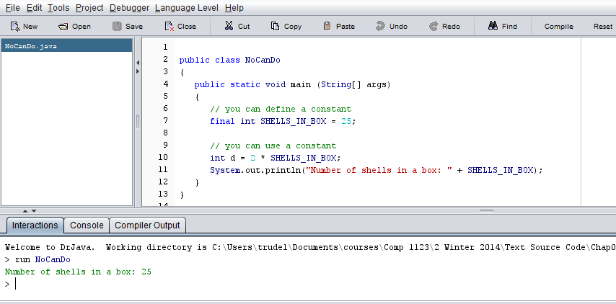
Example: constant

Slide 34
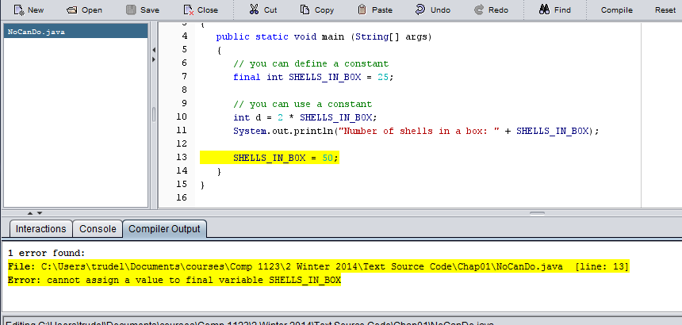
A constant cannot be changed

Slide 35
Constants are useful for three important reasons
They give a special meaning to numbers
Example: MAX_LOAD means more than the literal 250
They facilitate program maintenance
A constant is defined in one place and then can be used throughout the program. Guaranteed to always be using the same value.
If we need to update the value of a constant, only have to do it in one location.
They formally establish that a value should not change, avoiding inadvertent errors by other programmers

Slide 36
Style
All uppercase
Separate words with an underscore
Not every number should be defined as a constant.
If you have a number with a special meaning, it has to be defined as a constant
Example:
final double QUARTER_VALUE = 0.25

Slide 37
Primitive data types

Slide 38
Primitive Data
There are eight primitive data types in Java
Four of them represent integers:
byte, short, int, long
Two of them represent floating point numbers:
float, double
One of them represents characters:
char
And one of them represents boolean values:
boolean

Slide 39
Note
A string is not a primitive data type

Slide 40
Numeric Primitive Data
The difference between the numeric primitive types is their size and the values they can store:
Type
byte
short
int
long
float
double
Storage
8 bits
16 bits
32 bits
64 bits
32 bits
64 bits
Min Value
-128
-32,768
-2,147,483,648
< -9 x 10¹⁸
+/- 3.4 x 10³⁸ with 7 significant digits
+/- 1.7 x 10³⁰⁸ with 15 significant digits
Max Value
127
32,767
2,147,483,647
> 9 x 10¹⁸

Slide 41
Rule of thumb for this course
Use “int” for integers
Use “double” for floating point numbers

Slide 42
Characters
A char variable stores a single character
Character literals are delimited by single quotes:
'a' 'X' '7' '$' ',' '\n'
Example declarations:
char topGrade = 'A';
char terminator = ';', separator = ' ';

Slide 43
Boolean
A boolean value represents a true or false condition
The reserved words true and false are the only valid values for a boolean type
boolean done = false;

Slide 44
operators

Slide 45
Expressions
Arithmetic expressions compute numeric results and make use of the arithmetic operators:
Addition
Subtraction
Multiplication
Division
Remainder
+
-
*
/
%
If either or both operands are floating point values, then the result is a floating point value

Slide 46
Division and Remainder
If both operands to the division operator (/) are integers, the result is an integer (the fractional part is discarded)
14 / 3 equals 4
8 / 12 equals 0
The remainder operator (%) returns the remainder after dividing the first operand by the second
14 % 3 equals 2
8 % 12 equals 8

Slide 47
TopHat Q6-Q14

Slide 48
Operator precedence

Slide 49
Operator Precedence
Operators can be combined into larger expressions
result = total + count / max - offset;
Operators have a well-defined precedence which determines the order in which they are evaluated
Multiplication, division, and remainder are evaluated before addition, subtraction, and string concatenation
Arithmetic operators with the same precedence are evaluated from left to right
Parentheses can be used to change the evaluation order

Slide 50
Quick Check
In what order are the operators evaluated in the following expressions?
a + b + c + d + e
a + b * c - d / e
a / (b + c) - d % e
a / (b * (c + (d - e)))

Slide 51
Quick Check
In what order are the operators evaluated in the following expressions?
a + b + c + d + e
a + b * c - d / e
1
2
3
4
3
1
4
2
a / (b + c) - d % e
2
1
4
3
a / (b * (c + (d - e)))
4
3
2
1

Slide 52
TopHat Q15-Q17

Slide 53
Increment & decrement

Slide 54
Increment ++ and Decrement --
The statement
count++;
is the same as writing:
count = count + 1;
Similarly
count--;
is the same as writing:
count = count - 1;

Slide 55
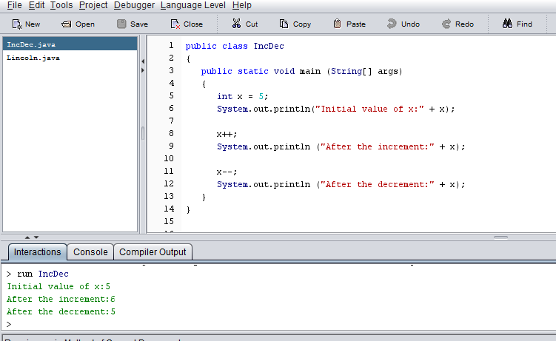
Example

Slide 56
2 forms of the operator
The increment and decrement operators can appear either after or before the variable name:
count++
++count
When used just to increment a variable, both forms have the same result.
Style: Always place the increment/decrement operator after the variable as in:
count++

Slide 57
Increment/Decrement used in an expression
The location of the operator makes a big difference
++x means increment x then use that value in the expression
x++ means use the current value of x to evaluate the expression, then increment x

Slide 58
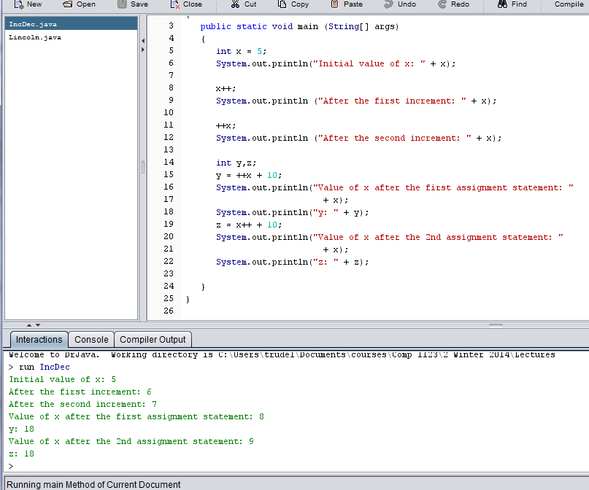
Example – let’s do this one on the board

Slide 59
Style: Do not do this!
You may encounter things like
y = ++x +10;
in other programmer’s code.
You need to know what it does.
But, never ever do it!
Confusing to update 2 variables in one statement.

Slide 60
Precedence rule
Increment/Decrement has a higher precedence than +,-,*,/,%.

Slide 61
TopHat Q19 – 20

Slide 62
Assignment Operators
num = num + count;
Can also be written as:
num += count;

Slide 63
Assignment Operators
Operator
+=
-=
*=
/=
%=
Example
x += y
x -= y
x *= y
x /= y
x %= y
Equivalent To
x = x + y
x = x - y
x = x * y
x = x / y
x = x % y

Slide 64
Style: do not do this!
The right hand side of an assignment operator can be a complex expression
The entire right-hand expression is evaluated first, then the result is combined with the original variable
Therefore
result /= (total-MIN) % num;
is equivalent to
result = result / ((total-MIN) % num);

Slide 65
Outline
Character Strings
Variables and Assignment
Primitive Data Types
Expressions
Data Conversion
Interactive Programs
Graphics
Applets
Drawing Shapes

Slide 66
Data Conversion
Java has many types
Sometimes it is convenient to convert data from one type to another
For example, we may want to treat an integer as a floating point value

Slide 67
Data Conversion
Widening conversions
safest because they go from a small data type to a larger one
E.g., an int to a double
Narrowing conversions
can lose information because they tend to go from a large data type to a smaller one
E.g., a double to an int

Slide 68
Data conversions can occur in three ways
assignment
promotion
casting

Slide 69
Assignment Conversion
Assignment conversion occurs when a value of one type is assigned to a variable of another
Example:
int dollars = 20;
double money = dollars;
Only widening conversions can happen via assignment
Note that the value or type of dollars did not change

Slide 70
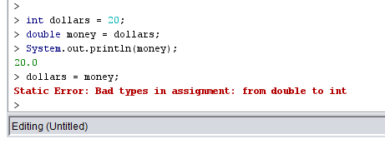
Example

Slide 71
Promotion
Promotion happens automatically when operators in expressions convert their operands
Example:
int count = 12;
double sum = 490.27;
double result = sum / count;
The value of count is converted to a floating point value to perform the division calculation

Slide 72
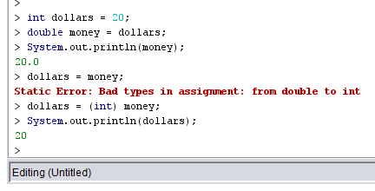
Casting

Slide 73
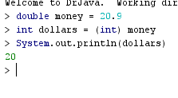
Casting truncates

Slide 74
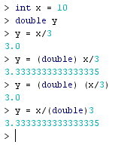
Be careful with casting

Slide 75
TopHat Q21

Slide 76
Outline
Character Strings
Variables and Assignment
Primitive Data Types
Expressions
Data Conversion
Interactive Programs
Graphics
Applets
Drawing Shapes

Slide 77
Input - Run this code in DrJava
//********************************************************************
// Echo.java Author: Lewis/Loftus
//
// Demonstrates the use of the nextLine method of the Scanner class
// to read a string from the user.
//********************************************************************
import java.util.Scanner;
public class Echo
{
//-----------------------------------------------------------------
// Reads a character string from the user and prints it.
//-----------------------------------------------------------------
public static void main (String[] args)
{
String message;
Scanner scan = new Scanner (System.in);
System.out.println ("Enter a line of text:");
message = scan.nextLine();
System.out.println ("You entered: \"" + message + "\"");
}
}

Slide 78
Sample Run
Enter a line of text:
You want fries with that?
You entered: "You want fries with that?"
//********************************************************************
// Echo.java Author: Lewis/Loftus
//
// Demonstrates the use of the nextLine method of the Scanner class
// to read a string from the user.
//********************************************************************
import java.util.Scanner;
public class Echo
{
//-----------------------------------------------------------------
// Reads a character string from the user and prints it.
//-----------------------------------------------------------------
public static void main (String[] args)
{
String message;
Scanner scan = new Scanner (System.in);
System.out.println ("Enter a line of text:");
message = scan.nextLine();
System.out.println ("You entered: \"" + message + "\"");
}
}

Slide 79
//********************************************************************
// Echo.java Author: Lewis/Loftus
//
// Demonstrates the use of the nextLine method of the Scanner class
// to read a string from the user.
//********************************************************************
import java.util.Scanner;
public class Echo
{
//-----------------------------------------------------------------
// Reads a character string from the user and prints it.
//-----------------------------------------------------------------
public static void main (String[] args)
{
String message;
Scanner scan = new Scanner (System.in);
System.out.println ("Enter a line of text:");
message = scan.nextLine();
System.out.println ("You entered: \"" + message + "\"");
}
}
Have to import the Scanner library.
Always included before the class.

Slide 80
//********************************************************************
// Echo.java Author: Lewis/Loftus
//
// Demonstrates the use of the nextLine method of the Scanner class
// to read a string from the user.
//********************************************************************
import java.util.Scanner;
public class Echo
{
//-----------------------------------------------------------------
// Reads a character string from the user and prints it.
//-----------------------------------------------------------------
public static void main (String[] args)
{
String message;
Scanner scan = new Scanner (System.in);
System.out.println ("Enter a line of text:");
message = scan.nextLine();
System.out.println ("You entered: \"" + message + "\"");
}
}
Represents the keyboard.

Slide 81
//********************************************************************
// Echo.java Author: Lewis/Loftus
//
// Demonstrates the use of the nextLine method of the Scanner class
// to read a string from the user.
//********************************************************************
import java.util.Scanner;
public class Echo
{
//-----------------------------------------------------------------
// Reads a character string from the user and prints it.
//-----------------------------------------------------------------
public static void main (String[] args)
{
String message;
Scanner scan = new Scanner (System.in);
System.out.println ("Enter a line of text:");
message = scan.nextLine();
System.out.println ("You entered: \"" + message + "\"");
}
}
scan is a variable of type
Scanner.

Slide 82
//********************************************************************
// Echo.java Author: Lewis/Loftus
//
// Demonstrates the use of the nextLine method of the Scanner class
// to read a string from the user.
//********************************************************************
import java.util.Scanner;
public class Echo
{
//-----------------------------------------------------------------
// Reads a character string from the user and prints it.
//-----------------------------------------------------------------
public static void main (String[] args)
{
String message;
Scanner scan = new Scanner (System.in);
System.out.println ("Enter a line of text:");
message = scan.nextLine();
System.out.println ("You entered: \"" + message + "\"");
}
}
Reads in a line of text from
the keyboard.

Slide 83
//********************************************************************
// Echo.java Author: Lewis/Loftus
//
// Demonstrates the use of the nextLine method of the Scanner class
// to read a string from the user.
//********************************************************************
import java.util.Scanner;
public class Echo
{
//-----------------------------------------------------------------
// Reads a character string from the user and prints it.
//-----------------------------------------------------------------
public static void main (String[] args)
{
String message;
Scanner scan = new Scanner (System.in);
System.out.println ("Enter a line of text:");
message = scan.nextLine();
System.out.println ("You entered: \"" + message + "\"");
}
}
Line of text is stored in the
variable message of type
String.

Slide 84
Exercise: Try changing the first println to a print
//********************************************************************
// Echo.java Author: Lewis/Loftus
//
// Demonstrates the use of the nextLine method of the Scanner class
// to read a string from the user.
//********************************************************************
import java.util.Scanner;
public class Echo
{
//-----------------------------------------------------------------
// Reads a character string from the user and prints it.
//-----------------------------------------------------------------
public static void main (String[] args)
{
String message;
Scanner scan = new Scanner (System.in);
System.out.println ("Enter a line of text:");
message = scan.nextLine();
System.out.println ("You entered: \"" + message + "\"");
}
}

Slide 85
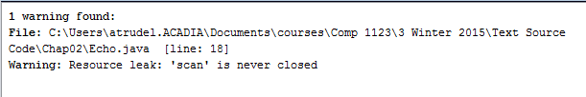
Compiling generates a warning
Add the following line to the end of the main method to get rid of the
warning:
scan.close( );

Slide 86
Can also read in values of type double and int.
Run the code in DrJava
//********************************************************************
// GasMileage.java Author: Lewis/Loftus
//
// Demonstrates the use of the Scanner class to read numeric data.
//********************************************************************
import java.util.Scanner;
public class GasMileage
{
//-----------------------------------------------------------------
// Calculates fuel efficiency based on values entered by the
// user.
//-----------------------------------------------------------------
public static void main (String[] args)
{
int miles;
double gallons, mpg;
Scanner scan = new Scanner (System.in);
continue

Slide 87
continue
System.out.print ("Enter the number of miles: ");
miles = scan.nextInt();
System.out.print ("Enter the gallons of fuel used: ");
gallons = scan.nextDouble();
mpg = miles / gallons;
System.out.println ("Miles Per Gallon: " + mpg);
}
}
Note: the 1 scan variable can be used to read in both
int and double values.

Slide 88
Sample Run
Enter the number of miles: 328
Enter the gallons of fuel used: 11.2
Miles Per Gallon: 29.28571428571429
continue
System.out.print ("Enter the number of miles: ");
miles = scan.nextInt();
System.out.print ("Enter the gallons of fuel used: ");
gallons = scan.nextDouble();
mpg = miles / gallons;
System.out.println ("Miles Per Gallon: " + mpg);
}
}

Slide 89
STYLE: All the variables used in a method are defined and
optionally initialized at the beginning of the method.
//********************************************************************
// GasMileage.java Author: Lewis/Loftus
//
// Demonstrates the use of the Scanner class to read numeric data.
//********************************************************************
import java.util.Scanner;
public class GasMileage
{
//-----------------------------------------------------------------
// Calculates fuel efficiency based on values entered by the
// user.
//-----------------------------------------------------------------
public static void main (String[] args)
{
int miles;
double gallons, mpg;
Scanner scan = new Scanner (System.in);
continue
Why should we do this?

