Slide 1


Chapter 3 Using Classes and Objects
Java Software Solutions
Foundations of Program Design
Seventh Edition
John Lewis
William Loftus

Slide 2
Variable contents
A variable holds either:
a primitive value
a reference to an object
An object reference can be thought of as a pointer to the location of the object

Slide 3
Example
int num1 = 38;
String name1 = “Steve Jobs”
num1
38
name1
"Steve Jobs"

Slide 4
Assignment involving variables
num1
38
Before:
num2
96
num2 = num1;
num1
38
After:
num2
38

Slide 5
Reference Assignment
name1
"Steve Jobs"
Before:
name2
"Steve Wozniak"
name2 = name1;
name1
"Steve Jobs"
After:
name2
"Steve Wozniak"

Slide 6
We do not get this!
name1
"Steve Jobs"
Before:
name2
"Steve Wozniak"
name2 = name1;
name1
"Steve Jobs"
After:
name2
"Steve Jobs"
"Steve Wozniak"

Slide 7
String “Steve Wozniak” cannot be accessed Kiss it goodbye… Java automatically reclaims the memory.
name1
"Steve Jobs"
Before:
name2
"Steve Wozniak"
name2 = name1;
name1
"Steve Jobs"
After:
name2
"Steve Wozniak"

Slide 8
Garbage Collection
When an object no longer has any valid references to it, it can no longer be accessed by the program
The object is useless, and therefore is called garbage
Java performs automatic garbage collection periodically, returning an object's memory to the system for future use
In other languages, the programmer is responsible for performing garbage collection

Slide 9
Outline
Creating Objects
The String Class
The Random and Math Classes
Formatting Output
Enumerated Types
Wrapper Classes
Components and Containers
Images

Slide 10
The String Class
Because strings are so common, we don't have to use the new operator to create a String object
title = "Java Software Solutions";
This is special syntax that works only for strings
Each string literal (enclosed in double quotes) represents a String object

Slide 11
String Methods
Once a String object has been created, neither its value nor its length can be changed
Therefore we say that an object of the String class is immutable
However, several methods of the String class return new String objects that are modified versions of the original

Slide 12
String Indexes
It is occasionally helpful to refer to a particular character within a string
This can be done by specifying the character's numeric index
The indexes begin at zero in each string
Cannot use -1 for the index of the last character (OK in Python)
E.g, the string "Hello“:
H | E | L | L | O
0 | 1 | 2 | 3 | 4

Slide 13
//********************************************************************
// StringMutation.java Author: Lewis/Loftus
//
// Demonstrates the use of the String class and its methods.
//********************************************************************
public class StringMutation
{
//-----------------------------------------------------------------
// Prints a string and various mutations of it.
//-----------------------------------------------------------------
public static void main (String[] args)
{
String phrase = "Change is inevitable";
String mutation1, mutation2, mutation3, mutation4;
System.out.println ("Original string: \"" + phrase + "\"");
System.out.println ("Length of string: " + phrase.length());
mutation1 = phrase.concat (", except from vending machines.");
mutation2 = mutation1.toUpperCase();
mutation3 = mutation2.replace ('E', 'X');
mutation4 = mutation3.substring (3, 30);
continued

Slide 14
continued
// Print each mutated string
System.out.println ("Mutation #1: " + mutation1);
System.out.println ("Mutation #2: " + mutation2);
System.out.println ("Mutation #3: " + mutation3);
System.out.println ("Mutation #4: " + mutation4);
System.out.println ("Mutated length: " + mutation4.length());
}
}

Slide 15
Output
Original string: "Change is inevitable"
Length of string: 20
Mutation #1: Change is inevitable, except from vending machines.
Mutation #2: CHANGE IS INEVITABLE, EXCEPT FROM VENDING MACHINES.
Mutation #3: CHANGX IS INXVITABLX, XXCXPT FROM VXNDING MACHINXS.
Mutation #4: NGX IS INXVITABLX, XXCXPT F
Mutated length: 27
continued
// Print each mutated string
System.out.println ("Mutation #1: " + mutation1);
System.out.println ("Mutation #2: " + mutation2);
System.out.println ("Mutation #3: " + mutation3);
System.out.println ("Mutation #4: " + mutation4);
System.out.println ("Mutated length: " + mutation4.length());
}
}

Slide 16
Substring
See the text for a partial list of other string methods.
mutation4 = mutation3.substring (3, 30);
Returns the substring from location 3 to 29
Note: does not go up to and including position 30!
Remember that there is a location 0.

Slide 17
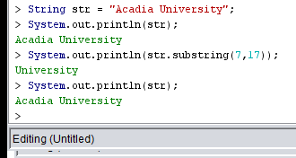
Example – a string cannot be changed…

Slide 18
String exercise
The program StringExercise.java is on Acorn
It is not working properly ☹
Please fix the code ☺
Use substring
The code, sample output, and desired output are shown on the next 2 slides

Slide 19
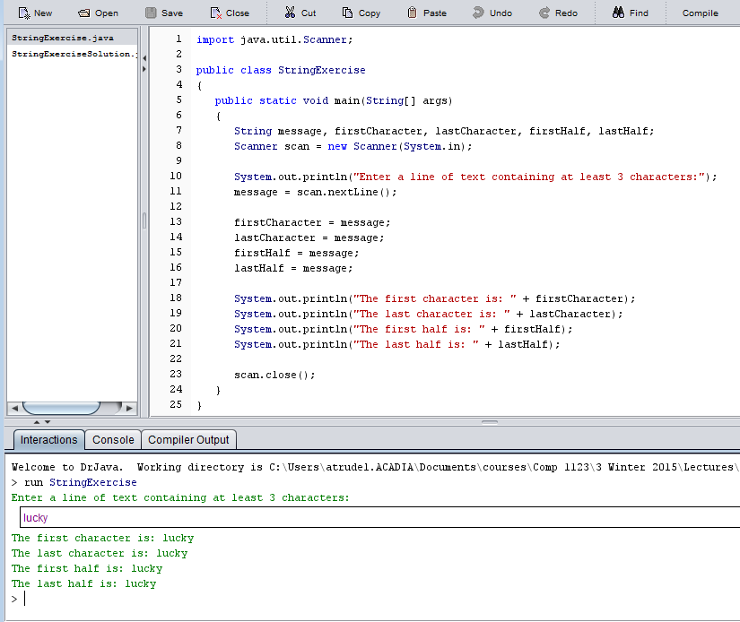
StringExercise.java

Slide 20
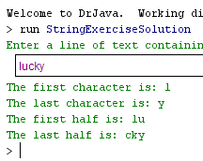
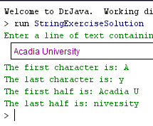
Desired output…

Slide 21
Outline
Creating Objects
The String Class
The Random and Math Classes
Formatting Output
Enumerated Types
Wrapper Classes
Components and Containers
Images

Slide 22
Class Libraries
A class library is a collection of classes that we can use when developing programs
The Java standard class library is part of any Java development environment
Its classes are not part of the Java language per se, but we rely on them heavily
Various classes we've already used (System , Scanner, String) are part of the Java standard class library

Slide 23
The Java API
The Java class library is sometimes referred to as the Java API
API stands for Application Programming Interface

Slide 24
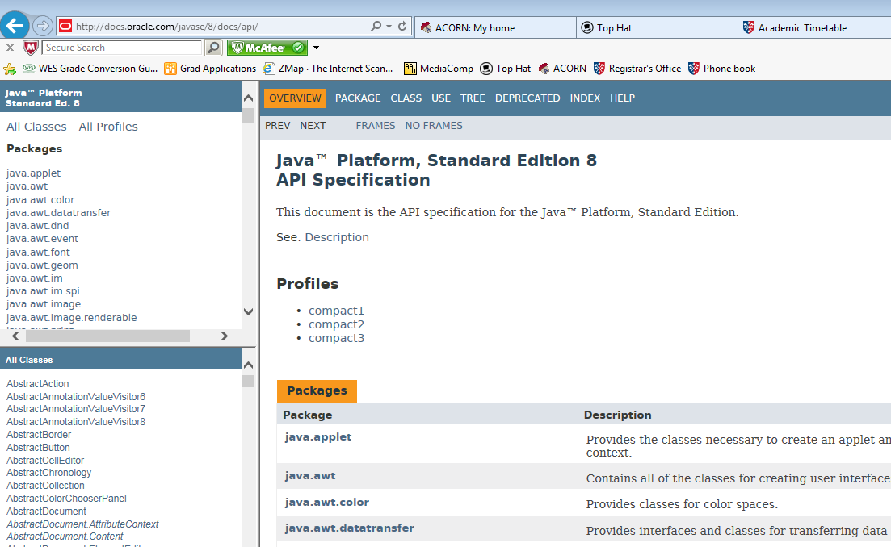
The Java API
Find the String class in bottom left menu
http://docs.oracle.com/javase/8/docs/api/

Slide 25
Packages
Classes in the Java API are organized into packages
Package
java.lang
java.applet
java.awt
javax.swing
java.net
java.util
javax.xml.parsers
Purpose
General support
Creating applets for the web
Graphics and graphical user interfaces
Additional graphics capabilities
Network communication
Utilities
XML document processing

Slide 26
The import Declaration
When you want to use a class from a package, you could use its fully qualified name
java.util.Scanner
Or you can import the class, and then use just the class name
import java.util.Scanner;
To import all classes in a particular package, you can use the * wildcard character
import java.util.*;

Slide 27
java.lang
All classes of the java.lang package are imported automatically into all programs
It's as if all programs contain the following line:
import java.lang.*;
That's why we didn't have to import the System or String classes explicitly in earlier programs
The Scanner class, on the other hand, is part of the java.util package, and therefore must be imported

Slide 28
The Random Class
The Random class is part of the java.util package
It provides methods that generate pseudorandom numbers
Method
nextInt(x)
returns a random integer in the range from 0 to x-1
nextFloat(x)
returns a random floating point number in the range 0 <= x < 1

Slide 29
//********************************************************************
// RandomNumbers.java Author: Lewis/Loftus
//
// Demonstrates the creation of pseudo-random numbers using the
// Random class.
//********************************************************************
import java.util.Random;
public class RandomNumbers
{
//-----------------------------------------------------------------
// Generates random numbers in various ranges.
//-----------------------------------------------------------------
public static void main (String[] args)
{
Random generator = new Random();
int num1;
float num2;
num1 = generator.nextInt();
System.out.println ("A random integer: " + num1);
num1 = generator.nextInt(10);
System.out.println ("From 0 to 9: " + num1);
continued

Slide 30
continued
num1 = generator.nextInt(10) + 1;
System.out.println ("From 1 to 10: " + num1);
num1 = generator.nextInt(15) + 20;
System.out.println ("From 20 to 34: " + num1);
num1 = generator.nextInt(20) - 10;
System.out.println ("From -10 to 9: " + num1);
num2 = generator.nextFloat();
System.out.println ("A random float (between 0-1): " + num2);
num2 = generator.nextFloat() * 6; // 0.0 to 5.999999
num1 = (int)num2 + 1;
System.out.println ("From 1 to 6: " + num1);
}
}

Slide 31
Sample Run
A random integer: 672981683
From 0 to 9: 0
From 1 to 10: 3
From 20 to 34: 30
From -10 to 9: -4
A random float (between 0-1): 0.18538326
From 1 to 6: 3
continued
num1 = generator.nextInt(10) + 1;
System.out.println ("From 1 to 10: " + num1);
num1 = generator.nextInt(15) + 20;
System.out.println ("From 20 to 34: " + num1);
num1 = generator.nextInt(20) - 10;
System.out.println ("From -10 to 9: " + num1);
num2 = generator.nextFloat();
System.out.println ("A random float (between 0-1): " + num2);
num2 = generator.nextFloat() * 6; // 0.0 to 5.999999
num1 = (int)num2 + 1;
System.out.println ("From 1 to 6: " + num1);
}
}

Slide 32
TopHat Q1-Q4

Slide 33
The Math Class
The Math class is part of the java.lang package
Do not have to do an import
The Math class contains methods that perform various mathematical functions
These include:
absolute value
square root
exponentiation
trigonometric functions

Slide 34
The Math Class
The methods of the Math class are static methods
Static methods are invoked through the class name – no object of the Math class is needed
value = Math.cos(90) + Math.sqrt(delta);

Slide 35
//********************************************************************
// Quadratic.java Author: Lewis/Loftus
//
// Demonstrates the use of the Math class to perform a calculation
// based on user input.
//********************************************************************
import java.util.Scanner;
public class Quadratic
{
//-----------------------------------------------------------------
// Determines the roots of a quadratic equation.
//-----------------------------------------------------------------
public static void main (String[] args)
{
int a, b, c; // ax^2 + bx + c
double discriminant, root1, root2;
Scanner scan = new Scanner (System.in);
System.out.print ("Enter the coefficient of x squared: ");
a = scan.nextInt();
continued

Slide 36
continued
System.out.print ("Enter the coefficient of x: ");
b = scan.nextInt();
System.out.print ("Enter the constant: ");
c = scan.nextInt();
// Use the quadratic formula to compute the roots.
// Assumes a positive discriminant.
discriminant = Math.pow(b, 2) - (4 * a * c);
root1 = ((-1 * b) + Math.sqrt(discriminant)) / (2 * a);
root2 = ((-1 * b) - Math.sqrt(discriminant)) / (2 * a);
System.out.println ("Root #1: " + root1);
System.out.println ("Root #2: " + root2);
}
}

Slide 37
Sample Run
Enter the coefficient of x squared: 3
Enter the coefficient of x: 8
Enter the constant: 4
Root #1: -0.6666666666666666
Root #2: -2.0
continued
System.out.print ("Enter the coefficient of x: ");
b = scan.nextInt();
System.out.print ("Enter the constant: ");
c = scan.nextInt();
// Use the quadratic formula to compute the roots.
// Assumes a positive discriminant.
discriminant = Math.pow(b, 2) - (4 * a * c);
root1 = ((-1 * b) + Math.sqrt(discriminant)) / (2 * a);
root2 = ((-1 * b) - Math.sqrt(discriminant)) / (2 * a);
System.out.println ("Root #1: " + root1);
System.out.println ("Root #2: " + root2);
}
}

Slide 38
continued
System.out.print ("Enter the coefficient of x: ");
b = scan.nextInt();
System.out.print ("Enter the constant: ");
c = scan.nextInt();
// Use the quadratic formula to compute the roots.
// Assumes a positive discriminant.
discriminant = Math.pow(b, 2) - (4 * a * c);
root1 = ((-1 * b) + Math.sqrt(discriminant)) / (2 * a);
root2 = ((-1 * b) - Math.sqrt(discriminant)) / (2 * a);
System.out.println ("Root #1: " + root1);
System.out.println ("Root #2: " + root2);
}
}
Java has no built-in exponentiation operator.
Equivalent to: b * b

Slide 39
Outline
Creating Objects
The String Class
The Random and Math Classes
Formatting Output
Enumerated Types
Wrapper Classes
Components and Containers
Images

Slide 40
Wrapper Classes
The java.lang package contains wrapper classes that correspond to each primitive type:
Primitive Type | Wrapper Class
byte | Byte
short | Short
int | Integer
long | Long
float | Float
double | Double
char | Character
boolean | Boolean

Slide 41
Wrapper Classes
The following declaration creates an Integer object which represents the integer 40 as an object
Integer age = new Integer(40);
The object age stores the single integer 40
There will be times where we need to represent an integer as an object

Slide 42
Wrapper Classes
Wrapper classes also contain static methods that help manage the associated type
For example, the Integer class contains a method to convert an integer stored in a String to an int value:
num = Integer.parseInt(str);
They often contain useful constants as well
For example, the Integer class contains MIN_VALUE and MAX_VALUE which hold the smallest and largest int values

Slide 43
Try the following in DrJava
Integer.parseInt(“1234”);
Integer.parseInt(“23 + 1234”);
Integer.parseInt(“Acadia”);
Integer.parseInt(“Acadia1234”);

Slide 44
Exercise
The program IntegerTest on Acorn and shown on the next slide reads in a number as a String, adds 1 to the number, then displays the result.
Please fix the code.
Do not modify anything above line 12.

Slide 45
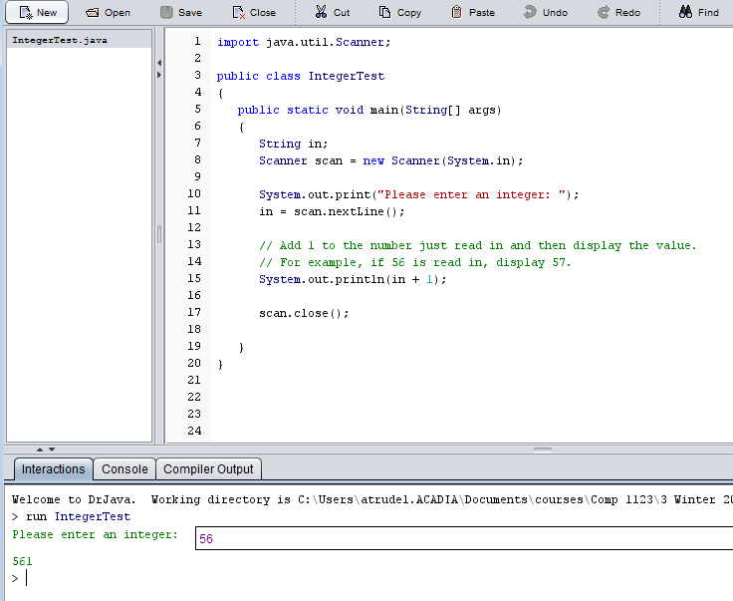
Exercise

Slide 46
Autoboxing
Autoboxing is the automatic conversion of a primitive value to a corresponding wrapper object:
Integer obj;
int num = 42;
obj = num;
The assignment creates the appropriate Integer object
The reverse conversion (called unboxing) also occurs automatically as needed

Slide 47
Outline
Creating Objects
The String Class
The Random and Math Classes
Formatting Output
Enumerated Types
Wrapper Classes
Components and Containers
Images

Slide 48
Labels

Slide 49
Run this code in DrJava & try re-sizing the window.
//********************************************************************
// Authority.java Author: Lewis/Loftus
//
// Demonstrates the use of frames, panels, and labels.
//********************************************************************
import java.awt.*;
import javax.swing.*;
public class Authority
{
//-----------------------------------------------------------------
// Displays some words of wisdom.
//-----------------------------------------------------------------
public static void main (String[] args)
{
JFrame frame = new JFrame ("Authority");
frame.setDefaultCloseOperation (JFrame.EXIT_ON_CLOSE);
JPanel primary = new JPanel();
primary.setBackground (Color.yellow);
primary.setPreferredSize (new Dimension(250, 75));
continued

Slide 50
continued
JLabel label1 = new JLabel ("Question authority,");
JLabel label2 = new JLabel ("but raise your hand first.");
primary.add (label1);
primary.add (label2);
frame.getContentPane().add(primary);
frame.pack();
frame.setVisible(true);
}
}

Slide 51


continued
JLabel label1 = new JLabel ("Question authority,");
JLabel label2 = new JLabel ("but raise your hand first.");
primary.add (label1);
primary.add (label2);
frame.getContentPane().add(primary);
frame.pack();
frame.setVisible(true);
}
}

Slide 52
//********************************************************************
// Authority.java Author: Lewis/Loftus
//
// Demonstrates the use of frames, panels, and labels.
//********************************************************************
import java.awt.*;
import javax.swing.*;
public class Authority
{
//-----------------------------------------------------------------
// Displays some words of wisdom.
//-----------------------------------------------------------------
public static void main (String[] args)
{
JFrame frame = new JFrame ("Authority");
frame.setDefaultCloseOperation (JFrame.EXIT_ON_CLOSE);
JPanel primary = new JPanel();
primary.setBackground (Color.yellow);
primary.setPreferredSize (new Dimension(250, 75));
continued
Always include these imports for a GUI

Slide 53
//********************************************************************
// Authority.java Author: Lewis/Loftus
//
// Demonstrates the use of frames, panels, and labels.
//********************************************************************
import java.awt.*;
import javax.swing.*;
public class Authority
{
//-----------------------------------------------------------------
// Displays some words of wisdom.
//-----------------------------------------------------------------
public static void main (String[] args)
{
JFrame frame = new JFrame ("Authority");
frame.setDefaultCloseOperation (JFrame.EXIT_ON_CLOSE);
JPanel primary = new JPanel();
primary.setBackground (Color.yellow);
primary.setPreferredSize (new Dimension(250, 75));
continued
The frame is the window for the GUI
Title that will appear on the Window
Always include this line…needed for shutting down the window.

Slide 55
//********************************************************************
// Authority.java Author: Lewis/Loftus
//
// Demonstrates the use of frames, panels, and labels.
//********************************************************************
import java.awt.*;
import javax.swing.*;
public class Authority
{
//-----------------------------------------------------------------
// Displays some words of wisdom.
//-----------------------------------------------------------------
public static void main (String[] args)
{
JFrame frame = new JFrame ("Authority");
frame.setDefaultCloseOperation (JFrame.EXIT_ON_CLOSE);
JPanel primary = new JPanel();
primary.setBackground (Color.yellow);
primary.setPreferredSize (new Dimension(250, 75));
continued
3 lines above define a panel which is used to hold the Labels.
The panel will later be added to the frame in order to display it.

Slide 56
Labels are used to display text
continued
JLabel label1 = new JLabel ("Question authority,");
JLabel label2 = new JLabel ("but raise your hand first.");
primary.add (label1);
primary.add (label2);
frame.getContentPane().add(primary);
frame.pack();
frame.setVisible(true);
}
}
The labels are added to the panel
Panel is added to the frame
Frame is displayed in a Window

Slide 57
Nested panels

Slide 58
Run code in DrJava & re-size the GUI Window
//********************************************************************
// NestedPanels.java Author: Lewis/Loftus
//
// Demonstrates a basic componenet hierarchy.
//********************************************************************
import java.awt.*;
import javax.swing.*;
public class NestedPanels
{
//-----------------------------------------------------------------
// Presents two colored panels nested within a third.
//-----------------------------------------------------------------
public static void main (String[] args)
{
JFrame frame = new JFrame ("Nested Panels");
frame.setDefaultCloseOperation (JFrame.EXIT_ON_CLOSE);
// Set up first subpanel
JPanel subPanel1 = new JPanel();
subPanel1.setPreferredSize (new Dimension(150, 100));
subPanel1.setBackground (Color.green);
JLabel label1 = new JLabel ("One");
subPanel1.add (label1);
continued

Slide 59
continued
// Set up second subpanel
JPanel subPanel2 = new JPanel();
subPanel2.setPreferredSize (new Dimension(150, 100));
subPanel2.setBackground (Color.red);
JLabel label2 = new JLabel ("Two");
subPanel2.add (label2);
// Set up primary panel
JPanel primary = new JPanel();
primary.setBackground (Color.blue);
primary.add (subPanel1);
primary.add (subPanel2);
frame.getContentPane().add(primary);
frame.pack();
frame.setVisible(true);
}
}

Slide 60
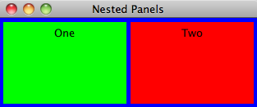
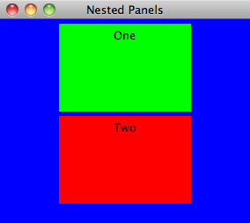
continued
// Set up second subpanel
JPanel subPanel2 = new JPanel();
subPanel2.setPreferredSize (new Dimension(150, 100));
subPanel2.setBackground (Color.red);
JLabel label2 = new JLabel ("Two");
subPanel2.add (label2);
// Set up primary panel
JPanel primary = new JPanel();
primary.setBackground (Color.blue);
primary.add (subPanel1);
primary.add (subPanel2);
frame.getContentPane().add(primary);
frame.pack();
frame.setVisible(true);
}
}

Slide 61
Problem
Modify the code so that the red panel appears before the green one.

Slide 62
Outline
Creating Objects
The String Class
The Random and Math Classes
Formatting Output
Enumerated Types
Wrapper Classes
Components and Containers
Images

Slide 63
Images
A JLabel can be used to display a line of text
It can also be used to display an image
A label can be composed of
text,
an image,
or both

Slide 64
Images
The ImageIcon class is used to represent the image that is stored in a label
If text is also included, the position of the text relative to the image can be set explicitly
The alignment of the text and image within the label can be set as well

Slide 65
Run code in DrJava
//********************************************************************
// LabelDemo.java Author: Lewis/Loftus
//
// Demonstrates the use of image icons in labels.
//********************************************************************
import java.awt.*;
import javax.swing.*;
public class LabelDemo
{
//-----------------------------------------------------------------
// Creates and displays the primary application frame.
//-----------------------------------------------------------------
public static void main (String[] args)
{
JFrame frame = new JFrame ("Label Demo");
frame.setDefaultCloseOperation (JFrame.EXIT_ON_CLOSE);
ImageIcon icon = new ImageIcon ("devil.gif");
JLabel label1, label2, label3;
label1 = new JLabel ("Devil Left", icon, SwingConstants.CENTER);
continued

Slide 66
continued
label2 = new JLabel ("Devil Right", icon, SwingConstants.CENTER);
label2.setHorizontalTextPosition (SwingConstants.LEFT);
label2.setVerticalTextPosition (SwingConstants.BOTTOM);
label3 = new JLabel ("Devil Above", icon, SwingConstants.CENTER);
label3.setHorizontalTextPosition (SwingConstants.CENTER);
label3.setVerticalTextPosition (SwingConstants.BOTTOM);
JPanel panel = new JPanel();
panel.setBackground (Color.cyan);
panel.setPreferredSize (new Dimension (200, 250));
panel.add (label1);
panel.add (label2);
panel.add (label3);
frame.getContentPane().add(panel);
frame.pack();
frame.setVisible(true);
}
}

Slide 67
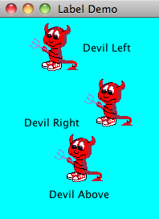
continued
label2 = new JLabel ("Devil Right", icon, SwingConstants.CENTER);
label2.setHorizontalTextPosition (SwingConstants.LEFT);
label2.setVerticalTextPosition (SwingConstants.BOTTOM);
label3 = new JLabel ("Devil Above", icon, SwingConstants.CENTER);
label3.setHorizontalTextPosition (SwingConstants.CENTER);
label3.setVerticalTextPosition (SwingConstants.BOTTOM);
JPanel panel = new JPanel();
panel.setBackground (Color.cyan);
panel.setPreferredSize (new Dimension (200, 250));
panel.add (label1);
panel.add (label2);
panel.add (label3);
frame.getContentPane().add(panel);
frame.pack();
frame.setVisible(true);
}
}

Slide 68
Run code in DrJava
//********************************************************************
// LabelDemo.java Author: Lewis/Loftus
//
// Demonstrates the use of image icons in labels.
//********************************************************************
import java.awt.*;
import javax.swing.*;
public class LabelDemo
{
//-----------------------------------------------------------------
// Creates and displays the primary application frame.
//-----------------------------------------------------------------
public static void main (String[] args)
{
JFrame frame = new JFrame ("Label Demo");
frame.setDefaultCloseOperation (JFrame.EXIT_ON_CLOSE);
ImageIcon icon = new ImageIcon ("devil.gif");
JLabel label1, label2, label3;
label1 = new JLabel ("Devil Left", icon, SwingConstants.CENTER);
continued
Can also use a JPEG picture

Slide 69
TopHat Q5-Q6

