Slide 1


Chapter 5 Conditionals and Loops
Java Software Solutions
Foundations of Program Design
Seventh Edition
John Lewis
William Loftus

Slide 2
Relational operators
== equal to
!= not equal to
< less than
> greater than
<= less than or equal to
>= greater than or equal to
Note the difference between the equality operator
==
and the assignment operator
=

Slide 3
//********************************************************************
// Age.java Author: Lewis/Loftus
//
// Demonstrates the use of an if statement.
//********************************************************************
import java.util.Scanner;
public class Age
{
//-----------------------------------------------------------------
// Reads the user's age and prints comments accordingly.
//-----------------------------------------------------------------
public static void main (String[] args)
{
final int MINOR = 21;
Scanner scan = new Scanner (System.in);
System.out.print ("Enter your age: ");
int age = scan.nextInt();
continue

Slide 4
continue
System.out.println ("You entered: " + age);
if (age < MINOR)
System.out.println ("Youth is a wonderful thing. Enjoy.");
System.out.println ("Age is a state of mind.");
}
}

Slide 5
Sample Run
Enter your age: 47
You entered: 47
Age is a state of mind.
continue
System.out.println ("You entered: " + age);
if (age < MINOR)
System.out.println ("Youth is a wonderful thing. Enjoy.");
System.out.println ("Age is a state of mind.");
}
}
Another Sample Run
Enter your age: 12
You entered: 12
Youth is a wonderful thing. Enjoy.
Age is a state of mind.

Slide 6
Exercise
continue
System.out.println ("You entered: " + age);
if (age < MINOR)
System.out.println ("Youth is a wonderful thing. Enjoy.");
System.out.println ("Age is a state of mind.");
}
}
Try replacing the “<“ above with “=“, then “==“.

Slide 7
Logical Operators
! NOT
&& AND
|| OR

Slide 8
Logical NOT (negation)
a | !a
true | false
false | true

Slide 9
AND - OR
a | b | a && b | a || b
true | true | true | true
true | false | false | true
false | true | false | true
false | false | false | false

Slide 10
Exercise: Modify the Age class so that it prints out the query
“Are you in university?” if the age entered is between 20 and 25
//********************************************************************
// Age.java Author: Lewis/Loftus
//
// Demonstrates the use of an if statement.
//********************************************************************
import java.util.Scanner;
public class Age
{
//-----------------------------------------------------------------
// Reads the user's age and prints comments accordingly.
//-----------------------------------------------------------------
public static void main (String[] args)
{
final int MINOR = 21;
Scanner scan = new Scanner (System.in);
System.out.print ("Enter your age: ");
int age = scan.nextInt();
continue

Slide 11
Outline
Boolean Expressions
The if Statement
Comparing Data
The while Statement
Iterators
The ArrayList Class
Determining Event Sources
Check Boxes and Radio Buttons

Slide 12
The if Statement
The condition must be a
boolean expression. It must
evaluate to either true or false.
if is a Java
reserved word
if ( condition )
statement;
Must have parentheses.
If the condition is true, the statement is executed.
If it is false, the statement is skipped.

Slide 13
Easy typing mistake to make with the if Statement
if ( condition );
statement;
There is no semicolon at the end of the “if” line.
What happens if one is there?

Slide 14
TopHat Q0 – Q0.5

Slide 15
The if-else Statement
if ( condition )
statement1;
else
statement2;
If the condition is true, statement1 is executed; if the condition is false, statement2 is executed
One or the other will be executed, but not both

Slide 16
//********************************************************************
// Wages.java Author: Lewis/Loftus
//
// Demonstrates the use of an if-else statement.
//********************************************************************
import java.text.NumberFormat;
import java.util.Scanner;
public class Wages
{
//-----------------------------------------------------------------
// Reads the number of hours worked and calculates wages.
//-----------------------------------------------------------------
public static void main (String[] args)
{
final double RATE = 8.25; // regular pay rate
final int STANDARD = 40; // standard hours in a work week
Scanner scan = new Scanner (System.in);
double pay = 0.0;
continue

Slide 17
continue
System.out.print ("Enter the number of hours worked: ");
int hours = scan.nextInt();
System.out.println ();
// Pay overtime at "time and a half"
if (hours > STANDARD)
pay = STANDARD * RATE + (hours-STANDARD) * (RATE * 1.5);
else
pay = hours * RATE;
NumberFormat fmt = NumberFormat.getCurrencyInstance();
System.out.println ("Gross earnings: " + fmt.format(pay));
}
}

Slide 18
Sample Run
Enter the number of hours worked: 46
Gross earnings: $404.25
continue
System.out.print ("Enter the number of hours worked: ");
int hours = scan.nextInt();
System.out.println ();
// Pay overtime at "time and a half"
if (hours > STANDARD)
pay = STANDARD * RATE + (hours-STANDARD) * (RATE * 1.5);
else
pay = hours * RATE;
NumberFormat fmt = NumberFormat.getCurrencyInstance();
System.out.println ("Gross earnings: " + fmt.format(pay));
}
}

Slide 19
The Coin Class
Let's look at an example that uses a class that represents a coin that can be flipped
Instance data is used to indicate which face (heads or tails) is currently showing

Slide 20
//********************************************************************
// CoinFlip.java Author: Lewis/Loftus
//
// Demonstrates the use of an if-else statement.
//********************************************************************
public class CoinFlip
{
//-----------------------------------------------------------------
// Creates a Coin object, flips it, and prints the results.
//-----------------------------------------------------------------
public static void main (String[] args)
{
Coin myCoin = new Coin();
myCoin.flip();
System.out.println (myCoin);
if (myCoin.isHeads())
System.out.println ("You win.");
else
System.out.println ("Better luck next time.");
}
}
Note that there are no relational
operators!

Slide 21
Sample Run
Tails
Better luck next time.
//********************************************************************
// CoinFlip.java Author: Lewis/Loftus
//
// Demonstrates the use of an if-else statement.
//********************************************************************
public class CoinFlip
{
//-----------------------------------------------------------------
// Creates a Coin object, flips it, and prints the results.
//-----------------------------------------------------------------
public static void main (String[] args)
{
Coin myCoin = new Coin();
myCoin.flip();
System.out.println (myCoin);
if (myCoin.isHeads())
System.out.println ("You win.");
else
System.out.println ("Better luck next time.");
}
}

Slide 22
//********************************************************************
// Coin.java Author: Lewis/Loftus
//
// Represents a coin with two sides that can be flipped.
//********************************************************************
public class Coin
{
private final int HEADS = 0;
private final int TAILS = 1;
private int face;
//-----------------------------------------------------------------
// Sets up the coin by flipping it initially.
//-----------------------------------------------------------------
public Coin ()
{
flip();
}
continue
Note: the constants are defined with
the instance variables and are
private.
Note: the constructor can call one of its
methods directly.

Slide 23
continue
//-----------------------------------------------------------------
// Flips the coin by randomly choosing a face value.
//-----------------------------------------------------------------
public void flip ()
{
face = (int) (Math.random() * 2);
}
//-----------------------------------------------------------------
// Returns true if the current face of the coin is heads.
//-----------------------------------------------------------------
public boolean isHeads ()
{
return (face == HEADS);
}
continue
Note: returns the result of a boolean
expression.

Slide 24
continue
//-----------------------------------------------------------------
// Returns the current face of the coin as a string.
//-----------------------------------------------------------------
public String toString()
{
String faceName;
if (face == HEADS)
faceName = "Heads";
else
faceName = "Tails";
return faceName;
}
}

Slide 25
Exercise: Replace the condition in the if statement with a call to the
isHeads method.
continue
//-----------------------------------------------------------------
// Returns the current face of the coin as a string.
//-----------------------------------------------------------------
public String toString()
{
String faceName;
if (face == HEADS)
faceName = "Heads";
else
faceName = "Tails";
return faceName;
}
}

Slide 26
Block Statements
Several statements can appear in the body of the if statement.
Must be delimited by braces
if (total > MAX)
{
System.out.println ("Error!!");
errorCount++;
}

Slide 27
Braces are important! What is difference here?
if (total > MAX)
{
System.out.println ("Error!!");
errorCount++;
}
if (total > MAX)
System.out.println ("Error!!");
errorCount++;

Slide 28
Block Statements
The if clause, or the else clause, or both, could have block statements
if (total > MAX)
{
System.out.println ("Error!!");
errorCount++;
}
else
{
System.out.println ("Total: " + total);
current = total*2;
}

Slide 29
//********************************************************************
// Guessing.java Author: Lewis/Loftus
//
// Demonstrates the use of a block statement in an if-else.
//********************************************************************
import java.util.*;
public class Guessing
{
//-----------------------------------------------------------------
// Plays a simple guessing game with the user.
//-----------------------------------------------------------------
public static void main (String[] args)
{
final int MAX = 10;
int answer, guess;
Scanner scan = new Scanner (System.in);
Random generator = new Random();
answer = generator.nextInt(MAX) + 1;
continue

Slide 30
continue
System.out.print ("I'm thinking of a number between 1 and "
+ MAX + ". Guess what it is: ");
guess = scan.nextInt();
if (guess == answer)
System.out.println ("You got it! Good guessing!");
else
{
System.out.println ("That is not correct, sorry.");
System.out.println ("The number was " + answer);
}
}
}
Note: There is a single statement in the “if” part,
and a block of statements in the “else” part.
No semicolon on the if-else lines!

Slide 31
Sample Run
I'm thinking of a number between 1 and 10. Guess what it is: 6
That is not correct, sorry.
The number was 9
continue
System.out.print ("I'm thinking of a number between 1 and "
+ MAX + ". Guess what it is: ");
guess = scan.nextInt();
if (guess == answer)
System.out.println ("You got it! Good guessing!");
else
{
System.out.println ("That is not correct, sorry.");
System.out.println ("The number was " + answer);
}
}
}

Slide 32
Nested if Statements
The statement executed as a result of an if or else clause could be another if statement
These are called nested if statements
An else clause is matched to the last unmatched if (no matter what the indentation implies)
Braces can be used to specify the if statement to which an else clause belongs

Slide 33
//********************************************************************
// MinOfThree.java Author: Lewis/Loftus
//
// Demonstrates the use of nested if statements.
//********************************************************************
import java.util.Scanner;
public class MinOfThree
{
//-----------------------------------------------------------------
// Reads three integers from the user and determines the smallest
// value.
//-----------------------------------------------------------------
public static void main (String[] args)
{
int num1, num2, num3, min = 0;
Scanner scan = new Scanner (System.in);
System.out.println ("Enter three integers: ");
num1 = scan.nextInt();
num2 = scan.nextInt();
num3 = scan.nextInt();
continue

Slide 34
continue
if (num1 < num2)
if (num1 < num3)
min = num1;
else
min = num3;
else
if (num2 < num3)
min = num2;
else
min = num3;
System.out.println ("Minimum value: " + min);
}
}

Slide 35
Sample Run
Enter three integers:
84 69 90
Minimum value: 69
continue
if (num1 < num2)
if (num1 < num3)
min = num1;
else
min = num3;
else
if (num2 < num3)
min = num2;
else
min = num3;
System.out.println ("Minimum value: " + min);
}
}

Slide 36
Exercise
continue
if (num1 < num2)
if (num1 < num3)
min = num1;
else
min = num3;
else
if (num2 < num3)
min = num2;
else
min = num3;
System.out.println ("Minimum value: " + min);
}
}
Rewrite the class MinOfThree so that the nested if statement above has
brackets which will show explicitly which “if” each “else” belongs to.

Slide 37
TopHat Q1-Q8

Slide 38
Comparing double values using ==

Slide 39
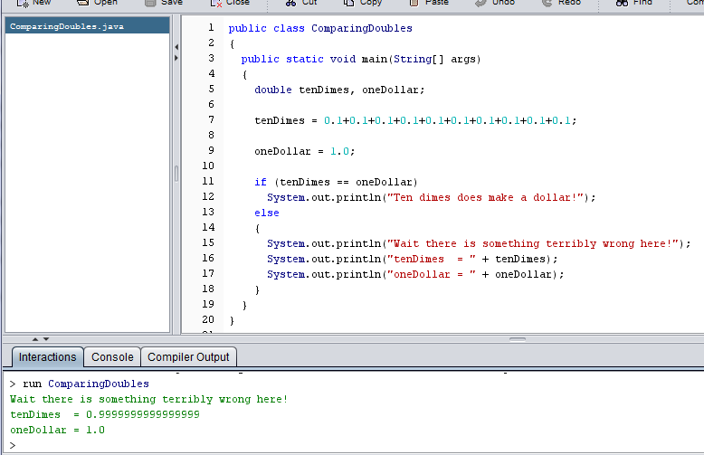
Not what one would expect. Any idea why?

Slide 40
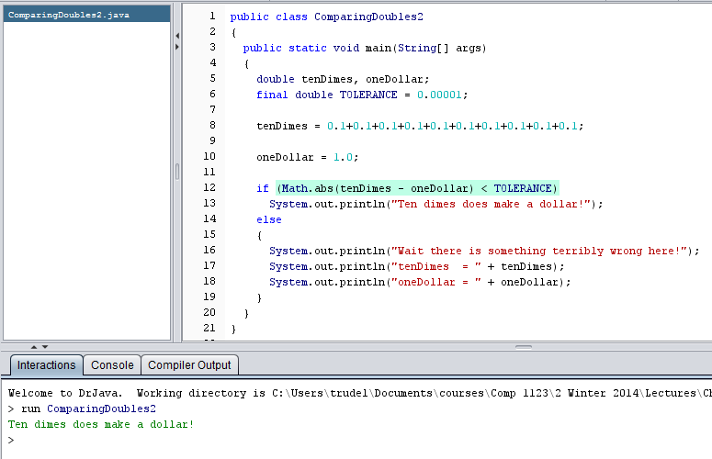
Should check if doubles are close enough

Slide 41
Warning
Don’t use variables of type double to keep track of money when you get a co-op placement with a bank.
Use a TOLERANCE constant when comparing doubles

Slide 42
Comparing char values

Slide 43
Comparing Characters
Java character data is based on the Unicode character set
Unicode establishes a particular numeric value for each character, and therefore an ordering
We can use relational operators on character data based on this ordering
For example, the character '+' is less than the character 'J' because it comes before it in the Unicode character set
Appendix C provides an overview of Unicode

Slide 44
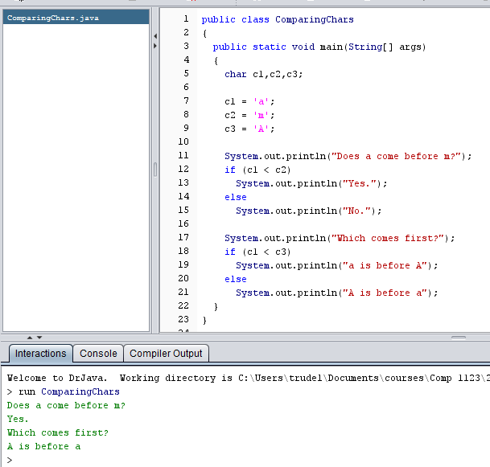
Example

Slide 45
Unicode Values
In Unicode, the digit characters (0-9) are contiguous and in order
Likewise, the uppercase letters (A-Z) and lowercase letters (a-z) are contiguous and in order
Characters | Unicode Values
0 – 9 | 48 through 57
A – Z | 65 through 90
a – z | 97 through 122

Slide 46

Comparing ‘A’ with ‘a’
The Unicode values are the reason that capital “A” comes before lower case “a”
Characters | Unicode Values
0 – 9 | 48 through 57
A – Z | 65 through 90
a – z | 97 through 122

Slide 47

Careful: ‘a’ is not always before ‘Z’
Characters | Unicode Values
0 – 9 | 48 through 57
A – Z | 65 through 90
a – z | 97 through 122

Slide 48

Possible to convert between Unicode and char
Characters | Unicode Values
0 – 9 | 48 through 57
A – Z | 65 through 90
a – z | 97 through 122

Slide 49
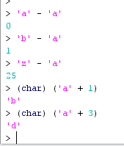
We can do math with the characters

Slide 50
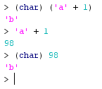
Careful with the casting

Slide 51
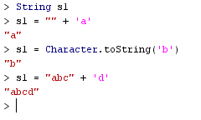
Converting from a char to a String

Slide 52
Comparing strings

Slide 53
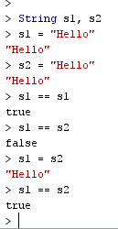
Why is String comparison giving strange results?

Slide 54
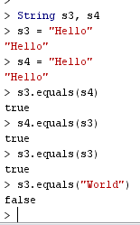
Use equals to compare strings

Slide 55

Cannot directly check if one string comes before another

Slide 56
compareTo
The String class contains the compareTo method for determining if one string comes before another
name1.compareTo(name2)returns:
zero if name1 and name2 are equal (contain the same characters)
a negative value if name1 is less than name2
a positive value if name1 is greater than name2

Slide 57
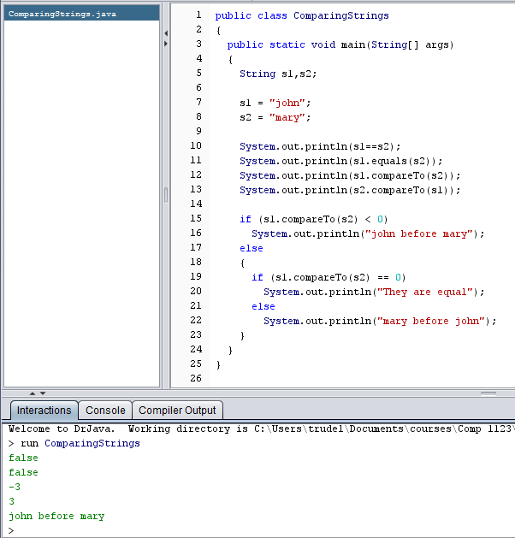
Example
Where does the
-3 and 3 come from??

Slide 58
Lexicographic Ordering
Lexicographic ordering is not strictly alphabetical when uppercase and lowercase characters are mixed
For example, the string "Great" comes before the string "fantastic" because all of the uppercase letters come before all of the lowercase letters in Unicode
Also, short strings come before longer strings with the same prefix (lexicographically)
Therefore "book" comes before "bookcase"

Slide 59
Outline
Boolean Expressions
The if Statement
Comparing Data
The while Statement
Iterators
The ArrayList Class
Determining Event Sources
Check Boxes and Radio Buttons

Slide 60
The while Statement
while ( condition )
statement;
If the condition is true, the statement is executed
Then the condition is evaluated again, and if it is still true, the statement is executed again
The statement is executed repeatedly until the condition becomes false

Slide 61
Example
What is the output?
If the condition of a while loop is false initially, the statement is never executed
Therefore, the body of a while loop will execute zero or more times
int count = 1;
while (count <= 5)
{
System.out.println (count);
count++;
}

Slide 62
TopHat Q9 – Q13

Slide 63
Careful!
There is no semi-colon after the condition:
What is the output if we include a semi-colon in the red circle?
Try running it in the Interactions pane.
int count = 1;
while (count <= 5)
{
System.out.println (count);
count++;
}

Slide 64
Challenge
What is the shortest possible while statement that will loop forever?

Slide 65
Example: Sentinel Values
A loop can be used to maintain a running sum
Keep reading in numbers until a sentinel value is read
A sentinel value is a special input value that represents the end of input

Slide 66
//********************************************************************
// Average.java Author: Lewis/Loftus
//
// Demonstrates the use of a while loop, a sentinel value, and a
// running sum.
//********************************************************************
import java.text.DecimalFormat;
import java.util.Scanner;
public class Average
{
//-----------------------------------------------------------------
// Computes the average of a set of values entered by the user.
// The running sum is printed as the numbers are entered.
//-----------------------------------------------------------------
public static void main (String[] args)
{
int sum = 0, value, count = 0;
double average;
Scanner scan = new Scanner (System.in);
System.out.print ("Enter an integer (0 to quit): ");
value = scan.nextInt();
continue

Slide 67
continue
while (value != 0) // sentinel value of 0 to terminate loop
{
count++;
sum += value;
System.out.println ("The sum so far is " + sum);
System.out.print ("Enter an integer (0 to quit): ");
value = scan.nextInt();
}
continue
Note: Impossible to tell how often the while statement will loop.
Not known until run time.

Slide 68
continue
System.out.println ();
if (count == 0)
System.out.println ("No values were entered.");
else
{
average = (double)sum / count;
DecimalFormat fmt = new DecimalFormat ("0.###");
System.out.println ("The average is " + fmt.format(average));
}
}
}

Slide 69
Sample Run
Enter an integer (0 to quit): 25
The sum so far is 25
Enter an integer (0 to quit): 164
The sum so far is 189
Enter an integer (0 to quit): -14
The sum so far is 175
Enter an integer (0 to quit): 84
The sum so far is 259
Enter an integer (0 to quit): 12
The sum so far is 271
Enter an integer (0 to quit): -35
The sum so far is 236
Enter an integer (0 to quit): 0
The average is 39.333
continue
System.out.println ();
if (count == 0)
System.out.println ("No values were entered.");
else
{
average = (double)sum / count;
DecimalFormat fmt = new DecimalFormat ("0.###");
System.out.println ("The average is " + fmt.format(average));
}
}
}

Slide 70
Example: Input Validation
A loop can also be used for input validation
Makes a program more robust

Slide 71
//********************************************************************
// WinPercentage.java Author: Lewis/Loftus
//
// Demonstrates the use of a while loop for input validation.
//********************************************************************
import java.text.NumberFormat;
import java.util.Scanner;
public class WinPercentage
{
//-----------------------------------------------------------------
// Computes the percentage of games won by a team.
//-----------------------------------------------------------------
public static void main (String[] args)
{
final int NUM_GAMES = 12;
int won;
double ratio;
Scanner scan = new Scanner (System.in);
System.out.print ("Enter the number of games won (0 to "
+ NUM_GAMES + "): ");
won = scan.nextInt();
continue

Slide 72
continue
while (won < 0 || won > NUM_GAMES)
{
System.out.print ("Invalid input. Please reenter: ");
won = scan.nextInt();
}
ratio = (double)won / NUM_GAMES;
NumberFormat fmt = NumberFormat.getPercentInstance();
System.out.println ();
System.out.println ("Winning percentage: " + fmt.format(ratio));
}
}
Note: while statement loops until the user enters valid input.

Slide 73
Sample Run
Enter the number of games won (0 to 12): -5
Invalid input. Please reenter: 13
Invalid input. Please reenter: 7
Winning percentage: 58%
continue
while (won < 0 || won > NUM_GAMES)
{
System.out.print ("Invalid input. Please reenter: ");
won = scan.nextInt();
}
ratio = (double)won / NUM_GAMES;
NumberFormat fmt = NumberFormat.getPercentInstance();
System.out.println ();
System.out.println ("Winning percentage: " + fmt.format(ratio));
}
}

Slide 74
Infinite Loops
The body of a while loop must eventually make the condition false
If not, it is called an infinite loop, which will execute until the user interrupts the program
This is a common logical error

Slide 75
Example of an infinite Loop
Why will this code run forever?
Copy it to the Interactions pane of DrJava and hit the Enter key
Do a Reset to stop the execution
int count = 1;
while (count <= 25)
{
System.out.println (count);
count = count - 1;
}

Slide 76
Palindromes
What is a palindrome?
Song of palindromes:
Weird Al Yankovic
BOB

Slide 77
A long palindrome
Dennis, Nell, Edna, Leon, Nedra, Anita, Rolf, Nora, Alice, Carol, Leo, Jane, Reed, Dena, Dale, Basil, Rae, Penny, Lana, Dave, Denny, Lena, Ida, Bernadette, Ben, Ray, Lila, Nina, Jo,﻿ Ira, Mara, Sara, Mario, Jan, Ina, Lily, Arne, Bette, Dan, Reba, Diane, Lynn, Ed, Eva, Dana, Lynne, Pearl, Isabel, Ada, Ned, Dee, Rena, Joel, Lora, Cecil, Aaron, Flora, Tina, Arden, Noel, and Ellen sinned.
An even longer palindrome

Slide 78
//********************************************************************
// PalindromeTester.java Author: Lewis/Loftus
//
// Demonstrates the use of nested while loops.
//********************************************************************
import java.util.Scanner;
public class PalindromeTester
{
//-----------------------------------------------------------------
// Tests strings to see if they are palindromes.
//-----------------------------------------------------------------
public static void main (String[] args)
{
String str, another = "y";
int left, right;
Scanner scan = new Scanner (System.in);
while (another.equalsIgnoreCase("y")) // allows y or Y
{
System.out.println ("Enter a potential palindrome:");
str = scan.nextLine();
left = 0;
right = str.length() - 1;
continue

Slide 79
continue
while (str.charAt(left) == str.charAt(right) && left < right)
{
left++;
right--;
}
System.out.println();
if (left < right)
System.out.println ("That string is NOT a palindrome.");
else
System.out.println ("That string IS a palindrome.");
System.out.println();
System.out.print ("Test another palindrome (y/n)? ");
another = scan.nextLine();
}
}
}
Note: a while inside a while

Slide 80
Sample Run
Enter a potential palindrome:
radar
That string IS a palindrome.
Test another palindrome (y/n)? y
Enter a potential palindrome:
able was I ere I saw elba
That string IS a palindrome.
Test another palindrome (y/n)? y
Enter a potential palindrome:
abracadabra
That string is NOT a palindrome.
Test another palindrome (y/n)? n
continue
while (str.charAt(left) == str.charAt(right) && left < right)
{
left++;
right--;
}
System.out.println();
if (left < right)
System.out.println ("That string is NOT a palindrome.");
else
System.out.println ("That string IS a palindrome.");
System.out.println();
System.out.print ("Test another palindrome (y/n)? ");
another = scan.nextLine();
}
}
}

Slide 81
Outline
Boolean Expressions
The if Statement
Comparing Data
The while Statement
Iterators
The ArrayList Class
Determining Event Sources
Check Boxes and Radio Buttons

Slide 82
Determining Event Sources
It is possible to assign one listener to two different components in a GUI.
Example:
A single listener can be assigned to 2 buttons.
When either button is pressed, the listener is called.
Problem:
The listener won’t know which button was pressed…
Solution:
The listener uses the getSource method

Slide 83
//********************************************************************
// LeftRight.java Authors: Lewis/Loftus
//
// Demonstrates the use of one listener for multiple buttons.
//********************************************************************
import javax.swing.JFrame;
public class LeftRight
{
//-----------------------------------------------------------------
// Creates the main program frame.
//-----------------------------------------------------------------
public static void main (String[] args)
{
JFrame frame = new JFrame ("Left Right");
frame.setDefaultCloseOperation (JFrame.EXIT_ON_CLOSE);
frame.getContentPane().add(new LeftRightPanel());
frame.pack();
frame.setVisible(true);
}
}

Slide 84
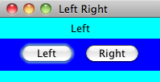
//********************************************************************
// LeftRight.java Authors: Lewis/Loftus
//
// Demonstrates the use of one listener for multiple buttons.
//********************************************************************
import javax.swing.JFrame;
public class LeftRight
{
//-----------------------------------------------------------------
// Creates the main program frame.
//-----------------------------------------------------------------
public static void main (String[] args)
{
JFrame frame = new JFrame ("Left Right");
frame.setDefaultCloseOperation (JFrame.EXIT_ON_CLOSE);
frame.getContentPane().add(new LeftRightPanel());
frame.pack();
frame.setVisible(true);
}
}

Slide 85
//********************************************************************
// LeftRightPanel.java Authors: Lewis/Loftus
//
// Demonstrates the use of one listener for multiple buttons.
//********************************************************************
import java.awt.*;
import java.awt.event.*;
import javax.swing.*;
public class LeftRightPanel extends JPanel
{
private JButton left, right;
private JLabel label;
private JPanel buttonPanel;
continue

Slide 86
continue
//-----------------------------------------------------------------
// Constructor: Sets up the GUI.
//-----------------------------------------------------------------
public LeftRightPanel ()
{
left = new JButton ("Left");
right = new JButton ("Right");
ButtonListener listener = new ButtonListener();
left.addActionListener (listener);
right.addActionListener (listener);
label = new JLabel ("Push a button");
buttonPanel = new JPanel();
buttonPanel.setPreferredSize (new Dimension(200, 40));
buttonPanel.setBackground (Color.blue);
buttonPanel.add (left);
buttonPanel.add (right);
setPreferredSize (new Dimension(200, 80));
setBackground (Color.cyan);
add (label);
add (buttonPanel);
}
continue
2 buttons
1 listener

Slide 87
continue
//*****************************************************************
// Represents a listener for both buttons.
//*****************************************************************
private class ButtonListener implements ActionListener
{
//--------------------------------------------------------------
// Determines which button was pressed and sets the label
// text accordingly.
//--------------------------------------------------------------
public void actionPerformed (ActionEvent event)
{
if (event.getSource() == left)
label.setText("Left");
else
label.setText("Right");
}
}
}

Slide 88
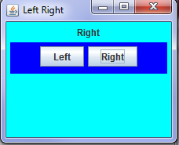
public LeftRightPanel ()
{
left = new JButton ("Left");
right = new JButton ("Right");
ButtonListener listener = new ButtonListener();
left.addActionListener (listener);
right.addActionListener (listener);
label = new JLabel ("Push a button");
buttonPanel = new JPanel();
buttonPanel.setPreferredSize (new Dimension(200, 40));
buttonPanel.setBackground (Color.blue);
buttonPanel.add (left);
buttonPanel.add (right);
setPreferredSize (new Dimension(200, 80));
setBackground (Color.cyan);
add (label);
add (buttonPanel);
}
continue
Note the extra panel
SubPanel for the 2 buttons
to keep them together.

Slide 89
When either button is pressed, the 1 listener is executed. It needs to determine which button was pressed.
continue
//*****************************************************************
// Represents a listener for both buttons.
//*****************************************************************
private class ButtonListener implements ActionListener
{
//--------------------------------------------------------------
// Determines which button was pressed and sets the label
// text accordingly.
//--------------------------------------------------------------
public void actionPerformed (ActionEvent event)
{
if (event.getSource() == left)
label.setText("Left");
else
label.setText("Right");
}
}
}

Slide 90
TopHat Q14-Q16

Slide 91
Outline
Boolean Expressions
The if Statement
Comparing Data
The while Statement
Iterators
The ArrayList Class
Determining Event Sources
Check Boxes and Radio Buttons

Slide 92
Check Boxes
A check box is a button that can be toggled on or off
It is represented by the JCheckBox class
Unlike a push button, which generates an action event, a check box generates an item event whenever it changes state

Slide 93
//********************************************************************
// StyleOptions.java Author: Lewis/Loftus
//
// Demonstrates the use of check boxes.
//********************************************************************
import javax.swing.JFrame;
public class StyleOptions
{
//-----------------------------------------------------------------
// Creates and presents the program frame.
//-----------------------------------------------------------------
public static void main (String[] args)
{
JFrame frame = new JFrame ("Style Options");
frame.setDefaultCloseOperation (JFrame.EXIT_ON_CLOSE);
StyleOptionsPanel panel = new StyleOptionsPanel();
frame.getContentPane().add (panel);
frame.pack();
frame.setVisible(true);
}
}

Slide 94
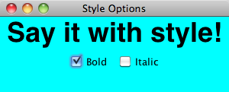
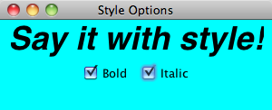
//********************************************************************
// StyleOptions.java Author: Lewis/Loftus
//
// Demonstrates the use of check boxes.
//********************************************************************
import javax.swing.JFrame;
public class StyleOptions
{
//-----------------------------------------------------------------
// Creates and presents the program frame.
//-----------------------------------------------------------------
public static void main (String[] args)
{
JFrame frame = new JFrame ("Style Options");
frame.setDefaultCloseOperation (JFrame.EXIT_ON_CLOSE);
StyleOptionsPanel panel = new StyleOptionsPanel();
frame.getContentPane().add (panel);
frame.pack();
frame.setVisible(true);
}
}

Slide 95
//********************************************************************
// StyleOptionsPanel.java Author: Lewis/Loftus
//
// Demonstrates the use of check boxes.
//********************************************************************
import javax.swing.*;
import java.awt.*;
import java.awt.event.*;
public class StyleOptionsPanel extends JPanel
{
private JLabel saying;
private JCheckBox bold, italic;
continue

Slide 96
continue
//-----------------------------------------------------------------
// Sets up a panel with a label and some check boxes that
// control the style of the label's font.
//-----------------------------------------------------------------
public StyleOptionsPanel()
{
saying = new JLabel ("Say it with style!");
saying.setFont (new Font ("Helvetica", Font.PLAIN, 36));
bold = new JCheckBox ("Bold");
bold.setBackground (Color.cyan);
italic = new JCheckBox ("Italic");
italic.setBackground (Color.cyan);
StyleListener listener = new StyleListener();
bold.addItemListener (listener);
italic.addItemListener (listener);
add (saying);
add (bold);
add (italic);
setBackground (Color.cyan);
setPreferredSize (new Dimension(300, 100));
}
continue
2 check boxes
1 listener

Slide 97
continue
//*****************************************************************
// Represents the listener for both check boxes.
//*****************************************************************
private class StyleListener implements ItemListener
{
//--------------------------------------------------------------
// Updates the style of the label font style.
//--------------------------------------------------------------
public void itemStateChanged (ItemEvent event)
{
int style = Font.PLAIN;
if (bold.isSelected())
style = Font.BOLD;
if (italic.isSelected())
style += Font.ITALIC;
saying.setFont (new Font ("Helvetica", style, 36));
}
}
}
Styles are added as integers
A check box knows if it has
been selected.

Slide 98
Note the colors of the checkboxes and the panel
public StyleOptionsPanel()
{
saying = new JLabel ("Say it with style!");
saying.setFont (new Font ("Helvetica", Font.PLAIN, 36));
bold = new JCheckBox ("Bold");
bold.setBackground (Color.cyan);
italic = new JCheckBox ("Italic");
italic.setBackground (Color.cyan);
StyleListener listener = new StyleListener();
bold.addItemListener (listener);
italic.addItemListener (listener);
add (saying);
add (bold);
add (italic);
setBackground (Color.cyan);
setPreferredSize (new Dimension(300, 100));
}
continue
Try commenting one out

Slide 99
Uses an ItemListener
Not an ActionListener (buttons use these)
private class StyleListener implements ItemListener
{
//--------------------------------------------------------------
// Updates the style of the label font style.
//--------------------------------------------------------------
public void itemStateChanged (ItemEvent event)
{
int style = Font.PLAIN;
if (bold.isSelected())
style = Font.BOLD;
if (italic.isSelected())
style += Font.ITALIC;
saying.setFont (new Font ("Helvetica", style, 36));
}
}
}

Slide 100
TopHat Q17-Q18

Slide 101
Radio Buttons
A group of radio buttons represents a set of mutually exclusive options
Only one can be selected at any given time
When a radio button from a group is selected, the button that is currently "on" in the group is automatically toggled off
To define the group of radio buttons that will work together, each radio button is added to a ButtonGroup object
A radio button generates an action event

Slide 102
//********************************************************************
// QuoteOptions.java Author: Lewis/Loftus
//
// Demonstrates the use of radio buttons.
//********************************************************************
import javax.swing.JFrame;
public class QuoteOptions
{
//-----------------------------------------------------------------
// Creates and presents the program frame.
//-----------------------------------------------------------------
public static void main (String[] args)
{
JFrame frame = new JFrame ("Quote Options");
frame.setDefaultCloseOperation (JFrame.EXIT_ON_CLOSE);
QuoteOptionsPanel panel = new QuoteOptionsPanel();
frame.getContentPane().add (panel);
frame.pack();
frame.setVisible(true);
}
}

Slide 103
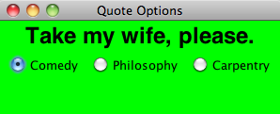
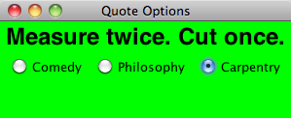
//********************************************************************
// QuoteOptions.java Author: Lewis/Loftus
//
// Demonstrates the use of radio buttons.
//********************************************************************
import javax.swing.JFrame;
public class QuoteOptions
{
//-----------------------------------------------------------------
// Creates and presents the program frame.
//-----------------------------------------------------------------
public static void main (String[] args)
{
JFrame frame = new JFrame ("Quote Options");
frame.setDefaultCloseOperation (JFrame.EXIT_ON_CLOSE);
QuoteOptionsPanel panel = new QuoteOptionsPanel();
frame.getContentPane().add (panel);
frame.pack();
frame.setVisible(true);
}
}

Slide 104
//********************************************************************
// QuoteOptionsPanel.java Author: Lewis/Loftus
//
// Demonstrates the use of radio buttons.
//********************************************************************
import javax.swing.*;
import java.awt.*;
import java.awt.event.*;
public class QuoteOptionsPanel extends JPanel
{
private JLabel quote;
private JRadioButton comedy, philosophy, carpentry;
private String comedyQuote, philosophyQuote, carpentryQuote;
//-----------------------------------------------------------------
// Sets up a panel with a label and a set of radio buttons
// that control its text.
//-----------------------------------------------------------------
public QuoteOptionsPanel()
{
comedyQuote = "Take my wife, please.";
philosophyQuote = "I think, therefore I am.";
carpentryQuote = "Measure twice. Cut once.";
quote = new JLabel (comedyQuote);
quote.setFont (new Font ("Helvetica", Font.BOLD, 24));
continue

Slide 105
continue
comedy = new JRadioButton ("Comedy", true);
comedy.setBackground (Color.green);
philosophy = new JRadioButton ("Philosophy");
philosophy.setBackground (Color.green);
carpentry = new JRadioButton ("Carpentry");
carpentry.setBackground (Color.green);
ButtonGroup group = new ButtonGroup();
group.add (comedy);
group.add (philosophy);
group.add (carpentry);
QuoteListener listener = new QuoteListener();
comedy.addActionListener (listener);
philosophy.addActionListener (listener);
carpentry.addActionListener (listener);
add (quote);
add (comedy);
add (philosophy);
add (carpentry);
setBackground (Color.green);
setPreferredSize (new Dimension(300, 100));
}
continue
Specifies which radio button is initially on.
Radio buttons are added to a
ButtonGroup.
Same listener added to
each radio button
ButtonGroup is not added to the panel

Slide 106
continue
//*****************************************************************
// Represents the listener for all radio buttons
//*****************************************************************
private class QuoteListener implements ActionListener
{
//--------------------------------------------------------------
// Sets the text of the label depending on which radio
// button was pressed.
//--------------------------------------------------------------
public void actionPerformed (ActionEvent event)
{
Object source = event.getSource();
if (source == comedy)
quote.setText (comedyQuote);
else
if (source == philosophy)
quote.setText (philosophyQuote);
else
quote.setText (carpentryQuote);
}
}
}
Uses a variable instead
of retyping
event.getSource()

Slide 107
If specify 2 or more radiobuttons to be true, only the first one is initially on.
OK to specify no radiobutton on initially (none are true).
Typing “false” as the 2nd parameter is the same as having no parameter.
continue
comedy = new JRadioButton ("Comedy", true);
comedy.setBackground (Color.green);
philosophy = new JRadioButton ("Philosophy");
philosophy.setBackground (Color.green);
carpentry = new JRadioButton ("Carpentry");
carpentry.setBackground (Color.green);
Specifies which radio button is initially on.

Slide 108
TopHat Q19-Q20

