Slide 1


Chapter 6 More Conditionals and Loops
Java Software Solutions
Foundations of Program Design
Seventh Edition
John Lewis
William Loftus

Slide 2
Outline
The switch Statement
The Conditional Operator
The do Statement
The for Statement
Drawing with Loops and Conditionals
Dialog Boxes

Slide 3
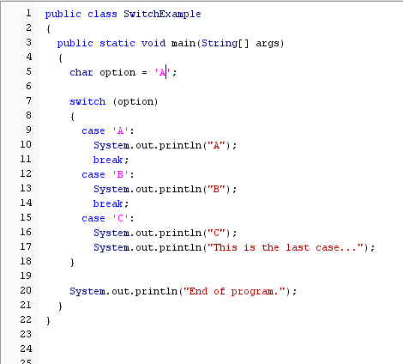
Run the following code on Acorn
Try ‘B’, ‘C’, and ‘D’

Slide 4
No semi-colon
No curly brackets for each case
break gets us out of the switch
statement
Switch statement is skipped if no cases match

Slide 5
default
A switch statement can have an optional default case
The default case has no associated value and simply uses the reserved word default
If the default case is present, control will transfer to it if no other case value matches
If there is no default case, and no other value matches, control falls through to the statement after the switch

Slide 6
Test with various grades including outside the range 0-100
//********************************************************************
// GradeReport.java Author: Lewis/Loftus
//
// Demonstrates the use of a switch statement.
//********************************************************************
import java.util.Scanner;
public class GradeReport
{
//-----------------------------------------------------------------
// Reads a grade from the user and prints comments accordingly.
//-----------------------------------------------------------------
public static void main (String[] args)
{
int grade, category;
Scanner scan = new Scanner (System.in);
System.out.print ("Enter a numeric grade (0 to 100): ");
grade = scan.nextInt();
category = grade / 10;
System.out.print ("That grade is ");
continue
Has the effect of throwing away the last digit.

Slide 7
continue
switch (category)
{
case 10:
System.out.println ("a perfect score. Well done.");
break;
case 9:
System.out.println ("well above average. Excellent.");
break;
case 8:
System.out.println ("above average. Nice job.");
break;
case 7:
System.out.println ("average.");
break;
case 6:
System.out.println ("below average. You should see the");
System.out.println ("instructor to clarify the material "
+ "presented in class.");
break;
default:
System.out.println ("not passing.");
}
}
}

Slide 8
Sample Run
Enter a numeric grade (0 to 100): 91
That grade is well above average. Excellent.
continue
switch (category)
{
case 10:
System.out.println ("a perfect score. Well done.");
break;
case 9:
System.out.println ("well above average. Excellent.");
break;
case 8:
System.out.println ("above average. Nice job.");
break;
case 7:
System.out.println ("average.");
break;
case 6:
System.out.println ("below average. You should see the");
System.out.println ("instructor to clarify the material "
+ "presented in class.");
break;
default:
System.out.println ("not passing.");
}
}
}

Slide 9
Break
Often a break statement is used as the last statement in each case's statement list
A break statement causes control to transfer to the end of the switch statement
If a break statement is not used, the flow of control will continue into the next case
Sometimes this may be appropriate, but often we want to execute only the statements associated with one case

Slide 10
Exercise
Comment out all the break statements in the previous program.
Try running it.

Slide 11
Style: A switch statement is the only time you should be using break!

Slide 12
Types that can be used in a switch:
int
char
String
Cannot be used with a double

Slide 13
TopHat Q1 –Q4

Slide 14
Outline
The switch Statement
The Conditional Operator
The do Statement
The for Statement
Drawing with Loops and Conditionals
Dialog Boxes

Slide 15
Conditional operator
total = (total>MAX) ? total+1 : total*2;
Is equivalent to:
if (total>MAX)
total=total+1;
else
total=total*2;
Note the symbols used

Slide 16
Print out the smaller of 2 numbers
System.out.println(“Smaller: “ + ((num1<num2) ? num1:num2));

Slide 17
Note
Conditional operator always returns a single value
You will come across it in other programs
Recommend not using it…
If statements are easier to read/understand…

Slide 18
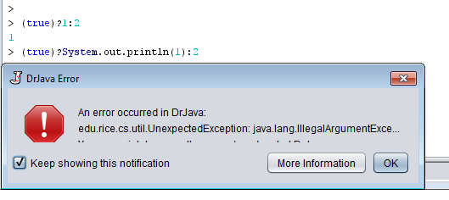
Note
The conditional operator returns a value.
It evaluates an expression.
It cannot execute general Java statements.
It is not a replacement for if statements.

Slide 19
TopHat Q5

Slide 20
Outline
The switch Statement
The Conditional Operator
The do Statement
The for Statement
Drawing with Loops and Conditionals
Dialog Boxes

Slide 21
The do Statement
A do statement has the following syntax:
do
{
statement-list;
}
while (condition);
The statement-list is executed once initially, and then the condition is evaluated
The statement is executed repeatedly until the condition becomes false

Slide 22
Example
Output?
Try running it in the Interactions pane
Note: The body of a do loop always executes at least once
int count = 0;
do
{
count++;
System.out.println (count);
} while (count < 5);

Slide 23
//********************************************************************
// ReverseNumber.java Author: Lewis/Loftus
//
// Demonstrates the use of a do loop.
//********************************************************************
import java.util.Scanner;
public class ReverseNumber
{
//-----------------------------------------------------------------
// Reverses the digits of an integer mathematically.
//-----------------------------------------------------------------
public static void main (String[] args)
{
int number, lastDigit, reverse = 0;
Scanner scan = new Scanner (System.in);
continue

Slide 24
continue
System.out.print ("Enter a positive integer: ");
number = scan.nextInt();
do
{
lastDigit = number % 10;
reverse = (reverse * 10) + lastDigit;
number = number / 10;
}
while (number > 0);
System.out.println ("That number reversed is " + reverse);
}
}

Slide 25
Sample Run
Enter a positive integer: 2896
That number reversed is 6982
continue
System.out.print ("Enter a positive integer: ");
number = scan.nextInt();
do
{
lastDigit = number % 10;
reverse = (reverse * 10) + lastDigit;
number = number / 10;
}
while (number > 0);
System.out.println ("That number reversed is " + reverse);
}
}

Slide 26
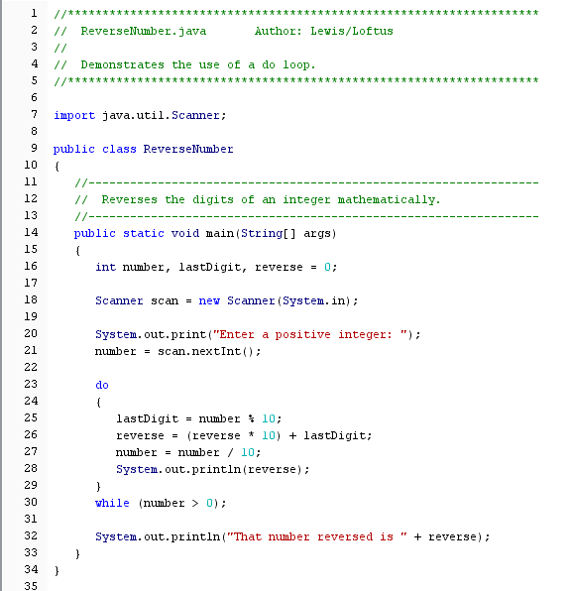
Insert a println and run it with 123456789

Slide 27
No ;
Yes ;

Slide 28
Comparing while and do
The while Loop
The do Loop
statement
condition
evaluated
true
false
condition
evaluated
true
statement
false

Slide 29
TopHat Q6-Q7

Slide 30
Outline
The switch Statement
The Conditional Operator
The do Statement
The for Statement
Drawing with Loops and Conditionals
Dialog Boxes

Slide 31
Example
for (int count=1; count <= 5; count++)
System.out.println (count);
Output?
Try running it in the Interactions pane.

Slide 32
Syntax
The initialization
is executed once
before the loop begins
The statement is
executed until the
condition becomes false
for ( initialization ; condition ; increment )
statement;
The increment portion is executed at the end of each iteration

Slide 33
Logic of a for loop
initialization
condition
evaluated
true
false
statement
increment

Slide 34
Equivalent
for ( initialization ; condition ; increment )
statement;
initialization;
while ( condition )
{
statement;
increment;
}

Slide 35
Review
An example of a for loop:
for (int count=1; count <= 5; count++)
System.out.println (count);
The initialization section can be used to declare a variable
Like a while loop, the condition of a for loop is tested prior to executing the loop body
Therefore, the body of a for loop will execute zero or more times

Slide 36
The for Statement
The increment section can perform any calculation:
for (int num=100; num > 0; num -= 5)
System.out.println (num);
Try running it in the Interactions pane.
A for loop is well suited for executing statements a specific number of times that can be calculated or determined in advance

Slide 37
//********************************************************************
// Multiples.java Author: Lewis/Loftus
//
// Demonstrates the use of a for loop.
//********************************************************************
import java.util.Scanner;
public class Multiples
{
//-----------------------------------------------------------------
// Prints multiples of a user-specified number up to a user-
// specified limit.
//-----------------------------------------------------------------
public static void main (String[] args)
{
final int PER_LINE = 5;
int value, limit, mult, count = 0;
Scanner scan = new Scanner (System.in);
System.out.print ("Enter a positive value: ");
value = scan.nextInt();
continue

Slide 38
continue
System.out.print ("Enter an upper limit: ");
limit = scan.nextInt();
System.out.println ();
System.out.println ("The multiples of " + value + " between " +
value + " and " + limit + " (inclusive) are:");
for (mult = value; mult <= limit; mult += value)
{
System.out.print (mult + "\t");
// Print a specific number of values per line of output
count++;
if (count % PER_LINE == 0)
System.out.println();
}
}
}

Slide 39
Sample Run
Enter a positive value: 7
Enter an upper limit: 400
The multiples of 7 between 7 and 400 (inclusive) are:
7 14 21 28 35
42 49 56 63 70
77 84 91 98 105
112 119 126 133 140
147 154 161 168 175
182 189 196 203 210
217 224 231 238 245
252 259 266 273 280
287 294 301 308 315
322 329 336 343 350
357 364 371 378 385
392 399
continue
System.out.print ("Enter an upper limit: ");
limit = scan.nextInt();
System.out.println ();
System.out.println ("The multiples of " + value + " between " +
value + " and " + limit + " (inclusive) are:");
for (mult = value; mult <= limit; mult += value)
{
System.out.print (mult + "\t");
// Print a specific number of values per line of output
count++;
if (count % PER_LINE == 0)
System.out.println();
}
}
}

Slide 40
//********************************************************************
// Stars.java Author: Lewis/Loftus
//
// Demonstrates the use of nested for loops.
//********************************************************************
public class Stars
{
//-----------------------------------------------------------------
// Prints a triangle shape using asterisk (star) characters.
//-----------------------------------------------------------------
public static void main (String[] args)
{
final int MAX_ROWS = 10;
for (int row = 1; row <= MAX_ROWS; row++)
{
for (int star = 1; star <= row; star++)
System.out.print ("*");
System.out.println();
}
}
}
Try changing the constant MAX_ROWS

Slide 41
Output
*
**
***
****
*****
******
*******
********
*********
**********
//********************************************************************
// Stars.java Author: Lewis/Loftus
//
// Demonstrates the use of nested for loops.
//********************************************************************
public class Stars
{
//-----------------------------------------------------------------
// Prints a triangle shape using asterisk (star) characters.
//-----------------------------------------------------------------
public static void main (String[] args)
{
final int MAX_ROWS = 10;
for (int row = 1; row <= MAX_ROWS; row++)
{
for (int star = 1; star <= row; star++)
System.out.print ("*");
System.out.println();
}
}
}

Slide 42
Exercise
//********************************************************************
// Stars.java Author: Lewis/Loftus
//
// Demonstrates the use of nested for loops.
//********************************************************************
public class Stars
{
//-----------------------------------------------------------------
// Prints a triangle shape using asterisk (star) characters.
//-----------------------------------------------------------------
public static void main (String[] args)
{
final int MAX_ROWS = 10;
for (int row = 1; row <= MAX_ROWS; row++)
{
for (int star = 1; star <= row; star++)
System.out.print ("*");
System.out.println();
}
}
}
Try printing out the value of row here.

Slide 43
Exercise
//********************************************************************
// Stars.java Author: Lewis/Loftus
//
// Demonstrates the use of nested for loops.
//********************************************************************
public class Stars
{
//-----------------------------------------------------------------
// Prints a triangle shape using asterisk (star) characters.
//-----------------------------------------------------------------
public static void main (String[] args)
{
final int MAX_ROWS = 10;
for (int row = 1; row <= MAX_ROWS; row++)
{
for (int star = 1; star <= row; star++)
System.out.print ("*");
System.out.println();
}
}
}
Try printing out the value of star here.

Slide 44
Exercise
//********************************************************************
// Stars.java Author: Lewis/Loftus
//
// Demonstrates the use of nested for loops.
//********************************************************************
public class Stars
{
//-----------------------------------------------------------------
// Prints a triangle shape using asterisk (star) characters.
//-----------------------------------------------------------------
public static void main (String[] args)
{
final int MAX_ROWS = 10;
for (int row = 1; row <= MAX_ROWS; row++)
{
for (int star = 1; star <= row; star++)
System.out.print ("*");
System.out.println();
}
}
}
Try inserting “int row;” and compiling.
Then remove “int”.

Slide 45
The for Statement
Each expression in the header of a for loop is optional
If the initialization is left out, no initialization is performed
If the condition is left out, it is always considered to be true, and therefore creates an infinite loop
If the increment is left out, no increment operation is performed

Slide 46
Example – run it in the Interactions pane
int x = 1;
for ( ; x<10; x++)
System.out.println(x);
Style – Don’t do the above!

Slide 47
TopHat Q8-Q10

Slide 48
Outline
The switch Statement
The Conditional Operator
The do Statement
The for Statement
Drawing with Loops and Conditionals
Dialog Boxes

Slide 49
//********************************************************************
// Bullseye.java Author: Lewis/Loftus
//
// Demonstrates the use of loops to draw.
//********************************************************************
import javax.swing.JFrame;
public class Bullseye
{
//-----------------------------------------------------------------
// Creates the main frame of the program.
//-----------------------------------------------------------------
public static void main (String[] args)
{
JFrame frame = new JFrame ("Bullseye");
frame.setDefaultCloseOperation (JFrame.EXIT_ON_CLOSE);
BullseyePanel panel = new BullseyePanel();
frame.getContentPane().add(panel);
frame.pack();
frame.setVisible(true);
}
}

Slide 50
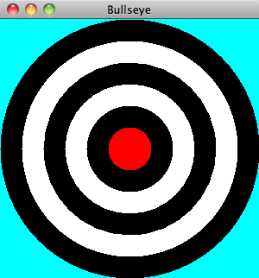
//********************************************************************
// Bullseye.java Author: Lewis/Loftus
//
// Demonstrates the use of loops to draw.
//********************************************************************
import javax.swing.JFrame;
public class Bullseye
{
//-----------------------------------------------------------------
// Creates the main frame of the program.
//-----------------------------------------------------------------
public static void main (String[] args)
{
JFrame frame = new JFrame ("Bullseye");
frame.setDefaultCloseOperation (JFrame.EXIT_ON_CLOSE);
BullseyePanel panel = new BullseyePanel();
frame.getContentPane().add(panel);
frame.pack();
frame.setVisible(true);
}
}

Slide 51
//********************************************************************
// BullseyePanel.java Author: Lewis/Loftus
//
// Demonstrates the use of conditionals and loops to guide drawing.
//********************************************************************
import javax.swing.JPanel;
import java.awt.*;
public class BullseyePanel extends JPanel
{
private final int MAX_WIDTH = 300, NUM_RINGS = 5, RING_WIDTH = 25;
//-----------------------------------------------------------------
// Sets up the bullseye panel.
//-----------------------------------------------------------------
public BullseyePanel ()
{
setBackground (Color.cyan);
setPreferredSize (new Dimension(300,300));
}
continue

Slide 52
continue
//-----------------------------------------------------------------
// Paints a bullseye target.
//-----------------------------------------------------------------
public void paintComponent (Graphics page)
{
super.paintComponent (page);
int x = 0, y = 0, diameter = MAX_WIDTH;
page.setColor (Color.white);
for (int count = 0; count < NUM_RINGS; count++)
{
if (page.getColor() == Color.black) // alternate colors
page.setColor (Color.white);
else
page.setColor (Color.black);
page.fillOval (x, y, diameter, diameter);
diameter -= (2 * RING_WIDTH);
x += RING_WIDTH;
y += RING_WIDTH;
}
// Draw the red bullseye in the center
page.setColor (Color.red);
page.fillOval (x, y, diameter, diameter);
}
}

Slide 53
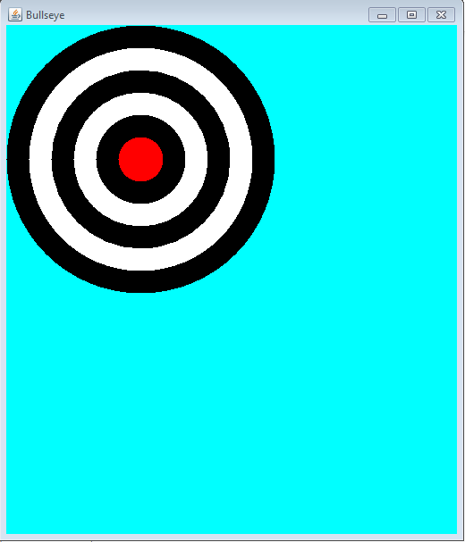
Note: the bullseye is a fixed size

Slide 54
//********************************************************************
// Boxes.java Author: Lewis/Loftus
//
// Demonstrates the use of loops to draw.
//********************************************************************
import javax.swing.JFrame;
public class Boxes
{
//-----------------------------------------------------------------
// Creates the main frame of the program.
//-----------------------------------------------------------------
public static void main (String[] args)
{
JFrame frame = new JFrame ("Boxes");
frame.setDefaultCloseOperation (JFrame.EXIT_ON_CLOSE);
BoxesPanel panel = new BoxesPanel();
frame.getContentPane().add(panel);
frame.pack();
frame.setVisible(true);
}
}

Slide 55
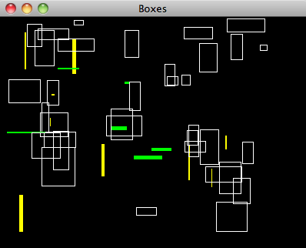
Note: Different picture each time the code is run. Try re-sizing the window!
//********************************************************************
// Boxes.java Author: Lewis/Loftus
//
// Demonstrates the use of loops to draw.
//********************************************************************
import javax.swing.JFrame;
public class Boxes
{
//-----------------------------------------------------------------
// Creates the main frame of the program.
//-----------------------------------------------------------------
public static void main (String[] args)
{
JFrame frame = new JFrame ("Boxes");
frame.setDefaultCloseOperation (JFrame.EXIT_ON_CLOSE);
BoxesPanel panel = new BoxesPanel();
frame.getContentPane().add(panel);
frame.pack();
frame.setVisible(true);
}
}

Slide 56
//********************************************************************
// BoxesPanel.java Author: Lewis/Loftus
//
// Demonstrates the use of conditionals and loops to guide drawing.
//********************************************************************
import javax.swing.JPanel;
import java.awt.*;
import java.util.Random;
public class BoxesPanel extends JPanel
{
private final int NUM_BOXES = 50, THICKNESS = 5, MAX_SIDE = 50;
private final int MAX_X = 350, MAX_Y = 250;
private Random generator;
//-----------------------------------------------------------------
// Sets up the drawing panel.
//-----------------------------------------------------------------
public BoxesPanel ()
{
generator = new Random();
setBackground (Color.black);
setPreferredSize (new Dimension(400, 300));
}
continue

Slide 57
continue
//-----------------------------------------------------------------
// Paints boxes of random width and height in a random location.
// Narrow or short boxes are highlighted with a fill color.
//-----------------------------------------------------------------
public void paintComponent(Graphics page)
{
super.paintComponent (page);
int x, y, width, height;
for (int count = 0; count < NUM_BOXES; count++)
{
x = generator.nextInt(MAX_X) + 1;
y = generator.nextInt(MAX_Y) + 1;
width = generator.nextInt(MAX_SIDE) + 1;
height = generator.nextInt(MAX_SIDE) + 1;
continue

Slide 58
continue
if (width <= THICKNESS) // check for narrow box
{
page.setColor (Color.yellow);
page.fillRect (x, y, width, height);
}
else
if (height <= THICKNESS) // check for short box
{
page.setColor (Color.green);
page.fillRect (x, y, width, height);
}
else
{
page.setColor (Color.white);
page.drawRect (x, y, width, height);
}
}
}
}

Slide 59
Outline
The switch Statement
The Conditional Operator
The do Statement
The for Statement
Drawing with Loops and Conditionals
Dialog Boxes

Slide 60
Dialog Boxes
A dialog box is a window that appears on top of any currently active window
A dialog box usually has a specific, solitary purpose, and the user interaction with it is brief

Slide 61
Note this is regular code with a main method.
We are not creating a frame with panels.
/********************************************************************
// EvenOdd.java Author: Lewis/Loftus
//
// Demonstrates the use of the JOptionPane class.
//********************************************************************
import javax.swing.JOptionPane;
public class EvenOdd
{
//-----------------------------------------------------------------
// Determines if the value input by the user is even or odd.
// Uses multiple dialog boxes for user interaction.
//-----------------------------------------------------------------
public static void main (String[] args)
{
String numStr, result;
int num, again;
continue
Import is required

Slide 62
Always returns a String.
Displays a String.
continue
do
{
numStr = JOptionPane.showInputDialog ("Enter an integer: ");
num = Integer.parseInt(numStr);
result = "That number is " + ((num%2 == 0) ? "even" : "odd");
JOptionPane.showMessageDialog (null, result);
again = JOptionPane.showConfirmDialog (null, "Do Another?");
}
while (again == JOptionPane.YES_OPTION);
}
}
null centers the window

Slide 63
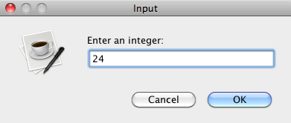
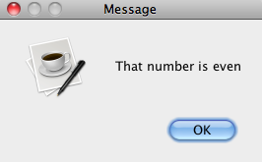
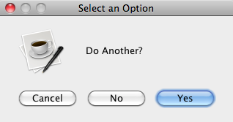
continue
do
{
numStr = JOptionPane.showInputDialog ("Enter an integer: ");
num = Integer.parseInt(numStr);
result = "That number is " + ((num%2 == 0) ? "even" : "odd");
JOptionPane.showMessageDialog (null, result);
again = JOptionPane.showConfirmDialog (null, "Do Another?");
}
while (again == JOptionPane.YES_OPTION);
}
}

Slide 64
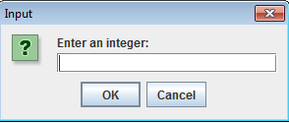
Making the code crash
Try
clicking “Cancel”
Click “OK” without entering an integer
Code does not deal with a null pointer or empty string
How can we change the code?

Slide 65
Modified code
//********************************************************************
// EvenOdd.java Author: Lewis/Loftus
//
// Demonstrates the use of the JOptionPane class.
//********************************************************************
import javax.swing.JOptionPane;
public class EvenOdd
{
//-----------------------------------------------------------------
// Determines if the value input by the user is even or odd.
// Uses multiple dialog boxes for user interaction.
//-----------------------------------------------------------------
public static void main (String[] args)
{
String numStr, result;
int num, again;
do
{
numStr = JOptionPane.showInputDialog ("Enter an integer: ");
if (numStr != null && !numStr.isEmpty())
{
num = Integer.parseInt(numStr);
result = num + " is " + ((num%2 == 0) ? "even" : "odd");
JOptionPane.showMessageDialog (null, result);
}
again = JOptionPane.showConfirmDialog (null, "Do Another?");
}
while (again == JOptionPane.YES_OPTION);
}
}

Slide 66
How can we still make it crash?

Slide 67
Enter text instead of an integer.

