Slide 1


Chapter 7 Object-Oriented Design
Java Software Solutions
Foundations of Program Design
Seventh Edition
John Lewis
William Loftus

Slide 2
Static methods
A static method is one that can be invoked through its class name
For example, the methods of the Math class are static:
result = Math.sqrt(25)
There is no need to create a variable of type Math

Slide 3
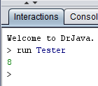
Example
public class Tester
{
public static void main(String[] args)
{
System.out.println(Helper.cube(2));
}
}
public class Helper
{
public static int cube (int num)
{
return num * num * num;
}
}
NOTE:
The method is static, not the class
No object of type Helper is created with a “new”
Have to use the class name “Helper” to call the method

Slide 4
main method
public class Tester
{
public static void main(String[] args)
{
System.out.println(Helper.cube(2));
}
}
This is why we do not have to create an object of type Tester in
order to run this code.

Slide 5
Style
public class Tester
{
public static void main(String[] args)
{
System.out.println(Helper.cube(2));
}
}
Visibility modifier always goes first

Slide 6
Static Variables
Normally, each object has its own memory space for storing its instance variables.
If a variable is declared as static, only one copy of the variable exists
private static double price;
Memory space for a static variable is created when the class is first referenced
All objects instantiated from the class share its static variables
Changing the value of a static variable in one object changes it for all others

Slide 7
Example
Static methods and static variables often work together
The following example keeps track of how many Slogan objects have been created using a static variable, and makes that information available using a static method

Slide 8
Run this code on the board
//********************************************************************
// SloganCounter.java Author: Lewis/Loftus
//
// Demonstrates the use of the static modifier.
//********************************************************************
public class SloganCounter
{
//-----------------------------------------------------------------
// Creates several Slogan objects and prints the number of
// objects that were created.
//-----------------------------------------------------------------
public static void main (String[] args)
{
Slogan obj;
obj = new Slogan ("Remember the Alamo.");
System.out.println (obj);
obj = new Slogan ("Don't Worry. Be Happy.");
System.out.println (obj);
continue

Slide 9
continue
obj = new Slogan ("Live Free or Die.");
System.out.println (obj);
obj = new Slogan ("Talk is Cheap.");
System.out.println (obj);
obj = new Slogan ("Write Once, Run Anywhere.");
System.out.println (obj);
System.out.println();
System.out.println ("Slogans created: " + Slogan.getCount());
}
}

Slide 10
Output
Remember the Alamo.
Don't Worry. Be Happy.
Live Free or Die.
Talk is Cheap.
Write Once, Run Anywhere.
Slogans created: 5
continue
obj = new Slogan ("Live Free or Die.");
System.out.println (obj);
obj = new Slogan ("Talk is Cheap.");
System.out.println (obj);
obj = new Slogan ("Write Once, Run Anywhere.");
System.out.println (obj);
System.out.println();
System.out.println ("Slogans created: " + Slogan.getCount());
}
}

Slide 11
//********************************************************************
// Slogan.java Author: Lewis/Loftus
//
// Represents a single slogan string.
//********************************************************************
public class Slogan
{
private String phrase;
private static int count = 0;
//-----------------------------------------------------------------
// Constructor: Sets up the slogan and counts the number of
// instances created.
//-----------------------------------------------------------------
public Slogan (String str)
{
phrase = str;
count++;
}
continue

Slide 12
continue
//-----------------------------------------------------------------
// Returns this slogan as a string.
//-----------------------------------------------------------------
public String toString()
{
return phrase;
}
//-----------------------------------------------------------------
// Returns the number of instances of this class that have been
// created.
//-----------------------------------------------------------------
public static int getCount ()
{
return count;
}
}

Slide 13
//********************************************************************
// Slogan.java Author: Lewis/Loftus
//
// Represents a single slogan string.
//********************************************************************
public class Slogan
{
private String phrase;
private static int count = 0;
//-----------------------------------------------------------------
// Constructor: Sets up the slogan and counts the number of
// instances created.
//-----------------------------------------------------------------
public Slogan (String str)
{
phrase = str;
count++;
}
continue
Can access and change the static variable

Slide 14
//********************************************************************
// Slogan.java Author: Lewis/Loftus
//
// Represents a single slogan string.
//********************************************************************
public class Slogan
{
private String phrase;
private static int count = 0;
//-----------------------------------------------------------------
// Constructor: Sets up the slogan and counts the number of
// instances created.
//-----------------------------------------------------------------
public Slogan (String str)
{
phrase = str;
count++;
}
continue
Always private
count is initialized here and not
in the constructor!
Initialization only happens the first
time the class is used

Slide 15
Exercise 1: the static variable and method can
be accessed before any Slogan objects are created
continue
obj = new Slogan ("Live Free or Die.");
System.out.println (obj);
obj = new Slogan ("Talk is Cheap.");
System.out.println (obj);
obj = new Slogan ("Write Once, Run Anywhere.");
System.out.println (obj);
System.out.println();
System.out.println ("Slogans created: " + Slogan.getCount());
}
}
Copy the last line to the top of the main method

Slide 16
Exercise 2: can have multiple Slogan objects
continue
obj = new Slogan ("Live Free or Die.");
System.out.println (obj);
obj = new Slogan ("Talk is Cheap.");
System.out.println (obj);
obj = new Slogan ("Write Once, Run Anywhere.");
System.out.println (obj);
System.out.println();
System.out.println ("Slogans created: " + Slogan.getCount());
}
}
Copy these lines to the end of the main method
Slogan obj2 = new Slogan("Hello class");
System.out.println ("Slogans created: " + Slogan.getCount());

Slide 17
Exercise 3: A method in Slogan can use the static
method
continue
//-----------------------------------------------------------------
// Returns this slogan as a string.
//-----------------------------------------------------------------
public String toString()
{
return phrase;
}
//-----------------------------------------------------------------
// Returns the number of instances of this class that have been
// created.
//-----------------------------------------------------------------
public static int getCount ()
{
return count;
}
}
Try appending: + "***Current count: " + getCount()

Slide 18
Exercise 4: A static method cannot access
non-static instance variables
continue
//-----------------------------------------------------------------
// Returns this slogan as a string.
//-----------------------------------------------------------------
public String toString()
{
return phrase;
}
//-----------------------------------------------------------------
// Returns the number of instances of this class that have been
// created.
//-----------------------------------------------------------------
public static int getCount ()
{
return count;
}
}
Try adding:
phrase = "Hello Class";

Slide 19
Static variables and methods
Static methods cannot reference instance variables because instance variables don't exist until an object exists
However, a static method can reference static variables or local variables
This is why all the main method variables are defined inside the main method.

Slide 20
Exercise 5: Use the class name.
Not an object to access a static method.
continue
obj = new Slogan ("Live Free or Die.");
System.out.println (obj);
obj = new Slogan ("Talk is Cheap.");
System.out.println (obj);
obj = new Slogan ("Write Once, Run Anywhere.");
System.out.println (obj);
System.out.println();
System.out.println ("Slogans created: " + Slogan.getCount());
}
}
Change “Slogan” to “obj”
Java will run but gives a warning

Slide 21
Exercise 6: Never initialize a static variable in the constructor
//********************************************************************
// Slogan.java Author: Lewis/Loftus
//
// Represents a single slogan string.
//********************************************************************
public class Slogan
{
private String phrase;
private static int count = 0;
//-----------------------------------------------------------------
// Constructor: Sets up the slogan and counts the number of
// instances created.
//-----------------------------------------------------------------
public Slogan (String str)
{
phrase = str;
count++;
}
continue
Add count=0 to the constructor

Slide 22
TopHat Q1-Q4

Slide 23
Outline
Software Development Activities
Identifying Classes and Objects
Static Variables and Methods
Class Relationships
Interfaces
Enumerated Types Revisited
Method Design
Testing
GUI Design and Layout

Slide 24
Class Relationships
Classes in a software system can have various types of relationships to each other
Three of the most common relationships:
Dependency: A uses B
Aggregation: A has-a B
Inheritance: A is-a B (covered later)

Slide 25
Dependency (A uses B)
A dependency exists when one class relies on another in some way
GUI Example:
One class has a main method and takes care of the frame
Uses another class to deal with the panel

Slide 26
Another form of dependency (A uses A)
Some dependencies occur between objects of the same class
A method of the class may accept an object of the same class as a parameter
For example, the concat method of the String class takes as a parameter another String object
str3 = str1.concat(str2);

Slide 27
Example
The following example defines a class called RationalNumber
A rational number is a value that can be represented as the ratio of two integers
Several methods of the RationalNumber class accept another RationalNumber object as a parameter

Slide 28
//********************************************************************
// RationalTester.java Author: Lewis/Loftus
//
// Driver to exercise the use of multiple Rational objects.
//********************************************************************
public class RationalTester
{
//-----------------------------------------------------------------
// Creates some rational number objects and performs various
// operations on them.
//-----------------------------------------------------------------
public static void main (String[] args)
{
RationalNumber r1 = new RationalNumber (6, 8);
RationalNumber r2 = new RationalNumber (1, 3);
RationalNumber r3, r4, r5, r6, r7;
System.out.println ("First rational number: " + r1);
System.out.println ("Second rational number: " + r2);
continue
No new objects are assigned to these variables.
They will receive objects via assignment statements.

Slide 29
continue
if (r1.isLike(r2))
System.out.println ("r1 and r2 are equal.");
else
System.out.println ("r1 and r2 are NOT equal.");
r3 = r1.reciprocal();
System.out.println ("The reciprocal of r1 is: " + r3);
r4 = r1.add(r2);
r5 = r1.subtract(r2);
r6 = r1.multiply(r2);
r7 = r1.divide(r2);
System.out.println ("r1 + r2: " + r4);
System.out.println ("r1 - r2: " + r5);
System.out.println ("r1 * r2: " + r6);
System.out.println ("r1 / r2: " + r7);
}
}

Slide 30
Output
First rational number: 3/4
Second rational number: 1/3
r1 and r2 are NOT equal.
The reciprocal of r1 is: 4/3
r1 + r2: 13/12
r1 - r2: 5/12
r1 * r2: 1/4
r1 / r2: 9/4
continue
if (r1.isLike(r2))
System.out.println ("r1 and r2 are equal.");
else
System.out.println ("r1 and r2 are NOT equal.");
r3 = r1.reciprocal();
System.out.println ("The reciprocal of r1 is: " + r3);
r4 = r1.add(r2);
r5 = r1.subtract(r2);
r6 = r1.multiply(r2);
r7 = r1.divide(r2);
System.out.println ("r1 + r2: " + r4);
System.out.println ("r1 - r2: " + r5);
System.out.println ("r1 * r2: " + r6);
System.out.println ("r1 / r2: " + r7);
}
}

Slide 31
//********************************************************************
// RationalNumber.java Author: Lewis/Loftus
//
// Represents one rational number with a numerator and denominator.
//********************************************************************
public class RationalNumber
{
private int numerator, denominator;
//-----------------------------------------------------------------
// Constructor: Sets up the rational number by ensuring a nonzero
// denominator and making only the numerator signed.
//-----------------------------------------------------------------
public RationalNumber (int numer, int denom)
{
if (denom == 0)
denom = 1;
// Make the numerator "store" the sign
if (denom < 0)
{
numer = numer * -1;
denom = denom * -1;
}
continue

Slide 32
continue
numerator = numer;
denominator = denom;
reduce();
}
//-----------------------------------------------------------------
// Returns the numerator of this rational number.
//-----------------------------------------------------------------
public int getNumerator ()
{
return numerator;
}
//-----------------------------------------------------------------
// Returns the denominator of this rational number.
//-----------------------------------------------------------------
public int getDenominator ()
{
return denominator;
}
continue

Slide 33
Returns an object
continue
//-----------------------------------------------------------------
// Returns the reciprocal of this rational number.
//-----------------------------------------------------------------
public RationalNumber reciprocal ()
{
return new RationalNumber (denominator, numerator);
}
//-----------------------------------------------------------------
// Adds this rational number to the one passed as a parameter.
// A common denominator is found by multiplying the individual
// denominators.
//-----------------------------------------------------------------
public RationalNumber add (RationalNumber op2)
{
int commonDenominator = denominator * op2.getDenominator();
int numerator1 = numerator * op2.getDenominator();
int numerator2 = op2.getNumerator() * denominator;
int sum = numerator1 + numerator2;
return new RationalNumber (sum, commonDenominator);
}
continue
Takes an object of the same type as an argument

Slide 34
continue
//-----------------------------------------------------------------
// Subtracts the rational number passed as a parameter from this
// rational number.
//-----------------------------------------------------------------
public RationalNumber subtract (RationalNumber op2)
{
int commonDenominator = denominator * op2.getDenominator();
int numerator1 = numerator * op2.getDenominator();
int numerator2 = op2.getNumerator() * denominator;
int difference = numerator1 - numerator2;
return new RationalNumber (difference, commonDenominator);
}
//-----------------------------------------------------------------
// Multiplies this rational number by the one passed as a
// parameter.
//-----------------------------------------------------------------
public RationalNumber multiply (RationalNumber op2)
{
int numer = numerator * op2.getNumerator();
int denom = denominator * op2.getDenominator();
return new RationalNumber (numer, denom);
}
continue

Slide 35
continue
//-----------------------------------------------------------------
// Divides this rational number by the one passed as a parameter
// by multiplying by the reciprocal of the second rational.
//-----------------------------------------------------------------
public RationalNumber divide (RationalNumber op2)
{
return multiply (op2.reciprocal());
}
//-----------------------------------------------------------------
// Determines if this rational number is equal to the one passed
// as a parameter. Assumes they are both reduced.
//-----------------------------------------------------------------
public boolean isLike (RationalNumber op2)
{
return ( numerator == op2.getNumerator() &&
denominator == op2.getDenominator() );
}
continue
Use op2’s getter methods to access op2’s instance variables.

Slide 36
continue
//-----------------------------------------------------------------
// Returns this rational number as a string.
//-----------------------------------------------------------------
public String toString ()
{
String result;
if (numerator == 0)
result = "0";
else
if (denominator == 1)
result = numerator + "";
else
result = numerator + "/" + denominator;
return result;
}
continue

Slide 37
continue
//-----------------------------------------------------------------
// Reduces this rational number by dividing both the numerator
// and the denominator by their greatest common divisor.
//-----------------------------------------------------------------
private void reduce ()
{
if (numerator != 0)
{
int common = gcd (Math.abs(numerator), denominator);
numerator = numerator / common;
denominator = denominator / common;
}
}
continue
Method is called from the constructor.
It cannot be called from outside the class.

Slide 38
continue
//-----------------------------------------------------------------
// Computes and returns the greatest common divisor of the two
// positive parameters. Uses Euclid's algorithm.
//-----------------------------------------------------------------
private int gcd (int num1, int num2)
{
while (num1 != num2)
if (num1 > num2)
num1 = num1 - num2;
else
num2 = num2 - num1;
return num1;
}
}

Slide 39
Aggregation (A has-a B)
An aggregate is an object that is made up of other objects
Aggregation is a has-a relationship
An aggregate object contains references to other objects as instance data

Slide 40
Example
In the following example, a Student object is composed, in part, of Address objects
A student has two addresses
Run the code on the board

Slide 41
//********************************************************************
// StudentBody.java Author: Lewis/Loftus
//
// Demonstrates the use of an aggregate class.
//********************************************************************
public class StudentBody
{
//-----------------------------------------------------------------
// Creates some Address and Student objects and prints them.
//-----------------------------------------------------------------
public static void main (String[] args)
{
Address school = new Address ("800 Lancaster Ave.", "Villanova",
"PA", 19085);
Address jHome = new Address ("21 Jump Street", "Lynchburg",
"VA", 24551);
Student john = new Student ("John", "Smith", jHome, school);
Address mHome = new Address ("123 Main Street", "Euclid", "OH",
44132);
Student marsha = new Student ("Marsha", "Jones", mHome, school);
System.out.println (john);
System.out.println ();
System.out.println (marsha);
}
}

Slide 42
Output
John Smith
Home Address:
21 Jump Street
Lynchburg, VA 24551
School Address:
800 Lancaster Ave.
Villanova, PA 19085
Marsha Jones
Home Address:
123 Main Street
Euclid, OH 44132
School Address:
800 Lancaster Ave.
Villanova, PA 19085
//********************************************************************
// StudentBody.java Author: Lewis/Loftus
//
// Demonstrates the use of an aggregate class.
//********************************************************************
public class StudentBody
{
//-----------------------------------------------------------------
// Creates some Address and Student objects and prints them.
//-----------------------------------------------------------------
public static void main (String[] args)
{
Address school = new Address ("800 Lancaster Ave.", "Villanova",
"PA", 19085);
Address jHome = new Address ("21 Jump Street", "Lynchburg",
"VA", 24551);
Student john = new Student ("John", "Smith", jHome, school);
Address mHome = new Address ("123 Main Street", "Euclid", "OH",
44132);
Student marsha = new Student ("Marsha", "Jones", mHome, school);
System.out.println (john);
System.out.println ();
System.out.println (marsha);
}
}
Note the amount of output generated by one println.

Slide 43
//********************************************************************
// Student.java Author: Lewis/Loftus
//
// Represents a college student.
//********************************************************************
public class Student
{
private String firstName, lastName;
private Address homeAddress, schoolAddress;
//-----------------------------------------------------------------
// Constructor: Sets up this student with the specified values.
//-----------------------------------------------------------------
public Student (String first, String last, Address home,
Address school)
{
firstName = first;
lastName = last;
homeAddress = home;
schoolAddress = school;
}
continue
A Student object contains
4 objects!

Slide 44
continue
//-----------------------------------------------------------------
// Returns a string description of this Student object.
//-----------------------------------------------------------------
public String toString()
{
String result;
result = firstName + " " + lastName + "\n";
result += "Home Address:\n" + homeAddress + "\n";
result += "School Address:\n" + schoolAddress;
return result;
}
}
We do not worry about the street, city, etc in the address.
Let the homeAddress and schoolAddress objects deal with
that in their own toString methods.

Slide 45
//********************************************************************
// Address.java Author: Lewis/Loftus
//
// Represents a street address.
//********************************************************************
public class Address
{
private String streetAddress, city, state;
private long zipCode;
//-----------------------------------------------------------------
// Constructor: Sets up this address with the specified data.
//-----------------------------------------------------------------
public Address (String street, String town, String st, long zip)
{
streetAddress = street;
city = town;
state = st;
zipCode = zip;
}
continue

Slide 46
continue
//-----------------------------------------------------------------
// Returns a description of this Address object.
//-----------------------------------------------------------------
public String toString()
{
String result;
result = streetAddress + "\n";
result += city + ", " + state + " " + zipCode;
return result;
}
}

Slide 47
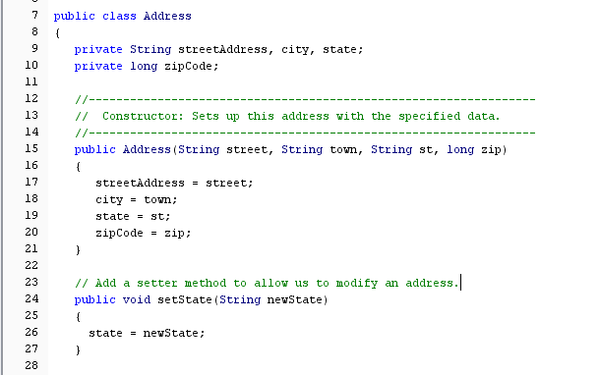
Exercise: Modify the Address class

Slide 48
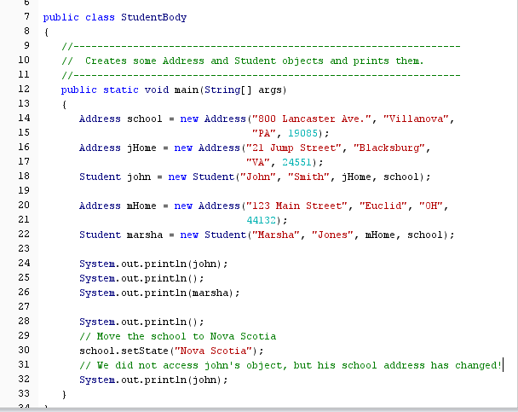
Modify the StudentBody class

Slide 49
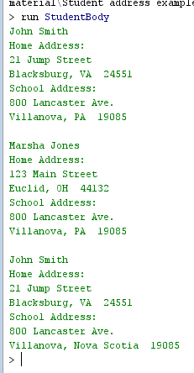
Output: By modifying the school object, we have modified all the objects that point to it.

Slide 50
The this Reference
The this reference allows an object to refer to itself
The this reference, used inside a method, refers to the object through which the method is being executed

Slide 51
Example: can re-write the Student constructor using “this”.
//********************************************************************
// Student.java Author: Lewis/Loftus
//
// Represents a college student.
//********************************************************************
public class Student
{
private String firstName, lastName;
private Address homeAddress, schoolAddress;
//-----------------------------------------------------------------
// Constructor: Sets up this student with the specified values.
//-----------------------------------------------------------------
public Student (String first, String last, Address home,
Address school)
{
this.firstName = first;
this.lastName = last;
this.homeAddress = home;
this.schoolAddress = school;
}
continue

Slide 52
Don’t do this with this…
//********************************************************************
// Student.java Author: Lewis/Loftus
//
// Represents a college student.
//********************************************************************
public class Student
{
private String first, last;
private Address home, school;
//-----------------------------------------------------------------
// Constructor: Sets up this student with the specified values.
//-----------------------------------------------------------------
public Student (String first, String last, Address home,
Address school)
{
this.first = first;
this.last = last;
this.home = home;
this.school = school;
}
continue

Slide 53
Outline
Software Development Activities
Identifying Classes and Objects
Static Variables and Methods
Class Relationships
Interfaces
Enumerated Types Revisited
Method Design
Testing
GUI Design and Layout

Slide 54
Interfaces
A Java interface is a collection of abstract methods and constants
An abstract method is a method header without a method body
An interface is used to establish a set of methods that a class will implement
An interface has no code!

Slide 55
Interfaces
None of the methods contain
code!
interface is a reserved word
public interface Doable
{
public void doThis();
public int doThat();
public void doThis2 (double value, char ch);
public boolean doTheOther (int num);
}
A semicolon immediately
follows each method header

Slide 56
Interfaces
An interface cannot be instantiated
E.g., cannot create an object of type Doable
Methods in an interface have public visibility by default
Sometimes you’ll see “public” missing.
Style: always include public!
A class formally implements an interface by:
stating so in the class header
providing implementations for every abstract method in the interface
If a class declares that it implements an interface, it must define all methods in the interface

Slide 57
Interfaces
implements is a
reserved word
public class CanDo implements Doable
{
public void doThis ()
{
// whatever
}
public int doThat ()
{
// whatever
}
// etc.
}
Each method listed
in Doable is
given a definition

Slide 58
Interfaces
In addition to (or instead of) abstract methods, an interface can contain constants
When a class implements an interface, it gains access to all its constants
A class that implements an interface can implement other methods as well

Slide 59
Try running this code. The interface and the classes that use it all have to be in the same folder.
//********************************************************************
// Complexity.java Author: Lewis/Loftus
//
// Represents the interface for an object that can be assigned an
// explicit complexity.
//********************************************************************
public interface Complexity
{
public void setComplexity (int complexity);
public int getComplexity();
}

Slide 60
//********************************************************************
// Question.java Author: Lewis/Loftus
//
// Represents a question (and its answer).
//********************************************************************
public class Question implements Complexity
{
private String question, answer;
private int complexityLevel;
//-----------------------------------------------------------------
// Constructor: Sets up the question with a default complexity.
//-----------------------------------------------------------------
public Question (String query, String result)
{
question = query;
answer = result;
complexityLevel = 1;
}
continue

Slide 61
continue
//-----------------------------------------------------------------
// Sets the complexity level for this question.
//-----------------------------------------------------------------
public void setComplexity (int level)
{
complexityLevel = level;
}
//-----------------------------------------------------------------
// Returns the complexity level for this question.
//-----------------------------------------------------------------
public int getComplexity()
{
return complexityLevel;
}
//-----------------------------------------------------------------
// Returns the question.
//-----------------------------------------------------------------
public String getQuestion()
{
return question;
}
continue
Must implement the interface’s 2 methods
Note: the parameter name is changed.

Slide 62
continue
//-----------------------------------------------------------------
// Returns the answer to this question.
//-----------------------------------------------------------------
public String getAnswer()
{
return answer;
}
//-----------------------------------------------------------------
// Returns true if the candidate answer matches the answer.
//-----------------------------------------------------------------
public boolean answerCorrect (String candidateAnswer)
{
return answer.equals(candidateAnswer);
}
//-----------------------------------------------------------------
// Returns this question (and its answer) as a string.
//-----------------------------------------------------------------
public String toString()
{
return question + "\n" + answer;
}
}

Slide 63
//********************************************************************
// MiniQuiz.java Author: Lewis/Loftus
//
// Demonstrates the use of a class that implements an interface.
//********************************************************************
import java.util.Scanner;
public class MiniQuiz
{
//-----------------------------------------------------------------
// Presents a short quiz.
//-----------------------------------------------------------------
public static void main (String[] args)
{
Question q1, q2;
String possible;
Scanner scan = new Scanner (System.in);
q1 = new Question ("What is the capital of Jamaica?",
"Kingston");
q1.setComplexity (4);
q2 = new Question ("Which is worse, ignorance or apathy?",
"I don't know and I don't care");
q2.setComplexity (10);
continue

Slide 64
continue
System.out.print (q1.getQuestion());
System.out.println (" (Level: " + q1.getComplexity() + ")");
possible = scan.nextLine();
if (q1.answerCorrect(possible))
System.out.println ("Correct");
else
System.out.println ("No, the answer is " + q1.getAnswer());
System.out.println();
System.out.print (q2.getQuestion());
System.out.println (" (Level: " + q2.getComplexity() + ")");
possible = scan.nextLine();
if (q2.answerCorrect(possible))
System.out.println ("Correct");
else
System.out.println ("No, the answer is " + q2.getAnswer());
}
}

Slide 65
Sample Run
What is the capital of Jamaica? (Level: 4)
Kingston
Correct
Which is worse, ignorance or apathy? (Level: 10)
apathy
No, the answer is I don't know and I don't care
continue
System.out.print (q1.getQuestion());
System.out.println (" (Level: " + q1.getComplexity() + ")");
possible = scan.nextLine();
if (q1.answerCorrect(possible))
System.out.println ("Correct");
else
System.out.println ("No, the answer is " + q1.getAnswer());
System.out.println();
System.out.print (q2.getQuestion());
System.out.println (" (Level: " + q2.getComplexity() + ")");
possible = scan.nextLine();
if (q2.answerCorrect(possible))
System.out.println ("Correct");
else
System.out.println ("No, the answer is " + q2.getAnswer());
}
}

Slide 66
Another interface example
public interface Age
{
public static final int DOG_YEARS = 7;
public void setAge (int years);
public int getAge();
public boolean antique();
}

Slide 67
Let’s define a few classes that implement Age
public class Dog implements Age
{
private int age;
private String name;
public Dog(int y, String n)
{
age = y;
name = n;
}
public void setAge (int years)
{
age = years;
}
public int getAge()
{
// return the age in human years
return age * Age.DOG_YEARS; //Could also refer to the constant without Age
}
Uses the constant defined in the interface

Slide 68
Dog class continued
public int getDogAge()
{
return age;
}
public boolean antique()
{
return (age>15);
}
public String toString()
{
return "Dog: " + name + " Age: " + getDogAge() + " Antique? " + antique();
}
}
There are extra methods defined that are not in the interface.

Slide 69
Furniture class
public class Furniture implements Age
{
private int age;
private String type;
public Furniture(int y, String t)
{
age = y;
type = t;
}
public void setAge (int years)
{
age = years;
}
public int getAge()
{
return age;
}
public boolean antique()
{
return (age>100);
}
public String toString()
{
return "Furniture: " + type + " Age: " + age + " Antique? " + antique();
}
}
Code differs from the
Dog class

Slide 70
Human class
public class Human implements Age
{
private int age;
private String name;
public Human(int y, String n)
{
age = y;
name = n;
}
public void setAge (int years)
{
age = years;
}
public int getAge()
{
return age;
}
public boolean antique()
{
return (age>80);
}
public String toString()
{
return "Human: " + name + " Age: " + age + " Antique? " + antique();
}
}
All 3 antique methods are
different

Slide 71
Problem
The Dog, Furniture, and Human classes all implement the Age interface
They therefore all have a getAge method
public int getAge();
We can compare Dog, Furniture, and Human objects based on their age.

Slide 72
Solution – Hire a co-op student to do a lot of coding…
We can write methods to compare the various objects:
public static boolean older1(Dog d, Furniture f)
{ return (d.getAge() > f.getAge());}
Need 1 method for each combination of object:
public static boolean older2(Furniture f, Dog d)
public static boolean older3(Dog d1, Dog d2)
public static boolean older4(Furniture f1, Furniture f2)
public static boolean older5(Dog d, Human h)
Etc…

Slide 73
This is where the magic happens
public class CompareAge
{
public static boolean older(Age obj1, Age obj2)
{
return (obj1.getAge() > obj2.getAge());
}
}
Age is an interface.
Cannot create objects of type Age.
The method older has 2 Age parameters.
Call older with any pair of objects which implement the Age interface.
When executed, method older has no idea what type of object it is working with. But it knows they have a getAge method.

Slide 74
Putting it all together
public class Tester
{
public static void main (String[ ] args)
{
Dog peggy = new Dog(8,"Peggy");
Human joe = new Human(21,"Joe");
Furniture table = new Furniture(120,"Granma's table");
System.out.println(peggy);
if (CompareAge.older(peggy,joe))
System.out.println("is older than");
else
System.out.println("is not older than");
System.out.println(joe);
System.out.println();
System.out.println(peggy);
if (CompareAge.older(peggy,table))
System.out.println("is older than");
else
System.out.println("is not older than");
System.out.println(table);
System.out.println();
System.out.println(joe);
if (CompareAge.older(joe,table))
System.out.println("is older than");
else
System.out.println("is not older than");
System.out.println(table);
System.out.println();
}
}
Every call to older is with
different types of objects!

Slide 75
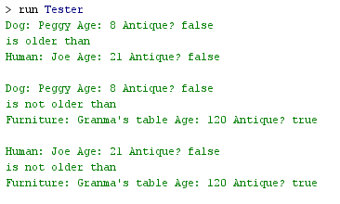
Output
public class Tester
{
public static void main (String[] args)
{
Dog peggy = new Dog(8,"Peggy");
Human joe = new Human(21,"Joe");
Furniture table = new Furniture(120,"Granma's table");
System.out.println(peggy);
if (CompareAge.older(peggy,joe))
System.out.println("is older than");
else
System.out.println("is not older than");
System.out.println(joe);
System.out.println();
System.out.println(peggy);
if (CompareAge.older(peggy,table))
System.out.println("is older than");
else
System.out.println("is not older than");
System.out.println(table);
System.out.println();
System.out.println(joe);
if (CompareAge.older(joe,table))
System.out.println("is older than");
else
System.out.println("is not older than");
System.out.println(table);
System.out.println();
}
}

Slide 76
Interfaces
A class can implement multiple interfaces
The interfaces are listed in the implements clause
The class must implement all methods in all interfaces listed in the header
class ManyThings implements interface1, interface2
{
// all methods of both interfaces
}

Slide 77
Interfaces
The Java API contains many helpful interfaces
The Comparable interface contains one abstract method called compareTo, which is used to compare two objects
We discussed the compareTo method of the String class in Chapter 5
The String class implements Comparable, giving us the ability to put strings in lexicographic order

Slide 78
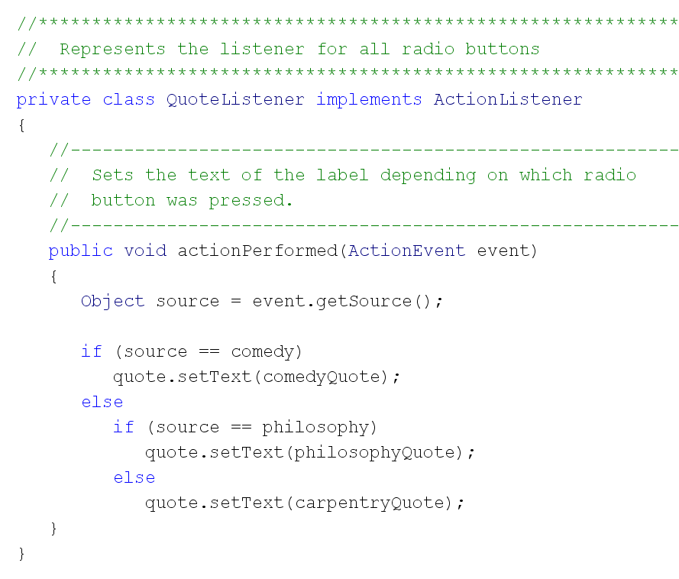
ActionListener Interface for GUIs
The interface
has 1 method

Slide 79
Outline
Software Development Activities
Identifying Classes and Objects
Static Variables and Methods
Class Relationships
Interfaces
Enumerated Types Revisited
Method Design
Testing
GUI Design and Layout

Slide 80
Objects as Parameters
Parameters in a Java method are passed by value
When we call a method, the parameters in the calling program are copied into the method’s parameters before executing the method.
Need to be careful when passing objects as parameters.

Slide 81
//********************************************************************
// ParameterTester.java Author: Lewis/Loftus
//
// Demonstrates the effects of passing various types of parameters.
//********************************************************************
public class ParameterTester
{
//-----------------------------------------------------------------
// Sets up three variables (one primitive and two objects) to
// serve as actual parameters to the changeValues method. Prints
// their values before and after calling the method.
//-----------------------------------------------------------------
public static void main (String[] args)
{
ParameterModifier modifier = new ParameterModifier();
int a1 = 111;
Num a2 = new Num (222);
Num a3 = new Num (333);
continue

Slide 82
continue
System.out.println ("Before calling changeValues:");
System.out.println ("a1\ta2\ta3");
System.out.println (a1 + "\t" + a2 + "\t" + a3 + "\n");
modifier.changeValues (a1, a2, a3);
System.out.println ("After calling changeValues:");
System.out.println ("a1\ta2\ta3");
System.out.println (a1 + "\t" + a2 + "\t" + a3 + "\n");
}
}

Slide 83
Output
Before calling changeValues:
a1 a2 a3
111 222 333
Before changing the values:
f1 f2 f3
111 222 333
After changing the values:
f1 f2 f3
999 888 777
After calling changeValues:
a1 a2 a3
111 888 333
continue
System.out.println ("Before calling changeValues:");
System.out.println ("a1\ta2\ta3");
System.out.println (a1 + "\t" + a2 + "\t" + a3 + "\n");
modifier.changeValues (a1, a2, a3);
System.out.println ("After calling changeValues:");
System.out.println ("a1\ta2\ta3");
System.out.println (a1 + "\t" + a2 + "\t" + a3 + "\n");
}
}

Slide 84
//********************************************************************
// ParameterModifier.java Author: Lewis/Loftus
//
// Demonstrates the effects of changing parameter values.
//********************************************************************
public class ParameterModifier
{
//-----------------------------------------------------------------
// Modifies the parameters, printing their values before and
// after making the changes.
//-----------------------------------------------------------------
public void changeValues (int f1, Num f2, Num f3)
{
System.out.println ("Before changing the values:");
System.out.println ("f1\tf2\tf3");
System.out.println (f1 + "\t" + f2 + "\t" + f3 + "\n");
f1 = 999;
f2.setValue(888);
f3 = new Num (777);
System.out.println ("After changing the values:");
System.out.println ("f1\tf2\tf3");
System.out.println (f1 + "\t" + f2 + "\t" + f3 + "\n");
}
}
Note: this class has no constructor

Slide 85
//********************************************************************
// Num.java Author: Lewis/Loftus
//
// Represents a single integer as an object.
//********************************************************************
public class Num
{
private int value;
//-----------------------------------------------------------------
// Sets up the new Num object, storing an initial value.
//-----------------------------------------------------------------
public Num (int update)
{
value = update;
}
continue

Slide 86
continue
//-----------------------------------------------------------------
// Sets the stored value to the newly specified value.
//-----------------------------------------------------------------
public void setValue (int update)
{
value = update;
}
//-----------------------------------------------------------------
// Returns the stored integer value as a string.
//-----------------------------------------------------------------
public String toString ()
{
return value + "";
}
}

Slide 87
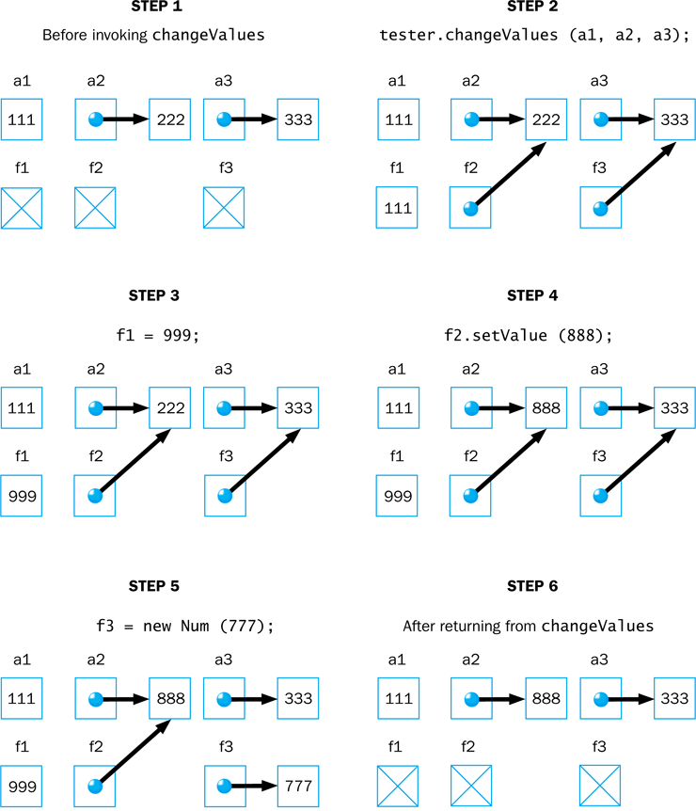

Slide 88
Method Overloading
Method overloading occurs when 2 or more methods have the same name!
If a method is overloaded, the method name is not sufficient to determine which method is being called
The signature of each overloaded method must be unique
The signature includes the number, type, and order of the parameters

Slide 89
Method Overloading
The compiler determines which method is being invoked by analyzing the parameters
public float tryMe(int x)
{
return x + .375;
}
Invocation
result = tryMe(25, 4.32)
public float tryMe(int x, float y)
{
return x*y;
}

Slide 90
Method Overloading
The println method is overloaded:
println (String s)
println (int i)
println (double d)
and so on...
The following lines invoke different versions of the println method:
System.out.println ("The total is:");
System.out.println (total);
int

Slide 91
Overloading Methods
The return type of the method is not part of the signature
That is, overloaded methods cannot differ only by their return type
Constructors can be overloaded
Overloaded constructors provide multiple ways to initialize a new object

Slide 92
Outline
Software Development Activities
Identifying Classes and Objects
Static Variables and Methods
Class Relationships
Interfaces
Enumerated Types Revisited
Method Design
Testing
GUI Design and Layout

Slide 93
Layout Managers
A layout manager determines the way that components are arranged in a panel
There are several predefined layout managers:
Flow Layout
Border Layout
Card Layout
Grid Layout
GridBag Layout
Defined in AWT
Box Layout
Overlay Layout
Defined in Swing

Slide 94
Layout Managers
Use the setLayout method of a panel to change its layout manager:
JPanel panel = new JPanel();
panel.setLayout(new BorderLayout());

Slide 95
Layout manager example
//********************************************************************
// LayoutDemo.java Authors: Lewis/Loftus
//
// Demonstrates the use of flow, border, grid, and box layouts.
//********************************************************************
import javax.swing.*;
public class LayoutDemo
{
//-----------------------------------------------------------------
// Sets up a frame containing a tabbed pane. The panel on each
// tab demonstrates a different layout manager.
//-----------------------------------------------------------------
public static void main (String[] args)
{
JFrame frame = new JFrame ("Layout Manager Demo");
frame.setDefaultCloseOperation (JFrame.EXIT_ON_CLOSE);
continue

Slide 96
continue
JTabbedPane tp = new JTabbedPane();
tp.addTab ("Intro", new IntroPanel());
tp.addTab ("Flow", new FlowPanel());
tp.addTab ("Border", new BorderPanel());
tp.addTab ("Grid", new GridPanel());
tp.addTab ("Box", new BoxPanel());
frame.getContentPane().add(tp);
frame.pack();
frame.setVisible(true);
}
}
A tabbed pane is a container which permits one of several
panels to be selected.

Slide 97
No layout manager specified
Default for a panel is Flow
//********************************************************************
// IntroPanel.java Authors: Lewis/Loftus
//
// Represents the introduction panel for the LayoutDemo program.
//********************************************************************
import java.awt.*;
import javax.swing.*;
public class IntroPanel extends JPanel
{
//-----------------------------------------------------------------
// Sets up this panel with two labels.
//-----------------------------------------------------------------
public IntroPanel()
{
setBackground (Color.green);
JLabel l1 = new JLabel ("Layout Manager Demonstration");
JLabel l2 = new JLabel ("Choose a tab to see an example of " +
"a layout manager.");
add (l1);
add (l2);
}
}

Slide 98
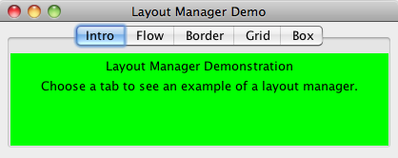
//********************************************************************
// IntroPanel.java Authors: Lewis/Loftus
//
// Represents the introduction panel for the LayoutDemo program.
//********************************************************************
import java.awt.*;
import javax.swing.*;
public class IntroPanel extends JPanel
{
//-----------------------------------------------------------------
// Sets up this panel with two labels.
//-----------------------------------------------------------------
public IntroPanel()
{
setBackground (Color.green);
JLabel l1 = new JLabel ("Layout Manager Demonstration");
JLabel l2 = new JLabel ("Choose a tab to see an example of " +
"a layout manager.");
add (l1);
add (l2);
}
}

Slide 99
Flow Layout
Flow layout puts as many components as possible on a row, then moves to the next row
Components are displayed in the order they are added to the container

Slide 100
//********************************************************************
// FlowPanel.java Authors: Lewis/Loftus
//
// Represents the panel in the LayoutDemo program that demonstrates
// the flow layout manager.
//********************************************************************
import java.awt.*;
import javax.swing.*;
public class FlowPanel extends JPanel
{
//-----------------------------------------------------------------
// Sets up this panel with some buttons to show how flow layout
// affects their position.
//-----------------------------------------------------------------
public FlowPanel ()
{
setLayout (new FlowLayout());
setBackground (Color.green);
continue

Slide 101
continue
JButton b1 = new JButton ("BUTTON 1");
JButton b2 = new JButton ("BUTTON 2");
JButton b3 = new JButton ("BUTTON 3");
JButton b4 = new JButton ("BUTTON 4");
JButton b5 = new JButton ("BUTTON 5");
add (b1);
add (b2);
add (b3);
add (b4);
add (b5);
}
}

Slide 102
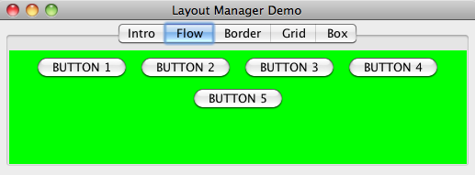
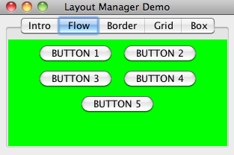
continue
JButton b1 = new JButton ("BUTTON 1");
JButton b2 = new JButton ("BUTTON 2");
JButton b3 = new JButton ("BUTTON 3");
JButton b4 = new JButton ("BUTTON 4");
JButton b5 = new JButton ("BUTTON 5");
add (b1);
add (b2);
add (b3);
add (b4);
add (b5);
}
}

Slide 103
Border Layout
A border layout defines five areas into which components can be added
North
West
Center
East
South
Each area displays one component
Say you want to add 2 buttons to one area.
Must first add the buttons to a panel,
then add the panel to the area.

Slide 104
//********************************************************************
// BorderPanel.java Authors: Lewis/Loftus
//
// Represents the panel in the LayoutDemo program that demonstrates
// the border layout manager.
//********************************************************************
import java.awt.*;
import javax.swing.*;
public class BorderPanel extends JPanel
{
//-----------------------------------------------------------------
// Sets up this panel with a button in each area of a border
// layout to show how it affects their position, shape, and size.
//-----------------------------------------------------------------
public BorderPanel()
{
setLayout (new BorderLayout());
setBackground (Color.green);
continue

Slide 105
continue
JButton b1 = new JButton ("BUTTON 1");
JButton b2 = new JButton ("BUTTON 2");
JButton b3 = new JButton ("BUTTON 3");
JButton b4 = new JButton ("BUTTON 4");
JButton b5 = new JButton ("BUTTON 5");
add (b1, BorderLayout.CENTER);
add (b2, BorderLayout.NORTH);
add (b3, BorderLayout.SOUTH);
add (b4, BorderLayout.EAST);
add (b5, BorderLayout.WEST);
}
}

Slide 106
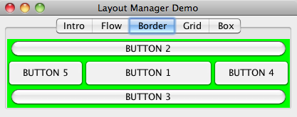
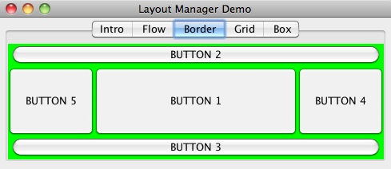
continue
JButton b1 = new JButton ("BUTTON 1");
JButton b2 = new JButton ("BUTTON 2");
JButton b3 = new JButton ("BUTTON 3");
JButton b4 = new JButton ("BUTTON 4");
JButton b5 = new JButton ("BUTTON 5");
add (b1, BorderLayout.CENTER);
add (b2, BorderLayout.NORTH);
add (b3, BorderLayout.SOUTH);
add (b4, BorderLayout.EAST);
add (b5, BorderLayout.WEST);
}
}

Slide 107
Grid Layout
A grid layout has a rectangular grid of rows and columns
One component is placed in each cell of the grid, and all cells have the same size
Components fill the grid from left-to-right and top-to-bottom (by default)

Slide 108
//********************************************************************
// GridPanel.java Authors: Lewis/Loftus
//
// Represents the panel in the LayoutDemo program that demonstrates
// the grid layout manager.
//********************************************************************
import java.awt.*;
import javax.swing.*;
public class GridPanel extends JPanel
{
//-----------------------------------------------------------------
// Sets up this panel with some buttons to show how grid
// layout affects their position, shape, and size.
//-----------------------------------------------------------------
public GridPanel()
{
setLayout (new GridLayout (2, 3));
setBackground (Color.green);
continue
Rows
Columns

Slide 109
continue
JButton b1 = new JButton ("BUTTON 1");
JButton b2 = new JButton ("BUTTON 2");
JButton b3 = new JButton ("BUTTON 3");
JButton b4 = new JButton ("BUTTON 4");
JButton b5 = new JButton ("BUTTON 5");
add (b1);
add (b2);
add (b3);
add (b4);
add (b5);
}
}

Slide 110
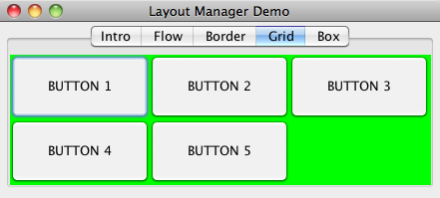
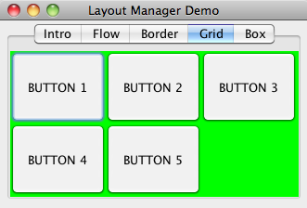
continue
JButton b1 = new JButton ("BUTTON 1");
JButton b2 = new JButton ("BUTTON 2");
JButton b3 = new JButton ("BUTTON 3");
JButton b4 = new JButton ("BUTTON 4");
JButton b5 = new JButton ("BUTTON 5");
add (b1);
add (b2);
add (b3);
add (b4);
add (b5);
}
}

Slide 111
Box Layout
A box layout organizes components horizontally (in one row) or vertically (in one column)
Components are placed top-to-bottom or left-to-right in the order in which they are added to the container

Slide 112
Box Layout
Invisible components can be added to a box layout container to take up space between components
Rigid areas have a fixed size
Glue specifies where excess space should go
Invisible components are created using these methods of the Box class:
createRigidArea(Dimension d)
createHorizontalGlue()
createVerticalGlue()

Slide 113
//********************************************************************
// BoxPanel.java Authors: Lewis/Loftus
//
// Represents the panel in the LayoutDemo program that demonstrates
// the box layout manager.
//********************************************************************
import java.awt.*;
import javax.swing.*;
public class BoxPanel extends JPanel
{
//-----------------------------------------------------------------
// Sets up this panel with some buttons to show how a vertical
// box layout (and invisible components) affects their position.
//-----------------------------------------------------------------
public BoxPanel()
{
setLayout (new BoxLayout (this, BoxLayout.Y_AXIS));
setBackground (Color.green);
continue

Slide 114
continue
JButton b1 = new JButton ("BUTTON 1");
JButton b2 = new JButton ("BUTTON 2");
JButton b3 = new JButton ("BUTTON 3");
JButton b4 = new JButton ("BUTTON 4");
JButton b5 = new JButton ("BUTTON 5");
add (b1);
add (Box.createRigidArea (new Dimension (0, 10)));
add (b2);
add (Box.createVerticalGlue());
add (b3);
add (b4);
add (Box.createRigidArea (new Dimension (0, 20)));
add (b5);
}
}
Note: static method

Slide 115
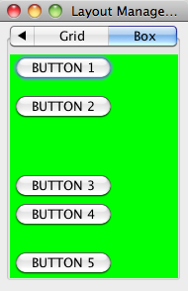
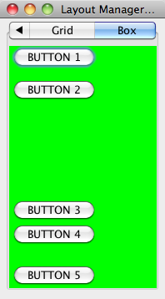
continue
JButton b1 = new JButton ("BUTTON 1");
JButton b2 = new JButton ("BUTTON 2");
JButton b3 = new JButton ("BUTTON 3");
JButton b4 = new JButton ("BUTTON 4");
JButton b5 = new JButton ("BUTTON 5");
add (b1);
add (Box.createRigidArea (new Dimension (0, 10)));
add (b2);
add (Box.createVerticalGlue());
add (b3);
add (b4);
add (Box.createRigidArea (new Dimension (0, 20)));
add (b5);
}
}

Slide 116
Borders

Slide 117
//********************************************************************
// BorderDemo.java Authors: Lewis/Loftus
//
// Demonstrates the use of various types of borders.
//********************************************************************
import java.awt.*;
import javax.swing.*;
import javax.swing.border.*;
public class BorderDemo
{
//-----------------------------------------------------------------
// Creates several bordered panels and displays them.
//-----------------------------------------------------------------
public static void main (String[] args)
{
JFrame frame = new JFrame ("Border Demo");
frame.setDefaultCloseOperation (JFrame.EXIT_ON_CLOSE);
JPanel panel = new JPanel();
panel.setLayout (new GridLayout (0, 2, 5, 10));
panel.setBorder (BorderFactory.createEmptyBorder (8, 8, 8, 8));
JPanel p1 = new JPanel();
p1.setBorder (BorderFactory.createLineBorder (Color.red, 3));
p1.add (new JLabel ("Line Border"));
panel.add (p1);
continue
Use as many rows as needed.
Gap between columns
Gap between rows
2 columns

Slide 118
//********************************************************************
// BorderDemo.java Authors: Lewis/Loftus
//
// Demonstrates the use of various types of borders.
//********************************************************************
import java.awt.*;
import javax.swing.*;
import javax.swing.border.*;
public class BorderDemo
{
//-----------------------------------------------------------------
// Creates several bordered panels and displays them.
//-----------------------------------------------------------------
public static void main (String[] args)
{
JFrame frame = new JFrame ("Border Demo");
frame.setDefaultCloseOperation (JFrame.EXIT_ON_CLOSE);
JPanel panel = new JPanel();
panel.setLayout (new GridLayout (0, 2, 5, 10));
panel.setBorder (BorderFactory.createEmptyBorder (8, 8, 8, 8));
JPanel p1 = new JPanel();
p1.setBorder (BorderFactory.createLineBorder (Color.red, 3));
p1.add (new JLabel ("Line Border"));
panel.add (p1);
continue
Sizes of the top, left, bottom, and
right edges.

Slide 119
continue
JPanel p2 = new JPanel();
p2.setBorder (BorderFactory.createEtchedBorder ());
p2.add (new JLabel ("Etched Border"));
panel.add (p2);
JPanel p3 = new JPanel();
p3.setBorder (BorderFactory.createRaisedBevelBorder ());
p3.add (new JLabel ("Raised Bevel Border"));
panel.add (p3);
JPanel p4 = new JPanel();
p4.setBorder (BorderFactory.createLoweredBevelBorder ());
p4.add (new JLabel ("Lowered Bevel Border"));
panel.add (p4);
JPanel p5 = new JPanel();
p5.setBorder (BorderFactory.createTitledBorder ("Title"));
p5.add (new JLabel ("Titled Border"));
panel.add (p5);
JPanel p6 = new JPanel();
TitledBorder tb = BorderFactory.createTitledBorder ("Title");
tb.setTitleJustification (TitledBorder.RIGHT);
p6.setBorder (tb);
p6.add (new JLabel ("Titled Border (right)"));
panel.add (p6);
continue

Slide 120
continue
JPanel p7 = new JPanel();
Border b1 = BorderFactory.createLineBorder (Color.blue, 2);
Border b2 = BorderFactory.createEtchedBorder ();
p7.setBorder (BorderFactory.createCompoundBorder (b1, b2));
p7.add (new JLabel ("Compound Border"));
panel.add (p7);
JPanel p8 = new JPanel();
Border mb = BorderFactory.createMatteBorder (1, 5, 1, 1,
Color.red);
p8.setBorder (mb);
p8.add (new JLabel ("Matte Border"));
panel.add (p8);
frame.getContentPane().add (panel);
frame.pack();
frame.setVisible(true);
}
}

Slide 121
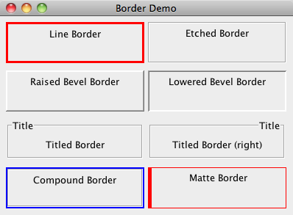
continue
JPanel p7 = new JPanel();
Border b1 = BorderFactory.createLineBorder (Color.blue, 2);
Border b2 = BorderFactory.createEtchedBorder ();
p7.setBorder (BorderFactory.createCompoundBorder (b1, b2));
p7.add (new JLabel ("Compound Border"));
panel.add (p7);
JPanel p8 = new JPanel();
Border mb = BorderFactory.createMatteBorder (1, 5, 1, 1,
Color.red);
p8.setBorder (mb);
p8.add (new JLabel ("Matte Border"));
panel.add (p8);
frame.getContentPane().add (panel);
frame.pack();
frame.setVisible(true);
}
}

Slide 122
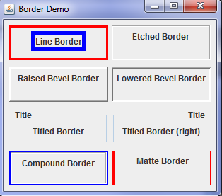
Exercise: Put a border around the first label
JPanel p1 = new JPanel();
JLabel lab = new JLabel("Line Border");
lab.setBorder(BorderFactory.createLineBorder(Color.blue,6));
p1.setBorder (BorderFactory.createLineBorder (Color.red, 3));
p1.add (lab);
panel.add (p1);

