Slide 1
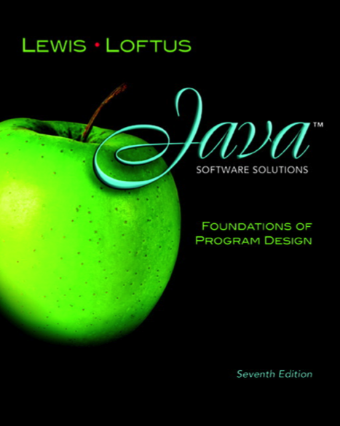

Chapter 8 Arrays
Java Software Solutions
Foundations of Program Design
Seventh Edition
John Lewis
William Loftus

Slide 2
Arrays
An array is an ordered list of values:
The entire array
has a single name
Each value has a numeric index
0 1 2 3 4 5 6 7 8 9
scores
79 87 94 82 67 98 87 81 74 91
An array of size N is indexed from zero to N-1
This array holds 10 values that are indexed from 0 to 9

Slide 3
Accessing array elements
scores[2]
Refers to the value 94
3rd value in the array
Not the 2nd value
0 1 2 3 4 5 6 7 8 9
scores
79 87 94 82 67 98 87 81 74 91

Slide 4
An array element can be assigned a value, printed, or used in a calculation
scores[2] = 89;
scores[first] = scores[first] + 2;
mean = (scores[0] + scores[1])/2;
System.out.println ("Top = " + scores[5]);
pick = scores[rand.nextInt(10)];

Slide 5
Array elements
The values held in an array are called array elements
An array stores multiple values of the same type
The element type can be a primitive type or an object reference
Can create an array of
integers
characters
String objects
Coin objects, etc.

Slide 6
An array is an object
scores
79
87
94
82
The name of the array
is an object reference
variable
67
98
87
81
74
91

Slide 7
Declaring an array
int[] scores = new int[10];
scores
0
0
0
0
0
0
0
0
0
0

Slide 8
Note
int[] scores = new int[10];
The type of the variable scores is int[]
an array of integers
Always use square brackets with arrays

Slide 9
Other examples of array declarations
int[] weights = new int[2000];
double[] prices = new double[500];
boolean[] flags;
flags = new boolean[20];
char[] codes = new char[1750];

Slide 10
//********************************************************************
// BasicArray.java Author: Lewis/Loftus
//
// Demonstrates basic array declaration and use.
//********************************************************************
public class BasicArray
{
//-----------------------------------------------------------------
// Creates an array, fills it with various integer values,
// modifies one value, then prints them out.
//-----------------------------------------------------------------
public static void main (String[] args)
{
final int LIMIT = 15, MULTIPLE = 10;
int[] list = new int[LIMIT];
// Initialize the array values
for (int index = 0; index < LIMIT; index++)
list[index] = index * MULTIPLE;
list[5] = 999; // change one array value
// Print the array values
for (int value : list)
System.out.print (value + " ");
}
}
Example
Note the format of the for loop.

Slide 11
Output
0 10 20 30 40 999 60 70 80 90 100 110 120 130 140
//********************************************************************
// BasicArray.java Author: Lewis/Loftus
//
// Demonstrates basic array declaration and use.
//********************************************************************
public class BasicArray
{
//-----------------------------------------------------------------
// Creates an array, fills it with various integer values,
// modifies one value, then prints them out.
//-----------------------------------------------------------------
public static void main (String[] args)
{
final int LIMIT = 15, MULTIPLE = 10;
int[] list = new int[LIMIT];
// Initialize the array values
for (int index = 0; index < LIMIT; index++)
list[index] = index * MULTIPLE;
list[5] = 999; // change one array value
// Print the array values
for (int value : list)
System.out.print (value + " ");
}
}

Slide 12
TopHat Q1-Q4

Slide 13
Exercise: Modify BasicArray to only print out the first 6 entries.

Slide 14
Exercise: What is the output if the array is only partially initialized?
//********************************************************************
// BasicArray.java Author: Lewis/Loftus
//
// Demonstrates basic array declaration and use.
//********************************************************************
public class BasicArray2
{
//-----------------------------------------------------------------
// Creates an array, fills it with various integer values,
// modifies one value, then prints them out.
//-----------------------------------------------------------------
public static void main (String[] args)
{
final int LIMIT = 15, MULTIPLE = 10;
int[] list = new int[LIMIT];
// Only initialize the start of the array
for (int index = 0; index < 3; index++)
list[index] = index * MULTIPLE;
list[5] = 999; // change one array value
// Print the array values
for (int value : list)
System.out.print (value + " ");
System.out.println();
}
}

Slide 15
Exercise: What is the output? Why?
//********************************************************************
// BasicArray.java Author: Lewis/Loftus
//
// Demonstrates basic array declaration and use.
//********************************************************************
public class BasicArray2
{
//-----------------------------------------------------------------
// Creates an array, fills it with various integer values,
// modifies one value, then prints them out.
//-----------------------------------------------------------------
public static void main (String[] args)
{
final int LIMIT = 15, MULTIPLE = 10;
int[] list = new int[LIMIT];
// Initialize each array element to 10
for (int value : list)
value = MULTIPLE;
list[5] = 999; // change one array value
// Print the array values
for (int value : list)
System.out.print (value + " ");
System.out.println();
}
}

Slide 16
Special for loop format
for (int value : list)
System.out.print (value + " ");
Only appropriate when processing all array elements starting at index 0
It can't be used to set the array values
Accesses the array elements one at a time

Slide 17
TopHat Q5-Q6

Slide 18
Bounds Checking
Once an array is created:
it has a fixed size
Size cannot be changed
An index used in an array reference must specify a valid element
the index value must be in range 0 to N-1
The Java interpreter throws an ArrayIndexOutOfBoundsException if an array index is out of bounds
This is called automatic bounds checking

Slide 19
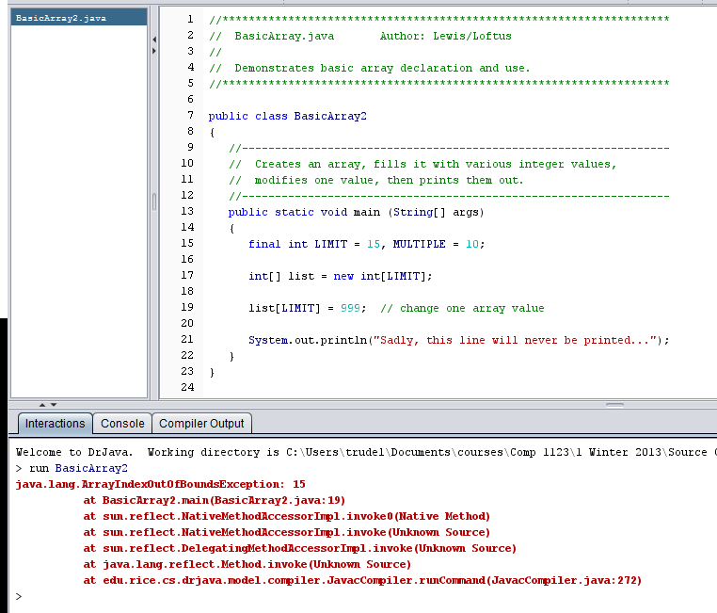
Why won’t this run?
Note that the error
was not caught by the
compiler!

Slide 20
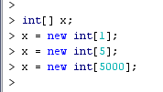
Can assign a new array of a different size to a variable.

Slide 21

This is also OK
Array elements are not copied when assigning one array to another
Only the pointers are copied
Draw the arrays.

Slide 22
Length of an array

Slide 23
Length
Each array has a constant called length that stores the size of the array
It is referenced using the array name:
scores.length

Slide 24
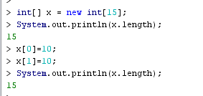
Note that length always equals the size of the array
Not the largest index (i.e., 14)
Not the number of values that were stored in the array (i.e., 2)
Not the highest index used (i.e., 1)

Slide 25
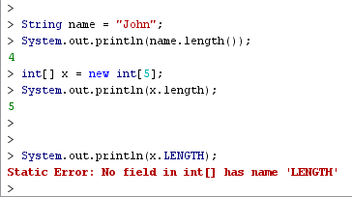
Length is confusing!
A String uses a method.
An array uses a constant which does not use upper case letters!

Slide 26
Example: read in numbers from the user then
print them out backwards
//********************************************************************
// ReverseOrder.java Author: Lewis/Loftus
//
// Demonstrates array index processing.
//********************************************************************
import java.util.Scanner;
public class ReverseOrder
{
//-----------------------------------------------------------------
// Reads a list of numbers from the user, storing them in an
// array, then prints them in the opposite order.
//-----------------------------------------------------------------
public static void main (String[] args)
{
Scanner scan = new Scanner (System.in);
double[] numbers = new double[10];
System.out.println ("The size of the array: " + numbers.length);
continue

Slide 27
continue
for (int index = 0; index < numbers.length; index++)
{
System.out.print ("Enter number " + (index+1) + ": ");
numbers[index] = scan.nextDouble();
}
System.out.println ("The numbers in reverse order:");
for (int index = numbers.length-1; index >= 0; index--)
System.out.print (numbers[index] + " ");
}
}

Slide 28
Sample Run
The size of the array: 10
Enter number 1: 18.36
Enter number 2: 48.9
Enter number 3: 53.5
Enter number 4: 29.06
Enter number 5: 72.404
Enter number 6: 34.8
Enter number 7: 63.41
Enter number 8: 45.55
Enter number 9: 69.0
Enter number 10: 99.18
The numbers in reverse order:
99.18 69.0 45.55 63.41 34.8 72.404 29.06 53.5 48.9 18.36
continue
for (int index = 0; index < numbers.length; index++)
{
System.out.print ("Enter number " + (index+1) + ": ");
numbers[index] = scan.nextDouble();
}
System.out.println ("The numbers in reverse order:");
for (int index = numbers.length-1; index >= 0; index--)
System.out.print (numbers[index] + " ");
}
}

Slide 29
//********************************************************************
// LetterCount.java Author: Lewis/Loftus
//
// Demonstrates the relationship between arrays and strings.
//********************************************************************
import java.util.Scanner;
public class LetterCount
{
//-----------------------------------------------------------------
// Reads a sentence from the user and counts the number of
// uppercase and lowercase letters contained in it.
//-----------------------------------------------------------------
public static void main (String[] args)
{
final int NUMCHARS = 26;
Scanner scan = new Scanner (System.in);
int[] upper = new int[NUMCHARS];
int[] lower = new int[NUMCHARS];
char current; // the current character being processed
int other = 0; // counter for non-alphabetics
continue
Example: count # of upper
and lower case characters

Slide 30
continue
System.out.println ("Enter a sentence:");
String line = scan.nextLine();
// Count the number of each letter occurence
for (int ch = 0; ch < line.length(); ch++)
{
current = line.charAt(ch);
if (current >= 'A' && current <= 'Z')
upper[current-'A']++;
else
if (current >= 'a' && current <= 'z')
lower[current-'a']++;
else
other++;
}
continue

Slide 31
continue
// Print the results
System.out.println ();
for (int letter=0; letter < upper.length; letter++)
{
System.out.print ( (char) (letter + 'A') );
System.out.print (": " + upper[letter]);
System.out.print ("\t\t" + (char) (letter + 'a') );
System.out.println (": " + lower[letter]);
}
System.out.println ();
System.out.println ("Non-alphabetic characters: " + other);
}
}

Slide 32
Sample Run
Enter a sentence:
In Casablanca, Humphrey Bogart never says "Play it again, Sam."
A: 0 a: 10
B: 1 b: 1
C: 1 c: 1
D: 0 d: 0
E: 0 e: 3
F: 0 f: 0
G: 0 g: 2
H: 1 h: 1
I: 1 i: 2
J: 0 j: 0
K: 0 k: 0
L: 0 l: 2
M: 0 m: 2
N: 0 n: 4
O: 0 o: 1
P: 1 p: 1
Q: 0 q: 0
continue
continue
// Print the results
System.out.println ();
for (int letter=0; letter < upper.length; letter++)
{
System.out.print ( (char) (letter + 'A') );
System.out.print (": " + upper[letter]);
System.out.print ("\t\t" + (char) (letter + 'a') );
System.out.println (": " + lower[letter]);
}
System.out.println ();
System.out.println ("Non-alphabetic characters: " + other);
}
}
Sample Run (continued)
R: 0 r: 3
S: 1 s: 3
T: 0 t: 2
U: 0 u: 1
V: 0 v: 1
W: 0 w: 0
X: 0 x: 0
Y: 0 y: 3
Z: 0 z: 0
Non-alphabetic characters: 14

Slide 33
Style
The following two declarations are equivalent:
double[] prices;
double prices[];
The first format generally is more readable and should always be used

Slide 34
Initializing an array

Slide 35
Initializer Lists
An initializer list can be used to instantiate and fill an array in one step
The values are delimited by braces and separated by commas
Examples:
int[] units = {147, 323, 89, 933, 540,
269, 97, 114, 298, 476};
char[] grades = {'A', 'B', 'C', 'D', ’F'};

Slide 36
Initializer Lists
Note that when an initializer list is used:
the new operator is not used
no size value is specified
Use squiggly brackets “{“ instead of square ones “[“
The size of the array is determined by the number of items in the list
An initializer list can be used only in the array declaration

Slide 37
//********************************************************************
// Primes.java Author: Lewis/Loftus
//
// Demonstrates the use of an initializer list for an array.
//********************************************************************
public class Primes
{
//-----------------------------------------------------------------
// Stores some prime numbers in an array and prints them.
//-----------------------------------------------------------------
public static void main (String[] args)
{
int[] primeNums = {2, 3, 5, 7, 11, 13, 17, 19};
System.out.println ("Array length: " + primeNums.length);
System.out.println ("The first few prime numbers are:");
for (int prime : primeNums)
System.out.print (prime + " ");
}
}

Slide 38
Output
Array length: 8
The first few prime numbers are:
2 3 5 7 11 13 17 19
//********************************************************************
// Primes.java Author: Lewis/Loftus
//
// Demonstrates the use of an initializer list for an array.
//********************************************************************
public class Primes
{
//-----------------------------------------------------------------
// Stores some prime numbers in an array and prints them.
//-----------------------------------------------------------------
public static void main (String[] args)
{
int[] primeNums = {2, 3, 5, 7, 11, 13, 17, 19};
System.out.println ("Array length: " + primeNums.length);
System.out.println ("The first few prime numbers are:");
for (int prime : primeNums)
System.out.print (prime + " ");
}
}

Slide 39
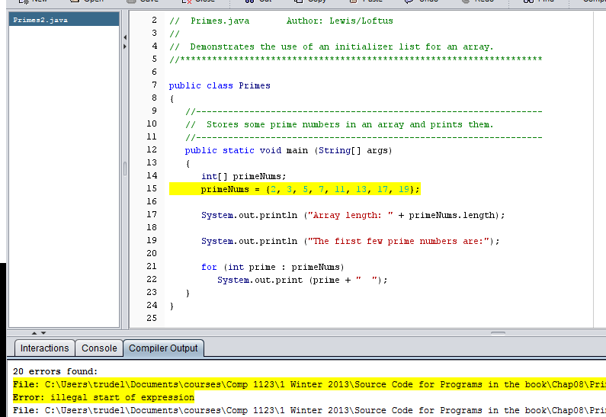
Initializer list can only be used when the array is declared – not afterwards.
Will not compile

Slide 40
Arrays as parameters

Slide 41
Arrays as Parameters
An entire array can be passed as a parameter to a method
Like any other object, the reference to the array is passed, making the formal and actual parameters aliases of each other
Therefore, changing an array element within the method changes the original
An individual array element can be passed to a method as well

Slide 42
Array parameter example
public class ArrayUtil
{
public static void setToX(int[] anArray, int x)
{
for (int i=0; i<anArray.length; i++)
anArray[i]=x;
}
public static int[] createX(int x, int size)
{
int[] temp = new int[size];
setToX(temp,x);
return temp;
}
}
Run the code which appears on Acorn

Slide 43
public class ParameterTester
{
//-----------------------------------------------------------------
// Stores some prime numbers in an array and prints them.
//-----------------------------------------------------------------
public static void main (String[] args)
{
int[] primeNums = {2, 3, 5, 7, 11, 13, 17, 19};
System.out.println ("Array length: " + primeNums.length);
System.out.println ("The first few prime numbers are:");
for (int prime : primeNums)
System.out.print (prime + " ");
System.out.println("\n");
ArrayUtil.setToX(primeNums,primeNums[3]);
System.out.println ("Array length: " + primeNums.length);
System.out.println ("The new values are:");
for (int prime : primeNums)
System.out.print (prime + " ");
System.out.println("\n");
primeNums = ArrayUtil.createX(9, 9);
System.out.println ("Array length: " + primeNums.length);
System.out.println ("The new values are:");
for (int prime : primeNums)
System.out.print (prime + " ");
System.out.println("\n");
}
}

Slide 44
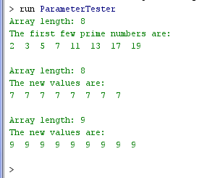
Output

Slide 45
Outline
Declaring and Using Arrays
Arrays of Objects
Variable Length Parameter Lists
Two-Dimensional Arrays
Polygons and Polylines
Mouse Events and Key Events

Slide 46
Arrays of Objects
The elements of an array can be object references
The following declaration reserves space to store 5 references to String objects
String[] words = new String[5];
It does NOT create the String objects themselves
Initially an array of objects holds null references
Each object stored in an array must be instantiated separately

Slide 47
Initialization
The words array when initially declared:
String[] words = new String[5];
words
-
-
-
-
-

Slide 48
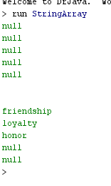
Example
public class StringArray
{
public static void main (String[] args)
{
String[] words = new String[5];
for (String value : words)
System.out.println(value);
System.out.println("\n");
words[0] = "friendship";
words[1] = "loyalty";
words[2] = "honor";
for (String value : words)
System.out.println(value);
}
}
Note that “value” in the for loops is an object.

Slide 49
The array at the end of the program
words
"friendship"
"loyalty"
"honor"
-
-

Slide 50
Initializer lists can also be used with an array of objects
The following declaration creates an array object called verbs and fills it with five String objects
String[] verbs = {"play", "work", "eat",
"sleep", "run"};

Slide 51
Example: Array of letter grades and their numeric equivalents
//********************************************************************
// GradeRange.java Author: Lewis/Loftus
//
// Demonstrates the use of an array of objects.
//********************************************************************
public class GradeRange
{
//-----------------------------------------------------------------
// Creates an array of Grade objects and prints them.
//-----------------------------------------------------------------
public static void main (String[] args)
{
Grade[] grades =
{
new Grade("A", 95), new Grade("A-", 90),
new Grade("B+", 87), new Grade("B", 85), new Grade("B-", 80),
new Grade("C+", 77), new Grade("C", 75), new Grade("C-", 70),
new Grade("D+", 67), new Grade("D", 65), new Grade("D-", 60),
new Grade("F", 0)
};
for (Grade letterGrade : grades)
System.out.println (letterGrade);
}
}

Slide 52
Output
A 95
A- 90
B+ 87
B 85
B- 80
C+ 77
C 75
C- 70
D+ 67
D 65
D- 60
F 0
//********************************************************************
// GradeRange.java Author: Lewis/Loftus
//
// Demonstrates the use of an array of objects.
//********************************************************************
public class GradeRange
{
//-----------------------------------------------------------------
// Creates an array of Grade objects and prints them.
//-----------------------------------------------------------------
public static void main (String[] args)
{
Grade[] grades =
{
new Grade("A", 95), new Grade("A-", 90),
new Grade("B+", 87), new Grade("B", 85), new Grade("B-", 80),
new Grade("C+", 77), new Grade("C", 75), new Grade("C-", 70),
new Grade("D+", 67), new Grade("D", 65), new Grade("D-", 60),
new Grade("F", 0)
};
for (Grade letterGrade : grades)
System.out.println (letterGrade);
}
}

Slide 53
//********************************************************************
// Grade.java Author: Lewis/Loftus
//
// Represents a school grade.
//********************************************************************
public class Grade
{
private String name;
private int lowerBound;
//-----------------------------------------------------------------
// Constructor: Sets up this Grade object with the specified
// grade name and numeric lower bound.
//-----------------------------------------------------------------
public Grade (String grade, int cutoff)
{
name = grade;
lowerBound = cutoff;
}
//-----------------------------------------------------------------
// Returns a string representation of this grade.
//-----------------------------------------------------------------
public String toString()
{
return name + "\t" + lowerBound;
}
continue

Slide 54
Remaining code is not used in this example
continue
//-----------------------------------------------------------------
// Name mutator.
//-----------------------------------------------------------------
public void setName (String grade)
{
name = grade;
}
//-----------------------------------------------------------------
// Lower bound mutator.
//-----------------------------------------------------------------
public void setLowerBound (int cutoff)
{
lowerBound = cutoff;
}
continue

Slide 55
continue
//-----------------------------------------------------------------
// Name accessor.
//-----------------------------------------------------------------
public String getName()
{
return name;
}
//-----------------------------------------------------------------
// Lower bound accessor.
//-----------------------------------------------------------------
public int getLowerBound()
{
return lowerBound;
}
}

Slide 56
Example: Managing a collection of DVD objects
An initial capacity of 100 is created for the collection
If more room is needed, a private method is used to create a larger array and transfer the current DVDs

Slide 57
//********************************************************************
// Movies.java Author: Lewis/Loftus
//
// Demonstrates the use of an array of objects.
//********************************************************************
public class Movies
{
//-----------------------------------------------------------------
// Creates a DVDCollection object and adds some DVDs to it. Prints
// reports on the status of the collection.
//-----------------------------------------------------------------
public static void main (String[] args)
{
DVDCollection movies = new DVDCollection();
movies.addDVD ("The Godfather", "Francis Ford Coppala", 1972, 24.95, true);
movies.addDVD ("District 9", "Neill Blomkamp", 2009, 19.95, false);
movies.addDVD ("Iron Man", "Jon Favreau", 2008, 15.95, false);
movies.addDVD ("All About Eve", "Joseph Mankiewicz", 1950, 17.50, false);
movies.addDVD ("The Matrix", "Andy & Lana Wachowski", 1999, 19.95, true);
System.out.println (movies);
movies.addDVD ("Iron Man 2", "Jon Favreau", 2010, 22.99, false);
movies.addDVD ("Casablanca", "Michael Curtiz", 1942, 19.95, false);
System.out.println (movies);
}
}

Slide 58
//********************************************************************
// Movies.java Author: Lewis/Loftus
//
// Demonstrates the use of an array of objects.
//********************************************************************
public class Movies
{
//-----------------------------------------------------------------
// Creates a DVDCollection object and adds some DVDs to it. Prints
// reports on the status of the collection.
//-----------------------------------------------------------------
public static void main (String[] args)
{
DVDCollection movies = new DVDCollection();
movies.addDVD ("The Godfather", "Francis Ford Coppala", 1972, 24.95, true);
movies.addDVD ("District 9", "Neill Blomkamp", 2009, 19.95, false);
movies.addDVD ("Iron Man", "Jon Favreau", 2008, 15.95, false);
movies.addDVD ("All About Eve", "Joseph Mankiewicz", 1950, 17.50, false);
movies.addDVD ("The Matrix", "Andy & Lana Wachowski", 1999, 19.95, true);
System.out.println (movies);
movies.addDVD ("Iron Man 2", "Jon Favreau", 2010, 22.99, false);
movies.addDVD ("Casablanca", "Michael Curtiz", 1942, 19.95, false);
System.out.println (movies);
}
}
Output
~~~~~~~~~~~~~~~~~~~~~~~~~~~~~~~~~~~~~~~~~~~
My DVD Collection
Number of DVDs: 5
Total cost: $98.30
Average cost: $19.66
DVD List:
$24.95 1972 The Godfather Francis Ford Coppala Blu-Ray
$19.95 2009 District 9 Neill Blomkamp
$15.95 2008 Iron Man Jon Favreau
$17.50 1950 All About Eve Joseph Mankiewicz
$19.95 1999 The Matrix Andy & Lana Wachowski Blu-Ray
continue

Slide 59
//********************************************************************
// Movies.java Author: Lewis/Loftus
//
// Demonstrates the use of an array of objects.
//********************************************************************
public class Movies
{
//-----------------------------------------------------------------
// Creates a DVDCollection object and adds some DVDs to it. Prints
// reports on the status of the collection.
//-----------------------------------------------------------------
public static void main (String[] args)
{
DVDCollection movies = new DVDCollection();
movies.addDVD ("The Godfather", "Francis Ford Coppala", 1972, 24.95, true);
movies.addDVD ("District 9", "Neill Blomkamp", 2009, 19.95, false);
movies.addDVD ("Iron Man", "Jon Favreau", 2008, 15.95, false);
movies.addDVD ("All About Eve", "Joseph Mankiewicz", 1950, 17.50, false);
movies.addDVD ("The Matrix", "Andy & Lana Wachowski", 1999, 19.95, true);
System.out.println (movies);
movies.addDVD ("Iron Man 2", "Jon Favreau", 2010, 22.99, false);
movies.addDVD ("Casablanca", "Michael Curtiz", 1942, 19.95, false);
System.out.println (movies);
}
}
Output
~~~~~~~~~~~~~~~~~~~~~~~~~~~~~~~~~~~~~~~~~~~
My DVD Collection
Number of DVDs: 5
Total cost: $98.30
Average cost: $19.66
DVD List:
$24.95 1972 The Godfather Francis Ford Coppala Blu-Ray
$19.95 2009 District 9 Neill Blomkamp
$15.95 2008 Iron Man Jon Favreau
$17.50 1950 All About Eve Joseph Mankiewicz
$19.95 1999 The Matrix Andy & Lana Wachowski Blu-Ray
continue
Output (continued)
~~~~~~~~~~~~~~~~~~~~~~~~~~~~~~~~~~~~~~~~~~~
My DVD Collection
Number of DVDs: 7
Total cost: $141.24
Average cost: $20.18
DVD List:
$24.95 1972 The Godfather Francis Ford Coppala Blu-Ray
$19.95 2009 District 9 Neill Blomkamp
$15.95 2008 Iron Man Jon Favreau
$17.50 1950 All About Eve Joseph Mankiewicz
$19.95 1999 The Matrix Andy & Lana Wachowski Blu-Ray
$22.99 2010 Iron Man 2 Jon Favreau
$19.95 1942 Casablanca Michael Curtiz

Slide 60
//********************************************************************
// DVDCollection.java Author: Lewis/Loftus
//
// Represents a collection of DVD movies.
//********************************************************************
import java.text.NumberFormat;
public class DVDCollection
{
private DVD[] collection;
private int count;
private double totalCost;
//-----------------------------------------------------------------
// Constructor: Creates an initially empty collection.
//-----------------------------------------------------------------
public DVDCollection ()
{
collection = new DVD[100];
count = 0;
totalCost = 0.0;
}
continue
An array is one of the instance variables.
Initial size is 100.

Slide 61
continue
//-----------------------------------------------------------------
// Adds a DVD to the collection, increasing the size of the
// collection array if necessary.
//-----------------------------------------------------------------
public void addDVD (String title, String director, int year,
double cost, boolean bluRay)
{
if (count == collection.length)
increaseSize();
collection[count] = new DVD (title, director, year, cost, bluRay);
totalCost += cost;
count++;
}
continue

Slide 62
continue
//-----------------------------------------------------------------
// Returns a report describing the DVD collection.
//-----------------------------------------------------------------
public String toString()
{
NumberFormat fmt = NumberFormat.getCurrencyInstance();
String report = "~~~~~~~~~~~~~~~~~~~~~~~~~~~~~~~~~~~~~~~~~~~\n";
report += "My DVD Collection\n\n";
report += "Number of DVDs: " + count + "\n";
report += "Total cost: " + fmt.format(totalCost) + "\n";
report += "Average cost: " + fmt.format(totalCost/count);
report += "\n\nDVD List:\n\n";
for (int dvd = 0; dvd < count; dvd++)
report += collection[dvd].toString() + "\n";
return report;
}
continue
Array contains objects.
We can execute a method directly on the object.

Slide 63
continue
//-----------------------------------------------------------------
// Increases the capacity of the collection by creating a
// larger array and copying the existing collection into it.
//-----------------------------------------------------------------
private void increaseSize ()
{
DVD[] temp = new DVD[collection.length * 2];
for (int dvd = 0; dvd < collection.length; dvd++)
temp[dvd] = collection[dvd];
collection = temp;
}
}

Slide 64
//********************************************************************
// DVD.java Author: Lewis/Loftus
//
// Represents a DVD video disc.
//********************************************************************
import java.text.NumberFormat;
public class DVD
{
private String title, director;
private int year;
private double cost;
private boolean bluRay;
//-----------------------------------------------------------------
// Creates a new DVD with the specified information.
//-----------------------------------------------------------------
public DVD (String title, String director, int year, double cost,
boolean bluRay)
{
this.title = title;
this.director = director;
this.year = year;
this.cost = cost;
this.bluRay = bluRay;
}
continue
BAD STYLE

Slide 65
continue
//-----------------------------------------------------------------
// Returns a string description of this DVD.
//-----------------------------------------------------------------
public String toString()
{
NumberFormat fmt = NumberFormat.getCurrencyInstance();
String description;
description = fmt.format(cost) + "\t" + year + "\t";
description += title + "\t" + director;
if (bluRay)
description += "\t" + "Blu-Ray";
return description;
}
}

Slide 66
Outline
Declaring and Using Arrays
Arrays of Objects
Variable Length Parameter Lists
Two-Dimensional Arrays
Polygons and Polylines
Mouse Events and Key Events

Slide 67
Problem
Suppose we wanted to create a method that processed a different amount of data from one invocation to the next
For example, let's define a method called average that returns the average of a set of integer parameters
// one call to average three values
mean1 = average (42, 69, 37);
// another call to average seven values
mean2 = average (35, 43, 93, 23, 40, 21, 75);

Slide 68
Solution 1 – Define a bunch of methods
public double average2(int x1, int x2)
public double average3(int x1, int x2, int x3)
public double average4(int x1, int x2, int x3, int x4)
Etc!

Slide 69
Solution 2 - Array
We could define the method to accept an array of integers
Downside: we'd have to create the array and store the integers prior to calling the method each time

Slide 70
Solution 3 - Variable Length Parameter Lists
We can define a method to accept any number of parameters of the same type
For each call, the parameters are automatically put into an array for easy processing in the method
Indicates a variable length parameter list
public double average (int ... list)
{
// whatever
}
element
type
array
name

Slide 71
Example
public double average (int ... list)
{
double result = 0.0;
if (list.length != 0)
{
int sum = 0;
for (int num : list)
sum += num;
result = (double)sum / list.length;
}
return result;
}
average(5,10) returns 7.5
average(1,2,3,4,5) returns 3.0
Note that we do not call average with an array.
But, list is an array!

Slide 72
Example: Method distance accepts a variable number of integers (which each represent the distance of one leg of a trip) and returns the total distance of the trip.
public int distance (int ... list)
{
int sum = 0;
for (int num : list)
sum = sum + num;
return sum;
}
distance() returns 0
distance(1) returns 1
distance(1,2) returns 3
distance(1,2,3) returns 6

Slide 73
Note
distance( ) returns 0
Empty
public int distance (int ... list)
{
int sum = 0;
for (int num : list)
sum = sum + num;
return sum;
}
Skipped

Slide 74
Variable Length Parameter Lists
A method that accepts a variable number of parameters can also accept other parameters
The following method accepts an int, a String object, and a variable number of double values into an array called nums
public void test (int count, String name,
double ... nums)
{
// whatever
}

Slide 75
Variable Length Parameter Lists
The varying number of parameters must come last in the formal arguments
A method cannot accept two sets of varying parameters

Slide 76
Constructors can also be set up to accept a variable number of parameters
//********************************************************************
// VariableParameters.java Author: Lewis/Loftus
//
// Demonstrates the use of a variable length parameter list.
//********************************************************************
public class VariableParameters
{
//-----------------------------------------------------------------
// Creates two Family objects using a constructor that accepts
// a variable number of String objects as parameters.
//-----------------------------------------------------------------
public static void main (String[] args)
{
Family lewis = new Family ("John", "Sharon", "Justin", "Kayla",
"Nathan", "Samantha");
Family camden = new Family ("Stephen", "Annie", "Matt", "Mary",
"Simon", "Lucy", "Ruthie", "Sam", "David");
System.out.println(lewis);
System.out.println();
System.out.println(camden);
}
}
6
9

Slide 77
Output
John
Sharon
Justin
Kayla
Nathan
Samantha
Stephen
Annie
Matt
Mary
Simon
Lucy
Ruthie
Sam
David
//********************************************************************
// VariableParameters.java Author: Lewis/Loftus
//
// Demonstrates the use of a variable length parameter list.
//********************************************************************
public class VariableParameters
{
//-----------------------------------------------------------------
// Creates two Family objects using a constructor that accepts
// a variable number of String objects as parameters.
//-----------------------------------------------------------------
public static void main (String[] args)
{
Family lewis = new Family ("John", "Sharon", "Justin", "Kayla",
"Nathan", "Samantha");
Family camden = new Family ("Stephen", "Annie", "Matt", "Mary",
"Simon", "Lucy", "Ruthie", "Sam", "David");
System.out.println(lewis);
System.out.println();
System.out.println(camden);
}
}

Slide 78
//********************************************************************
// Family.java Author: Lewis/Loftus
//
// Demonstrates the use of variable length parameter lists.
//********************************************************************
public class Family
{
private String[] members;
//-----------------------------------------------------------------
// Constructor: Sets up this family by storing the (possibly
// multiple) names that are passed in as parameters.
//-----------------------------------------------------------------
public Family (String ... names)
{
members = names;
}
continue

Slide 79
continue
//-----------------------------------------------------------------
// Returns a string representation of this family.
//-----------------------------------------------------------------
public String toString()
{
String result = "";
for (String name : members)
result += name + "\n";
return result;
}
}
Converts an array of Strings to a single String

Slide 80
Outline
Declaring and Using Arrays
Arrays of Objects
Variable Length Parameter Lists
Two-Dimensional Arrays
Polygons and Polylines
Mouse Events and Key Events

Slide 81
Two-Dimensional Arrays
A one-dimensional array stores a list of elements
A two-dimensional array can be thought of as a table of elements, with rows and columns
one
dimension
two
dimensions

Slide 82
Two-Dimensional Arrays
A two-dimensional array is an array of arrays
A two-dimensional array is declared by specifying the size of each dimension separately:
int[][] table = new int[12][50];
A array element is referenced using two index values:
value = table[3][6]
Row Column

Slide 83
Two-Dimensional Arrays
int[][] table = new int[12][50];
Expression | Type | Description
table | int[][] | 2D array of integers
table[5] | int[] (array of integers) | Row 5
table[5][12] | int | Integer in row 5 and column 12

Slide 84
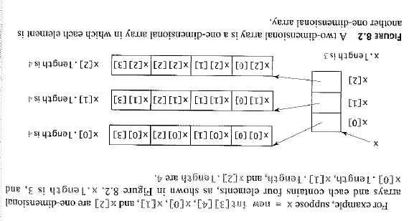
Example

Slide 85
//********************************************************************
// TwoDArray.java Author: Lewis/Loftus
//
// Demonstrates the use of a two-dimensional array.
//********************************************************************
public class TwoDArray
{
//-----------------------------------------------------------------
// Creates a 2D array of integers, fills it with increasing
// integer values, then prints them out.
//-----------------------------------------------------------------
public static void main (String[] args)
{
int[][] table = new int[5][10];
// Load the table with values
for (int row=0; row < table.length; row++)
for (int col=0; col < table[row].length; col++)
table[row][col] = row * 10 + col;
// Print the table
for (int row=0; row < table.length; row++)
{
for (int col=0; col < table[row].length; col++)
System.out.print (table[row][col] + "\t");
System.out.println();
}
}
}
Number of rows
Number of columns

Slide 86
//********************************************************************
// TwoDArray.java Author: Lewis/Loftus
//
// Demonstrates the use of a two-dimensional array.
//********************************************************************
public class TwoDArray
{
//-----------------------------------------------------------------
// Creates a 2D array of integers, fills it with increasing
// integer values, then prints them out.
//-----------------------------------------------------------------
public static void main (String[] args)
{
int[][] table = new int[5][10];
// Load the table with values
for (int row=0; row < table.length; row++)
for (int col=0; col < table[row].length; col++)
table[row][col] = row * 10 + col;
// Print the table
for (int row=0; row < table.length; row++)
{
for (int col=0; col < table[row].length; col++)
System.out.print (table[row][col] + "\t");
System.out.println();
}
}
}
Output
0 1 2 3 4 5 6 7 8 9
10 11 12 13 14 15 16 17 18 19
20 21 22 23 24 25 26 27 28 29
30 31 32 33 34 35 36 37 38 39
40 41 42 43 44 45 46 47 48 49

Slide 87
//********************************************************************
// TwoDArray.java Author: Lewis/Loftus
//
// Demonstrates the use of a two-dimensional array.
//********************************************************************
public class TwoDArray
{
//-----------------------------------------------------------------
// Creates a 2D array of integers, fills it with increasing
// integer values, then prints them out.
//-----------------------------------------------------------------
public static void main (String[] args)
{
int[][] table = new int[5][10];
// Load the table with values
for (int row=0; row < table.length; row++)
for (int col=0; col < table[row].length; col++)
table[row][col] = row * 10 + col;
// Print the table
for (int row=0; row < table.length; row++)
{
for (int col=0; col < table[row].length; col++)
System.out.print (table[row][col] + "\t");
System.out.println();
}
}
}
Note the difference
before the period.

Slide 88
Alternative implementation
public class TwoDArray2
{
public static void main (String[] args)
{
int[][] table = new int[5][10];
// Load the table with values
for (int row=0; row < table.length; row++)
setToX(table[row],5);
// Print the table
for (int row=0; row < table.length; row++)
{
for (int value : table[row])
System.out.print (value + "\t");
System.out.println();
}
}
public static void setToX(int[] anArray, int x)
{
for (int i=0; i<anArray.length; i++)
anArray[i]=x;
}
}

Slide 89
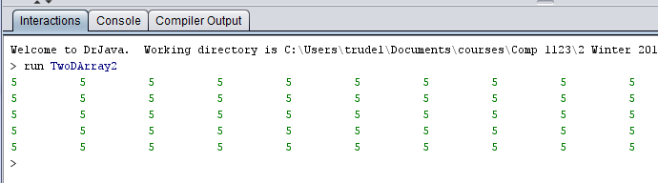
Output

Slide 90
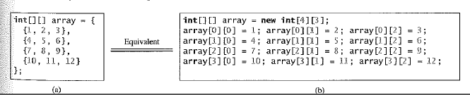
Initializer lists

Slide 91
//********************************************************************
// SodaSurvey.java Author: Lewis/Loftus
//
// Demonstrates the use of a two-dimensional array.
//********************************************************************
import java.text.DecimalFormat;
public class SodaSurvey
{
//-----------------------------------------------------------------
// Determines and prints the average of each row (soda) and each
// column (respondent) of the survey scores.
//-----------------------------------------------------------------
public static void main (String[] args)
{
int[][] scores = { {3, 4, 5, 2, 1, 4, 3, 2, 4, 4},
{2, 4, 3, 4, 3, 3, 2, 1, 2, 2},
{3, 5, 4, 5, 5, 3, 2, 5, 5, 5},
{1, 1, 1, 3, 1, 2, 1, 3, 2, 4} };
final int SODAS = scores.length; // # rows
final int PEOPLE = scores[0].length; // # columns
int[] sodaSum = new int[SODAS];
int[] personSum = new int[PEOPLE];
continue
Example

Slide 92
continue
for (int soda=0; soda < SODAS; soda++)
for (int person=0; person < PEOPLE; person++)
{
sodaSum[soda] += scores[soda][person];
personSum[person] += scores[soda][person];
}
DecimalFormat fmt = new DecimalFormat ("0.#");
System.out.println ("Averages:\n");
for (int soda=0; soda < SODAS; soda++)
System.out.println ("Soda #" + (soda+1) + ": " +
fmt.format ((float)sodaSum[soda]/PEOPLE));
System.out.println ();
for (int person=0; person < PEOPLE; person++)
System.out.println ("Person #" + (person+1) + ": " +
fmt.format ((float)personSum[person]/SODAS));
}
}

Slide 93
Output
Averages:
Soda #1: 3.2
Soda #2: 2.6
Soda #3: 4.2
Soda #4: 1.9
Person #1: 2.2
Person #2: 3.5
Person #3: 3.2
Person #4: 3.5
Person #5: 2.5
Person #6: 3
Person #7: 2
Person #8: 2.8
Person #9: 3.2
Person #10: 3.8
continue
for (int soda=0; soda < SODAS; soda++)
for (int person=0; person < PEOPLE; person++)
{
sodaSum[soda] += scores[soda][person];
personSum[person] += scores[soda][person];
}
DecimalFormat fmt = new DecimalFormat ("0.#");
System.out.println ("Averages:\n");
for (int soda=0; soda < SODAS; soda++)
System.out.println ("Soda #" + (soda+1) + ": " +
fmt.format ((float)sodaSum[soda]/PEOPLE));
System.out.println ();
for (int person=0; person < PEOPLE; person++)
System.out.println ("Person #" + (person+1) + ": " +
fmt.format ((float)personSum[person]/SODAS));
}
}

Slide 94
Note: getting the row and column totals by traversing the data once!
continue
for (int soda=0; soda < SODAS; soda++)
for (int person=0; person < PEOPLE; person++)
{
sodaSum[soda] += scores[soda][person];
personSum[person] += scores[soda][person];
}
DecimalFormat fmt = new DecimalFormat ("0.#");
System.out.println ("Averages:\n");
for (int soda=0; soda < SODAS; soda++)
System.out.println ("Soda #" + (soda+1) + ": " +
fmt.format ((float)sodaSum[soda]/PEOPLE));
System.out.println ();
for (int person=0; person < PEOPLE; person++)
System.out.println ("Person #" + (person+1) + ": " +
fmt.format ((float)personSum[person]/SODAS));
}
}

Slide 95
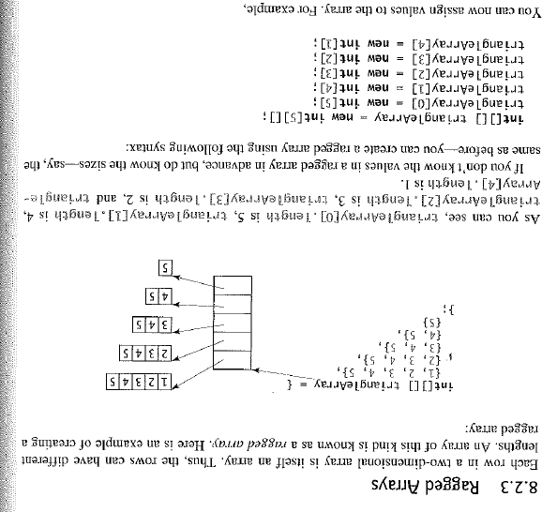
Ragged Arrays

Slide 96
Multidimensional Arrays
An array can have many dimensions – if it has more than one dimension, it is called a multidimensional array

Slide 97
Outline
Declaring and Using Arrays
Arrays of Objects
Variable Length Parameter Lists
Two-Dimensional Arrays
Polygons and Polylines
Mouse Events and Key Events

Slide 98
Polygons and Polylines
Arrays can be helpful in graphics processing
For example, they can be used to store a list of coordinates
A polygon is a multisided, closed shape
A polyline is similar to a polygon except that its endpoints do not meet, and it cannot be filled

Slide 99
//********************************************************************
// Rocket.java Author: Lewis/Loftus
//
// Demonstrates the use of polygons and polylines.
//********************************************************************
import javax.swing.JFrame;
public class Rocket
{
//-----------------------------------------------------------------
// Creates the main frame of the program.
//-----------------------------------------------------------------
public static void main (String[] args)
{
JFrame frame = new JFrame ("Rocket");
frame.setDefaultCloseOperation (JFrame.EXIT_ON_CLOSE);
RocketPanel panel = new RocketPanel();
frame.getContentPane().add(panel);
frame.pack();
frame.setVisible(true);
}
}

Slide 100
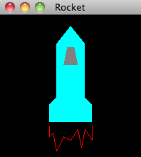
//********************************************************************
// Rocket.java Author: Lewis/Loftus
//
// Demonstrates the use of polygons and polylines.
//********************************************************************
import javax.swing.JFrame;
public class Rocket
{
//-----------------------------------------------------------------
// Creates the main frame of the program.
//-----------------------------------------------------------------
public static void main (String[] args)
{
JFrame frame = new JFrame ("Rocket");
frame.setDefaultCloseOperation (JFrame.EXIT_ON_CLOSE);
RocketPanel panel = new RocketPanel();
frame.getContentPane().add(panel);
frame.pack();
frame.setVisible(true);
}
}

Slide 101
//********************************************************************
// RocketPanel.java Author: Lewis/Loftus
//
// Demonstrates the use of polygons and polylines.
//********************************************************************
import javax.swing.JPanel;
import java.awt.*;
public class RocketPanel extends JPanel
{
private int[] xRocket = {100, 120, 120, 130, 130, 70, 70, 80, 80};
private int[] yRocket = {15, 40, 115, 125, 150, 150, 125, 115, 40};
private int[] xWindow = {95, 105, 110, 90};
private int[] yWindow = {45, 45, 70, 70};
private int[] xFlame = {70, 70, 75, 80, 90, 100, 110, 115, 120,
130, 130};
private int[] yFlame = {155, 170, 165, 190, 170, 175, 160, 185,
160, 175, 155};
continue
Corresponding x-y coordinates
have to be stored in separate
arrays.

Slide 102
continue
//-----------------------------------------------------------------
// Constructor: Sets up the basic characteristics of this panel.
//-----------------------------------------------------------------
public RocketPanel()
{
setBackground (Color.black);
setPreferredSize (new Dimension(200, 200));
}
//-----------------------------------------------------------------
// Draws a rocket using polygons and polylines.
//-----------------------------------------------------------------
public void paintComponent (Graphics page)
{
super.paintComponent (page);
page.setColor (Color.cyan);
page.fillPolygon (xRocket, yRocket, xRocket.length);
page.setColor (Color.gray);
page.fillPolygon (xWindow, yWindow, xWindow.length);
page.setColor (Color.red);
page.drawPolyline (xFlame, yFlame, xFlame.length);
}
}
Parameters: x values, y values,
number of points

Slide 103
Outline
Declaring and Using Arrays
Arrays of Objects
Variable Length Parameter Lists
Two-Dimensional Arrays
Polygons and Polylines
Mouse Events and Key Events

Slide 104
Mouse Events
Events related to the mouse are separated into mouse events and mouse motion events
Mouse Events:
mouse pressed | the mouse button is pressed down
mouse released | the mouse button is released
mouse clicked | the mouse button is pressed down and released without moving the mouse in between
mouse entered | the mouse pointer is moved onto (over) a component
mouse exited | the mouse pointer is moved off of a component

Slide 105
Mouse Motion Events
Listeners for mouse events are created using the MouseListener and MouseMotionListener interfaces
A MouseEvent object is passed to the appropriate method when a mouse event occurs
mouse moved | the mouse is moved
mouse dragged | the mouse is moved while the mouse button is pressed down

Slide 106
Mouse Events
For a given program, we may only care about one or two mouse events
To satisfy the implementation of a listener interface, empty methods must be provided for unused events

Slide 107
//********************************************************************
// Dots.java Author: Lewis/Loftus
//
// Demonstrates mouse events.
//********************************************************************
import javax.swing.JFrame;
public class Dots
{
//-----------------------------------------------------------------
// Creates and displays the application frame.
//-----------------------------------------------------------------
public static void main (String[] args)
{
JFrame frame = new JFrame ("Dots");
frame.setDefaultCloseOperation (JFrame.EXIT_ON_CLOSE);
frame.getContentPane().add (new DotsPanel());
frame.pack();
frame.setVisible(true);
}
}

Slide 108
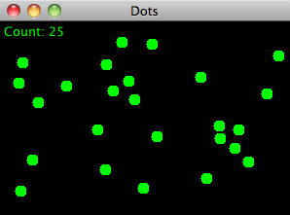
//********************************************************************
// Dots.java Author: Lewis/Loftus
//
// Demonstrates mouse events.
//********************************************************************
import javax.swing.JFrame;
public class Dots
{
//-----------------------------------------------------------------
// Creates and displays the application frame.
//-----------------------------------------------------------------
public static void main (String[] args)
{
JFrame frame = new JFrame ("Dots");
frame.setDefaultCloseOperation (JFrame.EXIT_ON_CLOSE);
frame.getContentPane().add (new DotsPanel());
frame.pack();
frame.setVisible(true);
}
}

Slide 109
Can resize the window and click anywhere in it!
Try clicking outside the window…nothing happens.

Slide 110
//********************************************************************
// DotsPanel.java Author: Lewis/Loftus
//
// Represents the primary panel for the Dots program.
//********************************************************************
import java.util.ArrayList;
import javax.swing.JPanel;
import java.awt.*;
import java.awt.event.*;
public class DotsPanel extends JPanel
{
private final int SIZE = 6; // radius of each dot
private ArrayList<Point> pointList;
continue
Point is a class in java.awt which represents a point (x,y)
We did not cover ArrayList’s…don’t worry about them…it’s a special kind of array with built-in methods.

Slide 111
continue
//-----------------------------------------------------------------
// Constructor: Sets up this panel to listen for mouse events.
//-----------------------------------------------------------------
public DotsPanel()
{
pointList = new ArrayList<Point>();
addMouseListener (new DotsListener());
setBackground (Color.black);
setPreferredSize (new Dimension(300, 200));
}
//-----------------------------------------------------------------
// Draws all of the dots stored in the list.
//-----------------------------------------------------------------
public void paintComponent (Graphics page)
{
super.paintComponent(page);
page.setColor (Color.green);
for (Point spot : pointList)
page.fillOval (spot.x-SIZE, spot.y-SIZE, SIZE*2, SIZE*2);
page.drawString ("Count: " + pointList.size(), 5, 15);
}
continue

Slide 112
continue
//*****************************************************************
// Represents the listener for mouse events.
//*****************************************************************
private class DotsListener implements MouseListener
{
//--------------------------------------------------------------
// Adds the current point to the list of points and redraws
// the panel whenever the mouse button is pressed.
//--------------------------------------------------------------
public void mousePressed (MouseEvent event)
{
pointList.add(event.getPoint());
repaint();
}
//--------------------------------------------------------------
// Provide empty definitions for unused event methods.
//--------------------------------------------------------------
public void mouseClicked (MouseEvent event) {}
public void mouseReleased (MouseEvent event) {}
public void mouseEntered (MouseEvent event) {}
public void mouseExited (MouseEvent event) {}
}
}

Slide 113
Mouse Events
Rubberbanding is the visual effect in which a shape is "stretched" as it is drawn using the mouse
The following example continually redraws a line as the mouse is dragged

Slide 114
//********************************************************************
// RubberLines.java Author: Lewis/Loftus
//
// Demonstrates mouse events and rubberbanding.
//********************************************************************
import javax.swing.JFrame;
public class RubberLines
{
//-----------------------------------------------------------------
// Creates and displays the application frame.
//-----------------------------------------------------------------
public static void main (String[] args)
{
JFrame frame = new JFrame ("Rubber Lines");
frame.setDefaultCloseOperation (JFrame.EXIT_ON_CLOSE);
frame.getContentPane().add (new RubberLinesPanel());
frame.pack();
frame.setVisible(true);
}
}

Slide 115
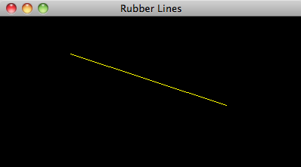
//********************************************************************
// RubberLines.java Author: Lewis/Loftus
//
// Demonstrates mouse events and rubberbanding.
//********************************************************************
import javax.swing.JFrame;
public class RubberLines
{
//-----------------------------------------------------------------
// Creates and displays the application frame.
//-----------------------------------------------------------------
public static void main (String[] args)
{
JFrame frame = new JFrame ("Rubber Lines");
frame.setDefaultCloseOperation (JFrame.EXIT_ON_CLOSE);
frame.getContentPane().add (new RubberLinesPanel());
frame.pack();
frame.setVisible(true);
}
}
Click in the window and drag the mouse.

Slide 116
Note
Click in window
Move mouse
Mouse can be dragged outside the window

Slide 117
//********************************************************************
// RubberLinesPanel.java Author: Lewis/Loftus
//
// Represents the primary drawing panel for the RubberLines program.
//********************************************************************
import javax.swing.JPanel;
import java.awt.*;
import java.awt.event.*;
public class RubberLinesPanel extends JPanel
{
private Point point1 = null, point2 = null;
//-----------------------------------------------------------------
// Constructor: Sets up this panel to listen for mouse events.
//-----------------------------------------------------------------
public RubberLinesPanel()
{
LineListener listener = new LineListener();
addMouseListener (listener);
addMouseMotionListener (listener);
setBackground (Color.black);
setPreferredSize (new Dimension(400, 200));
}
continue
Note: 1 listener object
for ALL the mouse events

Slide 118
continue
//-----------------------------------------------------------------
// Draws the current line from the initial mouse-pressed point to
// the current position of the mouse.
//-----------------------------------------------------------------
public void paintComponent (Graphics page)
{
super.paintComponent (page);
page.setColor (Color.yellow);
if (point1 != null && point2 != null)
page.drawLine (point1.x, point1.y, point2.x, point2.y);
}
//*****************************************************************
// Represents the listener for all mouse events.
//*****************************************************************
private class LineListener implements MouseListener, MouseMotionListener
{
//--------------------------------------------------------------
// Captures the initial position at which the mouse button is
// pressed.
//--------------------------------------------------------------
public void mousePressed (MouseEvent event)
{
point1 = event.getPoint();
}
continue
Pressing the mouse does not
draw anything

Slide 119
continue
//--------------------------------------------------------------
// Gets the current position of the mouse as it is dragged and
// redraws the line to create the rubberband effect.
//--------------------------------------------------------------
public void mouseDragged (MouseEvent event)
{
point2 = event.getPoint();
repaint();
}
//--------------------------------------------------------------
// Provide empty definitions for unused event methods.
//--------------------------------------------------------------
public void mouseClicked (MouseEvent event) {}
public void mouseReleased (MouseEvent event) {}
public void mouseEntered (MouseEvent event) {}
public void mouseExited (MouseEvent event) {}
public void mouseMoved (MouseEvent event) {}
}
}

Slide 120
Key Events
A key event is generated when the user types on the keyboard
Listeners for key events are created by implementing the KeyListener interface
A KeyEvent object is passed to the appropriate method when a key event occurs
key pressed | a key on the keyboard is pressed down
key released | a key on the keyboard is released
key typed | a key on the keyboard is pressed down and released

Slide 121
Key Events
The component that generates a key event is the one that has the current keyboard focus
Constants in the KeyEvent class can be used to determine which key was pressed
The following example "moves" an image of an arrow as the user types the keyboard arrow keys

Slide 122
//********************************************************************
// Direction.java Author: Lewis/Loftus
//
// Demonstrates key events.
//********************************************************************
import javax.swing.JFrame;
public class Direction
{
//-----------------------------------------------------------------
// Creates and displays the application frame.
//-----------------------------------------------------------------
public static void main (String[] args)
{
JFrame frame = new JFrame ("Direction");
frame.setDefaultCloseOperation (JFrame.EXIT_ON_CLOSE);
frame.getContentPane().add (new DirectionPanel());
frame.pack();
frame.setVisible(true);
}
}

Slide 123
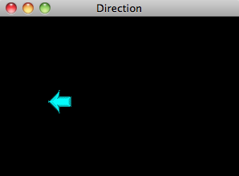
//********************************************************************
// Direction.java Author: Lewis/Loftus
//
// Demonstrates key events.
//********************************************************************
import javax.swing.JFrame;
public class Direction
{
//-----------------------------------------------------------------
// Creates and displays the application frame.
//-----------------------------------------------------------------
public static void main (String[] args)
{
JFrame frame = new JFrame ("Direction");
frame.setDefaultCloseOperation (JFrame.EXIT_ON_CLOSE);
frame.getContentPane().add (new DirectionPanel());
frame.pack();
frame.setVisible(true);
}
}

Slide 124
Type one of the arrow keys to make the arrow move

Slide 125
Try holding down one of the arrow keys.
Arrow can be moved outside the window.
Re-size the window larger to display the arrow!

Slide 126
Clicking on the window with the mouse or
pressing any other keyboard keys has no effect.

Slide 127
//********************************************************************
// DirectionPanel.java Author: Lewis/Loftus
//
// Represents the primary display panel for the Direction program.
//********************************************************************
import javax.swing.*;
import java.awt.*;
import java.awt.event.*;
public class DirectionPanel extends JPanel
{
private final int WIDTH = 300, HEIGHT = 200;
private final int JUMP = 10; // increment for image movement
private final int IMAGE_SIZE = 31;
private ImageIcon up, down, right, left, currentImage;
private int x, y;
continue

Slide 128
continue
//-----------------------------------------------------------------
// Constructor: Sets up this panel and loads the images.
//-----------------------------------------------------------------
public DirectionPanel()
{
addKeyListener (new DirectionListener());
x = WIDTH / 2;
y = HEIGHT / 2;
up = new ImageIcon ("arrowUp.gif");
down = new ImageIcon ("arrowDown.gif");
left = new ImageIcon ("arrowLeft.gif");
right = new ImageIcon ("arrowRight.gif");
currentImage = right;
setBackground (Color.black);
setPreferredSize (new Dimension(WIDTH, HEIGHT));
setFocusable(true);
}
continue
Tells Java that this panel will receive the keyboard events

Slide 129
continue
//-----------------------------------------------------------------
// Draws the image in the current location.
//-----------------------------------------------------------------
public void paintComponent (Graphics page)
{
super.paintComponent (page);
currentImage.paintIcon (this, page, x, y);
}
//*****************************************************************
// Represents the listener for keyboard activity.
//*****************************************************************
private class DirectionListener implements KeyListener
{
//--------------------------------------------------------------
// Responds to the user pressing arrow keys by adjusting the
// image and image location accordingly.
//--------------------------------------------------------------
public void keyPressed (KeyEvent event)
{
switch (event.getKeyCode())
{
case KeyEvent.VK_UP:
currentImage = up;
y -= JUMP;
break;
continue

Slide 130
continue
case KeyEvent.VK_DOWN:
currentImage = down;
y += JUMP;
break;
case KeyEvent.VK_LEFT:
currentImage = left;
x -= JUMP;
break;
case KeyEvent.VK_RIGHT:
currentImage = right;
x += JUMP;
break;
}
repaint();
}
//--------------------------------------------------------------
// Provide empty definitions for unused event methods.
//--------------------------------------------------------------
public void keyTyped (KeyEvent event) {}
public void keyReleased (KeyEvent event) {}
}
}
What happens if the “F”
on the keyboard is pressed?

