Slide 1


MINISTRYPLATFORM · MPNEXT
Building on MinistryPlatform with MPNext
An opinionated tour of building on it with Claude Code
What the framework decides for you, why those calls hold up, and where to deviate. MP shops get a head start; everyone else gets a case study.
Chris Kehayias
SVP Innovation & AI, ACS Technologies

Slide 2
OPEN
The plumbing every MP app rebuilds
WITHOUT A STARTER
WITH MPNEXT
Stand up OAuth from scratch. Hand-type interfaces for whichever of 300+ tables the app touches. Write a fetch wrapper. Only then start the feature someone asked for.
Clone the repo. Run the setup wizard. Generate 301 typed models and Zod schemas from the live schema. Start the feature someone asked for.
The OAuth logout trap alone costs most teams a day: users silently log back in because nobody configured OIDC RP-initiated logout with a post-logout redirect URI.
Building on MinistryPlatform with MPNext · MPNEXT
2

Slide 3
AGENDA
45 minutes, seven segments
0:00
0:04
0:15
0:23
0:34
0:39
0:42
4
11
8
11
5
3
3
min
min
min
min
min
min
min
Open
What it decides
Why it holds up
Claude Code
Where to deviate
The ecosystem
Q&A
Running long? Trim the demo to five minutes. Never cut where to deviate.
Building on MinistryPlatform with MPNext · MPNEXT
3

Slide 4



WHAT IT DECIDES
Not a blank app. Not a full CMS. An opinionated starter.
Hand-rolled
Generic starter
MPNext
You copy patterns between projects and re-debug OAuth logout every time.
A framework opinion with no idea MinistryPlatform exists. You still write the provider.
OAuth, 301 generated models, and a service layer are already decided. This is Claude Code.
Same MinistryPlatform REST API. Three very different starting points.
Building on MinistryPlatform with MPNext · MPNEXT
4

Slide 5

HOW IT WORKS
Five layers, one call away
What makes it hold together
300+ tables become 301 typed TypeScript models and Zod schemas
MPHelper hides OAuth token refresh, retries, and pagination
Validation is an optional argument, not a wall
Generated models never touch hand-written DTOs
Presentation → Auth → Service → Provider → Data
Building on MinistryPlatform with MPNext · MPNEXT
5

Slide 6

THE MENTAL MODEL
Codegen isn't just types.
It's your agent's memory.
Claude Code reads the generated schema doc the same way it reads your source. Keep both current — regenerate after every MP schema change — and the agent’s output stays predictable instead of a coin flip.
Building on MinistryPlatform with MPNext · MPNEXT
6

Slide 7

LIVE DEMO
The loop, on a real MPNext feature
1
2
3
4
5
Read schema
Scaffold
Validate
Test
Ship
.claude/references/ministryplatform.schema.md
Claude Code drafts the service call + DTO
Optional Zod schema on the CRUD call
Runs the relevant Vitest suite
/pr opens it with a test checklist
About 8 minutes for what used to take a day of hand-typing interfaces.
Building on MinistryPlatform with MPNext · MPNEXT
7

Slide 8
LIVE DEMO
Switch to
the terminal.
~/mpnext — claude
$ cd mpnext && claude
[ ] Read the schema doc
[ ] Scaffold service call + DTO
[ ] Validate with Zod
[ ] Run the tests
[ ] /pr
> _
Show it, don’t describe it. Claude Code on a real MPNext feature.
CUE Repo and terminal pre-opened. Font bumped. ~8 minutes.
Building on MinistryPlatform with MPNext · MPNEXT
8
Notes:
LIVE DEMO. Switch to the terminal. Walk the loop from the previous slide on a real MPNext feature: read the schema doc, scaffold the service call and DTO, validate with Zod, run the tests, open the PR with /pr. Budget about 8 minutes; if running long, trim to 5 and skip the PR step.

Slide 9


WHY IT HOLDS UP
What holds up, what to watch
HOLDS UP
WATCH FOR
Stateless JWT sessions — no session database to run
Optional Zod validation — adoption without a rewrite
DTOs kept separate from generated models
Singleton services for configuration consistency
~190+ tests across auth, sessions, routes, CRUD
Documented transitive postcss advisory (build-time only)
Singletons can fight per-request test isolation
Optional validation still needs a team-level policy
Hand-editing a generated file breaks the codegen contract
Building on MinistryPlatform with MPNext · MPNEXT
9

Slide 10
TWO NUMBERS WORTH REMEMBERING
301 and 190+
301
190+
typed models
test cases
TypeScript interfaces and Zod schemas, generated from your live MP schema in one CLI run.
Across 6 files: auth, session enrichment, route protection, and full CRUD.
The difference between a prototype and a starter is mostly test coverage.
Building on MinistryPlatform with MPNext · MPNEXT
10

Slide 11

BUILDING WITH CLAUDE CODE
The repo already talks to your agent
.claude/commands/
/audit-deps
Security audit, CVE search, categorized dependency updates
/branch-commit
Branch name + commit message generated from a GitHub issue number
/pr
Validates preconditions, opens a PR with a summary and test checklist
/newtool
Scaffolds a new admin tool in MPNext-Tools’ established pattern
Plus CLAUDE.md and .claude/references/ministryplatform.schema.md — the context that keeps generated code on-pattern.
Building on MinistryPlatform with MPNext · MPNEXT
11

Slide 12



WHERE TO DEVIATE
Opinions aren't universal truths
Regenerate, never hand-edit
DTOs stay separate
Validate at your boundary
A patched generated file breaks the codegen contract. Extend through DTOs instead.
Application logic lives above the generated models — never inside them.
Optional Zod is a sane default, not a mandate. Compliance-heavy teams should require it.
Known limitation: a transitive postcss advisory through Next.js 16 — build-time only, documented, doesn’t block deployment.
Building on MinistryPlatform with MPNext · MPNEXT
12

Slide 13
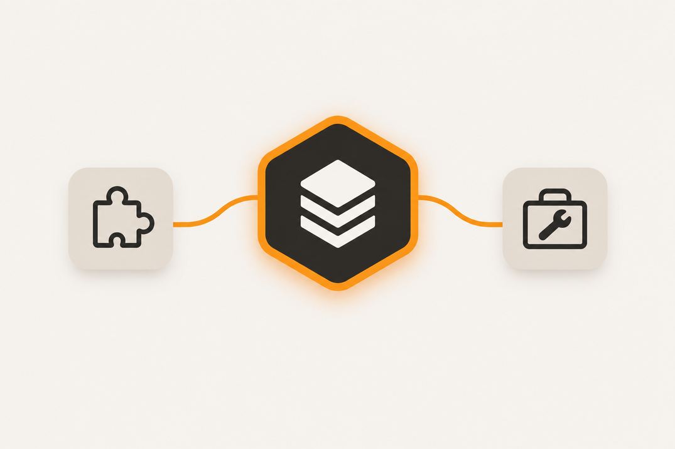
THE ECOSYSTEM
One pattern, three repos
MPNext
Core starter
OAuth, 301 generated models, MPHelper service layer
MPNext-Widgets
Embeddable web components
5 custom elements, Shadow DOM, short-lived JWT bearer auth
MPNext-Tools
Admin utilities
Address labels (USPS IMb), field management, GrapesJS template editor
A good opinionated core gets forked into adjacent problems — nobody re-litigates the architecture.
Building on MinistryPlatform with MPNext · MPNEXT
13

Slide 14

RESOURCES
Clone it, star it, fork it
MPNext
github.com/MinistryPlatform-Community/MPNext
MPNext-Widgets
github.com/MinistryPlatform-Community/MPNext-Widgets
MPNext-Tools
github.com/MinistryPlatform-Community/MPNext-Tools
Building on MinistryPlatform with MPNext · MPNEXT
14

Slide 15




MONDAY
Four steps to your first MPNext feature
1
2
3
4
Install
Generate
Add context
Ship small
Clone MPNext, run npm run setup
npm run mp:generate:models against your MP instance
Open CLAUDE.md, point Claude Code at one real table
One feature, one service call, through MPHelper
Building on MinistryPlatform with MPNext · MPNEXT
15

Slide 16

QUESTIONS
Building on MinistryPlatform.
Not from scratch.
Chris Kehayias · ACS Technologies
MinistryPlatform Community · MPNext
Building on MinistryPlatform with MPNext · MPNEXT
16

