Slide 1


CITN26 · AGENTS
All About Agents
A Church IT Reality Check
Everyone’s selling agents. Almost nobody defines one. We’ll open the hood, find where they pay off in ministry operations, and set the guardrails.
Chris Kehayias
SVP Innovation & AI, ACS Technologies
Notes:
Welcome. 45 minutes: 38 of content and a live demo, 7 for questions. The promise: you leave able to tell a real agent from a chatbot with a new label, know where one pays off, and know the guardrails to ask for.

Slide 2

COLD OPEN
Which of these is an agent?
“
An AI agent that answers member questions
“
Agentic giving insights
“
Autonomous volunteer scheduling
“Agent” is today’s “cloud” circa 2012. By minute 38, you’ll answer this yourself in 30 seconds.
All About Agents: A Church IT Reality Check · CITN26
2
Notes:
Read the three claims. Ask the room which ones are agents. Do not answer yet; we come back to these at the close. Keep the claims anonymous, no vendor names.

Slide 3
AGENDA
45 minutes, eight segments
0:00
0:03
0:10
0:13
0:20
0:28
0:36
0:38
3
7
3
7
8
8
2
7
min
min
min
min
min
min
min
min
Cold open
Open the hood
Agent or not?
Where they pay off
MCP + live demo
Guardrails
Spot a real agent
Q&A
Guardrails get the most time, because that’s what your exec pastor will ask about. Running long? Trim “where they pay off,” never guardrails.
All About Agents: A Church IT Reality Check · CITN26
3
Notes:
Quick run of show. Call out that guardrails is the biggest block on purpose.

Slide 4

OPEN THE HOOD
Let’s open
the hood.
Four parts, one loop, and one decision about when to stop.
All About Agents: A Church IT Reality Check · CITN26
4
Notes:
Transition. Everyone is selling the shiny box; we are going to look at what is actually inside it.

Slide 5




OPEN THE HOOD
Every agent has four parts
The model
Tools
Context
Stopping condition
Does the reasoning. Picks the next step based on the goal and what it has seen so far.
What it can do: query a table, send an email, create a record. No tools, no agent.
Everything it can see. It is the agent’s whole memory for the task, and its real limit.
How it knows it’s done: goal met, budget hit, or a human is needed.
The best vendor question in the room: “How does it know it’s done?”
All About Agents: A Church IT Reality Check · CITN26
5
Notes:
Model reasons. Tools act. Context is memory: bad data in context produces confident wrong actions, and long tasks drift as context fills. Stopping is the most overlooked part; it is the one to grill vendors on.

Slide 6
THE LOOP
An agent is a loop that decides when to stop
prompt, history, files
the reasoning step
MCP, APIs, search
fed back into context
Goal + context
Model picks a step
Calls a tool
Reads the result
Goal met or budget hit?
no: loop again
Walk it once: “Who on the worship team hasn’t served since June?” Query, read, query schedules, stop and report.
yes, or needs a human
Stop and report
All About Agents: A Church IT Reality Check · CITN26
6
Notes:
Walk the loop with the worship team example. The model queries people, reads results, realizes it needs schedules, queries again, then decides it has enough and stops. The loop is what separates an agent from a single answer.

Slide 7



THREE THINGS PEOPLE CONFUSE
Chatbot, workflow, agent
Chatbot
Workflow
Agent
Answers one turn. No tools. Nothing happens in your systems.
Runs steps a human designed in advance. Reliable, predictable, not intelligent.
Chooses its next step while it runs, using tools, until it decides to stop.
E.G. WEBSITE FAQ BOT
E.G. ZAPIER ZAP, MP PROCESS
E.G. LAPSED-ATTENDER SWEEP
Workflows aren’t worse. If a fixed process works, keep it. Agents earn their cost when the path can’t be drawn in advance.
All About Agents: A Church IT Reality Check · CITN26
7
Notes:
Most of what is marketed as an agent is one of the first two. That is fine; they are useful. Just call them what they are.

Slide 8
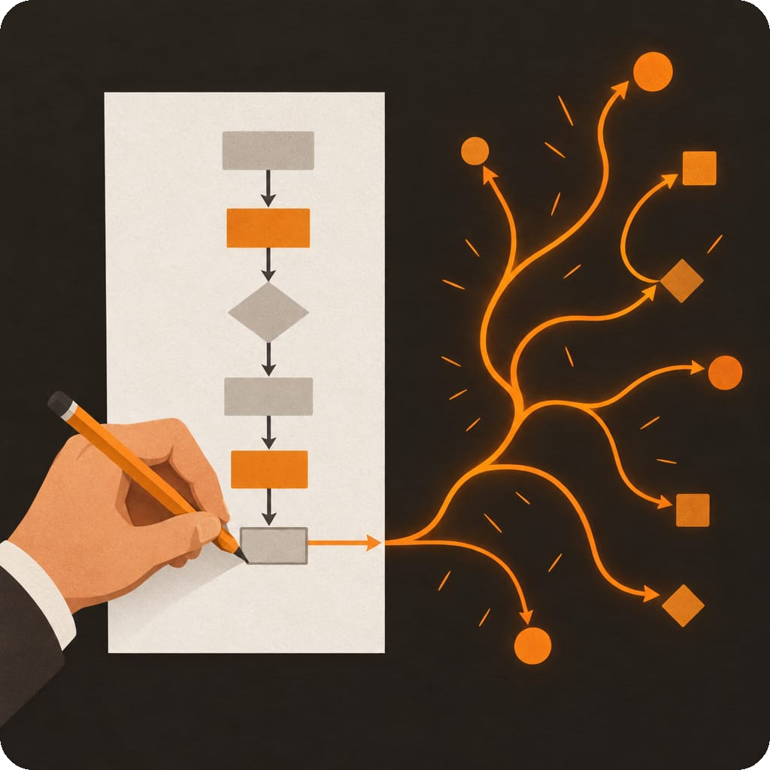
THE RULE
If a human drew every arrow in advance, it’s a workflow.
If the model draws the arrows while it runs, it’s an agent.
Everything else in this session hangs on that one distinction.
All About Agents: A Church IT Reality Check · CITN26
8
Notes:
Pause here. This is the line to land. Repeat it.

Slide 9
ONE MORE DISTINCTION
Agent vs. autonomous agent
Agent
You ask
Loop: plan, tool, read
Decides it’s done
Reports back
On demand
Autonomous agent
Schedule or event fires
Loop: plan, tool, read
Acts and remembers
Waits for the next one
Always on
Who starts it
When it stops
What it remembers
Guardrails
Agent: You, with a request
Agent: When the task is done
Agent: This task’s context
Agent: Approve the writes
Autonomous: A schedule or an event
Autonomous: It doesn’t. It waits.
Autonomous: Memory across every run
Autonomous: Daily budget, approvals, kill switch
All About Agents: A Church IT Reality Check · CITN26
9
Notes:
Same loop, different trigger and no finish line. An agent runs when you ask and stops when it decides the task is done. An autonomous agent is started by a clock or an event, keeps memory across runs, and acts while you are offline. Church example: “find lapsed group members” when you ask is an agent; “every Monday at 6 a.m., sweep lapsed members and queue notes for approval” is autonomous. OpenAI Dots and Meta Muse, both launched in September 2026, are autonomous agents sold as products. Autonomy raises the guardrail bar: a daily budget, an approval queue, and a kill switch someone actually owns.

Slide 10
AUDIENCE MOMENT
Agent or not? Hands up for “agent”
1
Website FAQ bot that answers service times
2
Guest form submitted: send template 3, create a follow-up task
3
Find small group dropouts in 60 days, check serving and attendance, draft a note to each leader
4
Copilot summarizing a staff meeting
5
Coding assistant fixes a broken report, runs it, reads the error, fixes it again
All About Agents: A Church IT Reality Check · CITN26
10
Notes:
Read each card, ask for hands up if they think it is an agent. Then advance to reveal.

Slide 11
AUDIENCE MOMENT
Agent or not? The answers
1
Website FAQ bot that answers service times
One turn, retrieval only
NOT AN AGENT
2
Guest form submitted: send template 3, create a follow-up task
Every arrow drawn in advance
WORKFLOW
3
Find small group dropouts in 60 days, check serving and attendance, draft a note to each leader
It chooses its own queries
AGENT
4
Copilot summarizing a staff meeting
One shot, no tools
NOT AN AGENT
5
Coding assistant fixes a broken report, runs it, reads the error, fixes it again
Loop, tools, and a stop
AGENT
All About Agents: A Church IT Reality Check · CITN26
11
Notes:
Reveal and tie each back to the rule: who drew the arrows?

Slide 12


WHERE THEY PAY OFF
Good fits share five traits
Multi-step
Data across tables or systems
A draft is acceptable
A human can check it
It recurs
Good fits
Bad fits
Duplicate contact review
Lapsed-attender and assimilation sweeps
Ad hoc reports for the board
Helpdesk ticket triage
Room and event conflict checks
Volunteer schedule gap-finding
Pastoral conversations
Messaging members without review
Financial transactions
One-shot questions a search answers cheaper
Processes that already work as a workflow
All About Agents: A Church IT Reality Check · CITN26
12
Notes:
Run the fit test out loud. Then tell one story from the MinistryPlatform MCP work, dedup review or donor reporting: what it did, what a human still checked. Only cite hours saved if the number is real.

Slide 13
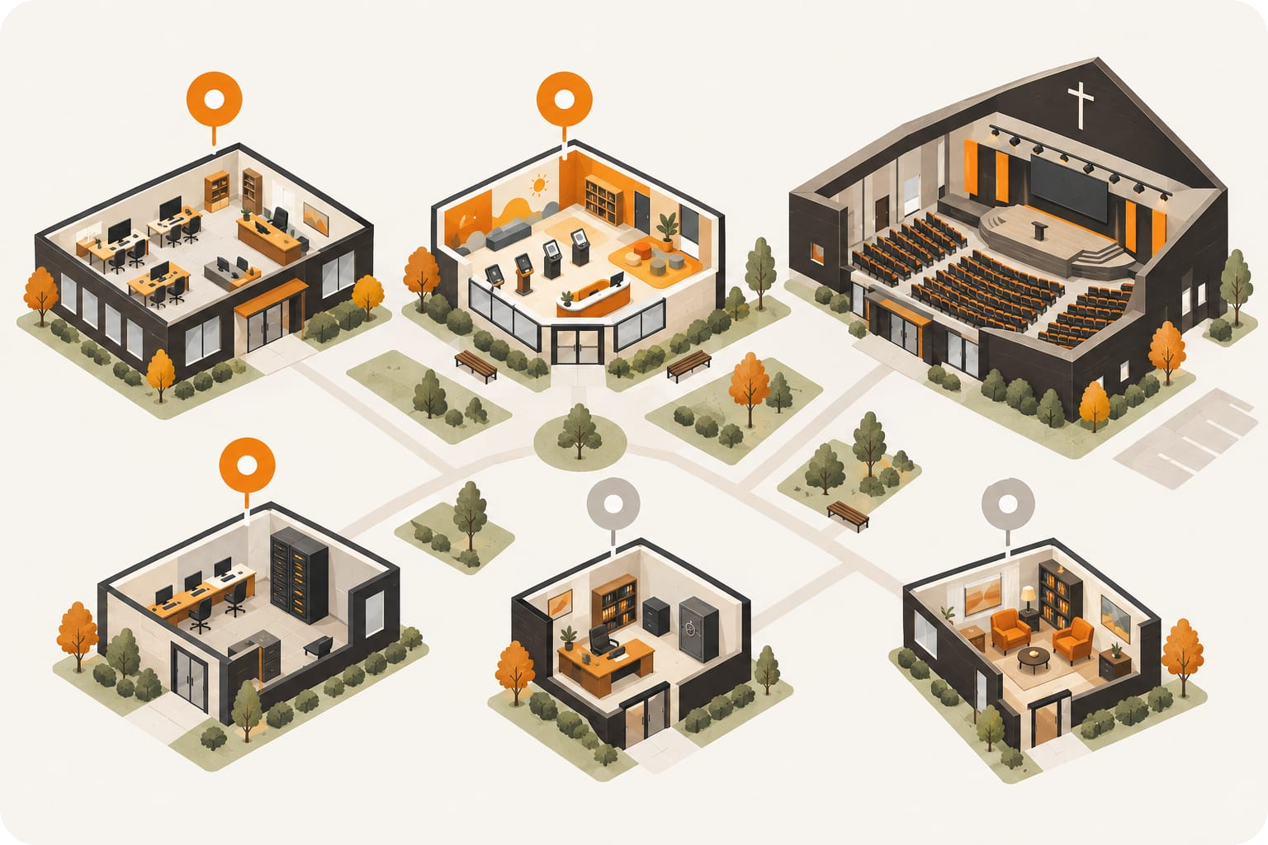
ON YOUR CAMPUS
Where agents fit on a church campus
Church office
Reports, data cleanup, follow-up sweeps
Kids check-in
Roster gaps and room conflicts
IT helpdesk
Ticket triage and account lookups
Finance office
No autonomous transactions
Pastor’s study
Pastoral care stays human
Orange markers: agent territory. Gray: keep a human in the seat.
All About Agents: A Church IT Reality Check · CITN26
13
Notes:
Walk the campus. The orange zones are multi-step, data-heavy, reviewable work. The gray zones are where trust, money or pastoral relationship is the point, so a human stays in the seat.

Slide 14
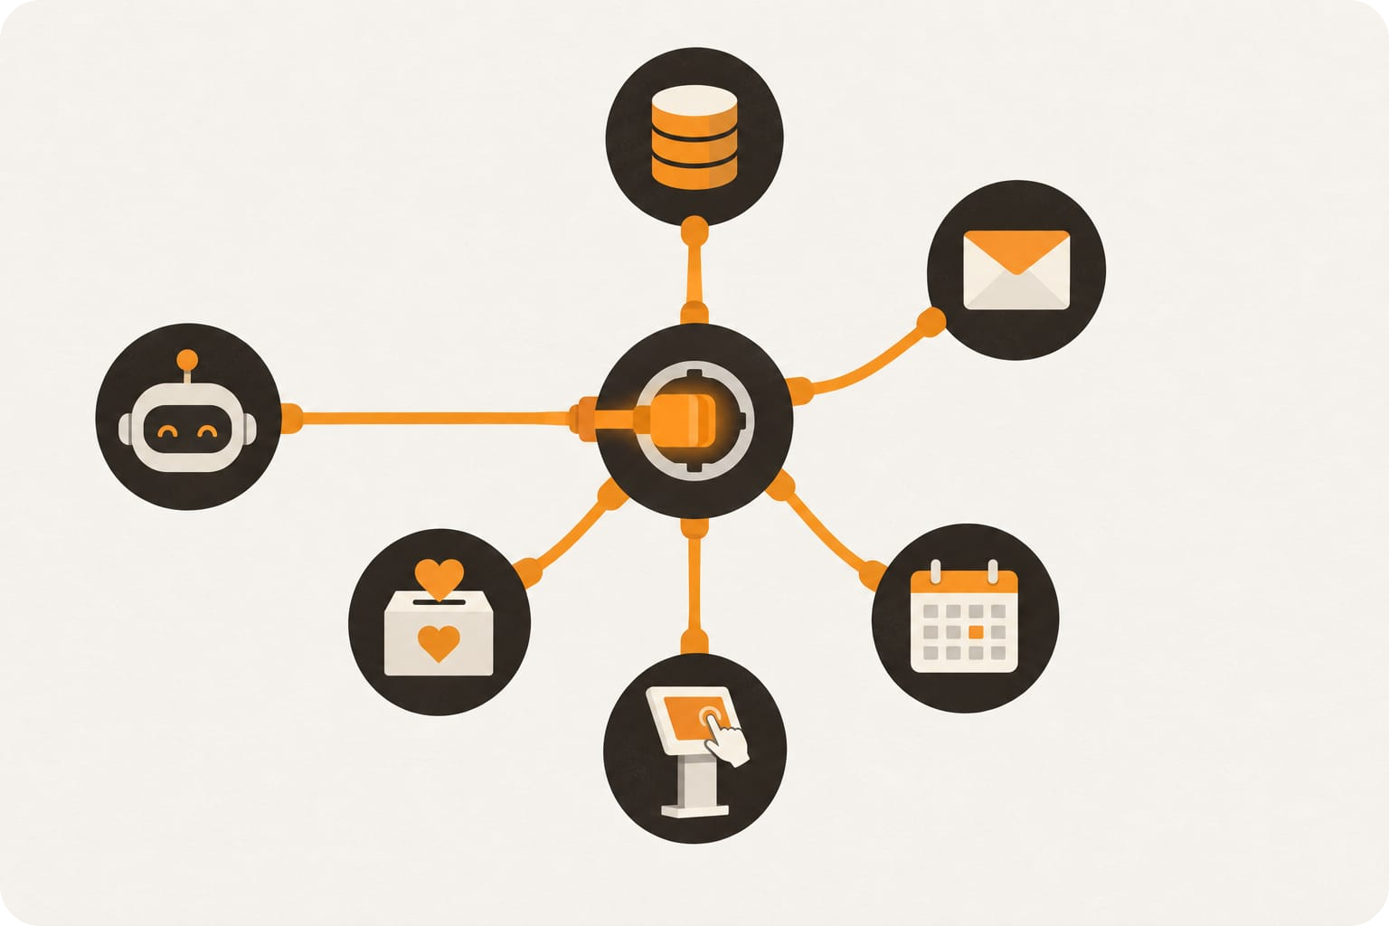
MCP
MCP is USB-C for AI tools
One connector, many clients
ChMS data
Build or buy it once; it works in Claude, Copilot and others.
Email
the MCP server
Permissions live at the server
Not in a prompt someone can talk around.
AI client
Giving
Calendar
Your identity, your roles
Calls run as the signed-in user via OAuth, so security roles still apply.
Check-in
All About Agents: A Church IT Reality Check · CITN26
14
Notes:
Model Context Protocol: a standard way for a server to expose tools to any compatible AI client. The ChMS pattern: discover the schema, look up columns, then query or write. The key point for church IT: permissions and identity are enforced at the server.

Slide 15
THE LANDSCAPE
Build with a framework, or subscribe to an agent
FRAMEWORKS YOU BUILD WITH
AGENTS YOU SUBSCRIBE TO
Vercel eve
TypeScript
Claude Agent SDK
Python, TS
Durable runs, approvals, sandboxes, MCP
The harness behind Claude Code, as a library
OpenAI Dots
Always-on coworkers with their own cloud computer and memory. DevDay, Sept 2026.
OpenAI Agents SDK
Python, TS
Microsoft Agent Framework
.NET, Python
Lightweight handoffs, guardrails and tracing
Successor to Semantic Kernel and AutoGen
Meta Muse
Google ADK
Python, Java
LangGraph
Python, TS
A business agent across Meta’s apps and 14+ tools like Slack, Stripe and QuickBooks. Sept 2026.
Hierarchical multi-agent, Gemini-native
Stateful graphs with human-in-the-loop
Mastra
TypeScript
CrewAI
Python
Products, not frameworks: autonomous agents someone else built and runs. Same checklist applies.
Agents and workflows for JavaScript teams
Role-based teams of cooperating agents
All About Agents: A Church IT Reality Check · CITN26
15
Notes:
Two ways in. Frameworks are how your team or a vendor builds an agent: eve, Claude Agent SDK, OpenAI Agents SDK, Microsoft Agent Framework, Google ADK, LangGraph, Mastra, CrewAI. Products like OpenAI Dots and Meta Muse are autonomous agents you subscribe to; you do not build them, so the Real Agent checklist is your only lever. For church IT, look first for durable runs, built-in approvals and MCP support. Sources: vercel.com/blog/introducing-eve (June 2026); VentureBeat on OpenAI Dots (Sept 2026); TechCrunch on Meta Muse (Sept 29, 2026); firecrawl.dev open-source agent frameworks roundup (June 2026). Landscape moves monthly; re-check the week of the talk.

Slide 16

LIVE DEMO
A lapsed-participant sweep, start to finish
1
2
3
4
5
6
Ask
Watch the loop
Self-correct
Draft
Approve a write
Check the log
Who hasn’t attended their group in 60 days?
Schema, lookup, query calls appear
It reads an error and retries
A note to each leader; nothing sent
Approve one task, decline one
Audit entry, step count, tokens
Running against a demo tenant with synthetic contacts. Real member data never goes on a conference projector, and that is the first guardrail.
All About Agents: A Church IT Reality Check · CITN26
16
Notes:
Demo script. 1: ask the question grouped by group leader. 2: point at the tool calls, that is the loop. 3: if a column name misses, let it recover. 4: draft notes, drafting is a free tier. 5: create follow-up tasks, the write pauses for approval; approve one, decline one. 6: open the MP audit log for the created record, then show step count and token usage, which is where a spend cap lives. Fallback: recorded capture in a second tab; switch at the first sign of Wi-Fi trouble.

Slide 17

GUARDRAILS
Keep it
on the road.
Approvals, PII, spend caps and audit trails: what you’d have to explain to your exec pastor.
All About Agents: A Church IT Reality Check · CITN26
17
Notes:
Transition into guardrails, the biggest block of the session. The road is fine; the guardrails are why you can drive it at night.

Slide 18




GUARDRAILS
Four things you’d have to explain to your exec pastor
Approvals
PII
Read and draft freely. Writes need a human confirm. Some actions never.
Least privilege: your identity or a scoped account, limited tables, no bulk export.
Spend caps
Audit trails
Max steps per run, a cost ceiling per run, and an org budget alert.
Every tool call logged: who, what, when, and who approved it.
All About Agents: A Church IT Reality Check · CITN26
18
Notes:
Two minutes on each. Frame every one as: what would you have to explain to your exec pastor if it went wrong?

Slide 19



APPROVALS
Tier every tool before you connect it
MORE CONTROL →
Never
Write with approval
Giving changes, bulk deletes, messaging members unreviewed
Draft
Tasks, record updates, a named approver
Read
Emails, notes, reports, nothing sent
Query people, groups, attendance
All About Agents: A Church IT Reality Check · CITN26
19
Notes:
Anything that emails members or touches giving needs a named approver, or is simply off. PII: check vendor data retention and training terms; children’s check-in data gets the strictest handling. Spend: the failure story is the runaway loop at 2 a.m. Audit: writes through the ChMS API should land in its own audit log under a real user; keep the transcript.

Slide 20

ROLLOUT
Roll it out like a pilot, not a launch
1
Pilot
One use case, one team, read-only to start
2
Scope
Pick the identity, tables and approval tiers
1 Pilot
6 Expand
2 Scope
3
Connect
Turn on the MCP server with spend caps set
4
Supervise
A human reviews every write for the first weeks
5 Audit
3 Connect
5
Audit
Read the tool-call log on a schedule
4 Supervise
6
Expand
Add one tool or one team, then go around again
All About Agents: A Church IT Reality Check · CITN26
20
Notes:
Every guardrail in practice is a lifecycle, not a switch. Start read-only with one team, scope before you connect, supervise the writes, audit on a schedule, and expand one step at a time.

Slide 21

THE EXEC PASTOR TEST
“Could you show every action it took,
and who approved it?”
If the answer is no, it isn’t ready for your data. Approvals, PII scope, spend caps and audit trails are how you get to yes.
All About Agents: A Church IT Reality Check · CITN26
21
Notes:
This one question ties the four guardrails together.

Slide 22
TAKE HOME
The Real Agent checklist
Is it an agent?
Is it safe to connect?
Does the model choose its next step at runtime?
Which actions need human approval, and can I change that?
Can it call tools that act, and read the results?
Whose identity does it act as, and what can it see?
Can it tell you how it decides it’s done?
Where does data go, how long is it kept, is it trained on?
What caps its steps and spend per run and per month?
Can I see a log of every tool call and approval?
All About Agents: A Church IT Reality Check · CITN26
22
Notes:
A no on any of the first three: it is not an agent. A no on any of the last five: it is not ready for your data. Put the QR code for the one-page PDF here once it exists.

Slide 23
START HERE
Early autonomous agents: watch, flag, never fix
ON NEW CONTACT
ON CONTACT SAVE
ON NEW CONTACT
ON NEW EVENT
Duplicate detection
Contact record review
Household check
Room and resource conflicts
Flags a likely duplicate of an existing record. Never merges.
Checks completeness, email format and mobile number format.
Flags contacts with no household or an address that doesn’t match it.
Flags double-booked rooms and equipment before the weekend.
DAILY
WEEKLY
WEEKLY
WEEKLY
Guest follow-up watch
Lapsed participant sweep
Volunteer clearance expiry
Bounced email cleanup
Flags first-time guests with no follow-up logged after three days.
Flags group and team members with no attendance in 60 days.
Flags kids’ ministry volunteers whose background check expires in 30 days.
Flags contacts whose email bounced so staff can confirm a new one.
Read and flag only. Each one writes a task or a report for a person, never a change to the record. Orange: triggered by an event. Charcoal: on a schedule.
All About Agents: A Church IT Reality Check · CITN26
23
Notes:
Where to start with autonomy: agents that watch and flag, with no write access to the records they check. The first two are the ones I would build first: duplicate detection only detects, it never merges; contact review checks completeness, email and mobile formats on every new or changed record. Event-triggered ones run when a record changes; scheduled ones sweep daily or weekly. Each output is a task or report for a named staff member, which keeps the approvals, spend and audit story simple. Graduate to drafting, then to writes with approval, only after weeks of clean flags.

Slide 24

QUESTIONS
An agent is a model in a loop,
choosing tools, reading results,
and deciding when to stop.
Now go back to those three claims.
Chris Kehayias · ACS Technologies
CITN26 · Louisville, KY
All About Agents: A Church IT Reality Check · CITN26
24
Notes:
Return to the cold-open claims and answer them with the room. Seed questions if quiet: Will this replace staff? Is our member data used to train the model?

