Slide 1
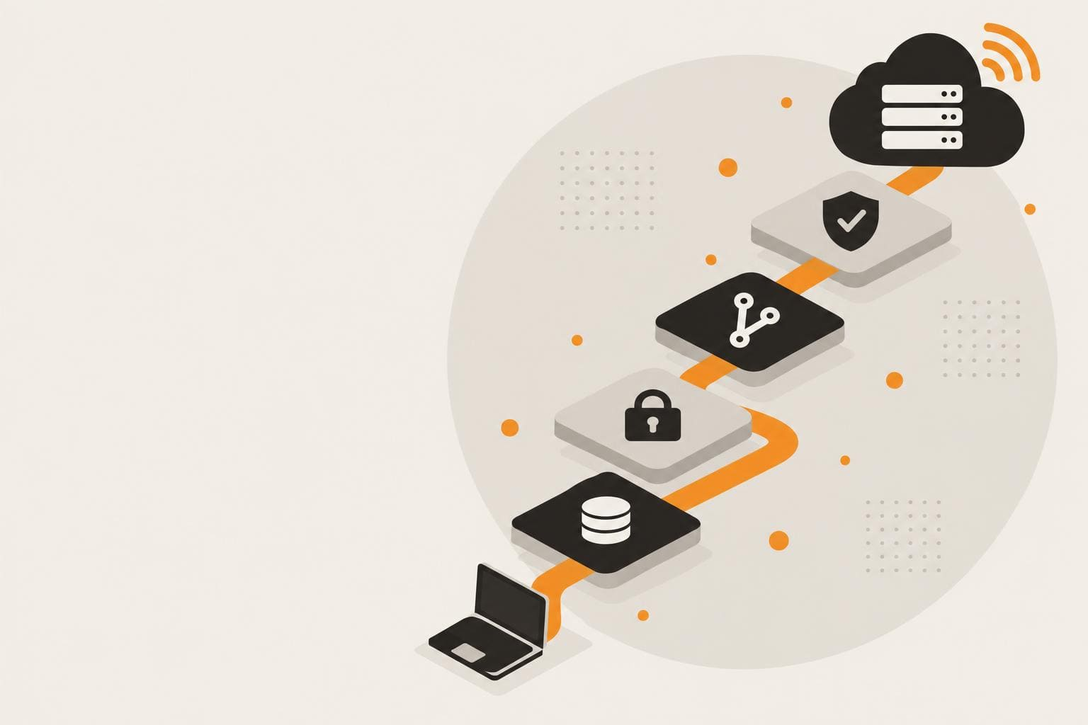
SESSION · 45 MIN
It Works on My Laptop
Taking a Claude Code Project Live
Your app works on your laptop. That's the easy 20%. This session walks the whole path to production — and the parts nobody demos.
Chris Kehayias
SVP Innovation & AI, ACS Technologies
It Works on My Laptop · Internal Session
1
Notes:
[0:00 | ~0:30] TITLE
Welcome. Frame it in one sentence: "Everyone here has built something that works on their laptop. This session is about the other 80% — what it takes to let other people depend on it."
Say who you are in ten seconds, then move on. Do not read the description off the slide.

Slide 2
AGENDA
45 minutes, five blocks
0–5
5–16
16–30
30–40
40–45
Open
The stack
Live demo
Nobody demos
Close
Most of our time goes to the live demo and to the parts nobody demos.
It Works on My Laptop · Internal Session
2
Notes:
[0:30 | ~0:45] AGENDA
Five blocks: open (5), the stack (11), live demo (14), what nobody demos (10), close (5).
Call out the two orange blocks: that is where the value is. Five live demos in the 16-30 window, one more in the 30-40 window.
PRESENTER TIMING RULE: if you are running long, trim the open and the tool slides (6-8) — never the demos or the on-call segment.

Slide 3
OPEN
The easy 20%, and the other 80%
20%
80%
Runs on your laptop
Safe for someone else to depend on
A working prototype, built fast with Claude Code.
Data, hosting, CI/CD, secrets, migrations, monitoring, cost, and who gets paged.
It Works on My Laptop · Internal Session
3
Notes:
[1:15 | ~3:30] THE EASY 20% / THE OTHER 80%
Left card: Claude Code makes the first 20% almost embarrassingly fast — a working prototype in an afternoon.
Right card: the 80% is everything that makes it safe for someone ELSE to depend on: data, hosting, CI/CD, secrets, migrations, monitoring, cost, and who gets paged.
Ask the room: "Who has built something that only runs on your machine?" Let hands go up. Then: "Who has let a coworker depend on it?" Fewer hands — that gap is today's talk.
Transition: "Let me tell you the question that actually matters."

Slide 4
THE REAL QUESTION
It's not “can I deploy this.”
It's “who's holding the pager at 2am.”
It Works on My Laptop · Internal Session
4
Notes:
[4:45 | ~0:15] THE REAL QUESTION (mic drop)
Say the orange line, pause, then the white line. Then stop talking for three full seconds.
This is the thesis of the session. Everything after it — the stack, the demos, the monitoring — exists to give you an answer to the white line.

Slide 5
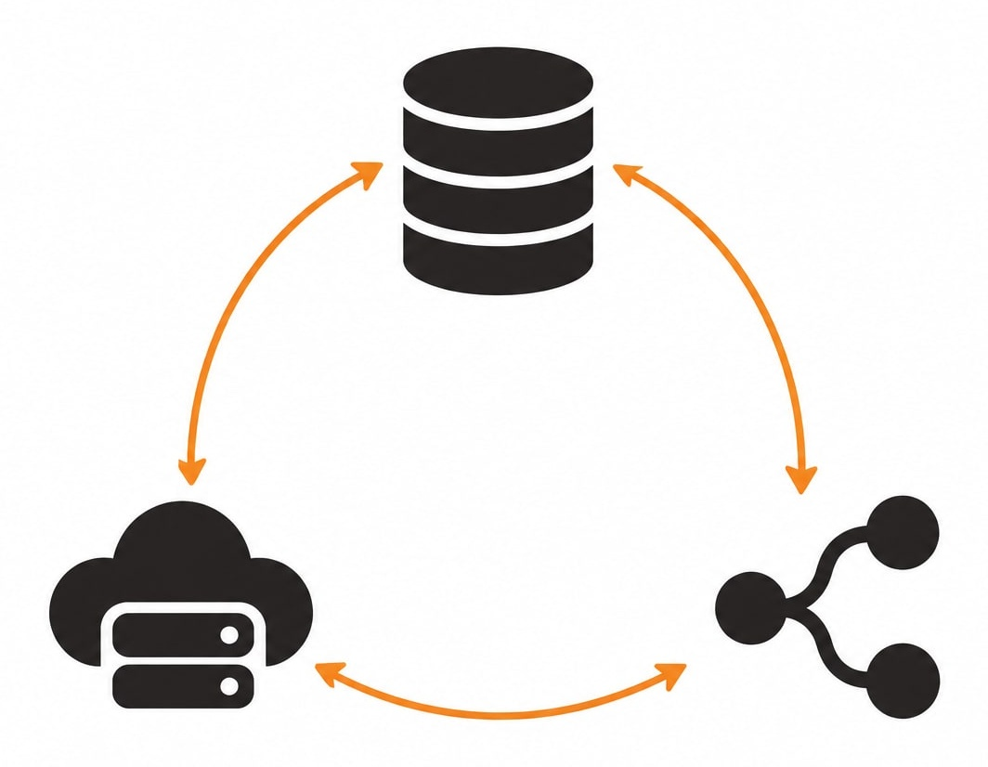
THE STACK
Three tools, one connected ecosystem
Neon · Data
Vercel · Hosting
GitHub Actions · Automation
It Works on My Laptop · Internal Session
5
Notes:
[5:00 | ~1:00] THE STACK
Three tools, each doing one job: Neon holds the data, Vercel runs the app, GitHub Actions is the glue that decides what is allowed to reach production.
Why these three: all have a free tier, all are git-native, none require you to run or patch a server. That is the point for a small team without a platform group.
Say explicitly: "This is not the only valid stack. It is a stack where the answer to 'who patches it' is 'nobody on our team'."

Slide 6

DATA
Neon — Postgres that isn't a pet
WHAT IT SOLVES
THE TRAP
Serverless Postgres that scales to zero when nobody's using it
Branches like git — a real database branch per pull request
No patch schedule, no backup script to babysit
Connection limits and cold-start latency on the free tier
Fix it before someone hits it in production: use a pooler (PgBouncer / Neon's built-in pooler)
Every branch is a real database — clean up stale ones or the bill creeps
It Works on My Laptop · Internal Session
6
Notes:
[6:00 | ~2:30] NEON
Left side: the pitch. Scale-to-zero means an internal tool used nine-to-five costs almost nothing overnight. Branching is the feature that changes how you work — you will SEE it in demo 2.
Right side: the trap. The two things that bite first are connection limits (serverless functions open lots of short connections) and branch sprawl.
The fix for connections: use the POOLED connection string (the hostname contains "-pooler"). You will point at it in the demo. Plant that now.
Do not demo anything yet — this is the setup for demo 2.

Slide 7

HOSTING
Vercel — hosting that deploys on every push
WHAT IT SOLVES
THE TRAP
Git-connected deploys — every branch gets a live URL automatically
Edge network and serverless functions handle API routes and cron jobs
Instant rollback to any previous deploy, one click
Env vars set in the dashboard but missing from .env.example — the next contributor can't run it at all
Serverless function timeouts surprise anything long-running
Preview URLs may be reachable by people you didn't intend — check Deployment Protection
It Works on My Laptop · Internal Session
7
Notes:
[8:30 | ~2:30] VERCEL
Left side: git push is the deploy. Every branch gets a URL. Rollback is a button.
Right side, the trap you will feel first: env vars live in the dashboard, not the repo, so a new contributor clones the project and nothing runs. Habit to teach: every variable gets a line in .env.example the same day it is added.
Second trap: serverless functions have time limits — long-running jobs belong somewhere else (a queue, a cron-triggered function, a background worker).
Third: who can open preview URLs. Vercel's deployment-protection defaults have changed over time, so do not assert a default from memory — in demo 4 you will open Project Settings > Deployment Protection and show what is actually on for this project.
Setup for demo 1.

Slide 8

AUTOMATION
GitHub Actions — the glue, not an afterthought
WHAT IT SOLVES
THE TRAP
CI: run tests and type-checks before anything reaches main
CD: gate every deploy on green checks, not “it looked fine locally”
One workflow file makes the deploy process reviewable, not tribal knowledge
A workflow that works—until a secret rotates or a token expires
A dependency needing a new permission scope breaks the run silently
No one reads a failing workflow until it blocks a release they care about
It Works on My Laptop · Internal Session
8
Notes:
[11:00 | ~2:30] GITHUB ACTIONS
The reframe: the workflow file turns "how we deploy" from tribal knowledge into a file that gets code-reviewed like everything else. Bus factor goes from 1 to the whole team.
CI = tests and type-checks before main. CD = deploys only happen when checks are green.
The trap is entropy: workflows rot quietly. A rotated token or a changed permission breaks a run and nobody notices until a release is blocked. Mitigation to mention: someone owns the "Actions" tab, and failures notify a channel, not just the PR author.
Setup for demo 3.

Slide 9
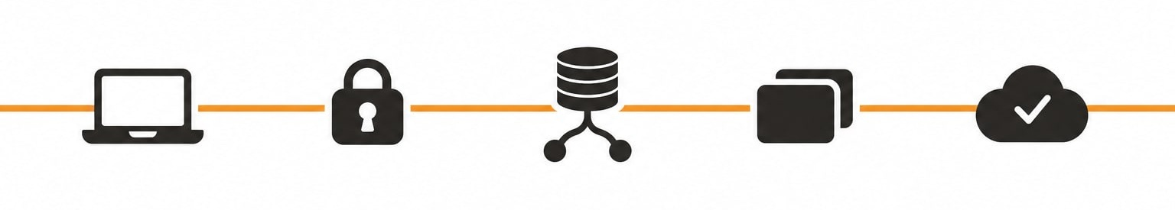
THE PIPELINE
Five stops between laptop and production
Laptop
Secrets
Migrations
Preview env
Promote
Your code, your machine — step one of every change
“If it's in your repo, it's not a secret anymore.”
Run against a Neon branch first — never straight at production
Every PR gets a full app + database copy, torn down on merge
Merge → tests run → Vercel promotes — rollback is one click
It Works on My Laptop · Internal Session
9
Notes:
[13:30 | ~2:30] THE PIPELINE — THE MAP FOR THE DEMOS
Walk left to right once, slowly. This is the map the audience holds in their heads during the next 14 minutes.
Laptop: the change starts here. Secrets: they live in Vercel and GitHub settings, never in the repo — "if it's in your repo, it's not a secret anymore." Migrations: always against a Neon branch first. Preview: every PR gets its own app plus its own database copy. Promote: merge, checks pass, Vercel promotes, and rollback is one click.
Tell them: "In the next 14 minutes I will show you every stop on this line, with a real project."

Slide 10
LIVE DEMO
Watch it happen, live.
One real change, pushed all the way to production.
1
Vercel
2
Neon
3
CI/CD
4
Preview
5
Ship
repo → live URL
a branch per PR
the gate before main
app + DB per PR
promote & roll back
It Works on My Laptop · Internal Session
10
Notes:
[16:00 | ~0:30] LIVE DEMO BLOCK — 14 MINUTES, FIVE DEMOS
Roadmap on screen: Vercel (3) · Neon (3) · CI/CD (3) · Preview (2.5) · Ship & roll back (2.5).
Each demo has its own cue slide that you show for ~10 seconds, then switch to the browser. Come back to the slide to land the takeaway ("Watch for" box).
PRE-FLIGHT CHECKLIST (do this the morning of, again 15 minutes before):
- Dedicated browser profile, already logged in to GitHub, Vercel and Neon. One tab per demo, in demo order.
- Browser zoom at 150%+, notifications off, bookmarks bar hidden, no personal tabs.
- Demo app repo ready with: a throwaway Vercel project NOT yet imported (demo 1), a prepared branch with a migration (demos 2 and 4), a PR opened with one intentionally failing test (demo 3), and a second PR ready to merge (demo 5).
- Screen recording of each demo saved locally as the safety net. If anything stalls for more than 20 seconds, say "let me show you the recording of this part" and keep moving — never debug live.
- Phone hotspot as network backup.
TIMING: if you are behind, drop demo 4 to a 60-second screenshot walk-through; demos 1, 3 and 5 are the ones people remember.

Slide 11
LIVE DEMO 1 OF 5 · ~3 MIN
Vercel — from GitHub repo to live URL
ON SCREEN
WATCH FOR
1
Import the repo — framework is auto-detected
Nothing on this screen is a server I had to build, patch or log in to.
2
Add environment variables, scoped to Production and Preview
3
Deploy: a live URL in about a minute
4
Open Deployments — every push is a row, each one rollback-able
It Works on My Laptop · Internal Session
11
Notes:
[16:30 | ~3:00] DEMO 1 — VERCEL SETUP
WHAT YOU ARE SHOWING: the whole "get it on the internet" step, from an unconnected GitHub repo to a live HTTPS URL, with no server work.
CLICK PATH
1. vercel.com > Add New > Project > import the GitHub repo. Point out: framework preset detected automatically; build and output settings need no changes.
2. Before deploying, open Environment Variables. Add DATABASE_URL (use a pre-copied POOLED Neon string). Show the scope checkboxes: Production, Preview, Development. Say: "Production and Preview should point at DIFFERENT databases — that is how preview environments stay safe."
3. Click Deploy. While the build log scrolls (about 60 seconds), talk: every push to any branch will do this again, automatically.
4. Click the live URL. Then open the Deployments tab: each row is a commit, each one is a rollback target.
SAY
"Nothing on this screen is a server I had to build, patch or log in to. That is the point."
Quick aside while the build runs: the .env.example habit — every variable added in the dashboard gets a line in .env.example the same day.
IF IT BREAKS
Build stalls or network drops: switch to the recorded demo, or open the pre-deployed project and narrate the same four steps. Do not debug live.
TRANSITION
"The app is live, but it has no database yet. Next: Neon."

Slide 12
LIVE DEMO 2 OF 5 · ~3 MIN
Neon — a database branch per pull request
ON SCREEN
WATCH FOR
1
Create the project — copy the pooled connection string
I tested a schema change against a real copy of my data — and production never knew.
2
Branch main in one click — a full copy of the data in seconds
3
Run the migration against the branch only
4
Compare: the new column exists on the branch, not on main
It Works on My Laptop · Internal Session
12
Notes:
[19:30 | ~3:00] DEMO 2 — NEON: POOLING AND BRANCHING
WHAT YOU ARE SHOWING: the two Neon ideas that matter operationally — the pooled connection string, and copy-on-write branches that make migrations safe to rehearse.
CLICK PATH
1. console.neon.tech > the project (pre-created; show how little setup there was). Open Connection Details and toggle "Pooled connection". Point at the hostname: it contains "-pooler". Say: "This is the one that goes in Vercel. The direct one is for migrations."
2. Branches > Create branch from main. Name it for the PR, e.g. add-notes-field. It takes seconds regardless of data size.
3. In the terminal, run the app's migration command against the BRANCH connection string (your migration tool, e.g. Drizzle or Prisma — adjust to your demo app). Show it succeed.
4. In the Neon SQL editor, run a SELECT / describe on the branch (new column present) and then on main (no new column).
SAY
"I just tested a schema change against a real copy of my data. If the migration is wrong, I delete the branch and production never knew."
Then the trap callback: "And this is also why branches need a clean-up habit — each one is a real database."
IF IT BREAKS
Migration errors: that is actually a fine demo — "this is exactly why we rehearse it on a branch" — then delete the branch and move on. Network drop: recording.
TRANSITION
"Now let's make sure no one can skip any of this. Enter GitHub Actions."

Slide 13
LIVE DEMO 3 OF 5 · ~3 MIN
GitHub Actions — the gate in front of main
ON SCREEN
WATCH FOR
1
Open the workflow file in the repo — about 30 lines
The deploy process is a file someone can review — not something one person remembers.
2
Walk it: install → type-check → test → build
3
Settings → Secrets: where tokens live (never in code)
4
A PR with a failing test: red check, merge blocked
It Works on My Laptop · Internal Session
13
Notes:
[22:30 | ~3:00] DEMO 3 — CI/CD WITH GITHUB ACTIONS
WHAT YOU ARE SHOWING: the workflow file, where secrets live, and branch protection actually blocking a bad merge.
CLICK PATH
1. GitHub repo > .github/workflows/ci.yml. Scroll slowly; do not read every line. Name the stages: checkout, install, type-check, test, build. "This file IS the deploy policy."
2. Repo Settings > Secrets and variables > Actions. Show the secret NAMES only (values are hidden by design). Say: "Tokens live here. If it's in your repo, it's not a secret anymore."
3. Open the pre-prepared PR with the intentionally failing test. Show the red X in the checks list and the greyed-out Merge button ("Required statuses must pass").
4. Optional if time allows: push the one-line fix from the GitHub web editor and watch the checks flip to green while you talk through Settings > Branches (branch protection rule: require status checks, require PR before merging).
SAY
"The deploy process is a file someone can review — not something one person remembers."
Tie back to the trap on the earlier slide: someone owns the Actions tab and failures notify a channel.
IF IT BREAKS
Actions queue slow (it happens): narrate over the already-completed run from this morning — it looks identical.
TRANSITION
"Green checks are great. But how do I SEE a change before it merges? Next: preview environments."

Slide 14

LIVE DEMO 4 OF 5 · ~2.5 MIN
Previews — every PR gets its own app
ON SCREEN
WATCH FOR
1
Open the PR — the Vercel bot has already commented a preview URL
Reviewers click a link and use the change — they never check out the code.
2
Click it: the change is live, on its own database branch
3
Try the change like a user would — on data that isn't production
4
Settings → Deployment Protection: confirm who can open previews
It Works on My Laptop · Internal Session
14
Notes:
[25:30 | ~2:30] DEMO 4 — PREVIEW ENVIRONMENTS
WHAT YOU ARE SHOWING: a pull request that comes with its own running copy of the app AND its own database branch, plus the access question people forget.
CLICK PATH
1. GitHub > the pre-opened PR (the one with the migration from demo 2). Point at the Vercel bot comment with the Preview URL, and the deployment status in the checks list.
2. Open the preview URL. Use the new feature (e.g. add a note, see the new field). Mention that, with the Neon-Vercel integration, this preview talks to its own Neon branch — NOT production. (Confirm your project has the integration enabled before the talk; if not, say it is one toggle in the Neon integration settings.)
3. Back in Neon, show the matching branch listed under Branches — created automatically for this PR.
4. Vercel > Project > Settings > Deployment Protection. Show what is actually enabled for preview deployments on THIS project and say it plainly. (Defaults have changed over time — read it off the screen rather than quoting from memory.)
SAY
"Your reviewers click a link and use the change. They never have to check out the code."
Cost callback (sets up the cost slide): "Each of these is real compute. They are torn down on merge — that is the clean-up habit."
IF IT BREAKS
Preview not ready: show a screenshot of the bot comment and the Neon branch list. This demo is the safest one to cut to 60 seconds if you are behind.
TRANSITION
"Everything looks good. Time to ship it."

Slide 15

LIVE DEMO 5 OF 5 · ~2.5 MIN
Production — ship it, then take it back
ON SCREEN
WATCH FOR
1
Merge the PR once checks are green
Rollback is a button, not a war room.
2
Watch the production deployment build and go live
3
Reload the production URL: the change is there
4
Instant Rollback to the previous deployment — no rebuild
It Works on My Laptop · Internal Session
15
Notes:
[28:00 | ~2:30] DEMO 5 — SHIP AND ROLL BACK
WHAT YOU ARE SHOWING: the payoff — merge to production, then undo it in seconds. Rollback is what makes shipping on a Tuesday afternoon unscary.
CLICK PATH
1. GitHub > the second prepared PR (all checks green). Click Merge. "Merging IS the deploy."
2. Switch to Vercel > Deployments. Watch the new Production deployment build (about a minute). Narrate: checks passed, so this is allowed to promote.
3. Reload the production URL; the change is live.
4. Vercel > Deployments > pick the previous Production deployment > "..." > Instant Rollback (wording may vary slightly by dashboard version). Reload production: the change is gone, in seconds, with no rebuild.
5. Remind them rollback does not undo database migrations — that is why migrations are written to be backwards-compatible and rehearsed on a branch (demo 2).
SAY
"Rollback is a button, not a war room."
Close the block: "That is the whole path: laptop, secrets, migrations, preview, promote. Now the part nobody demos — what happens at 2am."
IF IT BREAKS
Production build slow: play the recording. If rollback label differs, just say what you are clicking.
TRANSITION
"The tutorial would end here. Ours doesn't."

Slide 16
WHAT NOBODY DEMOS
The tutorial ends at “it's live.”
Your users don't care that it's live. They care that it stays up.
It Works on My Laptop · Internal Session
16
Notes:
[30:30 | ~0:30] WHAT NOBODY DEMOS
Pause on the headline. Every tutorial you have watched ended at the moment of "it's live." But a tool people depend on is judged on the second week, not the first minute.
Four things follow: monitoring (and a live page to your phone), real cost, who gets paged, and the close.

Slide 17

MONITORING
Know it's down before your users tell you
Uptime check
A free-tier uptime monitor (UptimeRobot / Better Stack) hitting a health endpoint every few minutes
Error tracking
Sentry wired into both the frontend and the API routes
Neon dashboard
Watch connection count and storage — the two numbers that quietly cause outages
It Works on My Laptop · Internal Session
17
Notes:
[31:00 | ~2:00] MONITORING
Three signals, three jobs. Uptime check: is it reachable at all (from outside). Error tracking: is it throwing errors for real users. Neon dashboard: connection count and storage are the two quiet killers.
Add a /health endpoint that actually touches the database — a health check that returns 200 without checking the database lies to you.
Free-tier check intervals are typically a few minutes, not seconds — so uptime monitors tell you "down", while Sentry tells you "broken", faster. You want both.
Next: don't just claim it works — show it.

Slide 18

LIVE DEMO 6 · ~2 MIN
Alerts — break it on purpose and get paged
ON SCREEN
WATCH FOR
1
Hit the deliberate error route on the production URL
The alert reached a human before a user ever noticed.
2
Sentry: the issue appears with a stack trace and the release
3
The alert rule fires — a push notification lands on my phone
4
Uptime monitor: show last week's test incident and its timeline
It Works on My Laptop · Internal Session
18
Notes:
[33:00 | ~2:00] DEMO 6 — BREAK IT ON PURPOSE, GET PAGED
WHAT YOU ARE SHOWING: the monitoring is real, and the alert goes to a phone — which sets up the on-call slide.
SETUP (before the session)
- Add a deliberate error route to the demo app (e.g. /api/boom that throws) and deploy it.
- Sentry project connected to the app; an issue alert rule that sends a push notification to the Sentry mobile app (or Slack/SMS) on any new issue in production.
- Phone mirrored to the projector or ready to hold up to the room camera. Do Not Disturb off for this app only.
- Uptime monitor created on the health endpoint with your phone as an alert contact; pause or fire a test beforehand so there is a real incident in the history to show.
CLICK PATH
1. Open the production URL /api/boom in a new tab (the error page is the point).
2. Switch to Sentry > Issues: the new issue appears within seconds, with the stack trace, the release, and the browser.
3. Pick up the phone: notification arrives. Show it. Pause for the room's reaction.
4. Show the uptime monitor dashboard and the earlier test incident: "down at 14:02, up at 14:07, alert sent to me."
SAY
"The alert reached a human before a user ever noticed. The question on the next slide is: which human?"
IF IT BREAKS
Push delayed: show the Sentry issue and a screenshot of the earlier phone alert. Never stand waiting for a notification — if nothing arrives in 10 seconds, move on.

Slide 19

REAL COST
What this actually costs, monthly
$0
~$20ish
Low-traffic internal tool
Once you outgrow free tiers
Usage-based, moves with adoption
Neon + Vercel free tiers, one uptime check
Neon Launch (~$19+) + Vercel Pro (~$20/seat) + monitoring
Function invocations and DB compute hours are the levers
It Works on My Laptop · Internal Session
19
Notes:
[35:00 | ~2:30] REAL COST
Three cards: a low-traffic internal tool can run on free tiers ($0 to maybe $50 with an uptime check and a bit of headroom). Past the free tiers, expect roughly $90 a month for a small team on the paid plans. After that cost is usage-based and tracks adoption — function invocations and database compute hours are the levers.
The honest framing: "The real cost is not the hosting bill. It is the person who gets paged." Then pivot straight to the next slide.
PRESENTER: PRICING CHECK BEFORE YOU GO LIVE
These vendors change plans and prices often. The figures here (Neon Launch from about $19, Vercel Pro about $20 per developer seat) are approximations — re-check the Neon and Vercel pricing pages the morning of the talk and update the slide if they have moved. Third-party price trackers disagree with each other, so use the vendor pages.

Slide 20

ON-CALL
Who gets paged, decided before launch
“Who's on call” is a decision to make before launch — not a question to answer during the first incident.
For a one-person project: say the expectation out loud, in writing — “best effort, business hours” is legitimate if stakeholders agree to it first
The uptime alert goes to a phone, not just an inbox someone checks Monday
Write down the answer to one question before you ship: who gets paged, and how
It Works on My Laptop · Internal Session
20
Notes:
[37:30 | ~3:00] WHO GETS PAGED
This is the emotional centre of the talk — slow down. Pick up from the phone buzz in demo 6.
The point is not "everyone needs a 24/7 rotation." The point is that the expectation is explicit. A one-person internal tool with a "best effort, business hours" promise is perfectly legitimate — IF the stakeholders agreed to it before launch, in writing.
Concrete asks: (1) alerts go to a phone, not an inbox; (2) there is a named person, and a named backup if it matters; (3) write the answer down next to the project README.
Invite the room: "If you are nervous about letting staff depend on something you built — this slide is your permission slip to negotiate the expectation, not just absorb it."

Slide 21

CLOSE
It works on my laptop.
Now make it work for everyone.
Before your next internal tool goes live, write down the answer to one question: who gets paged, and how.
Chris Kehayias · ACS Technologies
It Works on My Laptop · Internal Session
21
Notes:
[40:30 | ~4:30 incl. Q&A] CLOSE
Callback to the open: it works on my laptop — that was the easy 20%. You now have the map for the other 80%: Neon, Vercel, GitHub Actions; secrets and migrations; preview and promote; monitoring; cost; and an on-call answer.
The one action: before your next internal tool goes live, write down who gets paged, and how. Say it, then stop.
Then open Q&A. Likely questions: "Why not AWS?" (nothing wrong with it — this stack minimizes ops work for small teams), "What about compliance and data residency?" (check the vendors' regions and compliance docs for your data class before putting sensitive data here), "What if I'm the only person?" (slide 20).

