Slide 1


CITN26 · LOUISVILLE
You Can Build That
Getting Started with Claude Code
An honest orientation: what it is, how the workflow feels, where it shines, where it wastes your afternoon, and the habits that decide which you get.
Chris Kehayias
SVP Innovation & AI, ACS Technologies
Notes:
Welcome. This is the honest orientation: Claude Code makes it realistic for a church IT generalist to ship real software, and realistic to make an expensive mess. By the end you'll have a mental model you can explain to your team and a shortlist of right-sized first projects.

Slide 2

OPEN
Two Saturdays, same tool
SATURDAY ONE
SATURDAY TWO
One afternoon, one script, still running
"Build me a whole app"
Replaced a 40-minute weekly copy-paste job.
Six hours, 3,000 lines nobody understood, nothing shipped.
You Can Build That · CITN26
2
Notes:
0:00-3:00. Tell both stories (swap in real ones if you have them). Hand raise: Who has a script, report or spreadsheet you've meant to automate for a year? Transition: Same tool, different habits. Let's make sure you get Saturday one.

Slide 3
AGENDA
45 minutes, seven blocks
0:00
0:03
0:10
0:20
0:26
0:35
0:40
3
7
10
6
9
5
5
min
min
min
min
min
min
min
Open
What it actually is
Live demo
Shines vs. wastes
Habits + lifecycle
Pick a project
Q&A
You Can Build That · CITN26
3
Notes:
Quick map of the session. The demo sits at minute 10 so energy peaks early; habits get the most time because they're the real takeaway.

Slide 4

WHAT IT IS
Not a chatbot. Not autocomplete. An agent.
Chat
Autocomplete
Agent
You copy and paste between a chat window and your files.
Finishes the line you're typing in your editor.
Reads files, runs commands, edits and checks. This is Claude Code.
You Can Build That · CITN26
4
Notes:
3:00-10:00. Three things people confuse. Claude Code is the third: it works inside your project folder, not in a separate chat window. Same agent, different doors: terminal, VS Code or JetBrains, desktop, web.

Slide 5

HOW IT WORKS
The loop it runs, and what it knows
Context is the whole game
1 Read files
What's in the project folder
What you tell it in the session
CLAUDE.md, a short file it reads every session
You approve actions through permissions
5 Check
2 Propose
repeat
4 Run
3 Edit
You Can Build That · CITN26
5
Notes:
The agent loop: read, propose, edit, run, look at the output, try again. It only knows what's in the project, what you tell it, and CLAUDE.md. Permissions keep you in the approval seat.

Slide 6
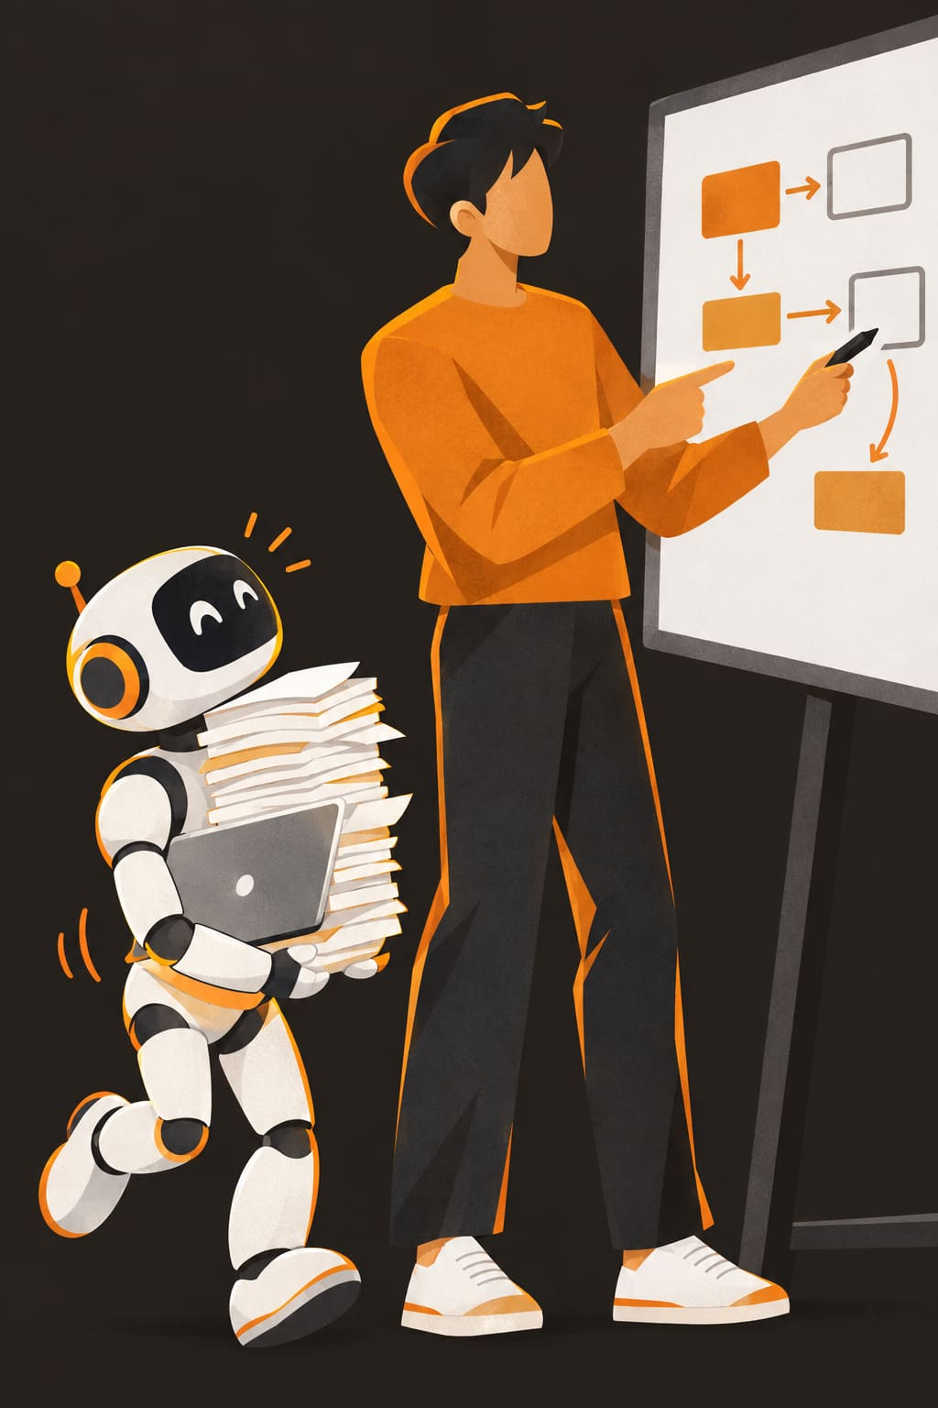
THE MENTAL MODEL
You're the tech lead.
It's a fast junior dev with no memory of yesterday.
Eager, tireless, and sometimes confidently wrong. Your job: scope the work, review it, and decide what ships.
You Can Build That · CITN26
6
Notes:
This is the one line to take back to your team. Transition: Let's watch that junior work.

Slide 7

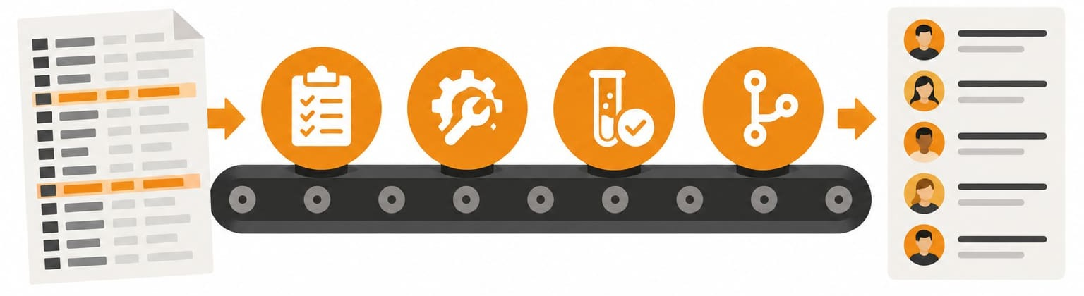
LIVE DEMO
The daily loop, on a real church task
Turn last month's ChMS guest export into a first-time guest follow-up list, with duplicates flagged.
Plan
Build
Test
Commit
Guest CSV
Plan mode first
Approve actions
Catch bad data
Then /clear
Follow-up list
About 8 minutes for what would take a generalist a day of searching.
You Can Build That · CITN26
7
Notes:
10:00-20:00. Narrate each beat aloud: empty folder under git with a 5-line CLAUDE.md; ask for a plan first and push back on one item; let it build and explain the permission prompts; run on sample data, where the planted malformed date breaks it, ask for a test that catches it, then fix; review the diff, commit, /clear. Fake data only. Backup recording cued. Advance to the three demo cue slides; each holds the exact prompt to type.

Slide 8
LIVE DEMO · 1 OF 4
~5 MIN · 10:00-15:00
Plan, then build
Plan
Build
Test
Commit
Guest Follow-Up Board · part 1
SWITCH TO
Terminal in the guest-followup folder. Shift+Tab into plan mode.
TYPE THIS
Build the Guest Follow-Up Board described in CLAUDE.md. I drop guests-september-2026.csv on the page; it shows a table of guests, groups duplicates (same email, same phone, or same name + address after normalizing case, spaces, phone formats and street abbreviations), flags rows with an invalid visit date or no contact info, and has a button to download the cleaned follow-up list as CSV, one row per household. Give me a plan first.
WATCH FOR
Read the plan out loud; push back on one item
First permission prompt (npm install): read it to the room
Drop the CSV on the page: about 192 households, orange duplicate badges
You Can Build That · CITN26
8
Notes:
Demo beats 1-3 from DEMO-SCRIPT.md. Show CLAUDE.md first (two lines aloud). Plan mode, paste the prompt, read the plan, push back on one item (no framework / nothing leaves the browser / skip styling). Approve. Read the first permission prompt aloud. Start the dev server, drop the CSV, point at Sofia Hernandez (ALL-CAPS email duplicate).

Slide 9
LIVE DEMO · 2 OF 4
~3 MIN · 15:00-18:00
Make it prove it
Plan
Build
Test
Commit
Guest Follow-Up Board · part 2
SWITCH TO
The browser, then back to the terminal. Scroll to Michael Brown (row 136).
TYPE THIS
Write unit tests for the date handling: "2026-09-31" must be flagged invalid, and "2026-09-13" must display as Sunday, Sep 13 no matter what time zone the browser is in. Run them, and fix the code if they fail.
IF THE TESTS PASS FIRST TIME
How many duplicate groups did you find, and which rule caught each one?
WATCH FOR
Michael Brown's visit date of Sep 31 is accepted or shown wrong
A test fails, Claude fixes the parser, the tests go green
Refresh: Michael Brown now shows a red "invalid date" flag
You Can Build That · CITN26
9
Notes:
Demo beat 4. JavaScript reads 2026-09-31 as October 1 and shows Sunday dates as the Saturday before in US time zones, so a test usually fails here. If it passes first time: 'It got it right, and now I know it, and it stays right.' Then ask the duplicate question and check against the key: 8 groups.

Slide 10
LIVE DEMO · 3 OF 4
~1 MIN · 18:00-19:00
Commit and reset
Plan
Build
Test
Commit
Guest Follow-Up Board · part 3
SWITCH TO
Terminal.
TYPE THIS
Review the diff with me in two sentences, then commit with a clear message.
THEN
/clear
WATCH FOR
A two-sentence summary of the diff
A clear commit message
/clear: a fresh session for the next task
You Can Build That · CITN26
10
Notes:
Demo beat 5. 'Commit, clear, next task. Small steps. About eight minutes for something that would have cost me a Saturday.' Running long? Skip the diff review and just commit. Back to slides with: 'That went well because the task was right-sized. Here's when it doesn't.'

Slide 11


CALIBRATE
Where it shines, where it wastes your afternoon
Shines
Wastes your afternoon
Glue scripts, exports, report reshaping
"Build me an app" with no spec
Explaining a legacy script or codebase
Arguing in circles on a bug in a stale session
Tests, docs and READMEs for what you have
Live production data without a sandbox
Small internal tools with one or two screens
Auth, payments or PII you can't review
Integrations with well-documented APIs
Requirements that change mid-session
You Can Build That · CITN26
11
Notes:
20:00-26:00. Walk both columns with a concrete example for each. The right column isn't 'never'; it's 'not first, and not without review.'

Slide 12
RULES OF THUMB
Two threes worth remembering
3
3
sentences
strikes
If you can't describe "done" in three sentences, it's not a first project.
Said "no, that's still wrong" three times? Stop, /clear, and restate with what you learned.
The difference between the two columns is mostly habits.
You Can Build That · CITN26
12
Notes:
Two easy-to-remember warning signs. Transition: The difference between those columns is mostly habits.

Slide 13

THE CORE
Five habits decide the outcome
Small steps, each one checked, toward a door you can actually walk through.
Notes:
26:00. Section break. Five habits, about 90 seconds each.

Slide 14
THE CORE
The five habits
WHAT IT LOOKS LIKE
WHAT IT PREVENTS
1
Plan before code
Ask for a plan, read it, cut scope, then say "go".
3,000 lines solving the wrong problem
2
Small steps, committed
Git from minute one; commit after each working step.
No way back when step 7 breaks 1-6
3
Write down the context
A short CLAUDE.md: what it is, how to run it, what not to touch.
Re-explaining your ChMS every session
4
Make it prove it
Ask for tests or a sample run; read the diff before accepting.
Code that silently drops rows
5
Reset instead of arguing
Three failed tries: /clear and restate what you learned.
An afternoon lost in a bloated session
You Can Build That · CITN26
14
Notes:
26:00-33:00. About 90 seconds per habit, each with a one-line example from the demo. These are the real takeaway; don't rush them.

Slide 15
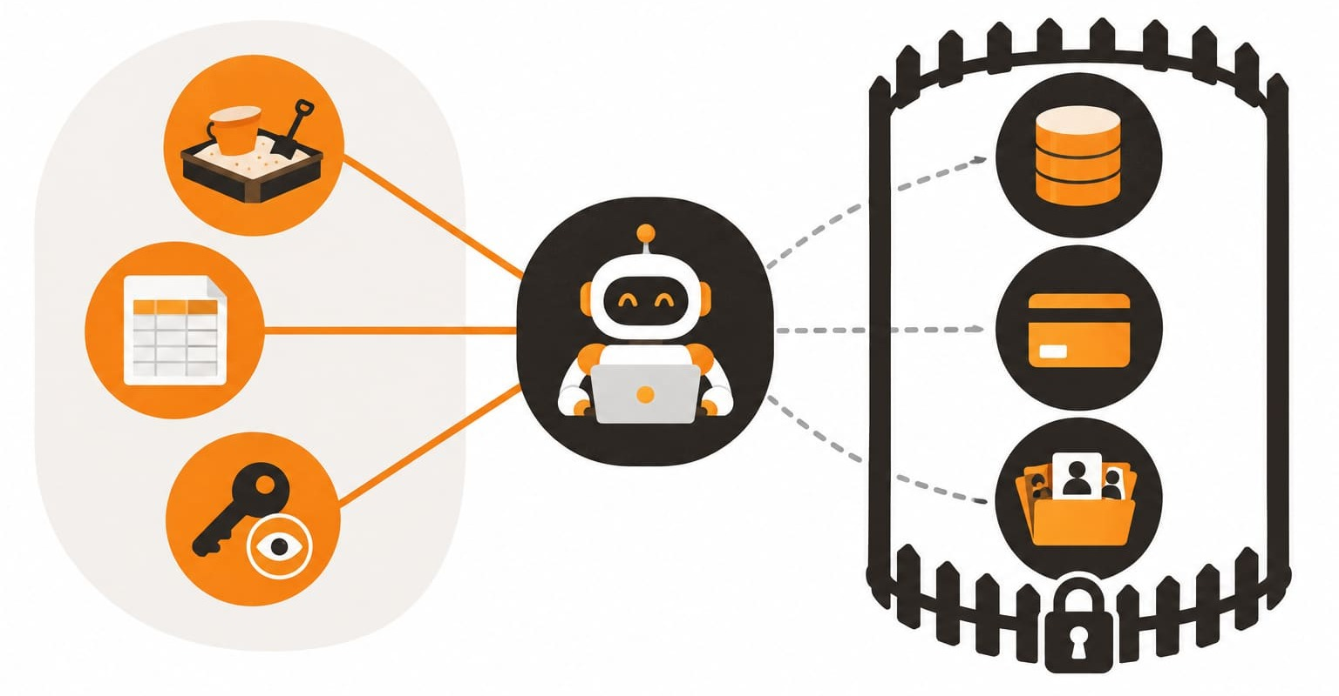
GUARDRAIL
Under all five: never production first
SAFE TO START
FENCED OFF
Sandbox
Production data
Sample export
Payments
Read-only key
Claude Code
Member records
Stay in the safe zone until you trust both the tool and the code it wrote.
You Can Build That · CITN26
15
Notes:
Member data and credentials stay out of reach while you're learning. Sandbox, sample exports, read-only API keys. This one isn't a habit, it's a rule.

Slide 16

THE BIG PICTURE
AI-SDLC for a team of one (or three)
1
Intent
YOU
1
Write the problem and "done" in a few sentences.
6
2
2
Plan
BOTH
Claude drafts the plan; you cut scope and approve.
3
Build
CLAUDE
Small steps on a branch; you approve actions.
4
Verify
BOTH
Tests, a sample run, and you read the diff.
5
3
5
Ship
YOU
Commit, open a PR even solo, deploy to real users.
4
6
Learn
YOU
Feed lessons back into CLAUDE.md and the backlog.
The lifecycle you already know. The agent speeds up the middle; you own both ends.
You Can Build That · CITN26
16
Notes:
33:00-35:00. Touch on this lightly. It's the same lifecycle any team runs, just compressed for one to three people. Claude does most of the Build, shares Plan and Verify with you, and you own Intent, Ship and Learn. The Learn step is what makes the next loop faster: every lesson goes back into CLAUDE.md.

Slide 17
FIRST PROJECTS
Small, internal, low-risk, checkable by dinner
PROJECT | RISK | FIRST WIN
Weekly CSV cleanup (dedupe, reformat, merge) | Low | 1-2 hrs
First-time guest follow-up list from a ChMS export | Low | 1-2 hrs
Explain and document a legacy script or stored proc | Very low | < 1 hr
Scheduled staff report (attendance, giving summary) | Low-med | Half day
Device or license inventory tracker | Low | Half day
Sunday AV / streaming checklist for volunteers | Low | Half day
Read-only ChMS API dashboard (sandbox key) | Medium | 1 day
You Can Build That · CITN26
17
Notes:
Every one of these has a clear input, a clear output, and a 'done' you can check the same day. The last one stretches you toward integrations, safely.

Slide 18
YOUR TURN
Pick one. Define done. Shrink it.
Pair exercise · 3 minutes
Not for a first project
1
Pick one project from the shortlist.
Anything that writes to live ChMS or giving data
Public sites, logins or payment flows
"Replace our [product]" rewrites
Anything you can't personally verify
2
Write what "done" means in three sentences.
3
Trade with your partner. Cut it in half.
My project's done means: ______________________
You Can Build That · CITN26
18
Notes:
35:00-40:00. Pairs take three minutes with the handout. Then advance to demo cue 4 and right-size one volunteer's project live in plan mode.

Slide 19
LIVE DEMO · 4 OF 4
~2 MIN · 38:00-40:00
Shrink it live
A volunteer's project, cut down to one afternoon
SWITCH TO
Terminal, plan mode, in any empty folder. Type the volunteer's idea into the prompt.
TYPE THIS
A church IT person wants to build: [volunteer's idea]. Ask me up to three questions, then propose the smallest version that could be built and checked in one afternoon, and list what to leave for later. Don't write any code.
WATCH FOR
It asks questions before it writes anything
A smallest version you can build and check in an afternoon
A short list of what to leave for later
You Can Build That · CITN26
19
Notes:
During Pick a project, after the pair exercise. Take one volunteer, type their idea in their words, answer its questions with them. Land it: 'That's habit one, live. Plan first, then shrink it.' If nobody volunteers, use: a volunteer scheduling app for the kids ministry.

Slide 20




MONDAY
Four steps to your first win
STEP 1
STEP 2
STEP 3
STEP 4
Install
New git repo
Add context
Build small
Claude Code in your terminal or editor
Commit early, commit often
A five-line CLAUDE.md file is enough
The smallest thing on your list
You Can Build That · CITN26
20
Notes:
The Monday next step. Everything else can wait until you've shipped one small thing.

Slide 21

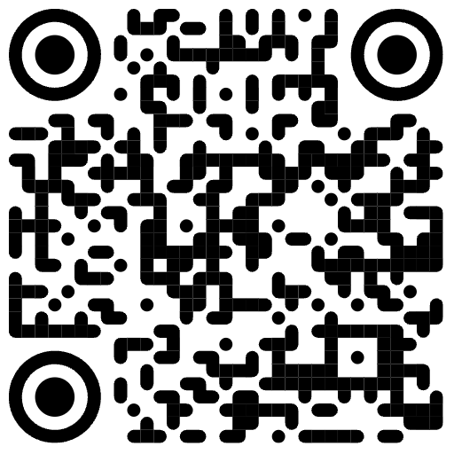
QUESTIONS
You can build that.
Build the small version first.
Chris Kehayias · ACS Technologies · Peer Learning · Community · Inspiration
Next session: we take the Guest Follow-Up Board live on Vercel.
Notes:
40:00-45:00. Likely questions: Is member data safe? (keep real PII out while learning; sample exports, read-only keys, check data terms with leadership). Do I need to code? (read well enough to spot nonsense; ask it to explain). Cost? (depends on plan; a first project fits light usage). Who maintains it? (CLAUDE.md, README, git history are the handoff). Replace our vendor? (no; it fills gaps around it). Close: You can build that. Build the small version first.

