Slide 1
CITN·AI
CHURCH IT NETWORK · WORKSHOP · SESSION 07
The Context Engineering
Loop
Explore · Plan · Code · Commit — the antidote to one-shotting.
CHRIS KEHAYIAS
DAY 1 · 3:50 – 4:20 PM · 30 MIN
Notes:
Welcome to Session 07. In the next 30 minutes I'll give you a name and a shape for the workflow you'll practice tomorrow: Explore, Plan, Code, Commit. This is the loop Anthropic teaches and the antidote to one-shotting. Five of our Ten Commandments live inside this loop — I'll point them out as we walk it.

Slide 2
EPCC · WHY A LOOP
01
02 / 10
STAGE 01 · WHY A LOOP
One-shotting is the default failure mode.
The loop is the cure.
• Without a loop, every feature feels like starting from scratch.
• Four words, all verbs, all pronounceable.
• Half the phases (Explore, Plan) are the ones people skip — naming them out loud makes skipping harder.
// THIS IS THE LOOP ANTHROPIC TEACHES
Notes:
Open with the failure mode. Without a loop, every feature feels like starting from scratch — and one-shotting is the default failure mode. The loop is the cure. Four words, all verbs, all pronounceable. Half the phases — Explore and Plan — are the ones people skip; naming them out loud makes skipping harder. This is the same loop you'll see in Anthropic's Claude Code best practices the moment you go home and search.

Slide 3
EPCC · THE LOOP
02
03 / 10
STAGE 02 · THE SHAPE OF IT
Explore → Plan → Code → Commit
[DIAGRAM TO INSERT: four phases (Explore, Plan, Code, Commit) in a circle, arrows clockwise between, CLAUDE.md in the center as the glue]
• Four phases arranged in a clockwise circle.
• Arrows show the loop returns — you can fall back from Code to Plan, or Plan to Explore.
• CLAUDE.md sits in the center: the shared context that makes every phase smarter.
GLUE
CLAUDE.md
is what makes every command in every phase smarter.
// IT IS A LOOP, NOT A WATERFALL
Notes:
This is the picture: Explore → Plan → Code → Commit, arranged in a circle with arrows. It's a loop, not a waterfall — you return to Plan every time Code surfaces something the plan missed; you return to Explore every time Plan reveals you don't actually understand what's there. The glue at the center is CLAUDE.md — the shared context you wrote this afternoon is what makes every command in every phase smarter.

Slide 4
EPCC · EXPLORE
01
04 / 10
COMMANDMENT IV — Dispatch subagents for context-polluting search
PHASE 01 · EXPLORE
Explore.
What already exists?
QUESTION
What's already in the codebase, the conventions, the constraints?
PRODUCES
A grounded sense of the codebase, conventions, and constraints — and an updated CLAUDE.md if anything was missing.
COMMANDS THAT HELP
/project:project-overview · read CLAUDE.md
// HALLWAY QUESTION #1: 'DID YOU EXPLORE?'
Notes:
Phase 1 — Explore. The question is: what already exists? You're getting grounded in the codebase, conventions, and constraints before you change anything. The output is a real sense of the terrain plus an updated CLAUDE.md if you find anything missing. Commandment IV lives here — dispatch subagents for context-polluting search so your main thread stays focused. Skipping Explore looks like 'I didn't read the existing code before asking Claude to add to it.' That's hallway question one: did you explore?

Slide 5
EPCC · PLAN
02
05 / 10
COMMANDMENT I — Plan Mode before edits; Shift+Tab is thy staff
PHASE 02 · PLAN
Plan.
What am I building, and why?
QUESTION
What am I building, what does done look like, and why is it worth building?
PRODUCES
Requirements, architecture notes, data model, acceptance criteria — written down before any code is written.
COMMANDS THAT HELP
/project:init-claude-md · Shift+Tab → Plan Mode
// HALLWAY QUESTION #2: 'DID YOU PLAN?'
Notes:
Phase 2 — Plan. The question is: what am I building and why? You're producing requirements, architecture notes, a data model, acceptance criteria. This is the phase people skip and regret. Day 2's first 105 minutes are literally Explore and Plan on purpose — the two phases that feel like 'not building yet' and are actually where the building happens. Commandment I — Shift+Tab into Plan Mode before you edit. That's hallway question two: did you plan?

Slide 6
EPCC · CODE
03
06 / 10
COMMANDMENTS VII & IX — Ritual = slash command · Read the diff
PHASE 03 · CODE
Code.
The inner loop: write → review → test → debug.
QUESTION
Does it work — really? Against real failure modes?
PRODUCES
Working code that's been reviewed, tested, and debugged against real failure modes. The commands here are designed to be run repeatedly, not once.
COMMANDS THAT HELP
/project:review · /project:gen-tests · /project:explain-error
// CODE IS THE INNER LOOP — WRITE · REVIEW · TEST · DEBUG · REPEAT
Notes:
Phase 3 — Code. This is the inner loop: write, review, test, debug, repeat until it actually works. The commands inside Code are designed to be run repeatedly, not once. Two commandments live here. Commandment VII — when you find a move that works, enshrine it as a slash command in .claude/commands/. Commandment IX — trust the plan, verify the patch. Read the diff every time.

Slide 7
EPCC · COMMIT
04
07 / 10
COMMANDMENT VI — /clear before the next loop. A fresh window is a righteous window.
PHASE 04 · COMMIT
Commit.
Can I ship it and explain it? (Stretched: deploy + comms.)
QUESTION
Can I ship it, and can I explain it to someone who didn't write it?
PRODUCES
A live URL, a clean git history, and a plain-language changelog non-technical stakeholders can read. Note: Anthropic uses Commit narrowly (git commit); we're stretching it to cover deploy and stakeholder comms.
COMMANDS THAT HELP
/project:summarize-changes · deploy (Session 13)
// BETWEEN LOOPS: /clear IS A SACRAMENT
Notes:
Phase 4 — Commit. Question: can I ship it and explain it? Output is a live URL, a clean git history, and a plain-language changelog. Acknowledge the stretch out loud — Anthropic uses Commit narrowly to mean git commit; we're stretching it to cover deploy and stakeholder comms. The devs in the room will respect the honesty. And between loops: Commandment VI — /clear is a sacrament. A fresh window is a righteous window.

Slide 8
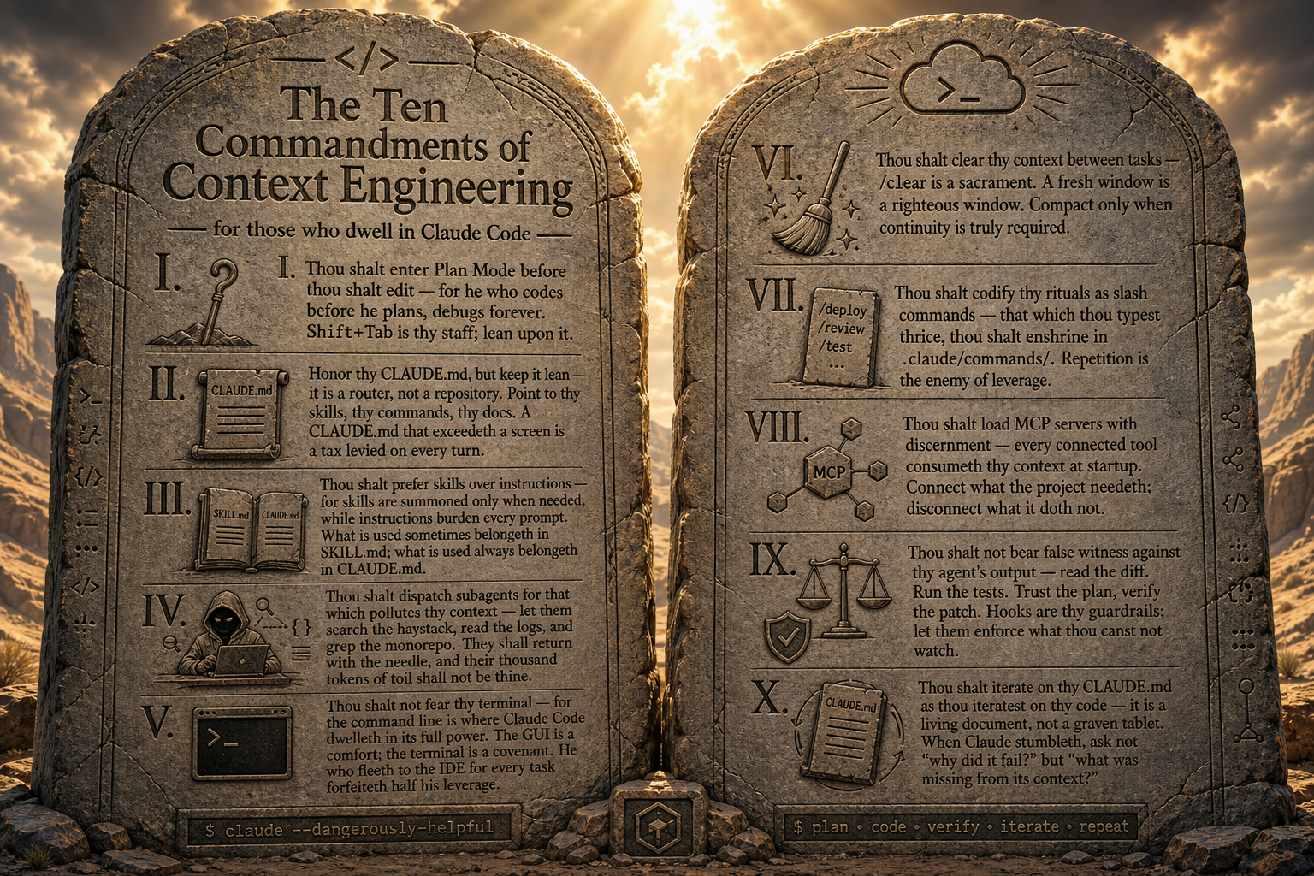
EPCC · COMMANDMENTS IN PLAY
08 / 10
STAGE · THE FIVE THAT MAP ONTO EPCC
Five commandments live in the loop.
COMMANDMENTS IN PLAY ACROSS EPCC
I Plan Mode before edits · Shift+Tab is thy staff · PLAN
IV Dispatch subagents for context-polluting search · EXPLORE
VI /clear before the next loop · fresh window = righteous window · BETWEEN LOOPS
VII Ritual = slash command · enshrine moves in .claude/commands · CODE
IX Trust the plan, verify the patch · read the diff · CODE
// I, IV, VI, VII, IX — THE FIVE THAT MATTER FOR THE LOOP
Notes:
The Ten Commandments aren't just a poster — five of them are workflow. As we walk the loop, point at the poster and call them by number. Don't lecture all ten; just the five that map onto EPCC: I (Plan Mode), IV (subagents for search), VI (/clear between loops), VII (slash commands as ritual), IX (read the diff). On the next slide we'll see how those five pin to the four phases.

Slide 9
EPCC · REFERENCE TABLE
08 / 10
STAGE · PHOTOGRAPHABLE
The four-phase reference table.
PHASE | QUESTION IT ANSWERS | WHAT IT PRODUCES | COMMANDS THAT HELP | COMMANDMENTS
Explore | What already exists? | Grounded sense of the codebase, conventions, constraints — updated CLAUDE.md if needed | /project:project-overview read CLAUDE.md | IV — subagents for context-polluting search
Plan | What am I building & why? | Requirements, architecture notes, data model, acceptance criteria | /project:init-claude-md Shift+Tab → Plan Mode | I — Plan Mode before edits
Code | Does it work — really? | Working code, reviewed, tested, debugged against real failure modes | /project:review /project:gen-tests /project:explain-error | VII — ritual = slash command IX — read the diff
Commit | Can I ship & explain it? | Live URL, clean git history, plain-language changelog for non-technical stakeholders | /project:summarize-changes deploy (Session 13) | VI — /clear before the next loop
// PRINT THIS · PEOPLE WILL WANT TO PHOTOGRAPH IT
Notes:
This is the photographable slide. Four phases, the question each answers, what each produces, the commands that help, and the commandments in play. Walk the table left-to-right, row-by-row, and call the commandments by number as you go. Don't live-demo every command — name them, link them, move on.

Slide 10
EPCC · NOT EVERY CHANGE NEEDS ALL FOUR
05
09 / 10
STAGE · WHICH PHASES FOR WHICH CHANGE
Not every change needs all four.
Typo, copy tweak, one-line fix → Code + Commit
Bug fix in code you wrote yesterday → Plan (briefly) + Code + Commit
Bug fix in code you didn't write → Explore + Plan + Code + Commit
New feature → All four, in full
Anything you'd describe as 'just quickly...' → probably needs Explore.
// THAT'S USUALLY WHERE 'JUST QUICKLY' GOES WRONG
Notes:
Not every change needs the full loop. A typo is mostly Code + Commit. A bug fix in code you wrote yesterday is Plan briefly, then Code + Commit. A bug fix in code you didn't write is all four. A new feature is all four in full. The punchline: anything you'd describe as 'just quickly...' probably needs Explore. That's usually where 'just quickly' goes wrong.

Slide 11
EPCC · DAY 2 PREVIEW
06
10 / 10
STAGE · TOMORROW
Tomorrow you run this loop end-to-end.
BUILD BLOCK 1
Explore + Plan
The 105 minutes that feel slow on purpose. Plan Mode is your staff.
BUILD BLOCK 2
Code
The inner loop: write → review → test → debug. Slash commands earn their keep.
DEPLOY BLOCK
Commit
Live URL · clean git history · changelog non-technical folks can read.
// NEXT UP — INNOVATION PANEL · THEN TOMORROW YOU PRACTICE THE LOOP
Notes:
Tee-up to the rest of the workshop. Tomorrow you actually run this loop end-to-end. Build Block 1 is Explore + Plan — the 105 minutes that feel slow on purpose. Build Block 2 is Code — the inner loop. The Deploy block is Commit — live URL, clean git history, changelog. The two hallway questions to remember when you get stuck: 'Did you Explore? Did you Plan?' Now over to the Innovation Panel.

