Slide 1
CITN·AI
PART 04 / 06 · CHURCH IT NETWORK · WORKSHOP
Building Context
Part 1
The concepts, the files, and what they look like when they're done right.
Notes:
Welcome back. We just finished Session 03 — yesterday's loop, the AI-SDLC. This session is the bridge from concept to practice. The phases didn't change. Context engineering is how you compress the cycle time. We will spend 60 minutes on the files that make the loop work: CLAUDE.md, requirements docs, conventions. By the end you should know what every artifact is for — even before you've written one. Part 2 after lunch is where you actually write yours.

Slide 2
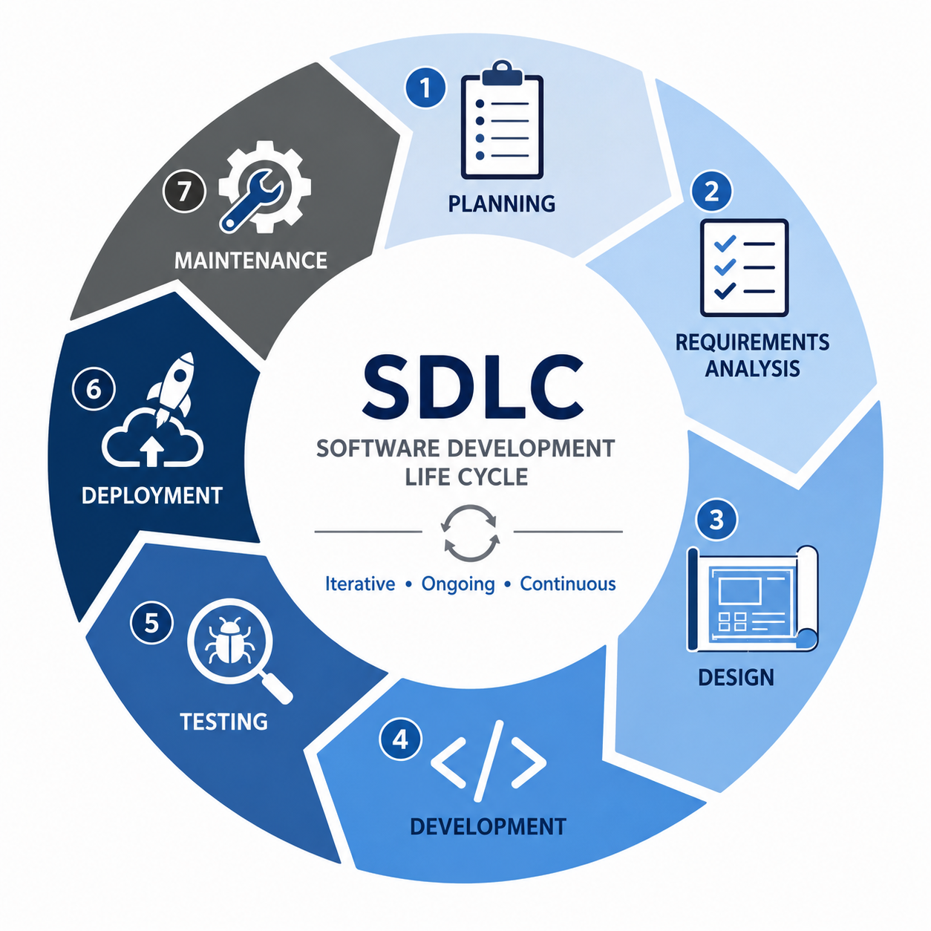
BUILDING CONTEXT · PART 1
02
02 / 22
BRIDGE · 3 MIN
Yesterday's loop, today's artifacts.
• The phases didn't change — Plan · Build · Test · Ship · Iterate.
• Context engineering is how you compress the cycle time.
• Today: the three files that turn the loop into a system you can repeat.
PROCESS → FILES
Notes:
Plant the bridge: yesterday's loop is a process; today is the files that make it work. Quote: 'The phases didn't change. Context engineering is how you compress the cycle time.' We're spending the next hour on three artifacts — CLAUDE.md, requirements docs, conventions files — because every team that gets value out of Claude Code has these in some form.

Slide 3
BUILDING CONTEXT · PART 1
03
03 / 22
WHAT YOU'LL LEAVE WITH
You can explain the role of three files — and recognize bad context when you see it.
CLAUDE.md · the project's router
requirements.md · model instructions with a business rationale
CONVENTIONS.md · naming, layout, commits, tests — written once
BREADTH NOW · DEPTH IN PART 2
Notes:
One sentence: by the end of this hour you can explain what each artifact is for, even if you haven't written one yet. Three names — CLAUDE.md, requirements.md, CONVENTIONS.md. We'll spend most of the hour on CLAUDE.md because that's where the design discipline lives. Part 2 after lunch is where you actually write one.

Slide 4
BUILDING CONTEXT · PART 1
04
04 / 22
WHY FILES · 7 MIN
Why context lives in files, not chat.
Amnesia. Every new session starts from zero. Files don't.
Reproducibility. Same prompt + same files = same answer tomorrow.
Sharing. Your teammate can read what you told the model.
Review. Pull-request the prompt the way you pull-request the code.
CHAT IS VOLATILE · FILES ARE DURABLE
Notes:
Four reasons context lives in files instead of chat. Amnesia — you cannot rely on the chat history across sessions. Reproducibility — files give you a deterministic starting state. Sharing — your team can read your context. Review — you can diff it, comment on it, ship it. If you're not writing things down, you're re-paying the explanation tax every morning. That's the next slide.

Slide 5
BUILDING CONTEXT · PART 1
05
05 / 22
THE EXPLANATION TAX
Without files, you pay it every morning.
[DIAGRAM TO INSERT: split panel — LEFT: developer re-typing context to a blank chat day after day. RIGHT: same developer points at CLAUDE.md and gets to work.]
• Re-explaining the stack, the layout, the naming, the gotchas — every single session.
• Multiply by every developer on your team. Multiply by every workday.
• Files turn a 5-minute warm-up into a 5-second one.
WRITE ONCE · REUSE FOREVER
Notes:
The explanation tax: every morning you sit down and re-tell the model the things it should already know. What stack, what folder layout, what tests. Multiply that by every dev on your team. A halfway-decent CLAUDE.md ends that tax. You will not write the perfect one on day one — and you don't have to. A half-good CLAUDE.md beats no CLAUDE.md by a mile.

Slide 6
BUILDING CONTEXT · PART 1
06
06 / 22
ANATOMY · 14 MIN · THE BIG ONE
CLAUDE.md — anatomy at a glance.
01
02
03
Overview
Tech stack
Structure
What this project is.
What it's built with.
Where things live.
04
05
06
Conventions
Build / test
Important notes
How we write code here.
Commands the model can run.
Things only humans know.
ONE PAGE · NO MORE
Notes:
Six sections. They live on one page. We're going to walk each one with a real example. If your CLAUDE.md is longer than what you can scan in 30 seconds, it's already too long — that's Commandment II, coming up. The six sections come from the init-claude-md template in resources/Claude/commands.

Slide 7
BUILDING CONTEXT · PART 1
07
07 / 22
CLAUDE.MD · SECTION 01
Section 01 · Overview
What this project is — in one paragraph the model can quote.
• Lead with the product, not the architecture.
• Name the audience — who uses this, what they accomplish.
• Two to four sentences. No marketing copy.
• If a new hire needs ten paragraphs to start, they'll never start.
// EXAMPLE
# Overview
Volunteer signup app for a mid-size
church (Northwoods, ~1,200 attendees).
Members browse open serving slots,
claim a slot, and receive a reminder.
Admins approve roles and export rosters.
Notes:
Section 1 is the product description. Two to four sentences. The model uses this to set tone for everything else — names, error messages, README copy. Lead with the user, not the framework. If you can't describe the product without mentioning the database, your overview is too low-level.

Slide 8
BUILDING CONTEXT · PART 1
08
08 / 22
CLAUDE.MD · SECTION 02
Section 02 · Tech stack
What it's built with. Versions matter.
• Languages, frameworks, runtime versions.
• Hosting target — local? Vercel? on-prem?
• External services and SDKs (auth, payments, email).
• If a constraint isn't here, the model can't honor it.
// EXAMPLE
# Tech Stack
- Next.js 15 (App Router)
- TypeScript 5.4 (strict)
- PostgreSQL 16 + Drizzle ORM
- Auth0 (organization plan)
- Resend for transactional email
- Hosted on Vercel (pro)
Notes:
Tech stack is where you list versions. 'Next.js 15 App Router' is very different from 'Next.js 13 Pages Router' — the model will guess wrong if you don't tell it. List the third-party services too. If you're on Auth0 organizations, that's a constraint the model needs.

Slide 9
BUILDING CONTEXT · PART 1
09
09 / 22
CLAUDE.MD · SECTION 03
Section 03 · Structure
Where things live. Path conventions over personality.
• A short tree of the top folders, with one-line purpose.
• Where new files go, by type.
• Anything you don't want touched (vendored code, generated files).
• If you can't draw it, the model can't follow it.
// EXAMPLE
# Structure
/app - routes & layouts
/components - shared UI
/lib - server utils, db
/db/schema - drizzle schemas
/scripts - one-off ops scripts
/tests - playwright + vitest
Notes:
Structure section lists the top-level folders and what goes where. It tells the model where to put a new component, a new route, a new test. Don't list every subfolder — list the ones where decisions get made. Vendored or generated code goes here too: 'don't touch /lib/generated'.

Slide 10
BUILDING CONTEXT · PART 1
10
10 / 22
CLAUDE.MD · SECTION 04
Section 04 · Conventions
How we write code here. The places junior devs trip.
• Naming: files, components, db tables, env vars.
• Imports: absolute vs relative, alias paths.
• Error handling and logging style.
• Comments — when, and what the team values.
// EXAMPLE
# Conventions
- Files: kebab-case
- Components: PascalCase, default export
- DB tables: snake_case, plural
- Imports: '@/' alias, no '../../'
- Errors: throw typed errors,
let route handler translate
Notes:
Conventions is where you write down the things you'd otherwise re-explain ten times. Naming, import style, error handling. This is also a tease for slide 17 where we go deeper — and for the dedicated CONVENTIONS.md if your project is big enough to warrant it.

Slide 11
BUILDING CONTEXT · PART 1
11
11 / 22
CLAUDE.MD · SECTION 05
Section 05 · Build / test
Commands the model can run — and rules for when.
• Install, dev, build, test, lint — exact commands.
• Pre-commit hooks and what they enforce.
• Which tests are mandatory before merging.
• What to do when a command fails (don't skip; fix or escalate).
// EXAMPLE
# Build / Test
- pnpm install
- pnpm dev # localhost:3000
- pnpm test # vitest watch
- pnpm test:e2e # playwright
- pnpm lint # eslint+tsc
All four must pass before merge.
Notes:
Build/test is the part the model uses to actually do work. List the exact commands. If you have a 'must-pass' set before merge, say so. If lint failures should not be auto-fixed without thought, say so. This unlocks 'Read the diff. Run the tests.' — Commandment IX.

Slide 12
BUILDING CONTEXT · PART 1
12
12 / 22
CLAUDE.MD · SECTION 06
Section 06 · Important notes
Things only humans know — and would forget to say.
• Gotchas: legacy decisions, deprecated paths, traps.
• Security or compliance constraints.
• Conventions that contradict the framework default.
• Anything that has bitten you twice.
// EXAMPLE
# Important notes
- Member emails are PII;
never log full address.
- Cron lives in /scripts; we
do NOT use Vercel cron.
- Migrations are manual on prod.
- Auth0 webhook secret is
in 1Password, not env file.
Notes:
Important notes is the final section, and it's the human-only knowledge. Anything that has bitten you twice belongs here. Compliance constraints, legacy decisions, traps. If you're staring at a Slack thread you're afraid to lose — that thread belongs in this section.

Slide 13
BUILDING CONTEXT · PART 1
13
13 / 22
COMMANDMENT II · CALLOUT
CLAUDE.md is a router, not a repository.
[DIAGRAM TO INSERT: side-by-side CLAUDE.md panels — bloated 200-line file vs. one-screen router file]
BLOATED · 300+ lines
ROUTER · one screen
# CLAUDE.md (excerpt)
## Database schema
- members table: id, email, role…
## All naming conventions
- file naming, var naming, fn naming…
## Full deploy runbook
## Onboarding for new devs
## Stand-up rituals
(model pays this on every turn)
# CLAUDE.md
Overview · Stack · Structure
Conventions · Build/test · Notes
→ See SKILL.md/db-schema
→ See SKILL.md/deploy-runbook
→ See docs/ONBOARDING.md
(model pays only what's needed)
ROUTE TO IT — DON'T REPEAT IT
Notes:
Commandment II. CLAUDE.md is a router, not a repository. If your CLAUDE.md exceeds a screen, it is a tax levied on every turn — every prompt the model receives loads the whole file. The router pattern says: keep CLAUDE.md skeletal, point to skills and docs. When you find yourself adding a fifth heading, ask: should this be a SKILL.md instead? We'll come back to this number. From now on I'll call it Commandment II.

Slide 14
BUILDING CONTEXT · PART 1
14
14 / 22
COMMANDMENT III · CALLOUT
Skills over instructions.
The rule of thumb — sometimes vs. always.
SOMETIMES → SKILL.md
ALWAYS → CLAUDE.md
• Database migrations.
• Deploy runbooks.
• PII redaction recipe.
• End-of-quarter reporting flow.
• Naming conventions.
• Folder layout.
• Required pre-commit checks.
• Stack & versions.
DON'T BURDEN EVERY PROMPT WITH ONCE-A-WEEK RULES
Notes:
Commandment III. What's used sometimes belongs in a SKILL.md; what's used always belongs in CLAUDE.md. The deploy runbook is a perfect SKILL.md — it gets invoked when you're shipping, not on every turn. Naming and folder layout are different — those apply to every task, so they live in CLAUDE.md. The discipline: when adding to CLAUDE.md, ask 'does this apply to every task this project will see?' If no — make it a skill.

Slide 15
BUILDING CONTEXT · PART 1
15
15 / 22
COMMANDMENT VIII · CALLOUT
Load MCP servers with discernment.
[DIAGRAM TO INSERT: token-cost-on-startup illustration — bar chart, baseline vs. each MCP server adding bytes]
• Every connected MCP server eats context at startup — before you've typed a single prompt.
• A 12-server setup can burn 30–40k tokens just describing tools you won't use.
• Connect what the project needs. Disconnect what it doesn't. Audit quarterly.
EVERY TOOL HAS A STARTUP TAX
Notes:
Commandment VIII. MCP servers are powerful — they connect Claude to Slack, Jira, your db, your design tool. But every connected server consumes context at startup. The tool descriptions, the parameter schemas, the auth flows — all of it ships in the system prompt before you say anything. A 12-server setup can burn 30–40k tokens describing tools you don't use today. Audit your MCP list. Connect what this project needs. Disconnect the rest.

Slide 16
BUILDING CONTEXT · PART 1
16
16 / 22
REQUIREMENTS · 10 MIN
Requirements docs for an LLM audience.
Explicit > implicit. Name the constraints the model can't infer.
Lists > prose. Bulleted requirements scan; paragraphs hide.
Examples > adjectives. 'Like our /reports endpoint' beats 'clean and modern'.
Not a product spec — model instructions with a business rationale.
WRITE FOR THE READER · THE READER IS A MODEL
Notes:
Requirements docs are the second artifact. Three rules: explicit beats implicit — name the things the model can't infer (don't say 'follow our security standards' — link them). Lists beat prose. Examples beat adjectives — 'like our /reports endpoint' is a thousand times more useful than 'clean and modern'. The mental shift: a requirements doc isn't a product spec. It's model instructions with a business rationale attached.

Slide 17
BUILDING CONTEXT · PART 1
17
17 / 22
CONVENTIONS · 8 MIN
Conventions that stick.
NAMING
LAYOUT
COMMITS
TESTS
Files. Components. DB tables. Env vars.
Where new files go. By type, not by feel.
Conventional Commits. PR titles match.
What's mandatory before merge.
Write them once — where they'll always be in context.
JUNIOR-DEV MISTAKE INSURANCE
Notes:
Conventions are the territory where junior-dev mistakes happen. Naming, layout, commits, tests. Write them once. Where? Either as Section 4 of CLAUDE.md, or — if the project is big enough — as a dedicated CONVENTIONS.md that CLAUDE.md routes to (Commandment II again). The point is: in context. Not in a Notion page no one reads.

Slide 18
BUILDING CONTEXT · PART 1
18
18 / 22
LIVE DEMO · 10 MIN
Watch this.
// IN A SAMPLE PROJECT
/project:init-claude-md
• Small, familiar app — volunteer signup or a church directory.
• Watch which Commandments the generated file embodies. (And which it violates.)
IF DEMO FAILS · NEXT SLIDE IS THE INSURANCE
Notes:
Live demo. We run /project:init-claude-md on a small familiar project. While it runs, narrate what's happening — it's gathering project context first (project-overview.md command), then writing the six sections. Pause as the file is generated and call out which Commandments the result embodies — and any it violates so we can correct in real time. If the demo fails, advance to slide 19 — that's the insurance.

Slide 19
BUILDING CONTEXT · PART 1
19
19 / 22
DEMO RESULT · ANNOTATED
What just got generated.
[DIAGRAM TO INSERT: annotated screenshot of the generated CLAUDE.md, with arrows pointing at the six sections and callouts for Commandment II/III/VIII]
• Six sections — Overview, Stack, Structure, Conventions, Build/test, Notes.
• One screen. No skills inlined that should be skills (Commandment III).
• If a section drifted long, we'd cut it back to a router pointer (Commandment II).
INSURANCE SLIDE · USE IF LIVE DEMO STUMBLED
Notes:
Insurance slide. If the live demo failed, this is the annotated screenshot — same six sections, same critique. Walk the screenshot, point out the parts that follow Commandments II, III, VIII. If the demo went well, this slide is just a recap.

Slide 20
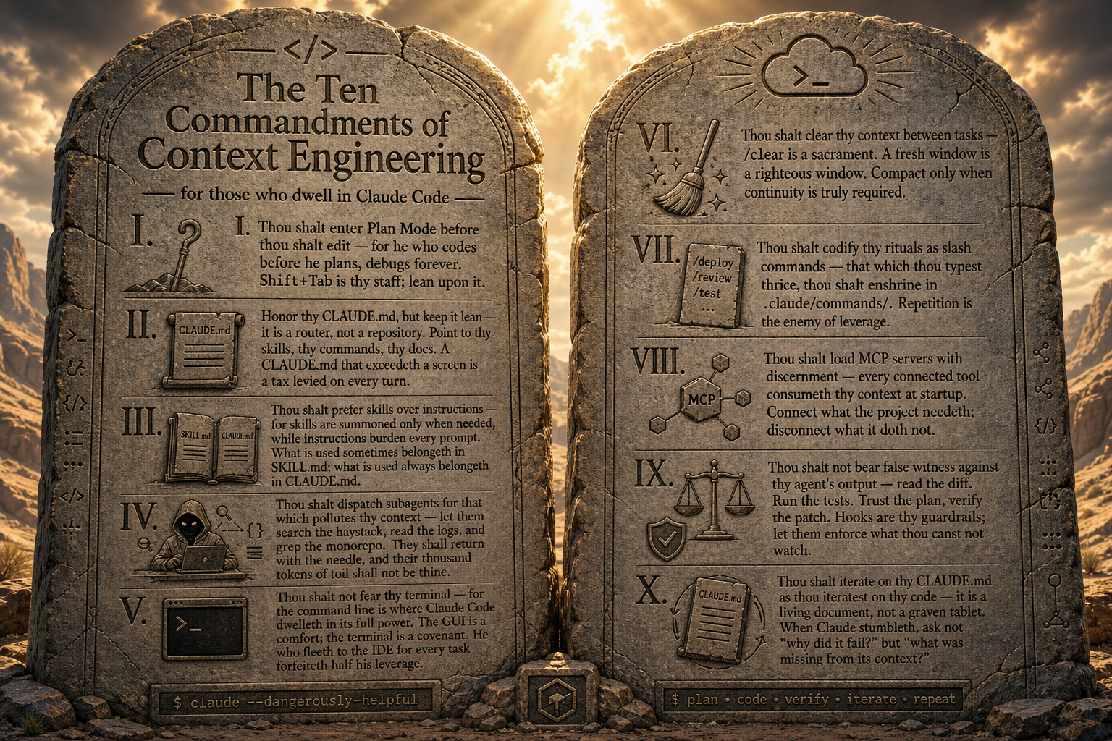
20 / 22
Notes:
Pause for 10 seconds. Let the room photograph it. This is the photo slide of Day 1. Read 4-5 commandments aloud, gesture at the rest.

Slide 21
BUILDING CONTEXT · PART 1
21
21 / 22
PREVIEW · PART 2 · AFTER LUNCH
You'll write your own. Then rewrite it.
01
02
03
WRITE
CRITIQUE
REWRITE
Draft a CLAUDE.md for a project you actually own.
Trade decks. Your partner reviews against the Ten Commandments.
Apply the feedback. That's Commandment X — iterate.
COMMANDMENT X · ITERATE LIKE YOU ITERATE CODE
Notes:
Preview Part 2. After lunch you'll write your own CLAUDE.md for a project you actually own — doesn't have to be perfect. Then you'll trade with a partner who critiques against the Ten Commandments. Then you'll rewrite. That last step is Commandment X in practice — CLAUDE.md is a living document, not a graven tablet.

Slide 22
BUILDING CONTEXT · PART 1
22 / 22
THE TRANSITION
END OF SESSION 04 · GO EAT
Notes:
Transition slide. Land it: 'After lunch, you write yours.' End two minutes early so the lunch break doesn't get squeezed. Tell the room to bring a project they actually own — Part 2 is hands-on, not theoretical.

