Slide 1
CITN·AI
CHURCH IT NETWORK · WORKSHOP
PART 05 / 14
Building Context Part 2 – Claude Code
Notes:
Welcome people back from lunch. This is the practice partner to Session 04 — Session 04 told you what good context looks like; Session 05 makes you write it, get critiqued, and rewrite. Land the line: 'Everyone writes. Everyone rewrites — that is Commandment X in practice.'

Slide 2
BUILDING CONTEXT · PART 1
03 / 22
WHAT YOU'LL LEAVE WITH
Comprehensive overview of Claude Code
Notes:
One sentence: by the end of this hour you can explain what each artifact is for, even if you haven't written one yet. Three names — CLAUDE.md, requirements.md, CONVENTIONS.md. We'll spend most of the hour on CLAUDE.md because that's where the design discipline lives. Part 2 after lunch is where you actually write one.

Slide 3


AI CONTEXT ENGINEERING WORKSHOP
PART 1 · THREE FILES
Claude.md , Memory, and Commands
Three things that turn Claude Code from a chatbot into a teammate.
PATRICK ABERNATHY — PRINCIPAL ENGINEER, AI ENABLEMENT

Slide 4

SPEAKER
Patrick Abernathy
Principal Engineer, AI – ACS Technologies
Notes:
Brief intro — keep it under 60 seconds. 'I ship AI products for a living and I've been in the church tech world a while. Most of what I'm sharing today is what I wish someone had told me two years ago.'

Slide 5
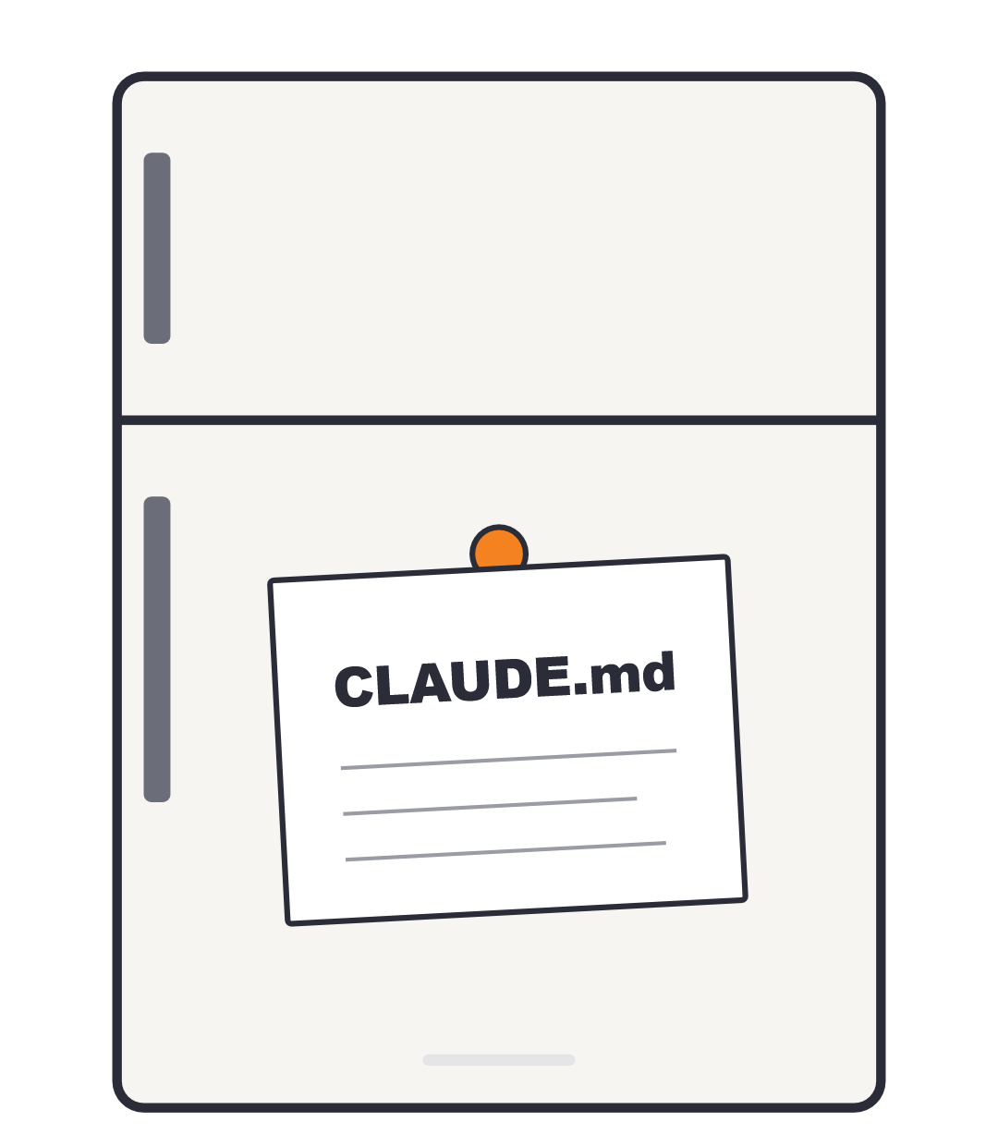
CHAPTER 1 · THE FILE
Meet CLAUDE.md
A plain text file Claude reads every time it works on your project.
Like a sticky note on the fridge — anyone who walks into the kitchen sees it before they start cooking.
Not magic. Not configuration. Just notes for the AI.
If you've ever explained the same thing to a new hire three times, this file is for you.

Slide 6
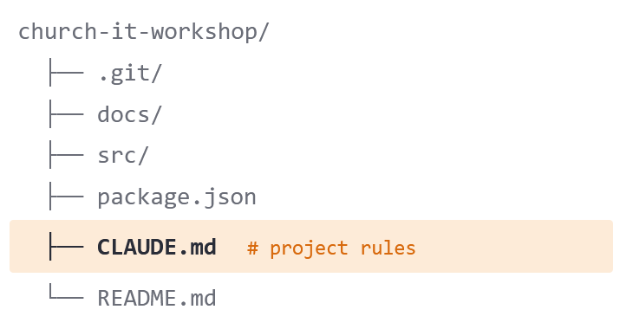
CHAPTER 1 · THE FILE
The project-level CLAUDE.md
church-it-workshop/
├── .git/
├── docs/
├── src/
Lives at the top of your project folder.
├── package.json
Tells Claude what this specific project needs to know.
├── CLAUDE.md # project rules
└── README.md
Things like: which framework, naming conventions, gotchas, "the user's name is Tripp, not Trip."
Everyone on the team sees the same notes — no more "Claude keeps forgetting."
FROM THIS REPO'S CLAUDE.MD
"The speaker's name is Tripp, not Trip."

Slide 7



CHAPTER 1 · THE FILE
ONE FILE · EVERY PROJECT
The global CLAUDE.md
One Ring to rule them all.
Lives in your home folder, not in any project:
~/.claude/CLAUDE.md
Applies to every project you ever touch.
For things that are true about you everywhere: branch naming, PR style, code review preferences.
It's the guardian. It travels with you, project to project.

Slide 8
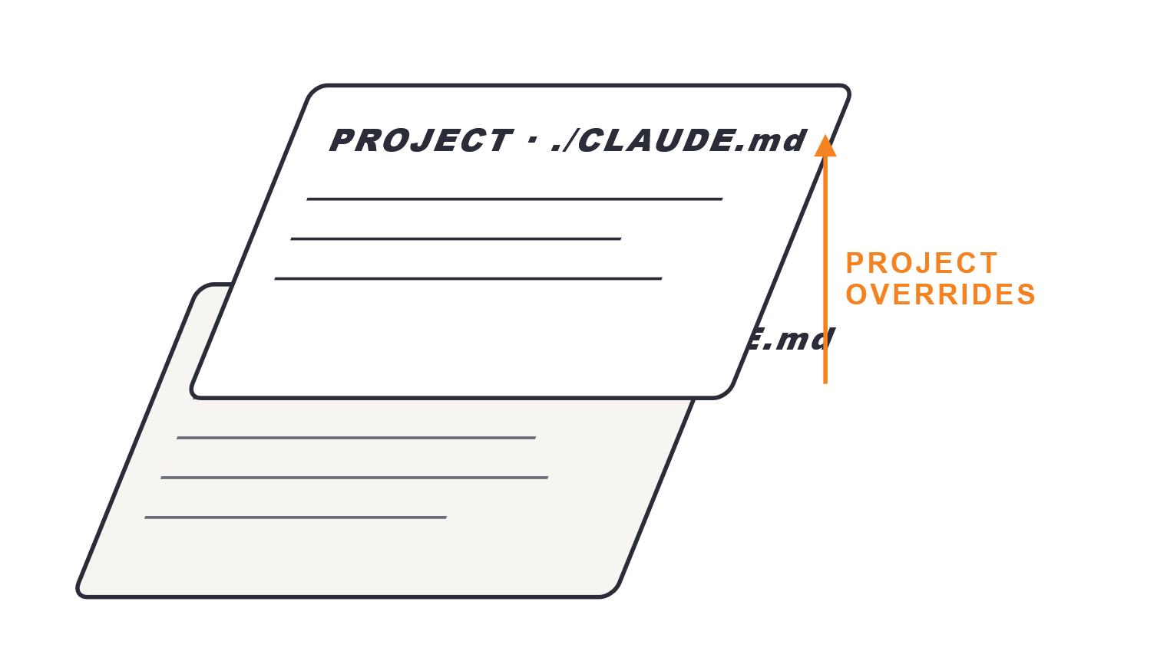
CHAPTER 1 · THE FILE
How they stack
Both files load at the same time, every conversation.
Global rules first, then project rules layered on top.
Project can override global when needed.
Two files, zero ceremony, infinite context savings.

Slide 9
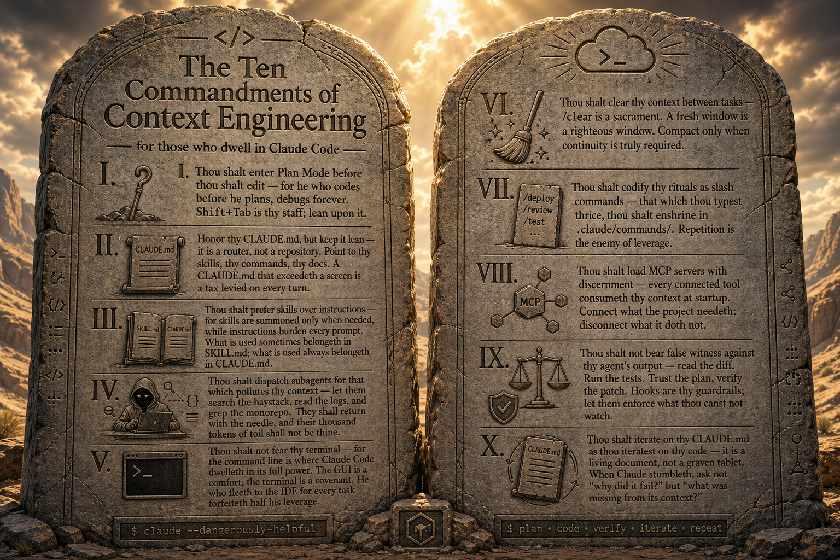
THE COMMANDMENT
REMEMBER THIS FROM BEFORE LUNCH?
Commandment X.
X.
Iterate CLAUDE.md as you iterate code.
Your context is a living document, not a graven tablet.
Rewrite it the day after the codebase changes.
A half-good CLAUDE.md you actually rewrite weekly
beats a polished one that never gets touched again.
What you just did is the practice. Do it weekly.
FLASH FOR TWO BEATS — THEN ZOOM TO X
Notes:
Flash the full poster for two beats. Then point at commandment X. 'What you just did is the practice. Do it weekly.' This is the third and most important time you say Commandment X out loud today — make it land.

Slide 10
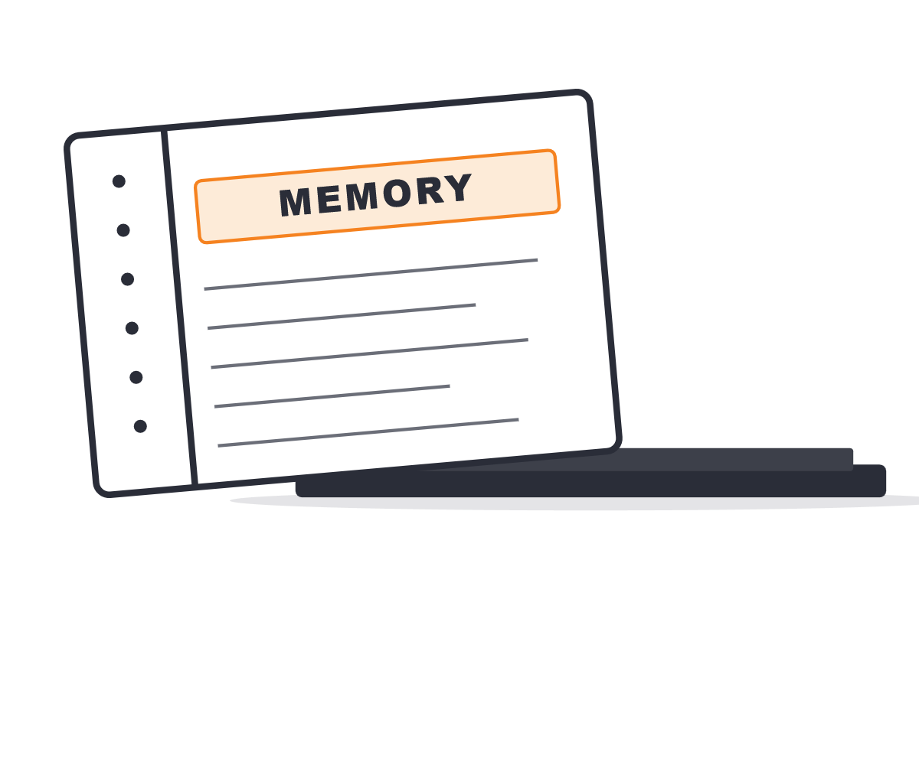
CHAPTER 2 · MEMORY
Auto-memory
The notebook Claude keeps about you.
Separate from CLAUDE.md.
Claude writes its own notes between conversations.
Stored quietly at ~/.claude/projects/<your-project>/memory/
Like an assistant who keeps a notebook: "Patrick prefers merge commits. He's working on the May workshop. He gets nervous about destructive git commands."

Slide 11
CHAPTER 2 · MEMORY
Auto-memory
The notebook Claude keeps about you.
Separate from CLAUDE.md.
Claude writes its own notes between conversations.
Stored quietly at ~/.claude/projects/<your-project>/memory/
Like an assistant who keeps a notebook: "Patrick prefers merge commits. He's working on the May workshop. He gets nervous about destructive git commands."

Slide 12




CHAPTER 2 · MEMORY
What ends up in there
Who you are & what you're working on.
Things you've corrected — or praised.
Your name, your role, the project you're in the middle of, the deadlines on your calendar.
Both matter. The corrections sharpen it; the praise tells it what "good" looks like for you.
Project status: deadlines, decisions, who's doing what.
Pointers to other systems.
Linear boards, Slack channels, dashboards — the places it should look when you ask.
Where this thing stands, and the trail of choices that got it there.

Slide 13

CHAPTER 2 · MEMORY
How it grows
Claude adds to it on its own when it learns something useful.
You can ask it to remember a thing: "remember that I always want PRs reviewed before merge."
You can ask it to forget.
Over weeks, it builds up a real working relationship.

Slide 14
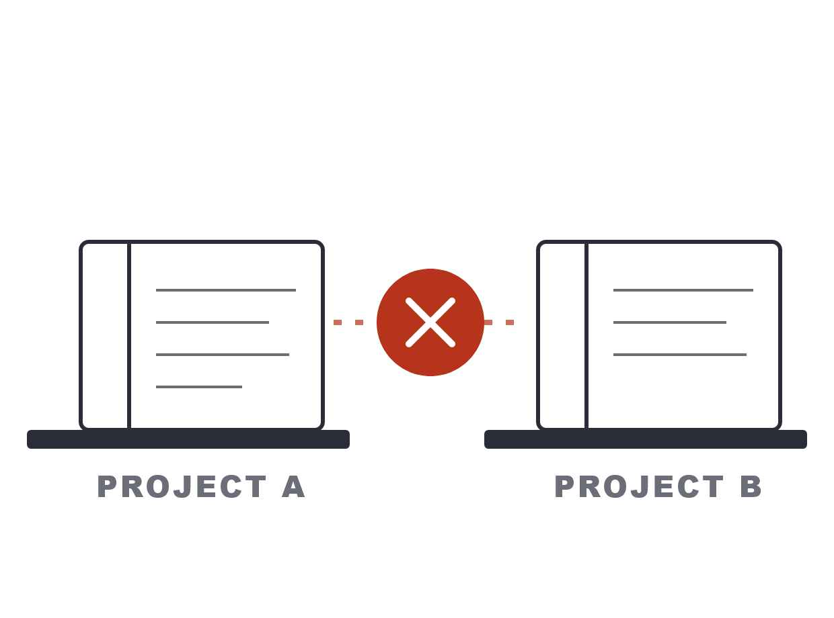
CHAPTER 2 · MEMORY
HEADS UP
The catch: memory is per-project
Memories live with one project, not with you.
Switch to a different project → Claude shows up with a fresh notebook.
It's a feature, not a bug — your work projects don't leak into your hobby projects.
But: don't expect "I told you this last week" to work across projects.

Slide 15
CHAPTER 3 · SHORTCUTS
Custom commands: saved shortcuts
claude code
A command is a recipe Claude can run on demand.
> /release▎
✓ run tests
You type /release — Claude runs the whole release recipe you wrote.
✓ bump version (1.4.2 → 1.4.3)
✓ generate changelog
… build & tag release
For developers: same idea as saving a routine as a function.
open PR & notify #releases
For everyone else: think of it as a saved Excel macro, but for AI.

Slide 16
CHAPTER 3 · SHORTCUTS
Custom commands: saved shortcuts
claude code
A command is a recipe Claude can run on demand.
> /release▎
✓ run tests
You type /release — Claude runs the whole release recipe you wrote.
✓ bump version (1.4.2 → 1.4.3)
✓ generate changelog
… build & tag release
For developers: same idea as saving a routine as a function.
open PR & notify #releases
For everyone else: think of it as a saved Excel macro, but for AI.

Slide 17
CHAPTER 3 · SHORTCUTS
THE RULE
If you've done it twice, make a command
Asked twice in two days?
Need the output to look the same every time?
Consistency > creativity?
Same rule developers follow for code.
→ command.
→ command.
If you do it twice, you write a function for it.
→ command.

Slide 18
CHAPTER 3 · SHORTCUTS
THE RULE
If you've done it twice, make a command
Asked twice in two days?
Need the output to look the same every time?
Consistency > creativity?
Same rule developers follow for code.
→ command.
→ command.
If you do it twice, you write a function for it.
→ command.

Slide 19




CHAPTER 3 · SHORTCUTS
Real examples
From my ~/.claude/commands/ folder (or Chris’).
/start-sprint
/issue
Create the sprint branch with the right naming convention.
From issue number to pushed branch — solo or many in parallel.
/review
/commit
Rewrite CLAUDE.md and reference docs from a fresh scan.
Summarize changes and commit with a clean message.
/release
/release-the-hounds
Run the release checklist end to end.
Fully autonomous: triage issues → implement → PR → ship.
ALL SAVED FILES · ALL SHAREABLE · ALL REPLAYABLE

Slide 20
CHAPTER 3 · SHORTCUTS
Closer look: /review
claude code
Type /review — Claude regenerates its understanding of the whole project.
> /review▎
✓ 10 explorers launched in parallel
~10 explorer agents fan out — one per area, all running in parallel.
✓ wrote 9 docs to .claude/docs/
✓ rewrote CLAUDE.md (218 lines)
… self-validating links & key terms
Writes deep-dive docs to .claude/docs/ — architecture, DB, auth, AI, UI, more.
context refreshed — ready
Rewrites CLAUDE.md as a tight overview — then self-validates the output.

Slide 21
CHAPTER 3 · SHORTCUTS
ONE COMMAND · MANY COMMANDS
It’s commands all the way down
/release-the-hounds isn’t new logic — just my other commands, run with two tweaks.
01 · CHAIN
02 · OVERRIDE
Commands call commands.
Rules bent on the fly.
Runs /issue → /pr → /pr-review, in order.
/issue usually pauses for review — here, it skips.
Each one is a recipe I’d already written.
/pr-review usually defers approval — here, it approves itself.
The new command is just the conductor.
Base commands stay safe. The meta-command opts in to autonomy.

Slide 22
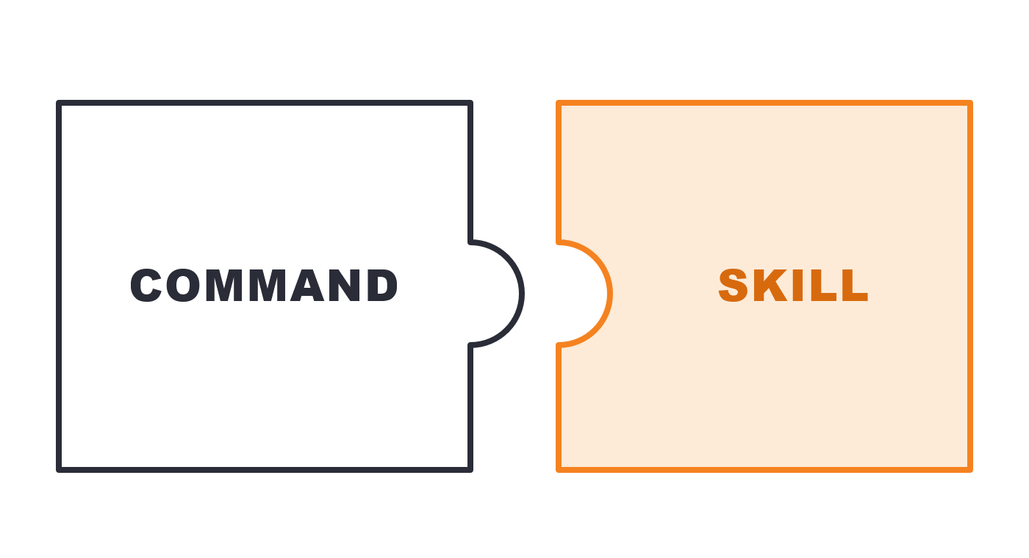
CHAPTER 3 · SHORTCUTS
Skills: same idea, slightly different shape
Skills are commands' close cousin.
Both are saved instructions Claude can call up.
Differences are mostly under the hood — for most uses, they're interchangeable.
Pick whichever feels natural; don't agonize.

Slide 23



CLOSING
From chatbot to teammate
TEAMMATE
TEAMMATE
Three files: CLAUDE.md, memory, commands.
Together: Claude shows up already knowing your project, your preferences, and your workflows.
That's the difference between talking to AI and working with AI.
The work you put in is permanent — it makes every future session better.

Slide 24
THE TAKEAWAY
12 / 12
“
Your CLAUDE.md is now a draft, not a relic.
— CHRIS KEHAYIAS · CITN.AI WORKSHOP
Notes:
Land it and stop. 'Your CLAUDE.md is now a draft, not a relic. Day 2 is when it earns its keep.' Hand off to the break / next session.

