Slide 1

CITN·AI
CHURCH IT NETWORK · WORKSHOP
Decoding Claude Code No Dev Skills Required—
Just Results
TRACE JACKSON · INNOVATION PROGRAM MANAGER

Slide 2
Where are you on the spectrum?
Most people sit at one of two extremes with AI.
Smarter Google.
That's a developer thing.
Quick questions.
Email proofing.
"Summarize this."
Heard "Claude Code" or seen agent demos.
Decided it isn't for them.
Tunes out.
CLAUDE FOR NON-DEVELOPERS
Notes:
You are officially on the spectrum! Where on the spectrum? Let’s find out.
Most people in this room — most people anywhere — sit at one of two extremes with AI.
On the left, you use it like a smarter Google.
Quick questions, proof an email, summarize a thing.
That's the whole relationship.
On the right, you've heard the words 'Claude Code’
or you've seen an agent demo on Twitter,
and you decided 'that's a developer thing, not for me,' and you tuned out.

Slide 3
Where are you on the spectrum?
Most people sit at one of two extremes with AI. The good stuff lives in between — and almost nobody is there.
The sweet spot.
↓
Smarter Google.
That's a developer thing.
Quick questions.
Email proofing.
"Summarize this."
Heard "Claude Code" or seen agent demos.
Decided it isn't for them.
Tunes out.
CLAUDE FOR NON-DEVELOPERS
Notes:
The good stuff — the stuff that gives you – and me – those of us who aren’t developers – where we get back hours of your week — is the entire middle ground.
The next 45 minutes are about the middle.
This is the Goldilocks Zone.
It’s not too simple
it’s not too technical
This is Juuuuust Right.
Workflows (and life flows!) that can truly change your week. No code required.

Slide 4



THE FRAMING
Three doors. None require code.
Walk through the ones that fit. Walk past the ones that don't.
DOOR 01
DOOR 02
DOOR 03
01
02
03
Claude Chat.
Claude Cowork.
Claude Code.
CLAUDE FOR NON-DEVELOPERS
Notes:
So here's the framing for everything we'll talk about. We’re going to peek inside three doors. None of them require code, even the one called 'Claude Code' — I promise we'll get to that.
Door one is Chat. That's where most of you live already.
Your conversational thinking partner. One-shot prompts, no files in play.
The door is nice and warm and inviting. There’s a back porch or coffee-shop feel. Friendly entry point.
Door two is Cowork — Claude with hands on your real files and apps.
Multi-step deliverables, scheduled tasks.
This door is a bit more industrial. Studio steel door like leading into a workshop. Heavier, hands-on.
Door three is Code — power-user mode.
Custom commands plugged into the systems you already use.
Notice the industrial vault door. Almost like a cockpit; it’s got a power-user feel. Heaviest, most dramatic
We’re going to peek around and see what’s behind each door today.
And hopefully, eventually, you will walk through the doors that fit.
You walk past the ones that don’t.
Nobody has to use all three.

Slide 5
LEARNING · 1 OF 5
Complain to AI.
Don't bring solutions. Bring problems.
CLAUDE FOR NON-DEVELOPERS
Notes:
Before we open door one, I will be sharing some of my own learnings with you. The things I’ve picked up that have exponentially changed how I use AI.
I’ve got 5 I’ll be sharing.
This is learning number one. This is the single most important thing I'll say today, and it has changed the AI game for me.
If you don’t know where to start with AI…
Just complain.

Slide 6
LEARNING · 1 OF 5
Just complain.
The model can't fix problems you've already disguised as solutions. Hand it the raw friction.
"I waste two hours every Friday on [X]."
"I can never keep track of [Y]."
"Our team keeps dropping the ball on [Z]."
"I dread [task] every week."
CLAUDE FOR NON-DEVELOPERS
Notes:
Here's what I mean.
People think they have to walk up to Claude with a fully-formed plan in their head, and they prompt the plan.
'Write me a five-step volunteer onboarding process.’
But that's a solution disguised as a question — the model will struggle to fix it, because you've already decided what the answer looks like.
Flip your strategy on its head.
Instead, complain. 'I waste two hours every Friday on volunteer scheduling.’
'I can never keep track of which families I've followed up with.’
'Our team keeps dropping the ball on new-member assimilation.’
'I dread writing the bulletin every week.’
The raw friction becomes the prompt. Hand it the problem and let it work the solution.

Slide 7
01
DOOR 01 / 03
Claude Chat.
Your conversational thinking partner.
01 · Chat
|
02 · Cowork
|
03 · Code
Notes:
Door one. Claude Chat.
This is the version most people picture when they think of AI — you type a question or paste in something you're working on, and Claude writes back.
Think: ChatGPT.
You can have a back-and-forth conversation,
share documents or images,
and ask follow-up questions.
It can also plug into things you already use — your email, calendar, Google Drive, Slack, [your church management system?] — so you don't have to copy-paste data back and forth.

Slide 8
CLAUDE CHAT · BEST KNOWN FOR
Jobs Chat does well.
Treat it like a conversation, not a query box. The model is happiest with context and intent.
Drafter
Summarizer
Brainstormer
Decider
Translator
Researcher
Coach
Personal
CLAUDE FOR NON-DEVELOPERS
Notes:
Chat is best known for…
Drafter — emails, letters, copy.
Summarizer — long things become short things.
Brainstormer — titles, taglines, sermon angles.
Decider — compare options, pressure-test a choice.
Translator — simplify, explain, rephrase. say this in a way that a non developer can understand
Researcher — smart Google, but with actual reasoning behind it.
Coach — pressure-test your thinking before you take an idea into a meeting.
And the orange one matters: personal stuff.
Vacation comparisons, recipes, life. This matters b/c
the people who get good at AI at work are the ones who use it constantly outside of work.
The reps compound.

Slide 9
CLAUDE CHAT · HOW I'M USING IT
It's a daily tool. Not a project.
A handful from this past week — work and life, no separation.
work
Drafted a one-page exec infographic for our leadership team.
work
Troubleshot OneDrive and MS Teams issues. And Outlook calendar. And more Teams issues.
work
Compared translations of an internal acronym.
work
Built social media strategy for Kingdom Creations.
life
Hunted for a warm, lightweight travel jacket.
CLAUDE FOR NON-DEVELOPERS
Notes:
This is how I’m using Chat…
This is a real list.
Just this past week I drafted an infographic for our leadership team.
We recently migrated from Google to Microsft and I had to turn to Claude to troubleshoot some issues. The struggle was real. And Claude even validated my frustration.
I compared translations of an internal acronym across teams.
I’ve used Claude to build a social media strategy because that is not my strong suit plus nobody got time for dat.
I set Chat to work researching a jacket to meet some very specific requirements.
Work and life, for me this tool has no separation.
But this is me. What about you?

Slide 10
CLAUDE CHAT · YOUR TURN
Find your role.
A starting line for every chair in this room.
Pastoral
Communications
Admin
Sermon angles, illustrations, cross-references.
Newsletter copy, captions, headlines.
Drafts, summaries, polished minutes.
Finance
Kids / Youth
Worship
Explain budgets, donor thank-yous.
Adapting lessons, parent guides.
Songs to themes, set-list logic.
Volunteer Coord
Operations
Leadership
Recruitment language that doesn't beg.
SOPs, vendor comparisons, policy drafts.
Pre-reads, decision memos, board prep.
CLAUDE FOR NON-DEVELOPERS
Notes:
I (and by me I mean we – Claude and I)
put together some ideas to help you get started using Claude Chat.
Find your role on this grid.
If you're pastoral — you can tap into Chat for sermon angles, illustrations, cross-references.
Communications — use it to help you craft copy, attention grabbing captions, headlines.
I’m not gonna read all of these to you. You’ll get this slide deck afterwards.
But I did want to point to the bottom, left:
Volunteer coordination — recruitment language that doesn't feel like you’re begging? Srsly.
But these might already be things you’re trying. And I wanted to provide you with some ideas beyond the obvious…

Slide 11
CLAUDE CHAT · YOUR TURN
Hide it under a bushel … No!
Let it shine, let it shine, let it shine!
Pastoral Care
Sermon +
Handbook
Screening
Translate
Discernment
Discipleship
Clarification
Evaluation
Reframing
“Draft a compassionate follow-up email for a grieving family situation.”
“Rewrite this sermon into a simple family devotional for parents and kids.”
“What do our documents say about leadership qualifications and term limits?”
“List potential red flags when evaluating candidates for youth ministry roles.”
“Translate this parent concern into a clear, respectful board-level summary.”
Notes:
Pastoral care prep. A pastor types out (without names) what's going on with a family, and asks Claude to help think through follow-up, suggest scripture for a specific kind of grief, or check the tone of a hard email before sending it.
Turning a sermon into small group material. Drop in the sermon, ask for discussion questions at three levels — for someone brand new to faith, for a regular attender, and for a group leader. Get a parent-and-kid version of the same passage for the family devotional that week.
"What does our handbook say?" Load your bylaws, denominational handbook, and recent board minutes, then let staff just ask plain questions like "can a deacon also be on the finance committee?" instead of bothering the executive pastor.
Volunteer screening help. Build interview questions and a list of red flags for kids or youth ministry roles, lined up with your child protection policy.
Translating between worlds. Take something written in seminary language and rewrite it for a kids ministry volunteer who has zero theology background. Or the reverse — take a parent's casual concern and help articulate it for a board conversation.
Pick one. From this slide or the previous.
And try it on Monday.

Slide 12
CLAUDE CHAT · BEST PRACTICES
Three habits that level up Chat.
Small setup moves that turn Chat from "smarter Google" into something that knows you.
Set up a Project for anything recurring.
Connect the tools you already live in.
Save a Style for recurring voice.
Treat the first answer like a first draft.
CLAUDE FOR NON-DEVELOPERS
Notes:
Let’s talk about a few Chat best practices.
One — set up a Project for anything recurring.
A folder where Claude remembers
your background and reference materials.
Onboard once instead of re-explaining every Monday.
Two — connect the tools you already live in.
Email, calendar, ChMS.
Claude pulls from there directly, and you stop summarizing.
Three — save a Style for recurring voice.
Board updates, donor emails. Lock the tone once.
And then: treat the first answer like a first draft. Push back. Two turns beats one perfect prompt.
Bonus: Keep at it.
The more you chat, the more context you give it about you.

Slide 13
LEARNING · 2 OF 5
Show. Don't describe.
A picture is worth 1,000 words.
CLAUDE FOR NON-DEVELOPERS
Notes:
Public service announcement
Learning number two.
Show, don't describe.
You know how they say that a picture is worth a thousand words?
Well on some prompts, it’s also worth ten minutes of typing.

Slide 14
LEARNING · 2 OF 5
Take the screenshot.
Stop typing out what you're seeing. Paste it in.
Same question typed → ten minutes of back-and-forth.
Screenshot pasted → thirty seconds.
Works for: error messages, weird software, confusing forms, slides.
Also works for: recipes, signs in another language, the dashboard light you can't identify.
CLAUDE FOR NON-DEVELOPERS
Notes:
Please.
Stop trying to type out and describe what you're seeing.
Take the screenshot.
A question typed out can become ten minutes of back-and-forth where Claude is guessing what your screen looks like. You forget to tell it where something is located, etc.
The same question with a screenshot pasted in is thirty seconds. And that’s a generous estimate of time.
This works for error messages, weird or complex software, confusing forms, slides someone sent you.
It also works for recipes, signs in another language, and the dashboard light in your car you can't identify.
Stop typing.
Start screenshotting.

Slide 15
02
DOOR 02 / 03
Claude Cowork.
Claude with hands on your files and apps.
01 · Chat
|
02 · Cowork
|
03 · Code
Notes:
Door two. Cowork.
This is the one most people don't know exists,
and I’m even still kind of learning our relationship.
But Cowork is Claude with hands on your real files and apps.
And it can do the clicky clicky work for you.

Slide 16
CLAUDE COWORK · BEST KNOWN FOR
Cook Up Something Great
Six building blocks that make Cowork worth opening before Chat.
Raw ingredients
Multi-step cooking
Standing recipes
Scheduled meals
Connected pantry
Plated dish
CLAUDE FOR NON-DEVELOPERS
Notes:
Cowork is best known for…
If we have any foodies in the house, Claude Cowork can get you everything from the Pantry to Chef’s Kiss!
Think of these as building blocks you can mix and match.
Raw ingredients — All the stuff you give Claude to work with.
In real life:
Sermon notes
Old emails
Church policies
Event details
Examples of how you like things written
You’re telling Claude: “Here’s everything you need—now help me make something out of it.”
Multi-step cooking —
You don’t expect perfection in one try—you go back and forth.
In real life:
Draft announcement → tweak tone → shorten → finalize
Write email → “make it warmer” → “make it clearer” → done
You’re telling Claude: “Let’s work on this together until it feels right.”
Standing recipes —A repeatable way to create something—without starting from scratch every time.
In real life:
“Turn sermon into small group questions” (same format every week)
“Create volunteer email from event details”
You build it once, then reuse it over and over.
You’re telling Claude: “This is how we always do this—just plug in new info.”
Scheduled meals —Things that happen automatically on a rhythm.
In real life:
Weekly bulletin gets generated every Thursday
Monthly ministry update email goes out automatically
You don’t have to remember—it just happens.
You’re telling Claude: “Set it and forget it.”
Connected pantry —Claude can pull info from the tools you already use.
In real life:
Looks at your church calendar → builds announcements
Pulls from Slack → summarizes team updates
Reads emails → drafts replies
You’re telling Claude: “Everything I need is already in the system—just use it.”
Plated dish (the orange one) — Final, ready-to-use output.
Everything else is about: How you work with Claude
“Plated dish” is about: What you walk away with
In real life:
A polished PDF bulletin
A PowerPoint for Sunday
A ready-to-send email
A formatted Excel report
An outline for a workshop session
Big picture (this is the “aha”)
Claude Cowork isn’t just:
“Ask a question, get an answer.”
It’s more like:
“Help me run this repeatable part of my job—from raw info → finished output—without starting over every time.”
Because this is the real promise of Cowork:
Not just “ideas” or “drafts”… but finished, usable work

Slide 17
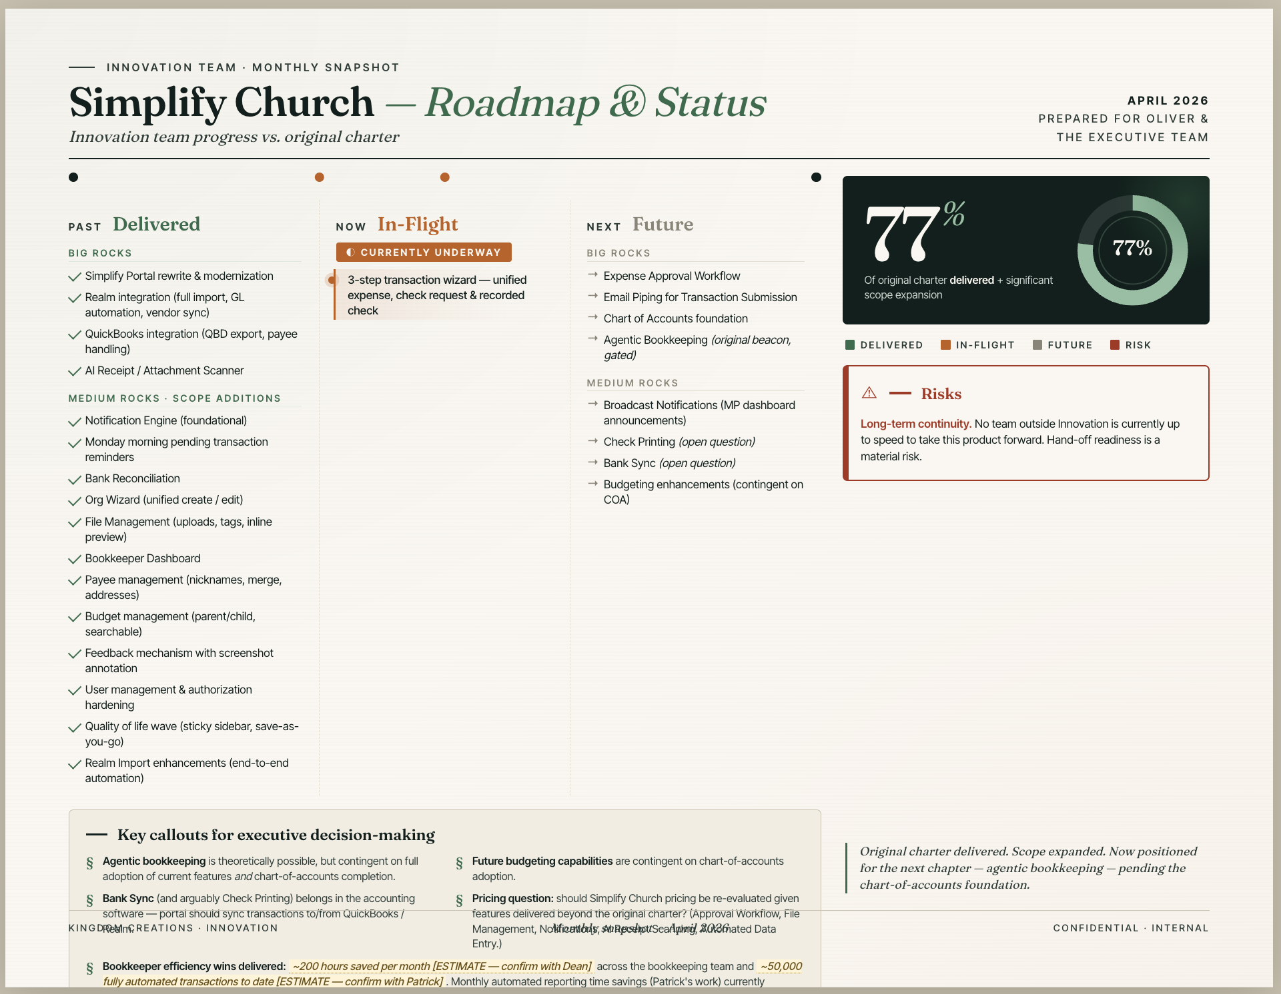
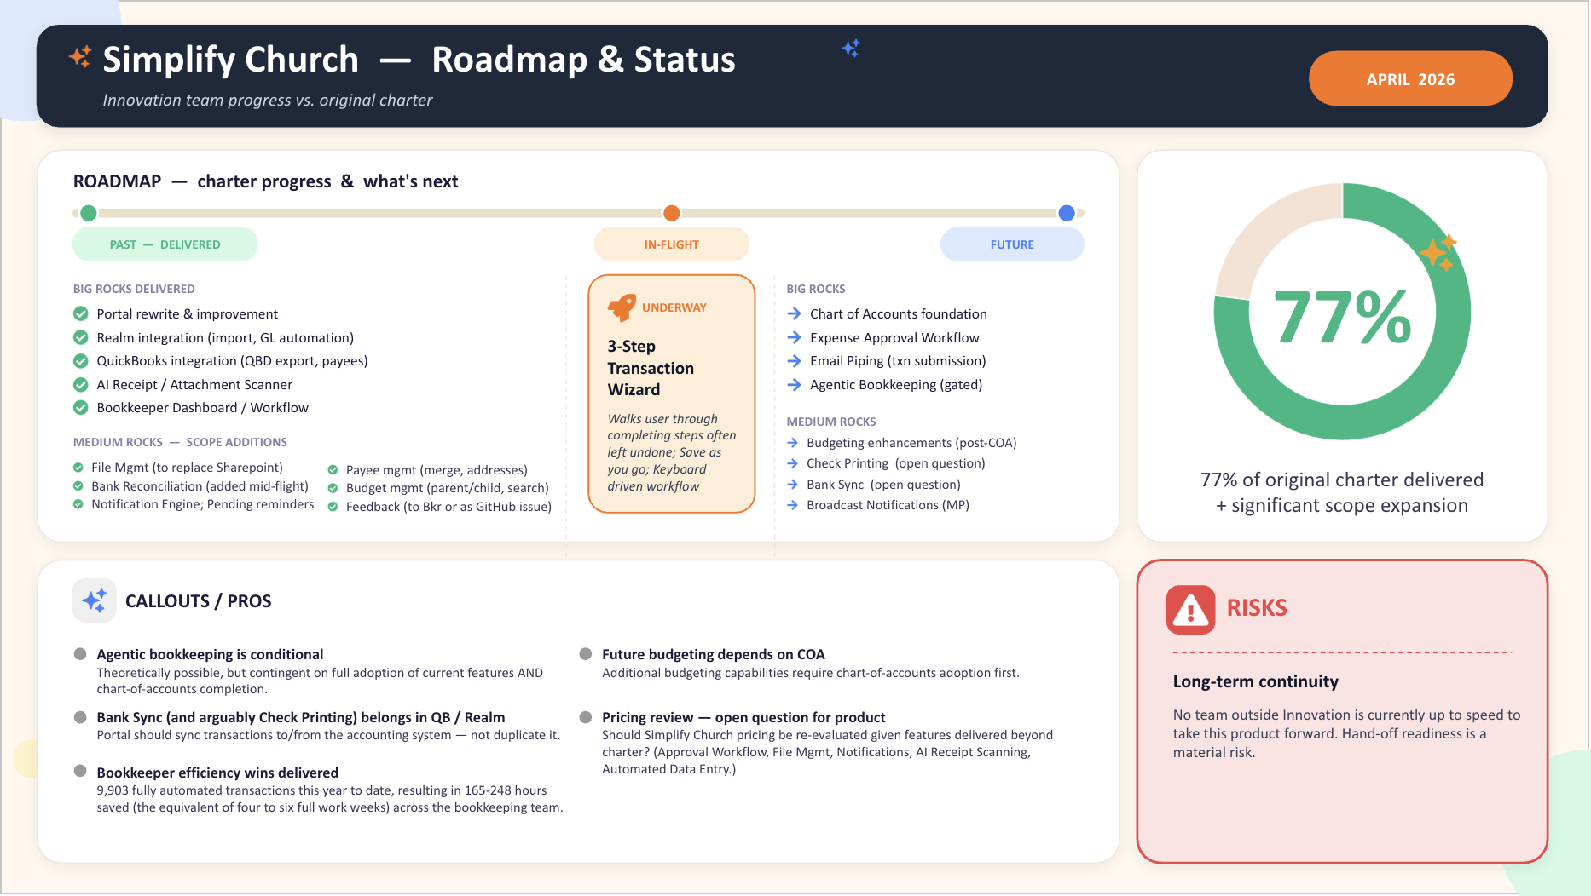
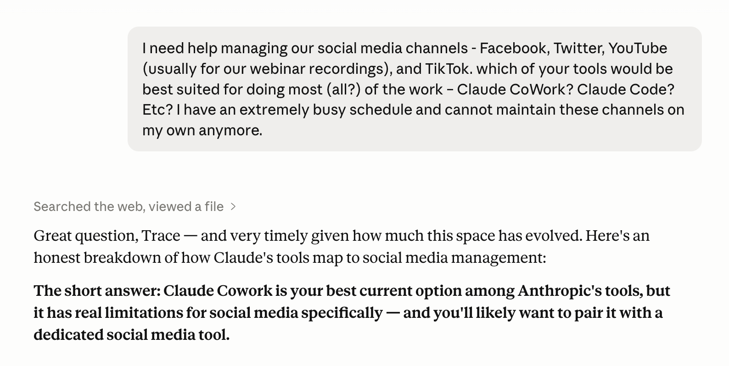
CLAUDE COWORK · HOW I'M USING IT
From idea to delivered – my not so secret weapon.
Real outputs, on cadence, hands-off after setup.
one-off
Created executive infographic deck.
one-off
Drafted and scheduled a Zoom webinar for AI in Ministry series.
one-off
And then scheduled Innov Team webinar run-through.
one-off
Setup end-to-end social media system for Kingdom Creations.
monthly
Generate a full month of social content – 15th of every month.
weekly
Deliver next week’s social posts – every Friday.
CLAUDE FOR NON-DEVELOPERS
Notes:
This is how I’m using Cowork…
Another real life list.
Created executive infographic deck — Built one-page roadmap & status infographics in Google Slides, iterated through palette/layout refinements with brand-aligned styling.
You might think – why Trace, didn’t you have Chat do that? Yep. And it wasn’t up to snuff, so I moved to cowork and gave it another go.
[ADVANCE] Case in point, this was Chat’s version.
[ADVANCE] This was Cowork’s.
Same prompt.
Created and scheduled a Zoom webinar for the AI & Ministry series — Built the March "Claude Cowork Co-Working Session" end-to-end: meeting summary doc, Zoom webinar setup (template, time, title, panelists), Google Drive folder, and a formatted Word agenda with 6-demo schedule and pre-webinar checklist.
Scheduled Innov Team webinar run-through — checked availability for 5 attendees, found a shared opening on Thu 3/5 at 9–10 AM, created the Google Calendar event, and sent invitations with a Meet link.
Setup end-to-end social media system for Kingdom Creations.
This one is the perfect example of Complaining to AI.
[ADVANCE] And technically, I complained to Chat and basically said, I do not have time to deal with our social channels.
What can you do to help?
And it told me that Cowork was the best resource for this.
So I went to Cowork, pasted in what Chat and I had already been talking about and it took things from there. [ADVANCE]
Generates a full month of social content on the 15th — Pulls latest webinar transcript + searches for recent AI news relevant to churches, produces posts across all three content tiers (webinar-sourced, news/industry, evergreen/engagement), maps each to a Canva template, and saves as a .docx to the outputs folder
Delivers next week's social posts every Friday at 9am — Pulls the 2 upcoming posts from the content calendar with exact copy, template assignments, graphic text, and platform labels ready to paste into Canva Content Planner. AND! It takes my Canva templates, makes a copy of them, plops in the text for the new posts, and saves those new graphics in a dedicated folder in Canva!

Slide 18
DEMO
DEMO
DEMO
DEMO
Notes:
Show schedules
Run Friday
Run X

Slide 19
CLAUDE COWORK · YOUR TURN
Five chores. Five handoffs.
Pick the one that wrecks your Friday afternoon.
01
02
03
04
05
Annual giving statements.
Camp registration sanity check.
VBS prep, sorted.
Funeral planning binder.
Board packet prep.
Catch bad addresses, duplicates, and returns before statements hit mailboxes.
Turn chaotic forms and notes into one clean, nurse-friendly spreadsheet.
Organize, rename, and print everything volunteers need, already sorted.
Draft service details and logistics, leaving space for pastoral care.
Pull scattered reports into one clear, ready-to-read quarterly narrative.
CLAUDE FOR NON-DEVELOPERS
Notes:
Alright, it’s Your turn again.
Five examples that you can handoff to Cowork.
Which one wrecks YOUR Friday afternoon?
One — annual giving statements.
Hand it last year's, this year's data, and the address list. It finds changed addresses, returned envelopes, duplicates — before the mailing goes out.
Two — camp registration sanity check.
Fourteen versions of medical forms, allergies on sticky notes, emergency contacts in PDF screenshots, all into one clean spreadsheet your camp nurse actually wants.
Three — VBS prep.
A folder of curriculum PDFs, theme art, last year's leftovers. It de-dupes, renames by day and station, prints a packet for each volunteer role.
Four — funeral planning binder.
Member info plus your funeral template, drafts the order of service, family contact sheet, facilities request. Leaves the human parts to the pastor.
Five — board packet prep.
Walks your finance and ministry folders. QuickBooks exports, ministry leader updates, last meeting's minutes into the quarterly narrative.
None of these are aspirational. They are doable today.

Slide 20
CLAUDE COWORK · YOUR TURN
Same work — fraction of the hours.
Real-world handoffs from staff who built these last quarter.
TASK
BEFORE
AFTER
Annual report from data
3 days
→
~3 hrs of review
Volunteer schedule
4 hours
→
15 minutes
Sermon → discussion guide
2 hours
→
15 minutes
Pastoral "Waiting On" tracker
manual, stale
→
live, fresh
Weekly bulletin draft
every Monday
→
runs on schedule
Monthly board packet
full day
→
runs on schedule
CLAUDE FOR NON-DEVELOPERS
Notes:
A few more ideas for you, but displayed as time saved.
But you get the idea.

Slide 21
CLAUDE COWORK · BEST PRACTICES
Four habits that keep Cowork in line.
Cowork has hands on real things. Set the rules of engagement first; let it run after.
Make it ask before doing anything.
Point at a folder, not your whole computer.
Save the recurring stuff as a scheduled task.
Keep your laptop awake while it's working.
CLAUDE FOR NON-DEVELOPERS
Notes:
B/c Cowork has hands on real things, it’s wise to set the rules of engagement at the outset.
Rules and boundaries first. Then unleash it to do its thing.
One — make it ask before doing anything.
Watch it the first few times. Once you trust a kind of task, let it run on its own.
Two — point at a folder, not your whole computer.
The camp registrations folder. This is your space. Not your desktop.
Give it boundaries for a Specific scope, specific job.
Three — save the recurring stuff as a scheduled task.
Set it once. It runs every week.
Four — keep your laptop awake while it's working.
If your computer goes to sleep, so does it.
Plug in before you kick off a long job.

Slide 22
LEARNING · 3 OF 5
Ask me questions.
Three words that fix bad output.
CLAUDE FOR NON-DEVELOPERS
Notes:
Learning number three. Three words that fix bad output, and almost nobody uses them: ask me questions.

Slide 23
LEARNING · 3 OF 5
Let AI run the interview.
Stop trying to prompt-engineer in one shot. Make it ask.
→
→
STEP 01 · VAGUE
STEP 02 · INTERVIEW
STEP 03 · DIALED IN
You ask.
It asks back.
You answer.
"Help me plan an outreach event."
"Audience? Indoor or outdoor? Budget? Outcomes you'd call a win?"
A tight, specific plan. Not a generic checklist.
CLAUDE FOR NON-DEVELOPERS
Notes:
Stop trying to prompt-engineer the perfect first message.
Let AI run the interview.
Step one — you ask something vague. 'Help me plan an outreach event.’
— and this is the only step that matters — you tell it
ask me questions
and
don’t assume anything
Step two — So now it asks back. 'Who's the audience? What’s the budget? Do you need attendees to register? Will you be offering child-care?’
Step three — You respond to the interview questions – there might even be a little more back and forth –
and then AI basically prompts its own self to return a solid plan for you.
The reason this works: the model is better at asking the right questions than you are at answering them upfront.
I don’t care how good you are! Even Chris employs this method. In fact, I learned it from him.

Slide 24
03
DOOR 03 / 03
Claude Code.
Power-user mode. Custom commands. Plugged into your real systems.
01 · Chat
|
02 · Cowork
|
03 · Code
Notes:
Ok.
Claude Code.
And remember — this is not about writing code. This isn’t even about developing or building necessarily.
This is about Claude knowing you, your team, your tools, your conventions, your routines, and acting on them.
So don’t tune out, b/c this is part has changed the way that I work.

Slide 25
CLAUDE CODE · BEST KNOWN FOR
A teammate plugged into your systems.
Claude Code isn’t always about writing code. It's about Claude knowing your team and conventions, and acting on them.
Recurring multi-step
Heavy memory
Custom commands
Direct connections
Outgrow tabs
Boundless
CLAUDE FOR NON-DEVELOPERS
Notes:
Claude Code is best known for…
Recurring multi-step work — encode what you do every week.
This is about taking something you do the same way over and over—and capturing all the steps so you don’t have to redo them manually every time.
Not just “write an email,” but: gather info → format it → write it → prep it to send.
I’m gonna pause here b/c you might be thinking – doesn’t Cowork do multi-step work, too? Yes. You’re not wrong.
And there are a lot of crossover capabilities amongst these products.
Cowork – it’s in the name.
I find that with cowork it really is “co” – working. I’m a lot more involved.
I’m still in the driver’s seat when it comes to Claude Code, but with Cowork, I feel like I’m more hands on rather than the coach.
How it differs from Cowork: Cowork helps you redo it each time with help. Code lets you stop redoing it altogether.
Heavy memory — it knows your team, your tools, your conventions.
It remembers how your team works—your tone, your formats, your preferences—so you don’t have to keep reminding it.
Like a staff member who already knows “how we do things here.”
How it differs from Cowork: Cowork can remember context in a conversation. Code is built to rely on that memory consistently across repeat tasks.
Custom commands — slash-pr, slash-mtg, slash-rmm — one phrase replaces a workflow.
You create a short phrase that triggers a whole routine.
Instead of explaining: “summarize this, format it, pull action items…” You just say: /mtg
How it differs from Cowork: Cowork = you explain the task again (even if loosely). Code = you name the task once, then reuse it instantly.
Direct connections — multiple systems in one flow, not copy-paste between five tabs.
It can grab what it needs from different places without you bouncing between tabs.
Calendar, docs, spreadsheets—all feeding into one flow.
How it differs from Cowork: Cowork usually works with what you paste in. Code can go get the inputs itself as part of the workflow.
Outgrowing tabs — that's the moment you know you're ready for door three.
This is the moment when your workflow becomes messy—too many tabs, too much copy/paste, too many steps to keep straight.
That frustration is the signal something should be streamlined.
How it differs from Cowork: Cowork still lives comfortably in that tab-heavy world. Code exists because that way of working stops scaling.
And boundless — if you can describe what you want, you can build a slash-command for it. Code is the door for power users, but the bar to entry is way lower than people think. If you can clearly describe a repeatable process, you can turn it into a reusable command.
You’re not limited to pre-built features—you define your own.
How it differs from Cowork: Cowork is open-ended help in the moment. Code turns that open-ended thinking into something fixed you can reuse.

Slide 26

CLAUDE CODE · HOW I'M USING IT
Meet Claudia. She earns her keep.
EMPLOYEE PROFILE
Name
Title
Manager
Performance
Claudia
AI Chief of Staff
Trace Jackson
Exceeds expectations
CLAUDE FOR NON-DEVELOPERS
Notes:
I think it might be time to make an introduction.
Meet Claudia.
As you can see I work with all guys, and so I needed another female to keep me sane. So I renamed by Claude Code – Claudia.
And she has become my absolute right hand.

Slide 27
CLAUDE CODE · HOW I'M USING IT
Meet Claudia. She earns her keep.
IN HER OWN WORDS
Runs your meeting workflow end-to-end — pulls Fathom transcripts, drafts summaries and action items, and posts them to Notion once you approve
Manages GitHub issues and sprints — drafts issues, balances assignments across the team, sets sizes, sprints, and statuses on the project board
Bridges your tools — Fathom, Notion, GitHub, Jira, and Playwright all talk to each other through me instead of you copy-pasting between tabs
Tests staging like a QA team — drives Simplify and Inkwell through Playwright as various user roles
Turns ideas into working prototypes — when you have a concept to pitch or validate, I build a functional demo you can click through instead of just describing it in a doc
CLAUDE FOR NON-DEVELOPERS
Notes:
I asked Claudia to tell you in her own words what she does for me.
B/c I work with dev dudes, a lot of our meetings will result in me creating tickets for them to work through.
And so I have taught Claudia – yes I taught her! I’ll show you that in a bit – how to take my meeting transcripts and process them the way I need them – with action steps and then suggesting any of these tickets or issues that she might need to write.
Those tickets get added to GitHub as issues – you can see that second bullet right there.
She helps me to manage how many issues get put into a single week, or assigned to everyone fairly. And by fairly, I mean that Tripp gets most of them right now. Hi Tripp.
She’s the epicenter of my work ecosystem by being the hub that connects all of my tools together. Fathom for my meetings, turn into issues that go to GitHub. Playwright will test GitHub issues in the software itself. Like – she’s unreplaceable at this point.

Slide 28
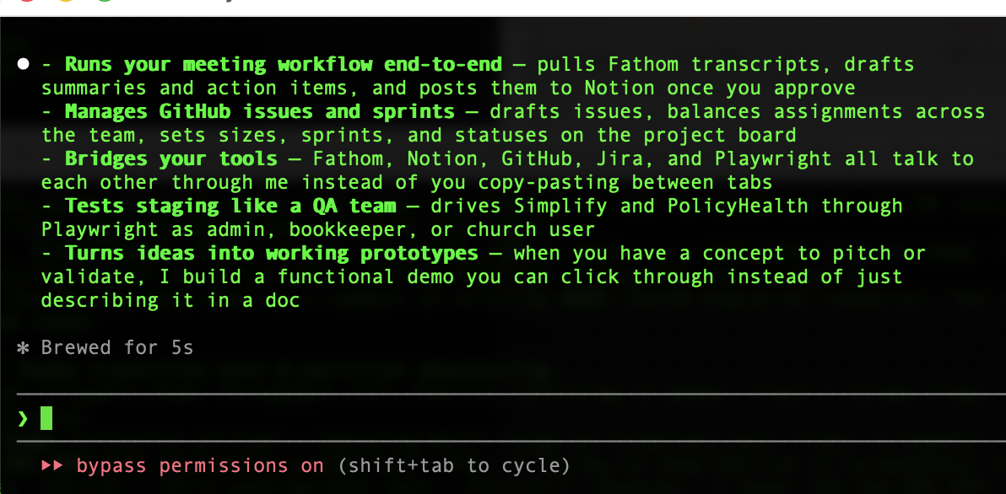
CLAUDE CODE · HOW I'M USING IT
Meet Claudia. She earns her keep.
CLAUDE FOR NON-DEVELOPERS
Notes:
And I don’t want to scare you, but this is how she talks to me.
I run Claudia through my Terminal app.
Never would I have ever thought I’d say that.
But one day, Chris got on a call with me and said, ok share your screen. Now launch your terminal.
I didn’t even know this was coming! and I’m like – where’s my terminal??
But he got me started using Claude Code through terminal, and I think it wasn’t even the next day, I think it was a few hours in of me just working along and I messaged him and said my life is changed.

Slide 29
CLAUDE CODE · HOW I'M USING IT
My right hand.
Stuff I used to do. Now it just handles.
work
Runs meeting workflow end-to-end.
work
Manages GitHub issues + sprints.
work
Bridges tools.
work
Tests software like QA.
life
Builds working prototypes.
▶ LIVE DEMO
CLAUDE FOR NON-DEVELOPERS
Notes:
This is how I’m using Claude Code…
work Runs meeting workflow end-to-end — pulls Fathom transcripts, drafts summaries + action items, posts to Notion after approval.
work Manages GitHub issues + sprints — drafts tickets, assigns work, sets sizes, updates board status.
work Bridges tools — Fathom, Notion, GitHub, Jira, Playwright — no more copy-pasting between tabs.
work Tests staging like QA — runs Simplify + Inkwell through Playwright across user roles.
work Builds working prototypes — turns ideas into clickable demos, not just docs.

Slide 30











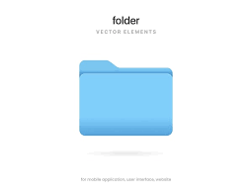
CLAUDE CODE · HOW I'M USING IT
Meet Claudia. She earns her keep.
CLAUDE FOR NON-DEVELOPERS
Notes:
Claudia acts as a central orchestrator, seamlessly integrating with and driving various tools and platforms.
From document creation to project management
I can – she! She can streamline complex workflows from a single command.
She is the epicenter of my work ecosystem.

Slide 31
LEARNING · 4 OF 5
Rinse, repeat?
There's a command for that.
CLAUDE FOR NON-DEVELOPERS
Notes:
Learning number four. Rinse, repeat? There's a command for that.

Slide 32
LEARNING · 4 OF 5
Three times = a command.
If you've explained the same task three times, you've found a command. Build it.
Weekly Release Management Meeting prep — sprint data, strict Excel checklist, Jira ticket.
Used to take 30+ minutes every week.
Claudia built /rmm.
Now I type three letters. She does it all in ~30 seconds. I review. Done.
CLAUDE FOR NON-DEVELOPERS
Notes:
Three times equals a command.
If you've explained the same task to Claude more than twice, you've found a command you need to build.
And by build, I mean let Claude Code build it.
My example: weekly Release Management Meeting prep.
I have to write a status report every Thursday about what is shipping out for the week. Nobody hands me a tidy list. But I do have a form I have to fill out.
I have to go find the current "batch" of work.
Scroll through a long list of completed work to find the last "we shipped it" moment — that’s my starting line for this week.
Pull every piece of work that crossed the finish line since then. Could be 5 items, could be 25. Each one lives on its own record somewhere.
Then I get to open every single one. For each, you have to look up:
- What it was actually called (and rewrite it to fit a small box on a form)
- What kind of work it was — a bug fix? A new feature? A small tweak?
- Whether it's truly done, or still being tested, or stuck somewhere
Throw out the items that aren't ready yet. Some are still in progress and don't belong on this week's form. Others do. You have to judge each one.
Watch for three special situations that change what the form says:
- Did anything in this batch fix a security issue? (Different paperwork.)
- Was anything an emergency fix? (Extra verbiage required.)
- Is this launching a brand-new named feature? (Triggers a whole different conversation.)
That's the research half — and it's all just to know what to write down. You haven't filled out a single cell yet.
So I asked Claudia to build /rmm.
Now I type three letters. - ok with the slash technically it’s four characters.
Claudia does it all in about thirty seconds.
Pull sprint data. Match it against a strict Excel checklist. Fills out all the requirements.
I review.
Creates the right Jira ticket. And then pushes it onto the board.
Done.
Thirty minutes a week became thirty seconds a week.
That's twenty-six hours back this year, from one command.

Slide 33
CLAUDE CODE · HOW I'M USING IT
Claudia. Scripted.
Six commands I run more than I run my coffee maker.
/pr
Drafts pull requests with the right reviewers and template.
/validate
Runs a feature validation pass against acceptance criteria.
/mtg
Builds a 1:1 review pulled straight from Fathom.
/issuenext
Drafts the next issue with a full body — ready to ship.
/nextdev
Tells me what to work on next based on priorities.
/rmm
Weekly release prep · 30 min → ~30 sec.
CLAUDE FOR NON-DEVELOPERS
Notes:
So, let’s talk about some of my weekly and favorite commands.
/pr
"Package this work up so a teammate can review it”
/validate
"Walk me through testing this feature one piece at a time”
It points the test site at the right version of the work, walks me through each requirement one at a time, captures my feedback, and drafts the response back to the developer.
/mtg
Pulls the recording from Fathom, drafts the summary, lists action items by owner (tagged by who suggested them — the AI, me, or the meeting tool), flags ones that should become tickets, and waits for my approval before writing anything down. Will write the tickets to the GitHub repo and then also add any action steps that I want in Notion.
Almost half of the weekly savings comes from this meeting workflow alone.
/issuenext
When something needs to become tracked work — a bug, an enhancement, a new feature — there's a surprising amount of ceremony.
But Claudia can handle it. She drafts the whole thing, checks for duplicates across open and closed work, suggests every piece of metadata, and only writes it down once I approve.
And the next part of the title tells me which repo it’s going to write it to. I’ve given it specific guardrails and nuances.
/nextdev
"Switch the test website to the version I want to look at”
And that incorporates another tool in our ecosystem – Vercel. So now I don’t have to log into Vercel every time and change the url every time I want to test a new issue.
/rmm
"Do my weekly release paperwork"

Slide 34
CLAUDE CODE · HOW I'M USING IT
Reclaiming my week. One / at a time.
CLAUDE FOR NON-DEVELOPERS

Slide 35
DEMO
DEMO
DEMO
DEMO
Notes:
Run /mtg – bookkeeping portal last week
Run /rmm – but don’t post to jira

Slide 36
CLAUDE CODE · YOUR TURN · 1 OF 2
Start here.
Friday-afternoon wins and weekly rhythms — the gateway commands.
TIER 01
Friday-afternoon wins
— one-shot cleanups
/rename
800 sermon files renamed from recording_FINAL_v2.mp3 → 2024-03-17_easter_pastor-mike.mp3 from a CSV.
/sort-drive
12 years of /Communications chaos reorganized into a clean folder structure with naming conventions.
/photos
2,000 event photos from the last decade converted and resized for the new website.
TIER 02
Weekly rhythms
— scheduled, hands-off
/attendance
Monday-morning digest. Planning Center numbers vs last 4 weeks → one-pager to the lead pastor before staff meeting.
/volunteers
Volunteer gap report. Scans next Sunday's schedule, flags empty slots, drafts personalized texts to lapsed regulars.
/giving
Giving anomaly check. This week vs rolling avg → new recurring gifts (thank-you) + lapsed givers (pastoral care).
CLAUDE FOR NON-DEVELOPERS
Notes:
More ideas for you.
Just some thoughts.
Use these to spark your own creativity or dreaming session of what you can do.
We’ve got some Tier one items — these are like your one-shot cleanups.
Slash-rename: 800 sermon files renamed from recording-FINAL-v2 to date-event-pastor, from a CSV.
Slash-sort-drive: 12 years of communications chaos into a clean folder structure.
Slash-photos: 2,000 event photos web-ready in one batch.
Tier two — weekly rhythms, hands-off.
Slash-attendance: Monday digest from Planning Center to the lead pastor before staff meeting.
Slash-volunteers: gap report on next Sunday's schedule, drafts personalized texts to lapsed regulars.
Slash-giving: anomaly check, surfaces new recurring gifts and lapsed givers.
These are the gateway commands. Boring beats brilliant.

Slide 37
CLAUDE CODE · YOUR TURN · 2 OF 2
Then this.
Real multi-step workflows — and the "wait, you can do that?" tier.
TIER 03
Real workflows
— multi-step, multi-system
/visitor
New-visitor follow-up. Reads connect cards, drafts personalized welcomes referencing what they marked, schedules 2- and 6-week check-ins.
/sermon
Sermon-to-everything. Manuscript → social posts, small group questions, kid's lesson tie-in, bulletin insert.
/elder-mtg
Elder meeting → action engine. Recording → summary, decisions log, action items by person, draft of next month's agenda.
/care-ledger
Pastoral care ledger. Hospital visits, counseling, prayer requests → weekly digest. Flags anyone untouched in 90 days.
TIER 04
"Wait — you can do that?"
— synthesis across years and systems
/annual-report
Pulls giving, attendance, baptisms, missions spend from 4 systems → board-ready narrative draft.
/curriculum
One adult Bible study → kids, students, and Spanish versions. In an afternoon.
/handbook
Ask the handbook. Point at policies. Staff asks "how many bereavement days?" — gets the right answer with citations.
CLAUDE FOR NON-DEVELOPERS
Notes:
And then I’ve put together some example workflows mic drop moments.
Slash-visitor: connect cards to personalized welcome emails referencing what each visitor marked, plus scheduled check-ins.
Slash-sermon: manuscript to social posts, small group questions, kid's lesson tie-in, bulletin insert.
Slash-elder-mtg: meeting recording to summary, decisions log, action items, next agenda draft.
Slash-care-ledger: weekly digest of pastoral care, flags anyone untouched in 90 days.
Slash-annual-report: pulls giving, attendance, baptisms, missions spend from four systems into a board-ready narrative.
Slash-curriculum: one adult Bible study to kids, students, and Spanish versions in an afternoon.
Slash-handbook: ask the policies folder anything. The first one you ship pays for the next three.

Slide 38
CLAUDE CODE · YOUR TURN
Aspirational — but real.
Four commands a church staff could ship this quarter.
/weekly
Communications. Pulls upcoming sermon, this week's events, recent giving stats → newsletter draft.
/board
Executive Pastor. Pulls Planning Center, ACS, staff updates → monthly board packet skeleton.
/care
Pastoral Care. Pulls follow-ups, appointments, prayer requests → single weekly view.
/giving
Finance. Pulls week's giving, flags anomalies, drafts thank-yous for new donors.
CLAUDE FOR NON-DEVELOPERS
Notes:
Your turn. Aspirational, but real. Four commands a church staff could ship this quarter. Slash-weekly for communications: pulls the upcoming sermon, this week's events, recent giving stats — drafts the newsletter. Slash-board for the executive pastor: pulls Planning Center, ACS, staff updates — drafts the monthly board packet skeleton. Slash-care for pastoral care: pulls follow-ups, appointments, prayer requests into a single weekly view. Slash-giving for finance: pulls the week's giving, flags anomalies, drafts thank-yous for new donors. Pick one. The first one you ship will pay for the next three.
Where it shines for ministry staff (beyond the obvious) This one really only fits if you have developers on staff or working with you. But for tech-leaning churches and ministries:
Reconstructing technical history when the developer who built something has moved on — using the trail of code changes as the story of what was built and why.
Helping non-developers query the database. Junior staff describe what they're looking for in plain English ("who led a small group last year but isn't this year") and Claude Code writes the actual database query, runs it, and explains what came back.
Fixing automation when it breaks at 11pm. When a workflow connecting two of your systems quits working and you don't want to wake the developer, Claude Code can look at the broken pieces and propose the fix.
Building the bridge between systems no vendor offers. Got two tools that don't talk to each other but should? Claude Code writes the connector.
Small internal tools. A finance admin describes what she wishes a giving dashboard did; Claude Code builds it as a small web app the dev team reviews before launch.

Slide 39
CLAUDE CODE · BEST PRACTICES
Three habits that earn Code its keep.
Code is power-user mode. The setup tax is real — but it pays off the tenth time you run the command.
Keep yourself in the driver's seat.
Set it up once with your tools.
Reserve it for workflows you do over and over.
Name it. Make it yours.
CLAUDE FOR NON-DEVELOPERS
Notes:
Code is power-user mode.
There is some Setup involved, but you can just ask Claude Chat how to do it.
Keep yourself in the driver's seat. Have it ask before it acts on anything important. It does the keystrokes; you say go.
Set it up once with your tools. Fathom, Notion, GitHub, Slack, my testing tool Playwright, Vercel. From then on, describe what you want — it knows where to go.
Reserve it for workflows you do over and over. First run takes setup. Tenth run takes a sentence. Hundredth run is three letters.
And — name it. Make it yours. Mine is Claudia. Sounds silly. Changes the relationship from tool-I-use to teammate-I-direct.

Slide 40
LEARNING · 5 OF 5
Can AI do it? Ask it.
Don't assume the limits.
CLAUDE FOR NON-DEVELOPERS
Notes:
If you just don’t know if AI can do something for you. Ask it.
It’ll know.
I’m a great use case for using AI especially in this dev environment that I find myself in. b/c I don’t know what I don’t know.
There have been times when someone’s told me, I didn’t know you could get Claude Code to do that.
And I’m like: I didn’t know I couldn’t.
I just ask.

Slide 41
CERTIFICATE OF PERMISSION
This presentation entitles the holder to ask AI ridiculous, boundary-pushing, "could you maybe" questions without embarrassment .
Don't assume the limits. The worst it can say is "no" — and the best it can say is something you didn't know was possible until five seconds ago.
SIGNED
VALID
Claudia
Today + every day after.
CLAUDE FOR NON-DEVELOPERS
Notes:
So - This is your certificate of permission.
You may now ask AI ridiculous, boundary-pushing questions on whether or not it can make that graphic for you, on whether or not you can drag and drop a screenshot into Claude Code via terminal and will it read it? Ask it to create a document for you and then open it when it’s done.
Don't assume its limits — and if something is bugging you, ask it to fix it! The worst it can say is no.
The best it can say is something that can save you minutes or hours a week, and maybe even produce results better than you could on your own.
Claudia is giving you permission.
And so am I.

Slide 42
RECAP
Three doors. None require code.
Walk through the ones that fit. Walk past the ones that don't.
DOOR 01
DOOR 02
DOOR 03
01
02
03
Claude Chat.
Claude Cowork.
Claude Code.
CLAUDE FOR NON-DEVELOPERS
Notes:
Chat is the conversation. You and Claude, thinking through something together.
Cowork is the assistant who runs your errands on your computer. Office work, file work, app work.
Code is the operator who runs your workflows end-to-end. Connects your tools, does the clicking, ships the actual work.

Slide 43
THIS MONDAY
One task. One door. One week.
Pick the chore that drains you. Hand it off in whichever door fits.
Pick ONE recurring task that drains you.
Not your moonshot. Your chore.
Hand it off in whichever door fits.
Boring beats brilliant.
CLAUDE FOR NON-DEVELOPERS
Notes:
This Monday. One task and carry it through one door.
Pick something that drains you.
This doesn’t have to be your moonshot — just something that ruins our Thursday afternoon every week.
Hand it off in whichever door fits.
And remember: Boring beats brilliant. The win isn't transforming your job. The win is getting Friday back.

Slide 44
RECAP
The five learnings.
01
Complain to AI.
02
Show. Don't describe.
03
Ask me questions.
04
Rinse, repeat? There's a command for that.
05
Can AI do it? Ask it.
Notes:
Quick recap. Five learnings.
One: complain to AI — bring problems, not solutions.
Two: show, don't describe — take the screenshot.
Three: ask me questions — let AI run the interview.
Four: rinse, repeat — three times equals a command.
Five: can AI do it? Ask it. Don't assume the limits.

Slide 45

QUESTIONS & CONVERSATION
Thanks for walking through.
Trace Jackson · ACS Technologies Find me after — bring your chore.
Notes:
Thanks for walking through. I'm Trace, ACS Technologies. Find me after the session — bring your chore. The conversation I most want to have is the specific one. What's the task? Which door? Let's spec the first one together before you leave.

Slide 46
BONUS MATERIAL · NOT PRESENTED LIVE
A fourth door: Claude Design.
Brand new. Worth knowing about. Take this with you.

Slide 47
BONUS · CLAUDE DESIGN
Words in. Visuals out.
Launched in April. Instead of writing words, Claude makes visuals — a slide deck, a landing page, an app screen, a one-pager. You describe what you want. It produces a working version on screen.
EXPORT TARGETS
Canva
PowerPoint
PDF
Developer handoff
You refine it by chatting, clicking on specific parts to comment ("make this button bigger"), or dragging sliders for color and spacing.
STRENGTH · IDEA → SHOWABLE THING, FAST
CLAUDE FOR NON-DEVELOPERS

Slide 48
BONUS · WHERE IT SHINES
Five places it earns the click.
Beyond the obvious "make me a slide." Five real ministry use cases.
01
02
03
04
05
Capital campaign donor decks.
Mock the tool before you build it.
Sermon series branding.
Onboard a new volunteer.
The annual report.
Every nonprofit owes one. Nobody enjoys making it. Design does the layout. You bring the numbers and stories.
Polished pitch energy, on your church brand. First draft in ten minutes.
Clickable prototype → leadership walkthrough → real spec. In that order.
Main graphic, social posts, stage backgrounds, bulletin header — one concept, full kit.
Short, interactive walkthrough for check-in or first-impressions. Posted as an internal link.
CLAUDE FOR NON-DEVELOPERS

Slide 49
BONUS · THINGS TO KNOW GOING IN
It's brand new. Set it up like it matters.
Four things to know before you walk through this door.
ROUGH EDGES
Still has bugs — comments occasionally disappear, certain views can throw save errors. Don't trust it as your only copy.
FIRST DRAFT
The first thing it makes will look interesting but won't always communicate well — especially with charts and data. Plan to push back.
ENTERPRISE
For business plans, it's turned off by default — an admin has to flip it on.
SETUP MATTERS
It doesn't know your church. Without your brand and aesthetic up front, it'll default to stock-photo-cathedral vibes. Setup matters more here than anywhere else.

Slide 50
BONUS · BEST PRACTICES
Four habits for Claude Design.
Design rewards taste. Bring yours up front and the output stops looking like every other AI deck.
Hand it your brand before your prompt.
Click the thing. Don't describe it.
Logo, fonts, color tokens, three reference designs you actually like. Without this, it defaults to stock-photo-cathedral vibes for every church it talks to.
Comment directly on the button, the headline, the chart. "Make this teal." "Cut this in half." Pointing beats prompting.
Use the sliders before the chat.
Treat draft one as a sketch.
Color, spacing, density — drag, don't type. The chat is for ideas; the controls are for taste.
First output is a starting point, not a deliverable. Especially with charts and data — push back, refine, swap layouts. Two rounds of feedback is the rule, not the exception.
CLAUDE FOR NON-DEVELOPERS

Slide 51
If I can use these tools there’s hope for anyone.

Slide 52
AND NOW · A SHORT SEGMENT
AI Bloopers.
Outtakes from how AI tried (and failed) to build this presentation.
Notes:
And now — a short segment. AI bloopers. Outtakes from how AI tried, and failed, to build this presentation. [TRACE: insert outtakes here.]

Slide 53
AI BLOOPERS

