Slide 1

CITN·AI
SESSION 03 · 60 MIN · DAY 1
SDLC Crash Course
Notes:
Welcome to Session 03 — SDLC Crash Course. We have 60 minutes. Two halves: first 30 minutes are concept fly-through (the loop, the AI overlay). Second 30 minutes are slow, live mechanics — terminal, git, VS Code, GitHub. By the end you'll have made a real commit and pushed it to GitHub. If you're nervous about the mechanics, that's the right feeling. We'll go slow there.

Slide 2
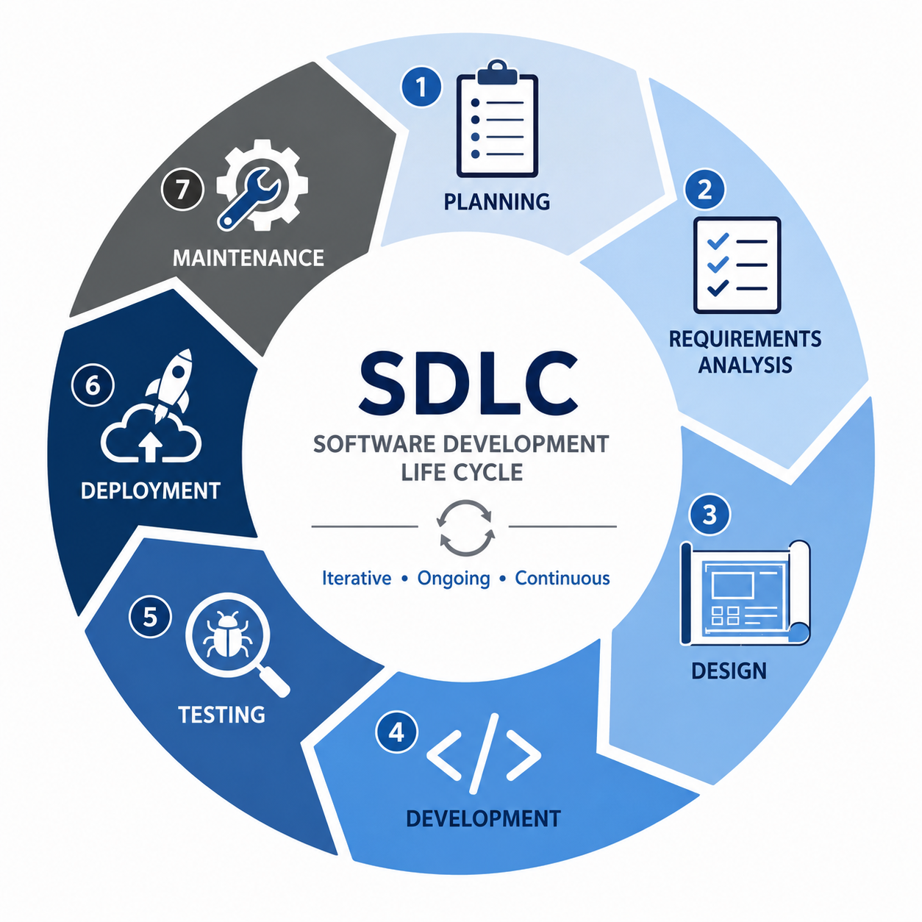
SDLC CRASH COURSE
03 / 16
THE SDLC LOOP
The shape of
software work.
Notes:
Show the loop. Name each phase in one sentence. Resist the urge to elaborate. The point is the SHAPE, not the definitions — those come on the next slide. If anyone asks 'what about discovery / requirements / etc.', say it folds into Plan.

Slide 3
SDLC CRASH COURSE
04 / 16
THE SIX PHASES, ONE LINE EACH
Plan · Design · Build · Test · Ship · Maintain.
▸ PLAN — decide what's worth building, and why.
▸ DESIGN — sketch how it will work before writing it.
▸ BUILD — write the code that makes it real.
▸ TEST — prove it does what you said it would.
▸ SHIP — get it in front of the people who use it.
▸ MAINTAIN — keep it alive, keep it learning.
Notes:
Walk down the list at 5–7 seconds per phase. Don't define them academically — use the verbs from the slide. The goal is for everyone to have a one-line mental label for each phase by the time we leave this slide.

Slide 4
SDLC CRASH COURSE
05 / 16
THE PUNCHLINE
It's a loop, not a line.
Maintain feeds back into Plan — that's the whole job.
Notes:
This is the moment that lands the whole first half. Most people imagine SDLC as a waterfall going left-to-right. It isn't. Maintain is where you LEARN what to plan next. If you skip the loop-back, you're not doing SDLC — you're doing one-off projects.

Slide 5
SDLC CRASH COURSE
06 / 16
WITH AI IN THE LOOP
The phases don't change. The density does.
Same six phases — what shifts is how much fits inside one cycle.
▸ PLAN — context, not just features. You design what Claude needs to know.
▸ DESIGN — diagrams and PRDs become inputs the AI consumes, not artifacts on a shelf.
▸ BUILD — atomic prompts beget atomic commits. Cycle time drops 5–10×.
▸ TEST — verify, don't trust. The model is fast; that's why the gate matters more.
▸ SHIP / MAINTAIN — the loop tightens; the carry-over of context is the asset.
Notes:
Don't walk every phase deep. Show the shape of the change. Most AI failures aren't 'the model was wrong' — they're 'the model didn't have what it needed.' That's why this conference is called Context Engineering. Sessions 04, 05, 07 are how you do this.

Slide 6
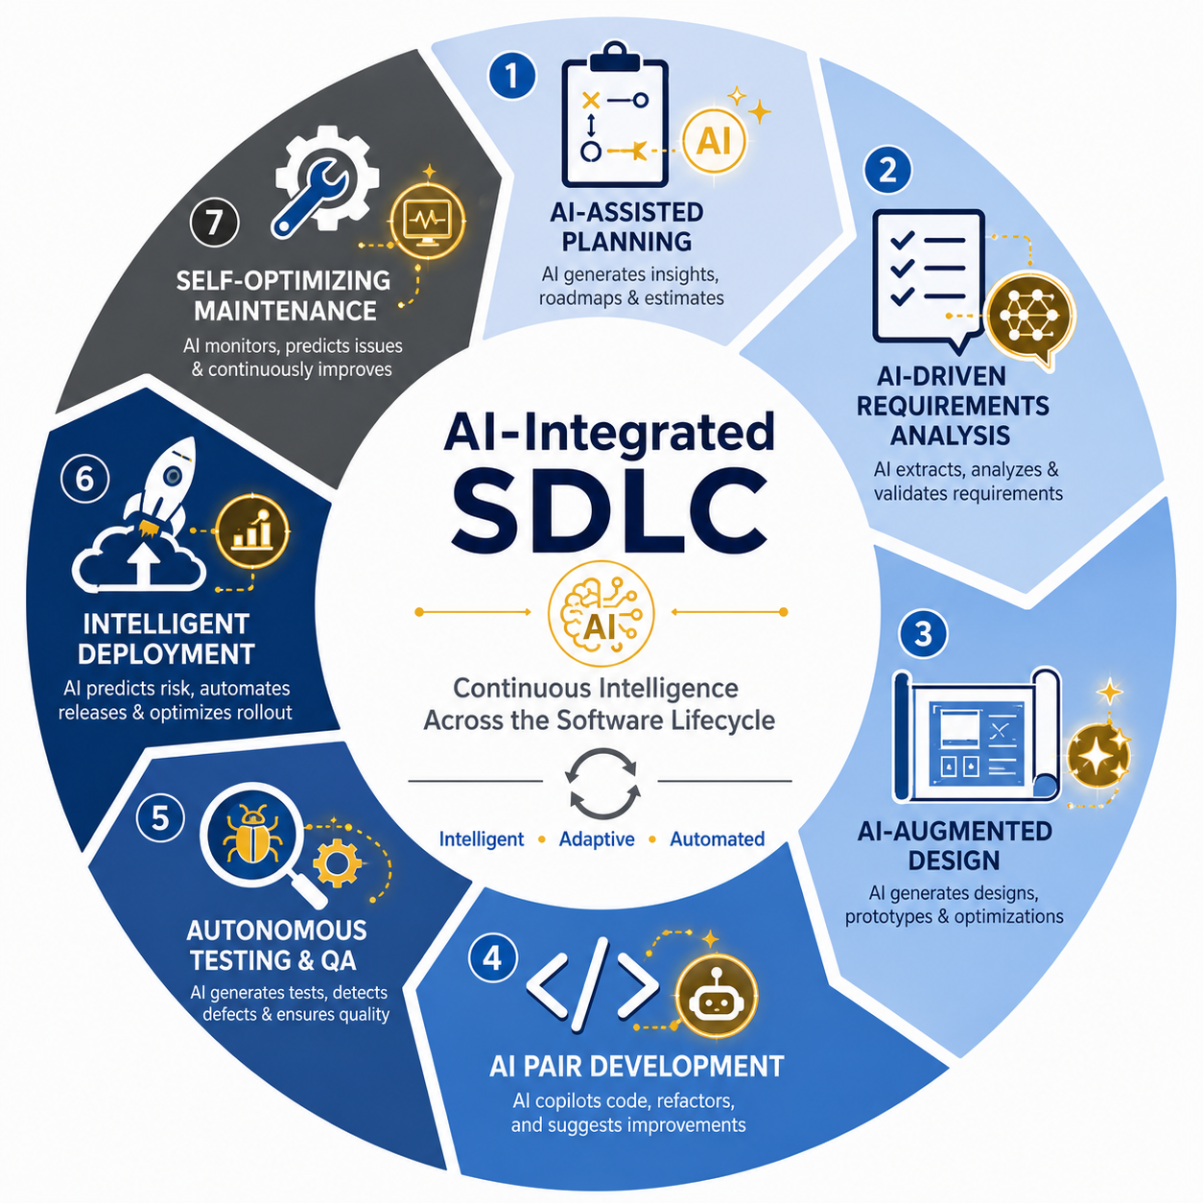
SDLC CRASH COURSE
05 / 16
Notes:
This is the moment that lands the whole first half. Most people imagine SDLC as a waterfall going left-to-right. It isn't. Maintain is where you LEARN what to plan next. If you skip the loop-back, you're not doing SDLC — you're doing one-off projects.

Slide 7
SDLC CRASH COURSE
07 / 16
THE 5 CROSS-CUTTING PRINCIPLES
Five habits that hold the AI-SDLC together.
▸ CONTEXT ENGINEERING — give the model what it needs before you ask.
▸ PLAN BEFORE GENERATE — outline the work; let the model fill it in.
▸ VERIFY, DON'T TRUST — every output is a draft until you read it.
▸ ATOMIC PROMPTS → ATOMIC COMMITS — one idea per prompt, one idea per commit.
▸ RIGHT TOOL FOR RIGHT SCOPE
Notes:
These five show up everywhere in the workshop. Read them aloud once. They're memorable as a set; the depth is in AI-SDLC.md and in Sessions 04-07. If someone takes a photo of one slide today, this is the slide.

Slide 8
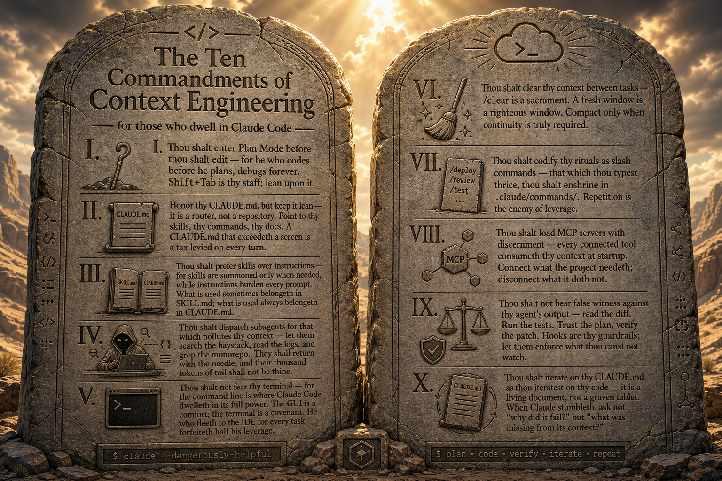

Slide 9
08 / 16
PART TWO · THE MECHANICS
Now: just enough
git, terminal, and
VS Code.
Notes:
Pacing change. The first half was a fly-through; from here on we go slow and live. Get the room to breathe. Tell people to close their laptops for the next two minutes and just watch — they'll do it themselves at slide 14.

Slide 10
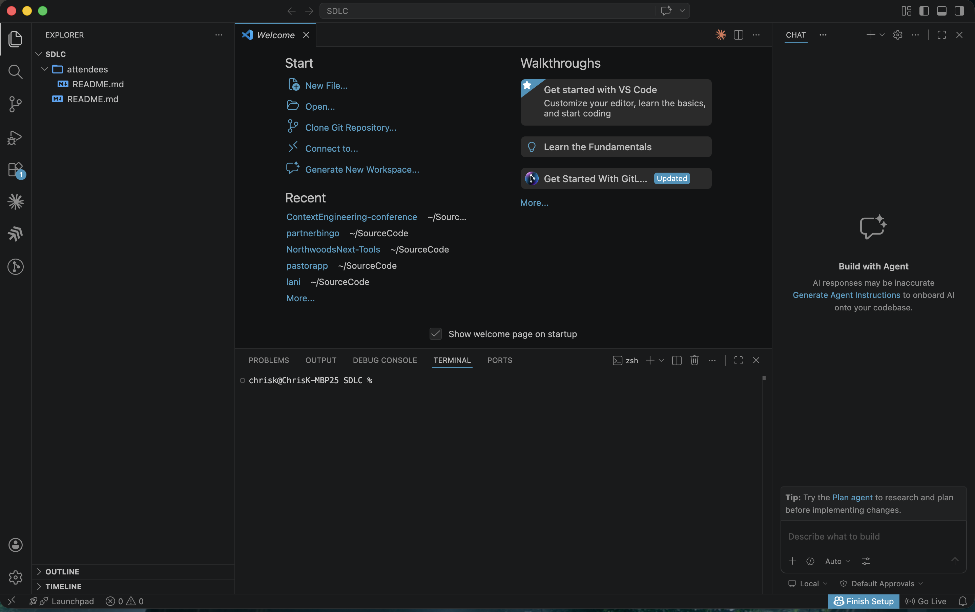
SDLC CRASH COURSE
12 / 16
Notes:
Don't read the screenshot — point at it. Open VS Code live and show the four panels. The Claude Code extension is the centerpiece — Sessions 04+ assume you have it installed and signed in. GitLens shows you who wrote each line; Peacock colors VS Code windows so you don't lose track when you have three repos open later today.

Slide 11
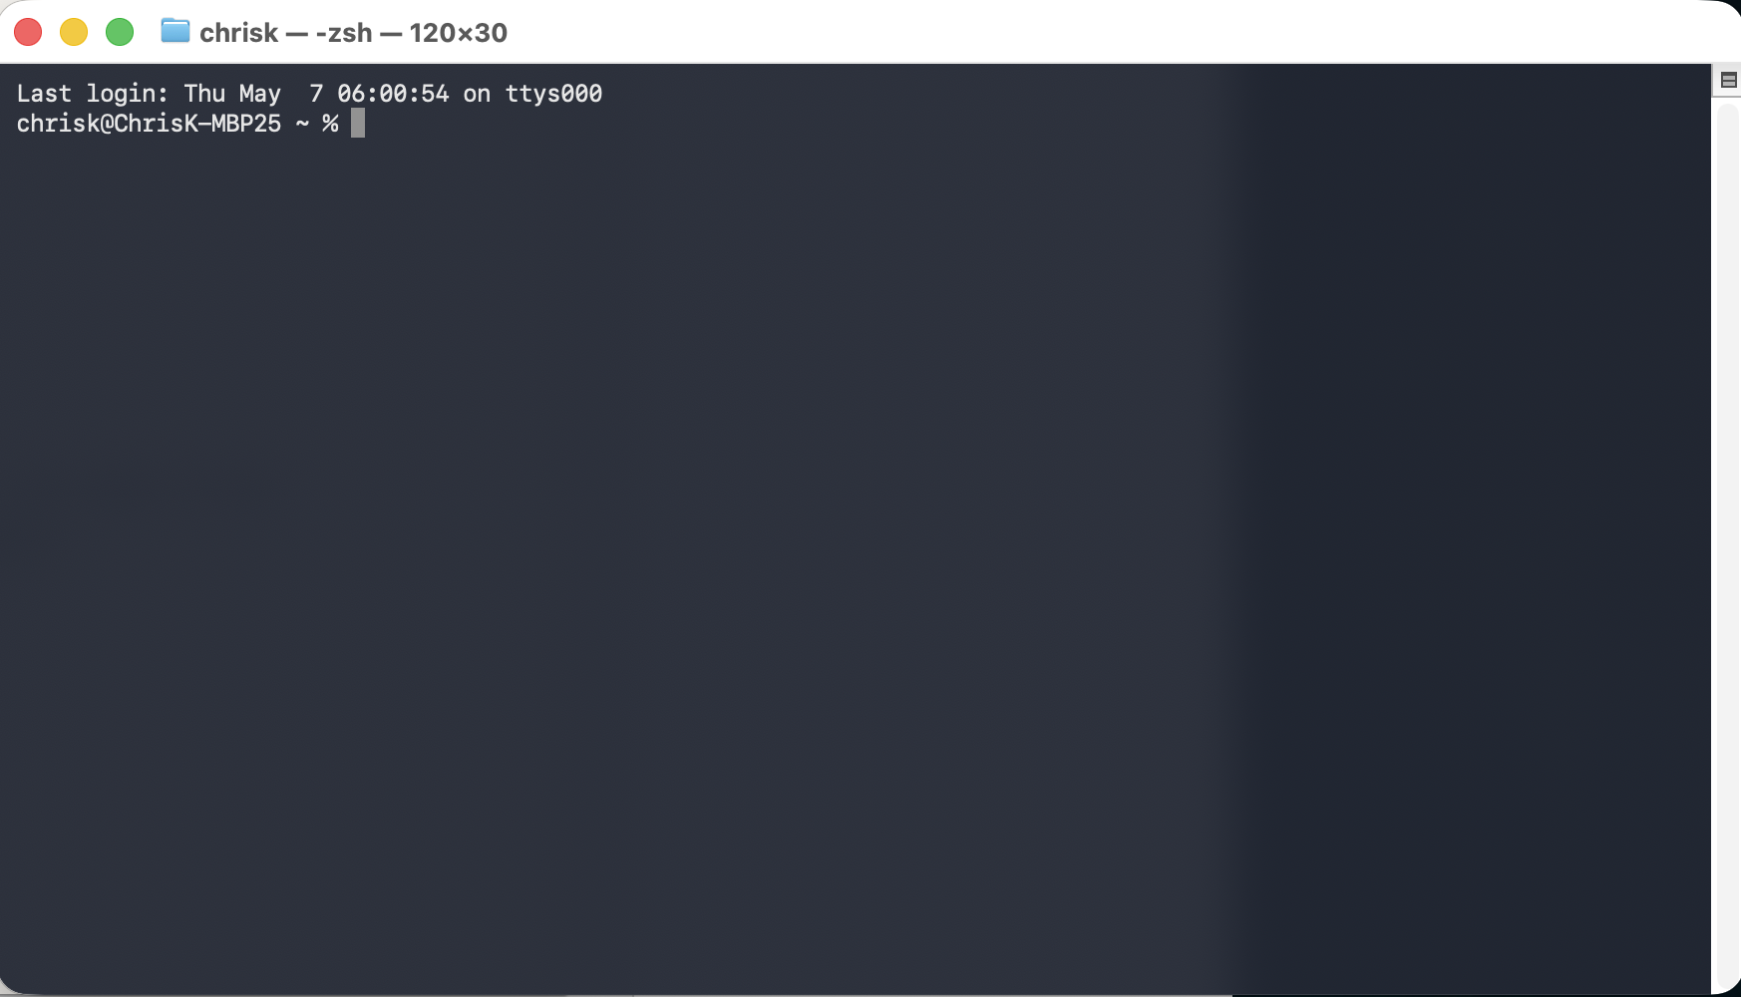
SDLC CRASH COURSE
09 / 16
THE TERMINAL, WITHOUT THE PANIC
The terminal is back!
Commandment V — Thou shalt not fear thy terminal.
Notes:
Anchor with Commandment V: thou shalt not fear thy terminal. The GUI is a comfort; the terminal is a covenant — that's where Claude Code lives. Live demo: open a terminal, run pwd / cd / ls.

Slide 12
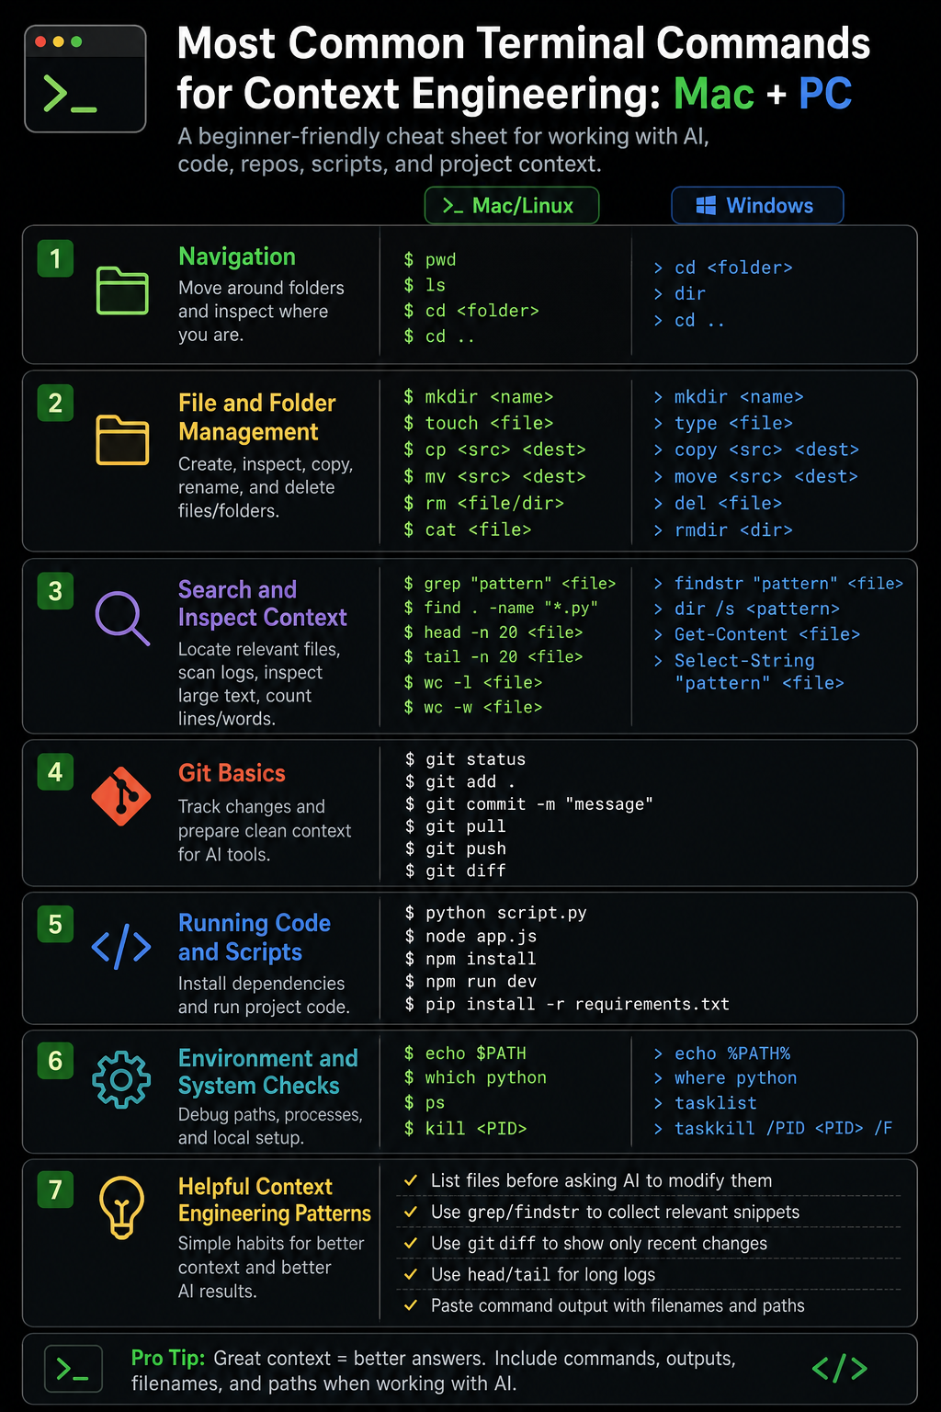
SDLC CRASH COURSE
09 / 16
THE TERMINAL, WITHOUT THE PANIC
Let’s go to the Terminal
▸ pwd — print working directory. Where am I?
▸ cd — change directory. Move me there.
▸ ls — list. What's in this folder?
▸ mkdir — Make a directory
▸ ren — rename
▸ del/rm — delete
Commandment V — Thou shalt not fear thy terminal.
Notes:
Anchor with Commandment V: thou shalt not fear thy terminal. The GUI is a comfort; the terminal is a covenant — that's where Claude Code lives. Live demo: open a terminal, run pwd / cd / ls.

Slide 13
SDLC CRASH COURSE
04 / 16
THE SIX PHASES, ONE LINE EACH
Terminal First Steps
git clone https://github.com/chriskehayias/SDLC

Slide 14
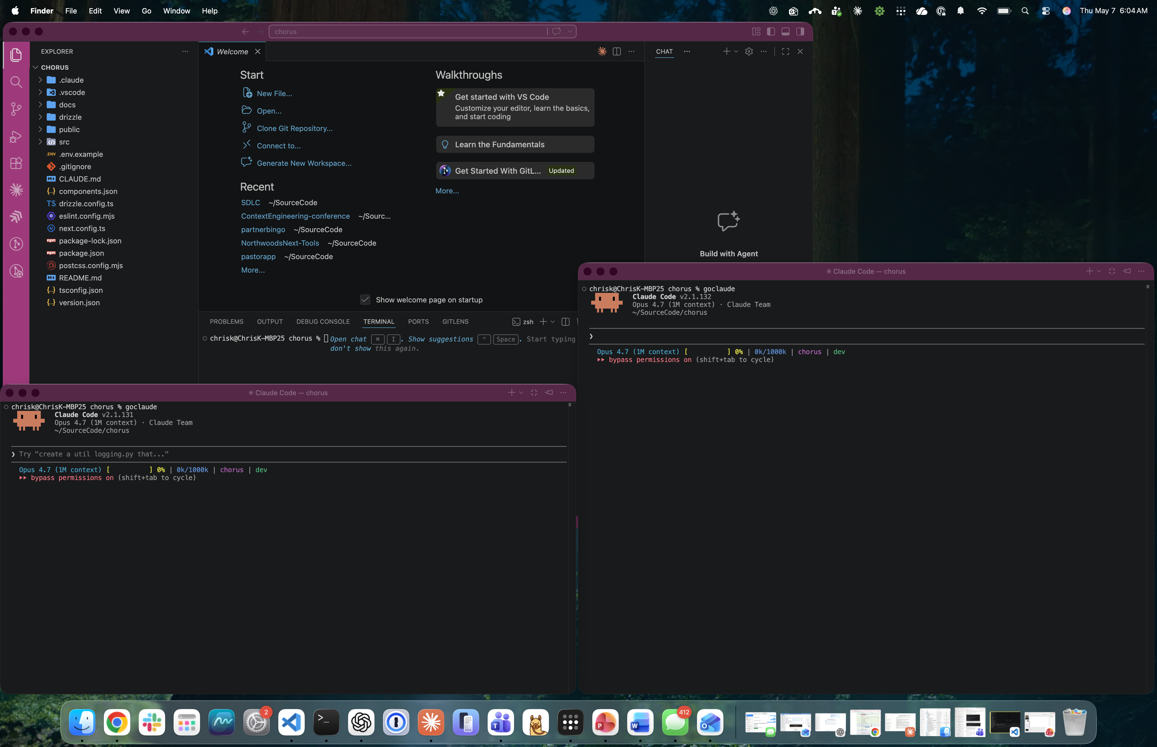

Slide 15
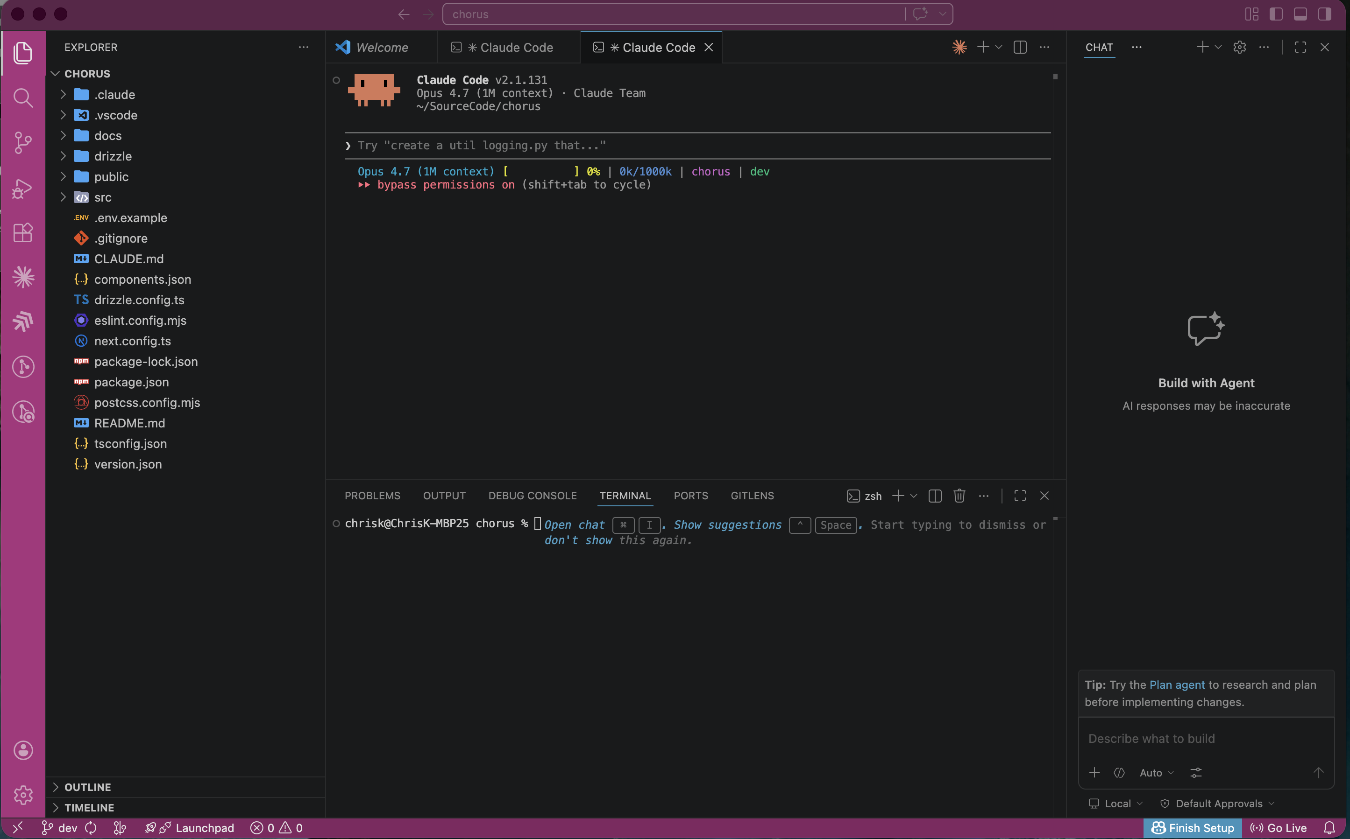

Slide 16
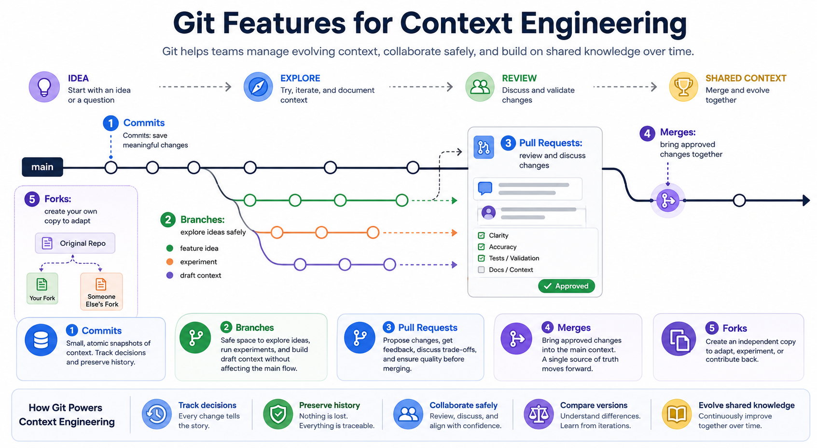
SDLC CRASH COURSE
11 / 16
THE ONLY 6 COMMANDS YOU NEED TODAY
Git essentials
// SESSION 03 · CHRIS KEHAYIAS

Slide 17
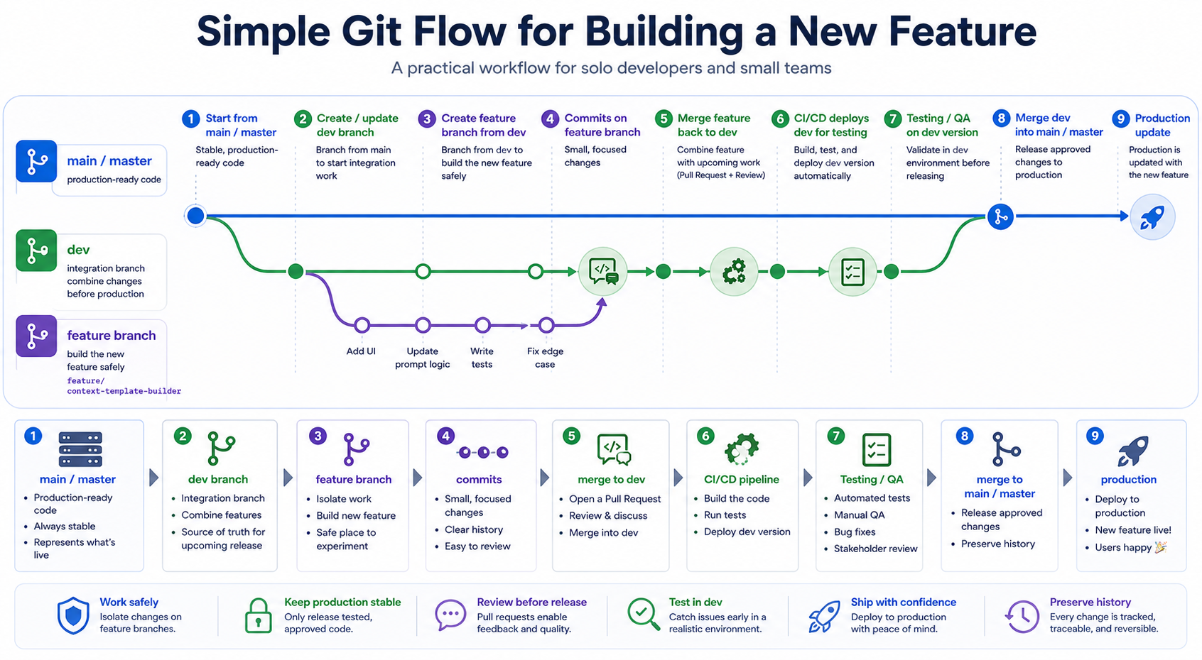

Slide 18
SDLC CRASH COURSE
13 / 16
GITHUB BASICS
GitHub is where your commits go to be seen.
Personal account vs. org, the gh CLI, the PR view.
▸ PERSONAL vs. ORG — your account holds your repos; an org holds the team's.
Notes:
Keep this slide tight — most people already have a GitHub account. The new thing here is the gh CLI, which is how Claude Code interacts with GitHub. If `gh auth status` isn't passing for someone, get a TA to them now — they'll be stuck on slide 14 otherwise.

Slide 19
SDLC CRASH COURSE
15 / 16
WHAT YOU JUST DID
You are now operating the loop.
Cloned · edited · committed · pushed · verified.
▸ You moved a change from your machine to a remote — the full loop
▸ You used both the GUI and the terminal — covenant kept.
▸ You wrote a commit message — a context document for future you.
▸ You verified on github.com — closing the loop.
Notes:
Take 60 seconds to celebrate. Some people in this room have never pushed a commit before today. Name that. The mechanics are real, and they own them now. From here on, every session assumes you can do these five steps without thinking.

Slide 20
16 / 16
UP NEXT · SESSION 04
Inspiration

