Slide 1


CITN·AI
CHURCH IT NETWORK · WORKSHOP
AI Context Engineering
NORTHWOODS CHURCH
PEORIA, IL
Notes:
Welcome them in. Big energy. 'AI Context Engineering — that's a long title for what's actually a really practical workshop. Over the next 90 minutes we're going to get hands-on with what makes AI useful at your church versus useless at your church.'

Slide 2
CITN · AI
CHURCH IT NETWORK · WORKSHOP
Welcome.
SPEAKER
Jason Lee
Day 1 · Session 01
WHERE
Peoria, IL · May 7–8, 2026
Welcome & Kickoff
AI CONTEXT ENGINEERING WORKSHOP
Set the tone. Name the thesis. Get the room ready to build.
Notes:
Welcome them in. Big energy. You're setting the emotional tone for the whole event — warmth first, then structure. Smile, look around, name a few people. Thank Northwoods for hosting. Then move.

Slide 3
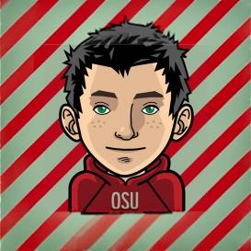
HOST
Jason Lee
Digital Innovation Pastor – Northwoods Church
Notes:
Brief intro — keep it under 60 seconds. 'I ship AI products for a living and I've been in the church tech world a while. Most of what I'm sharing today is what I wish someone had told me two years ago.'

Slide 4
THE THESIS
Stop experimenting
with AI.
Start building tools
that actually work.
— FROM THE EVENT README
01 · WELCOME & KICKOFF
PEORIA, IL · MAY 7–8, 2026
Notes:
Pause. Read it. Let it land. This is the line we want echoing in their heads when they walk in tomorrow morning.

Slide 5
SESSION GOAL
By 9:30 you'll know three things.
That's it. Three things. Then we're off and running.
01
02
03
What context engineering is
What the next two days look like
That your environment works
A discipline — not a prompt trick. What you put in front of the model is the whole game.
Day 1 is the craft. Day 2 you ship something real. Here's the arc and the rhythm.
claude, gh, node — all green. If not, we have people who can help.
01 · WELCOME & KICKOFF
GOAL
Notes:
These are the three bars we have to clear in the next 30 minutes. If we leave the room with all three, we've done our job.

Slide 6
LOGISTICS
A few housekeeping things.
BATHROOMS
BREAK SCHEDULE
Just out the back
Two breaks + lunch
Hallway to the right, follow the signs. Go whenever — no need to ask.
15 min at 9:45 · 75 min lunch at 11:45 · 20 min snack break at 3:45. Clock on the wall is the truth.
FOOD
BASEBALL
Coffee out front, lunch in back
Game is at 6:30. We'll be done.
Doughnuts already out. Lunch starts at 11:45 — sponsors get 2–5 min before we eat.
Dinner at 6:15 PM. We'll wrap by 5:00 sharp so nobody misses first pitch.
01 · WELCOME & KICKOFF
HOUSEKEEPING
Notes:
Keep this tight — 2 to 3 minutes max. Energy stays up. The baseball line gets a laugh; lean into it briefly and move on.

Slide 7
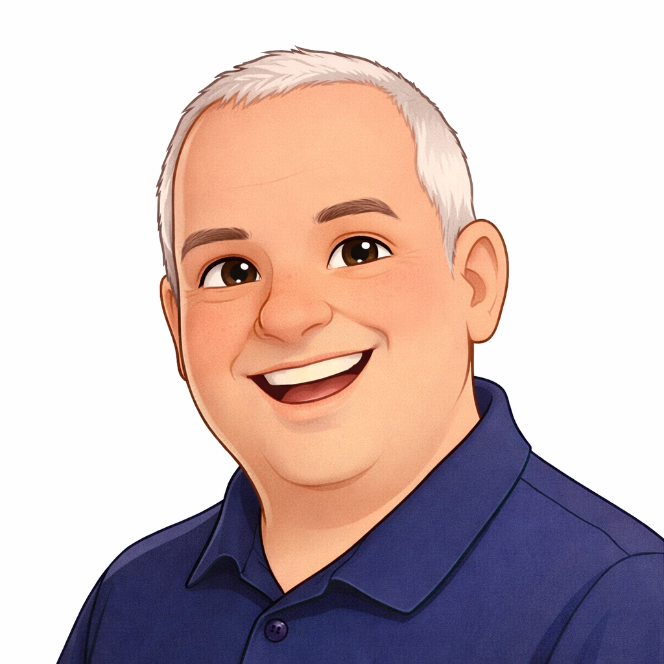
DEVO
Dean Lisenby
Chief Ventures Officer – ACS Technologies
Notes:
Brief intro — keep it under 60 seconds. 'I ship AI products for a living and I've been in the church tech world a while. Most of what I'm sharing today is what I wish someone had told me two years ago.'

Slide 8
LOGISTICS
Devo Time
01 · WELCOME & KICKOFF
HOUSEKEEPING
Notes:
Keep this tight — 2 to 3 minutes max. Energy stays up. The baseball line gets a laugh; lean into it briefly and move on.

Slide 9

SPEAKER
Chris Kehayias
SVP, AI & INNOVATION – ACS Technologies
Notes:
Brief intro — keep it under 60 seconds. 'I ship AI products for a living and I've been in the church tech world a while. Most of what I'm sharing today is what I wish someone had told me two years ago.'

Slide 10
THE ARC
Two days. One arc.
Day 1 you learn the craft. Day 2 you ship something real.
DAY 1 · MAY 7
DAY 2 · MAY 8
Foundations
Build Day
Learn the mindset, the workflow, and how to build context.
Apply it end-to-end: plan, build, and ship a Next.js app.
Vibe coding vs. context engineering
SDLC crash course (git, repos, terminal)
Building context — Part 1 & 2
Claude Code for the non-developer
Context Engineering Workflow Overview
Inspire Leaders panel
Choosing your Claude Code Adventure
Next.js with Claude Code
Build Block 1 — plan & review
Build Block 2 — code & commit
Deploying – ship it
Show & tell + closing
01 · WELCOME & KICKOFF
TWO DAYS · ONE ARC
Notes:
Don't read the bullets. The point is the headline: Day 1 craft, Day 2 ship. Everything else is in the schedule on the table.

Slide 11
WORKING DEFINITION
Context engineering is a discipline, not a prompt trick.
What you put in front of the model is the whole game.
Day 1 is learning the craft. Day 2 is using it to ship.
01 · WELCOME & KICKOFF
WHAT IT IS
Notes:
Read it slowly, twice. This is the one sentence to leave the room with. Note: this preview lands the idea, then we hand off to the next session for the full unpack.

Slide 12
SETUP CHECK · 8 MIN
Run these three commands together.
prerequisites · check
AI Help
$ claude --version
Tripp & Patrick
Jason & Matt
✓ claude code 1.x · ready
Standing by at every break.
$ gh auth status
✓ Logged in to github.com as you
If any of those three are red or missing – turn your name plate vertical.
Anthropic account, Claude Code CLI, and GitHub CLI unlock the rest of the workshop.
$ node --version
✓ v20.x or newer
01 · WELCOME & KICKOFF
PREREQUISITES · GREEN BY 10:00
Notes:
If more than ~20% of the room isn't green, silently extend the 10:15 break by 10 min rather than pushing people into the SDLC session cold. Don't shame anyone — just point them at the AI Genius Bar.

Slide 13
UP NEXT
Vibe coding
vs. context engineering.
Session 02 / 14
What the difference is. Why it matters. What “good” looks like.
01 · WELCOME & KICKOFF
HAND-OFF
Notes:
Land it, smile, hand off cleanly. Don't oversell the next session — let it speak for itself. Last words: 'Let's build.'

