Slide 1
Hidden Markov Models
HARVARD DATA VENTURES

Slide 2
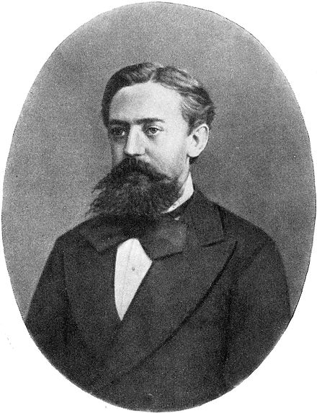
Andrei Andreyevich Markov

Slide 3
Markov-ness

Slide 4


Markov Models
Value of X at a given time is called the state
Parameters: called transition probabilities or dynamics, specify how the state evolves over time (also, initial state probabilities)
Stationarity assumption: transition probabilities the same at all times
X₁
X₂
X₃
X₄

Slide 5
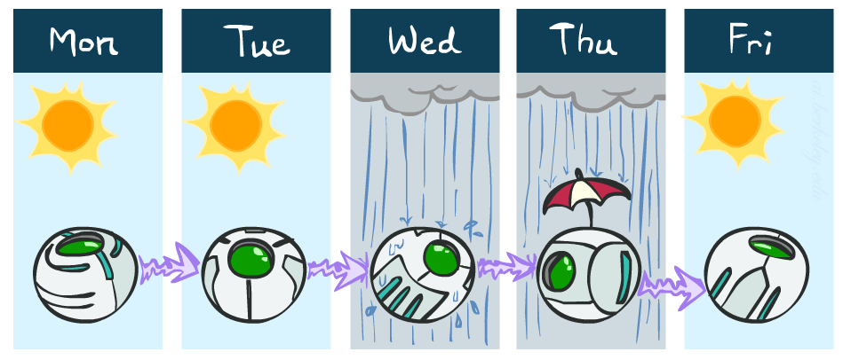
Example Markov Chain: Weather
States: X = {rain, sun}
Initial distribution: 1.0 sun
CPT P(X_{t} | X_{t-1}):
Two new ways of representing the same CPT
X_{t-1} | X_{t} | P(X_{t}|X_{t-1})
sun | sun | 0.9
sun | rain | 0.1
rain | sun | 0.3
rain | rain | 0.7
0.9
0.3
0.9
rain
sun
sun
sun
0.1
0.3
rain
0.7
rain
0.7
0.1

Slide 6
Example Markov Chain: Weather
0.9
0.3
Initial distribution: 1.0 sun
What is the probability distribution after one step?
rain
sun
0.7
0.1

Slide 7
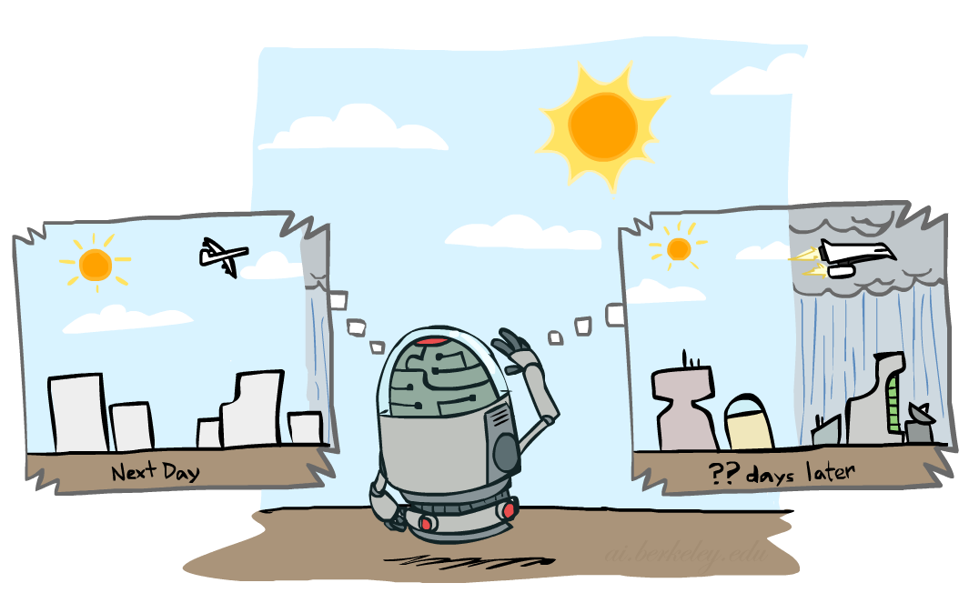

Mini-Forward Algorithm
Question: What’s P(X) on some day t?
X₁
X₂
X₃
X₄
Forward simulation

Slide 8
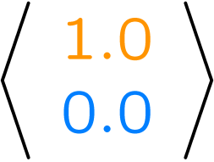
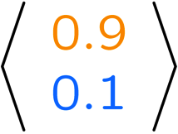
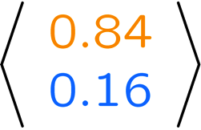
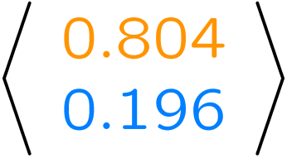
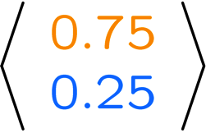
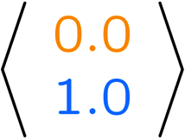
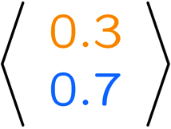
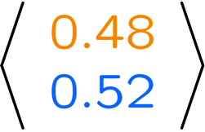
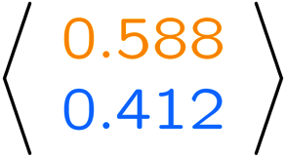
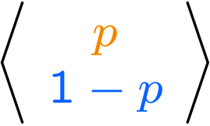
Example Run of Mini-Forward Algorithm
From initial observation of sun
From initial observation of rain
From yet another initial distribution P(X₁):
P(X₁)
P(X₂)
P(X₃)
P(X₄)
P(X∞)
P(X₁)
P(X₂)
P(X₃)
P(X₄)
P(X∞)
…
P(X₁)
P(X∞)

Slide 9
But what if…
We can’t observe the states?

Slide 10

Example: Weather HMM
Rain_{t-1}
Rain_{t}
Rain_{t+1}
Umbrella_{t-1}
Umbrella_{t}
Umbrella_{t+1}
R_{t} | R_{t+1} | P(R_{t+1}|R_{t})
+r | +r | 0.7
+r | -r | 0.3
-r | +r | 0.3
-r | -r | 0.7
R_{t} | U_{t} | P(U_{t}|R_{t})
+r | +u | 0.9
+r | -u | 0.1
-r | +u | 0.2
-r | -u | 0.8
An HMM is defined by:
Initial distribution:
Transitions:
Emissions:
Notes:
demo

Slide 11
Example: Robot Localization
Example from Michael Pfeiffer
Prob
0
1
t=0
Sensor model: can read in which directions there is a wall, never more than 1 mistake
Motion model: may not execute action with small prob.

Slide 12
Example: Robot Localization
Prob
0
1
t=1
Lighter grey: was possible to get the reading, but less likely b/c required 1 mistake

Slide 13
Example: Robot Localization
Prob
0
1
t=2

Slide 14
Example: Robot Localization
Prob
0
1
t=3

Slide 15
Example: Robot Localization
Prob
0
1
t=4

Slide 16
Example: Robot Localization
Prob
0
1
t=5

Slide 17




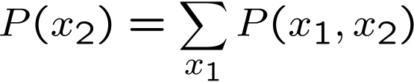

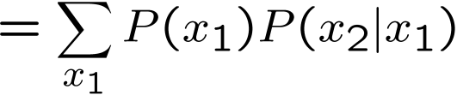

Inference: Base Cases
X₁
X₁
X₂
E₁

Slide 18

Passage of Time
Assume we have current belief P(X | evidence to date)
Then, after one time step passes:
Basic idea: beliefs get “pushed” through the transitions
With the “B” notation, we have to be careful about what time step t the belief is about, and what evidence it includes
X₁
X₂
Or compactly:
Notes:
TODO: intermediate step in derivation!

Slide 19

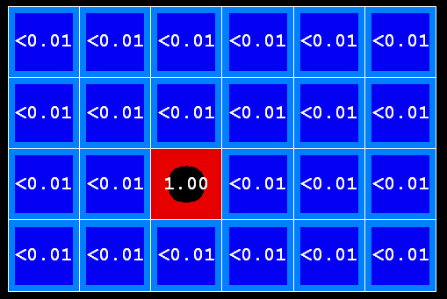
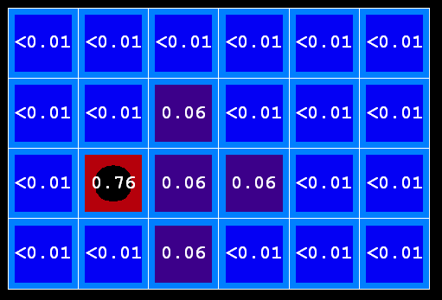
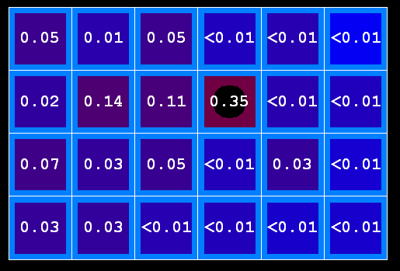
Example: Passage of Time
As time passes, uncertainty “accumulates”
T = 1
T = 2
T = 5
(Transition model: ghosts usually go clockwise)

Slide 20
Observation
X₁
Assume we have current belief P(X | previous evidence):
Then, after evidence comes in:
Or, compactly:
E₁
Basic idea: beliefs “reweighted” by likelihood of evidence
Unlike passage of time, we have to renormalize
Notes:
Basic idea: beliefs “reweighted” by likelihood of evidence
Unlike passage of time, we have to renormalize

Slide 21




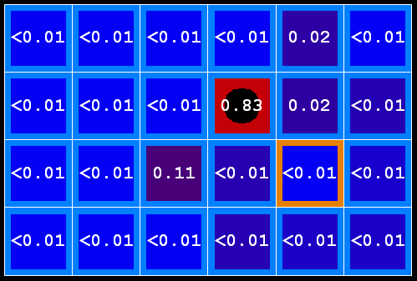
Example: Observation
As we get observations, beliefs get reweighted, uncertainty “decreases”
Before observation
After observation

Slide 22
Example: Weather HMM
B’(+r) = 0.5
B’(-r) = 0.5
B’(+r) = 0.627
B’(-r) = 0.373
B(+r) = 0.5
B(-r) = 0.5
B(+r) = 0.818
B(-r) = 0.182
B(+r) = 0.883
B(-r) = 0.117
Rain₀
Rain₁
Rain₂
R_{t} | R_{t+1} | P(R_{t+1}|R_{t})
+r | +r | 0.7
+r | -r | 0.3
-r | +r | 0.3
-r | -r | 0.7
Umbrella₁
Umbrella₂
Notes:
demo

Slide 23

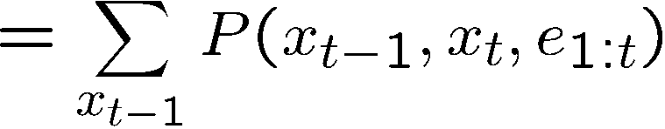
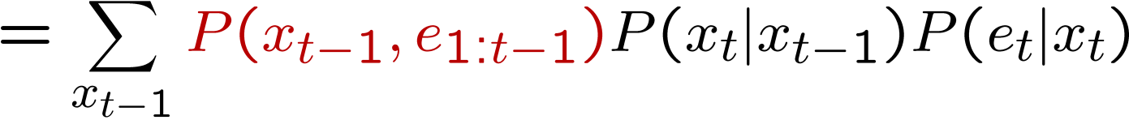
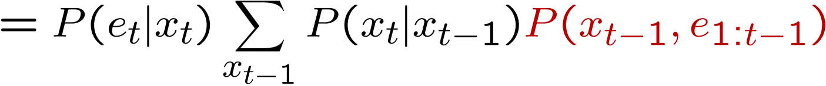
The Forward Algorithm
We are given evidence at each time and want to know
We can derive the following updates
We can normalize as we go if we want to have P(x|e) at each time step, or just once at the end…
Notes:
TODO: explain propto and it’s X_t, not X

Slide 24
Online Belief Updates
Every time step, we start with current P(X | evidence)
We update for time:
We update for evidence:
The forward algorithm does both at once (and doesn’t normalize)
X₁
X₂

