Slide 1


Gross Domestic Product by Country:
Analysis and ML model

Slide 2

The Source and the Data:
National Acc
Monetary
COUNTRY
or
REGION
INDICATORS
Trade
Demographics
Gov. Finance

Slide 3
National Acc
Monetary
Gross domestic product, constant price ( gdp_con)
% GDP (inc. exports – imports)
Gross domestic product, current prices (gdp_curr): $
GDP (inc. exports – imports)
Gross domestic product, deflator (gdp_defl)
Gross domestic product per capita, constant prices
(gdp_percap_cons) $
Total investment(tot_invest) % GDP
Gross national savings (gross_savings) % GDP
Inflation, average consumer prices (inflation_ind) %
Demographics
Unemployment rate (unemployment) % of labour force
Population (pop)
Gov. Finance
Trade
General government revenue (gov_rev) % gdp
General government total expenditure (gov_expend) % gdp
General government net lending/borrowing ( gov_net_len/borr) % gdp
General government gross debt(gross_debt) % gdp
Current account balance (acc_bal) % gdp
Volume of imports of goods and services (import_g_s) % change
Volume of exports of goods and services (export_g_s) % change

Slide 5
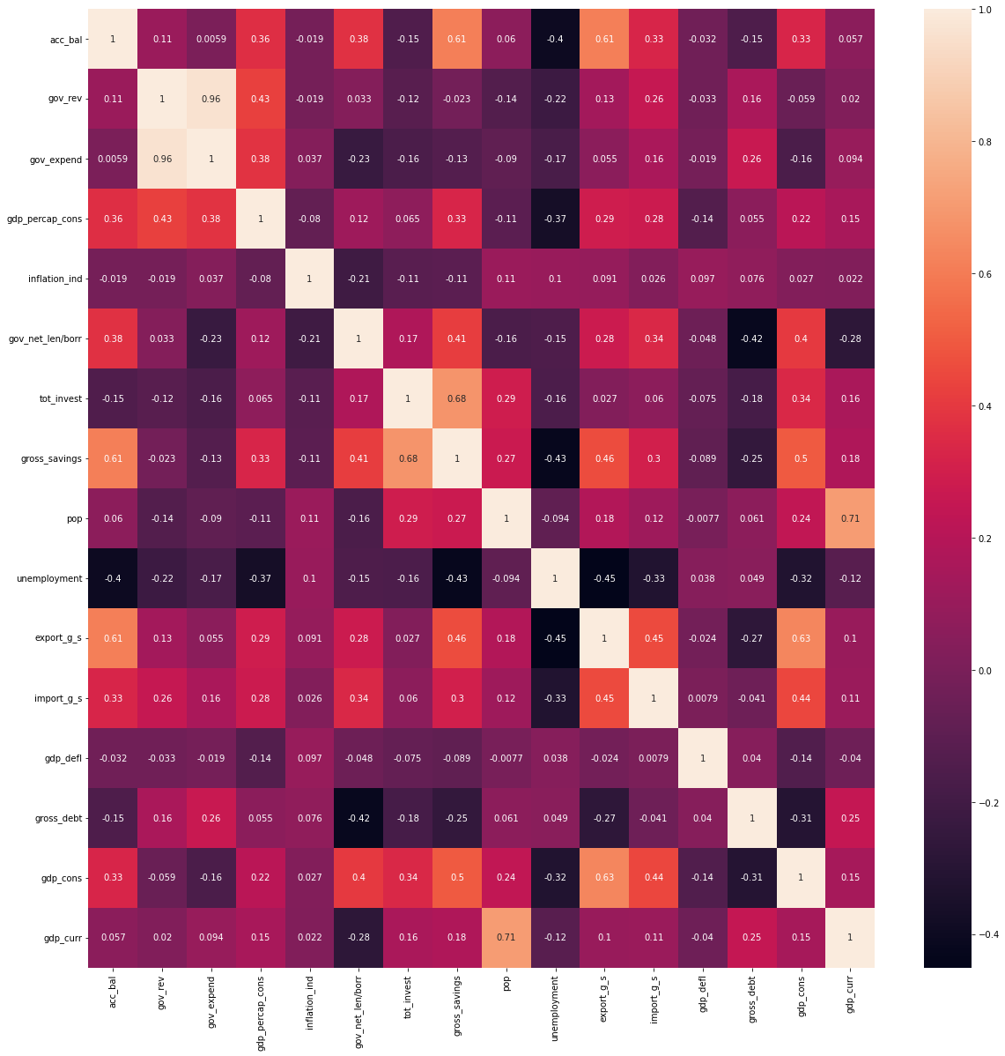
The relations with the target feature:

Slide 6
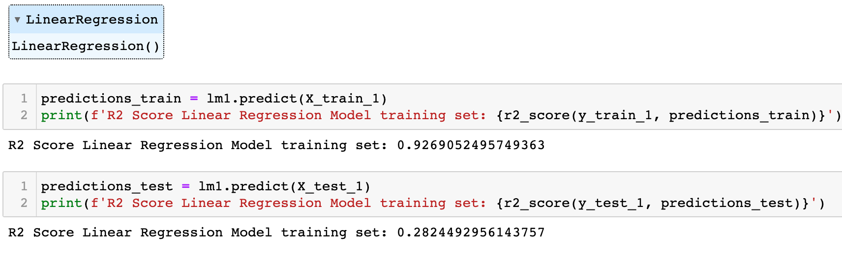
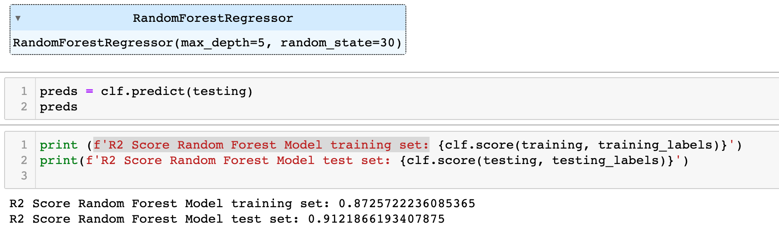
ML approach:
Based on the selected
features data from IMF
AIM :
Supervised ML model
Predict Country GDP (Curr $)
What kind of model ?
Sample size ( 91 countries )
Numerical data ( mostly indexes or %)
Linear Regression Model
Random Forest Model

Slide 7
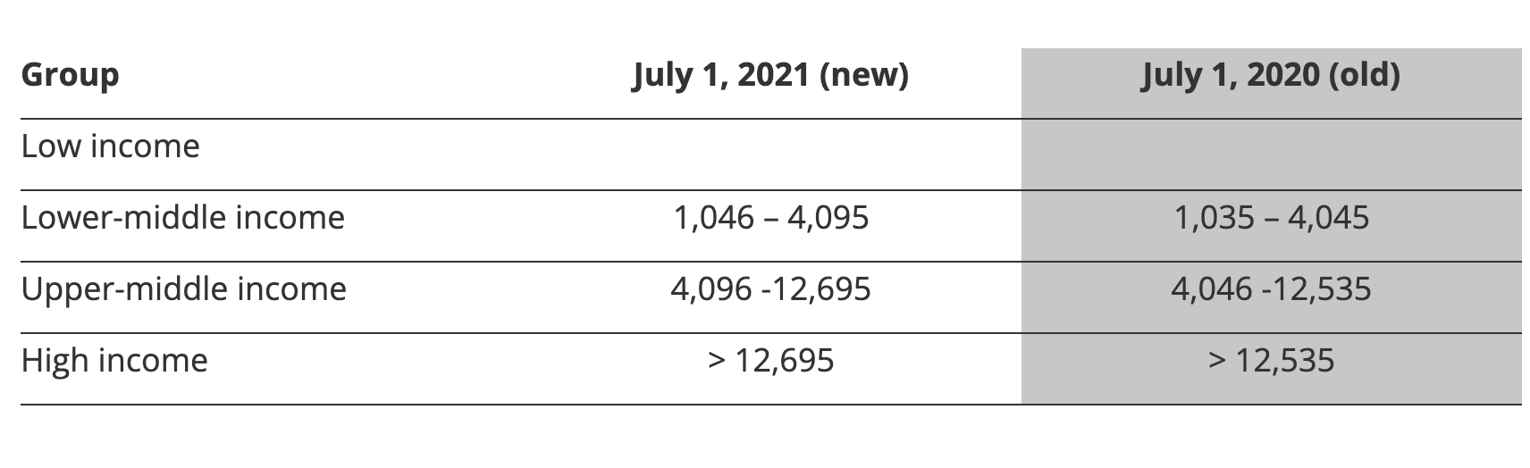

Hypothesis testing:

Slide 10
https://blogs.worldbank.org/opendata/new-world-bank-country-classifications-income-level-2021-2022

