Slide 1


Gross Domestic Product by Country:
Analysis and ML model

Slide 2

The Source and the Data:
National Acc
Monetary
COUNTRY
and
REGION
INDICATORS
Trade
Demographics
Gov. Finance

Slide 3
National Acc
Monetary
Gross domestic product, current prices (gdp_curr): $
GDP (inc. exports – imports) TARGET
Gross domestic product, constant price ( gdp_con)
% growth (inc. exports – imports)
Gross domestic product, deflator (gdp_defl)
Gross domestic product in PPP units, constant prices
(gdp_percap_cons) $
Total investment(tot_invest) % GDP
Gross national savings (gross_savings) % GDP
Inflation, average consumer prices (inflation_ind) %
Demographics
Unemployment rate (unemployment) % of labour force
Population (pop)
Gov. Finance
Trade
General government revenue (gov_rev) % gdp
General government total expenditure (gov_expend) % gdp
General government net lending/borrowing ( gov_net_len/borr) % gdp
General government gross debt(gross_debt) % gdp
Current account balance (acc_bal) % gdp
Volume of imports of goods and services (import_g_s) % change
Volume of exports of goods and services (export_g_s) % change

Slide 4
Data visualization and Story-Telling :

Slide 5
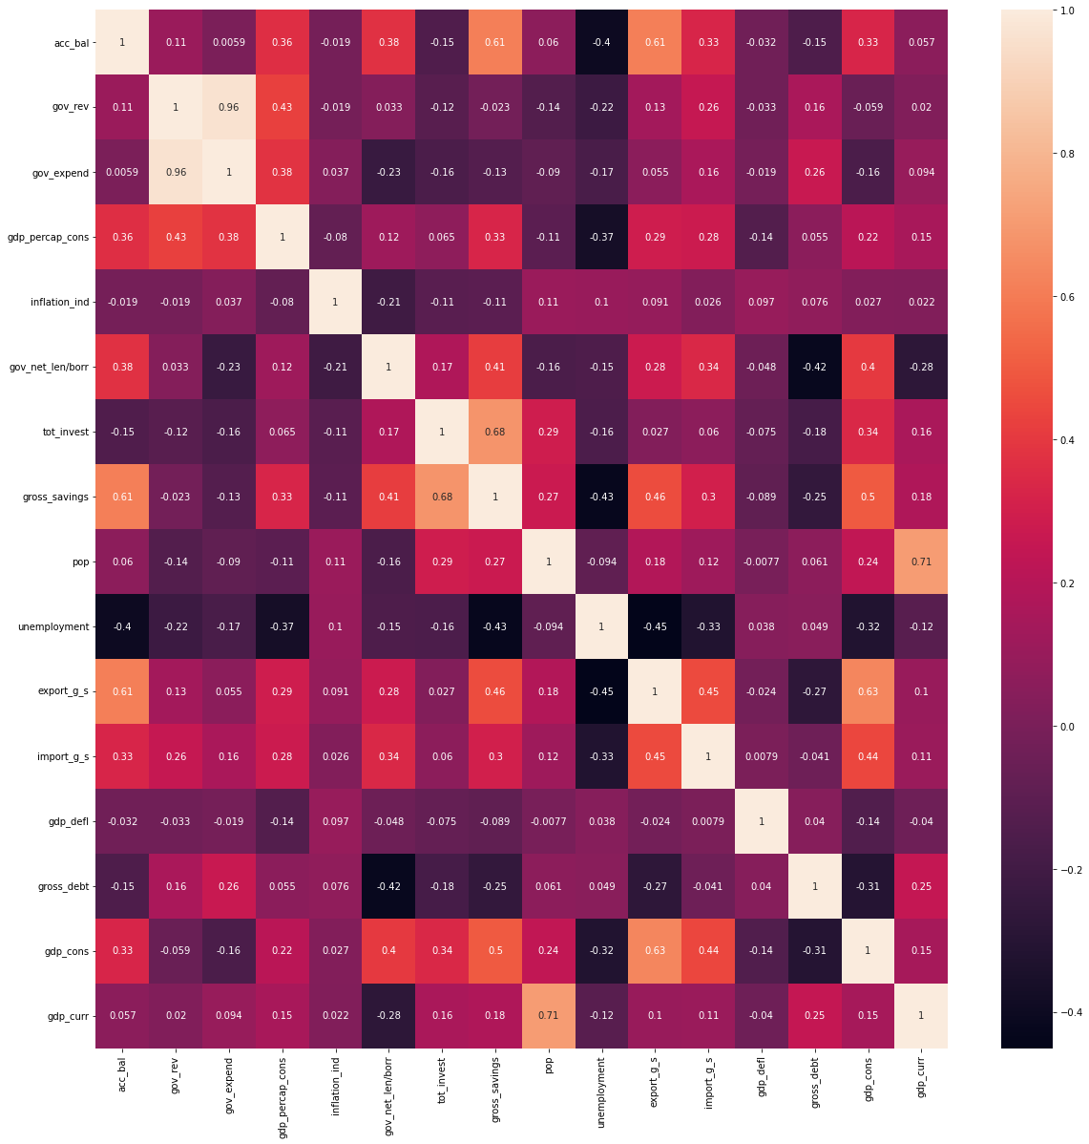
The relations with the target feature:

Slide 6
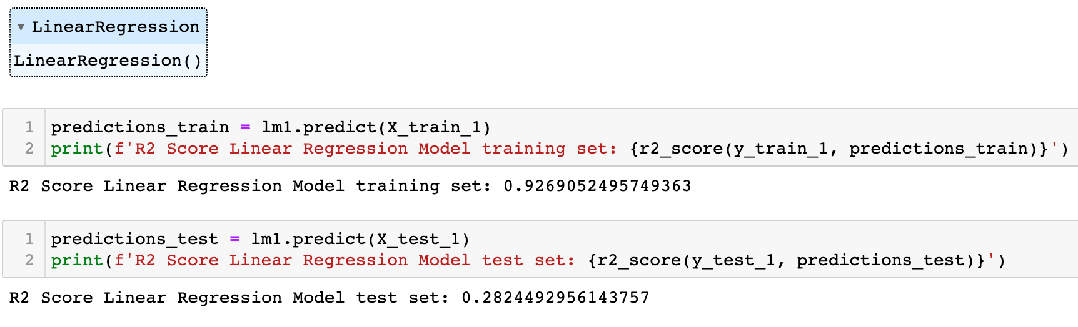
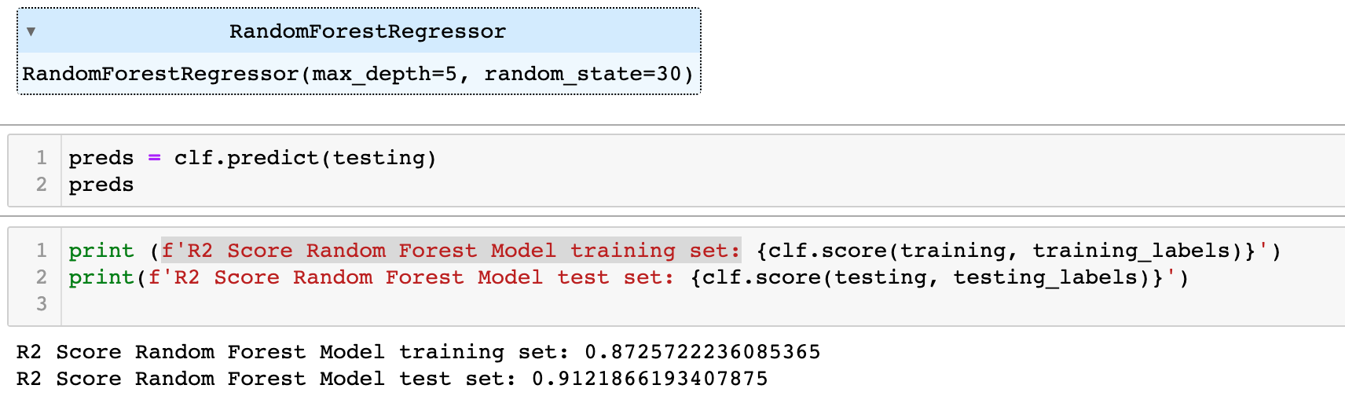
ML approach:
Based on the selected
features data from IMF
AIM :
Supervised ML model
Predict Country GDP (Curr $)
What kind of model ?
Sample size ( 91 countries )
Numerical data ( mostly indexes or %)
Random Forest Model
Linear Regression Model

Slide 7




Credits:
Towards a New Paradigm in Monetary Economics
BY: Joseph E. Stiglitz (1943 - )
Professor at Columbia University
Nobel Memorial Prize in Economic Sciences (2001)
Arthur Okun (1928 – 1980): Yale professor
Okun’s Law: Economic Growth and Unemployment :
https://www.investopedia.com/articles/economics/12/okuns-law.asp
https://blogs.worldbank.org/opendata/new-world-bank-country-classifications-income-level-2021-2022
MACROECONOMICS
Olivier Blanchard, Professor of Economics at MIT
Chief Economist International Monetary Fund (2008-2015)

Slide 8
Q & A

Slide 12
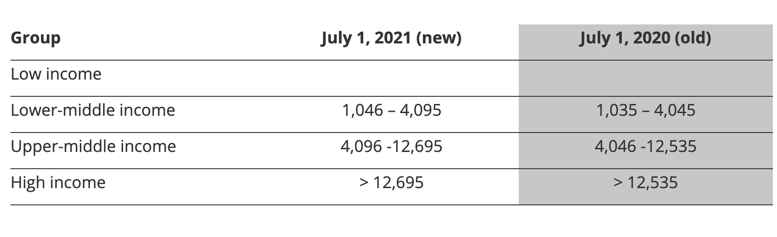
Hypothesis testing:

