Slide 1
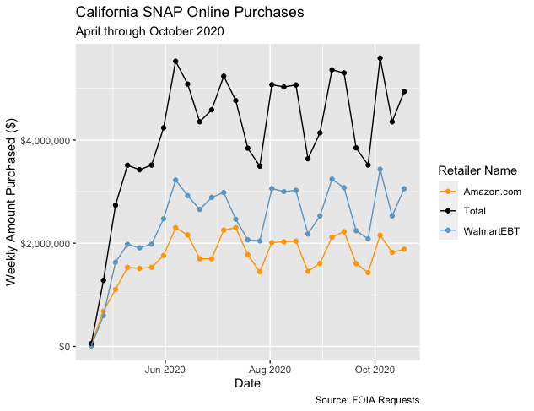
Retailer | Total Transactions | Av. Basket Size ($) | Amount Spent ($)
Amazon | 875,283 | 53 | 46,411,323
Walmart | 893,369 | 73 | 65,613,641

