Slide 1
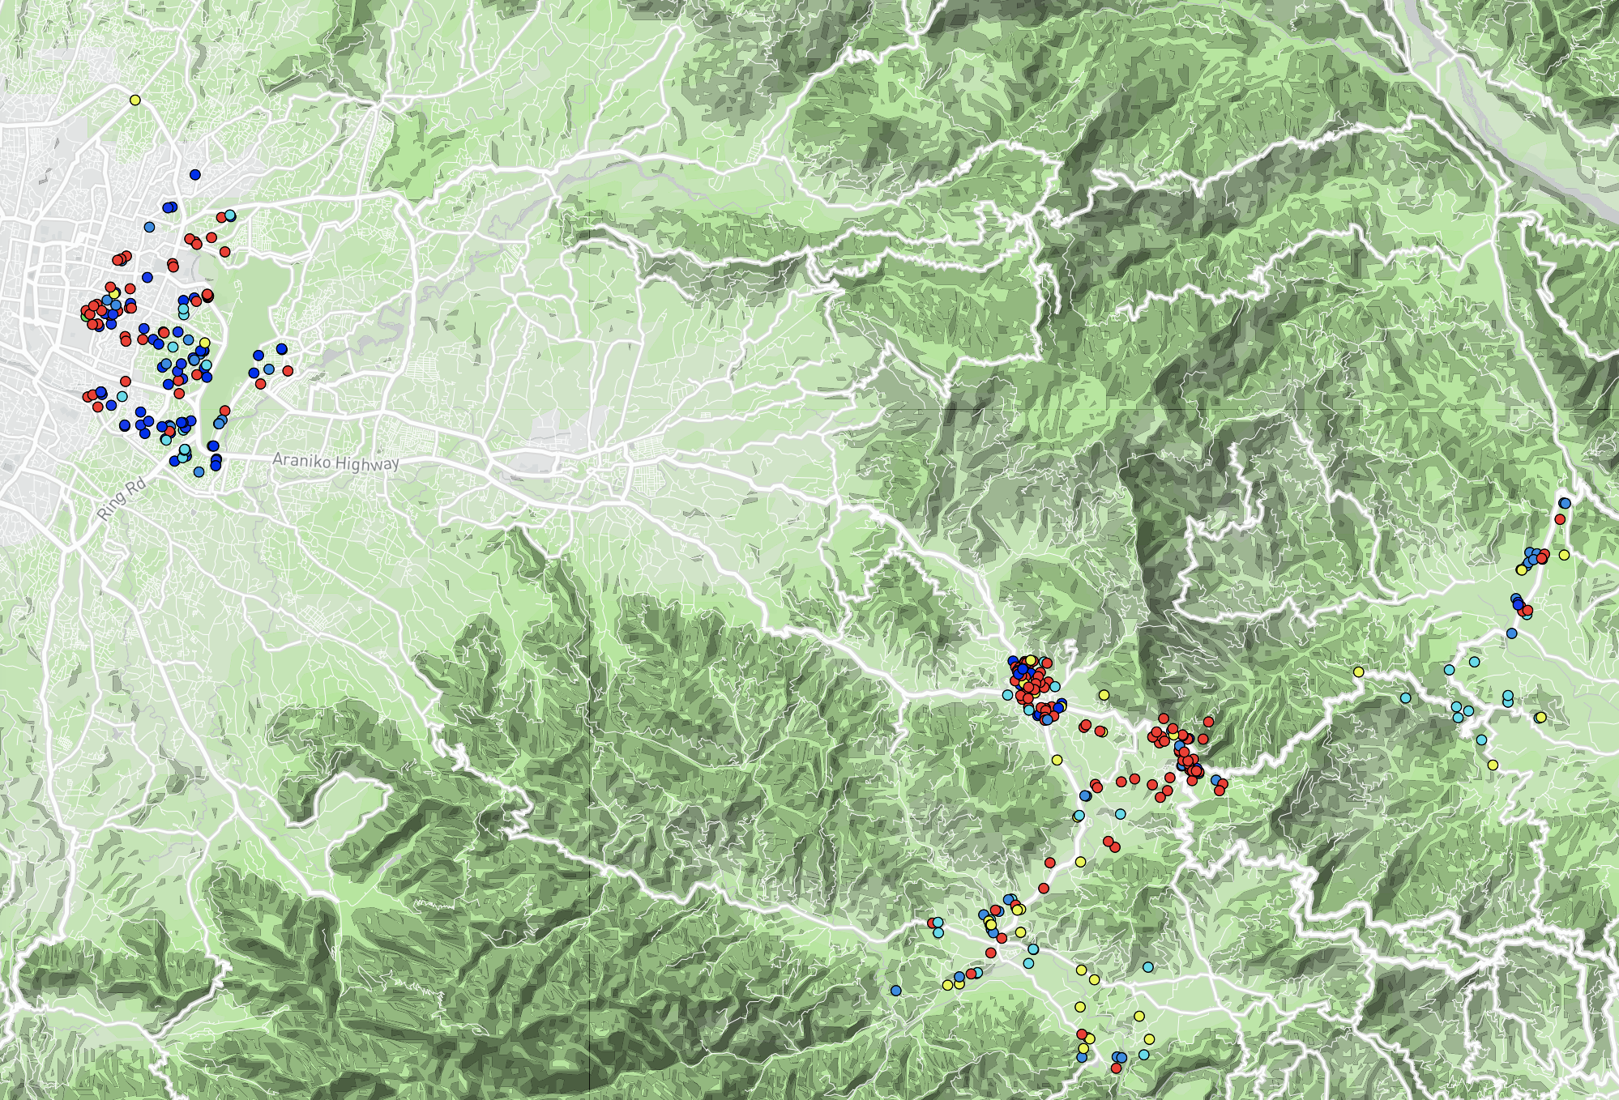
Kathmandu
Bhaktapur
Lalitpur
Banepa
Drinking water type
bore or tube well
Municipal Supply
municipal Supply
surface water
municipal supply

