Slide 1
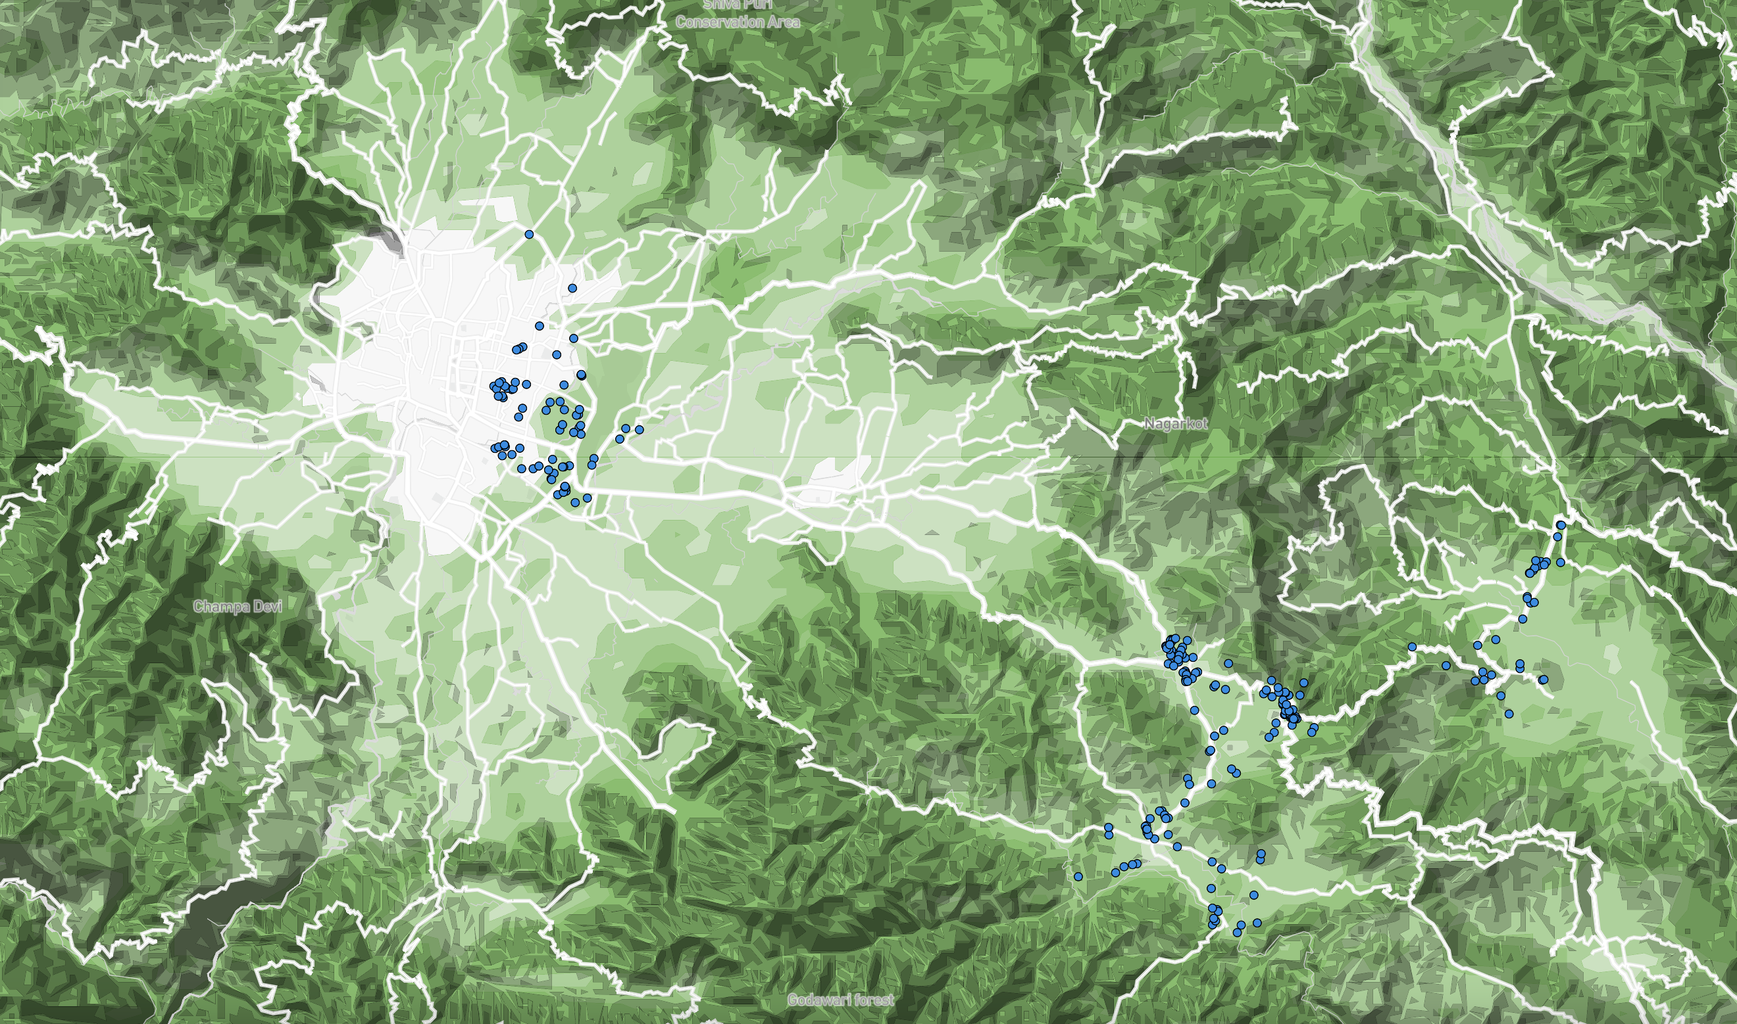
Kathmandu
Kavre

