Slide 1
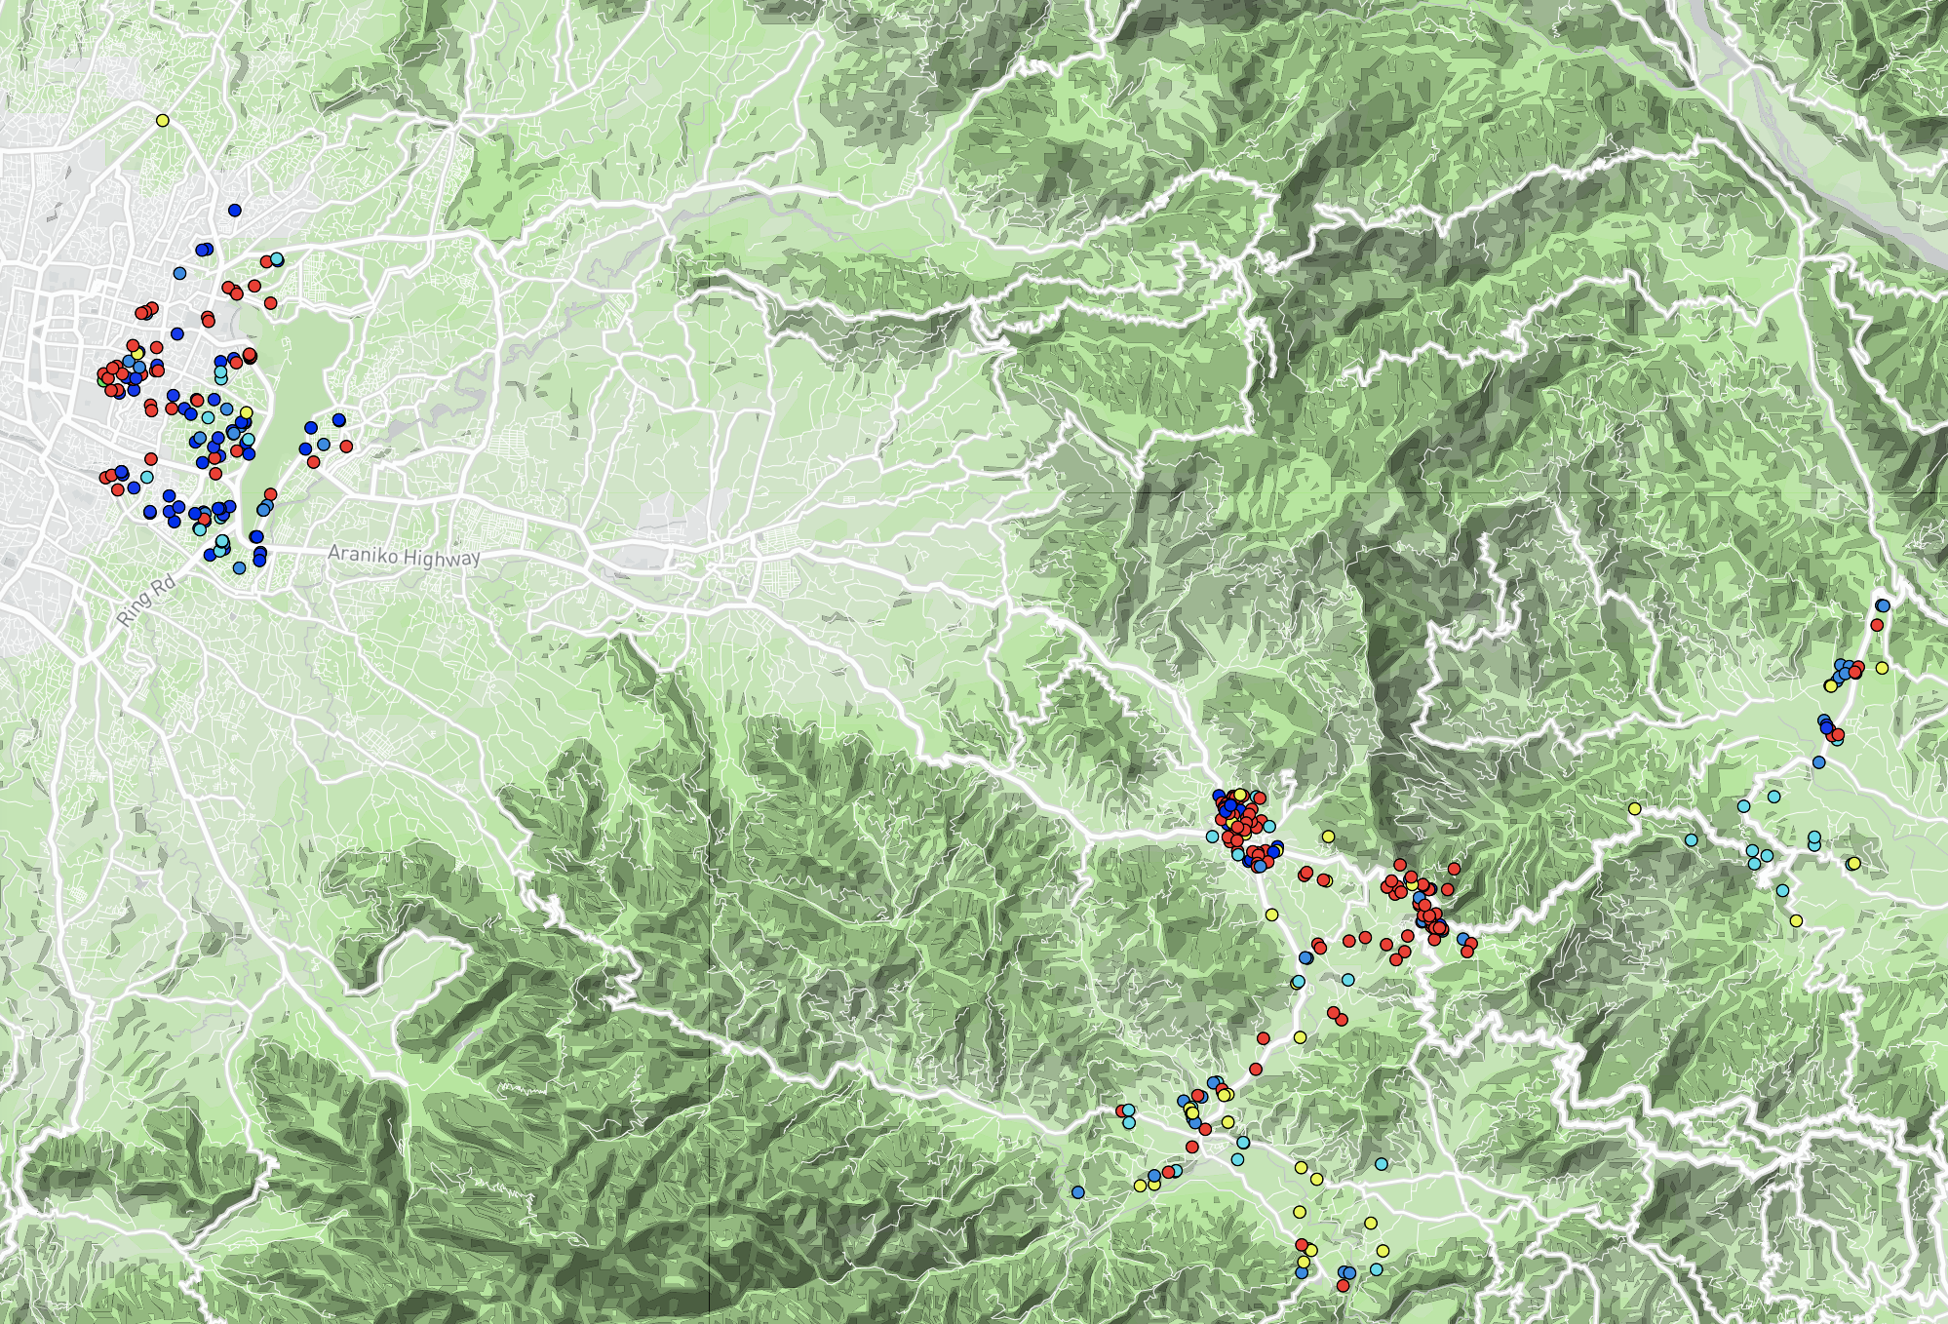
Kathmandu
Kavre
Drinking water type
bore or tube well
Municipal Supply
municipal Supply
surface water
municipal supply

