Slide 1
Selecting the best places in Toronto to put business
Christian Leon

Slide 2
Business Problem
Allocation of resources should be optimal, specially when we talk about land, in this case we aimed to persue the best business to settle in Toronto, Canada.

Slide 3
Data
Sources:
Wikipedia
Foursquare API
Transformation so we could get a final data set of:
Neighborhood
Bourgh
Latitude
Longitude
Common Venues
Etc.

Slide 4
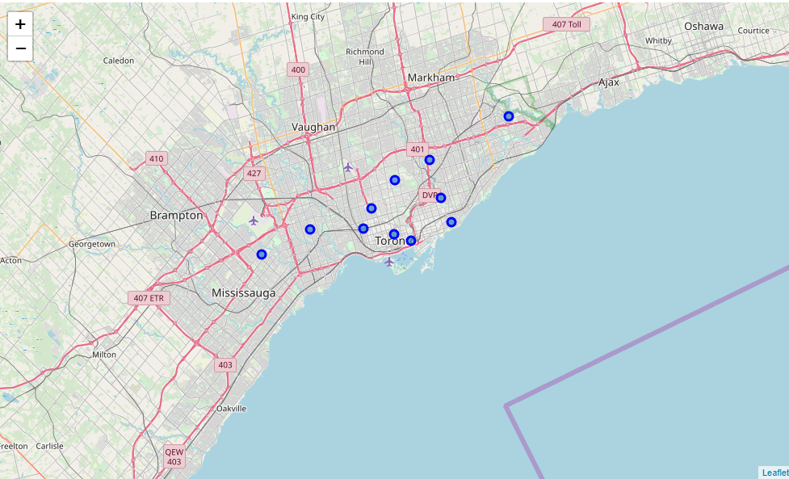
Geospatial Location
Toronto

Slide 5
Methodology
As we can see the k-means algorithm will be used for the aimed of this investigation. Here are some pros and cons of the use of this algorithm
Pros:
Simplicity to implement,
Escalation to large data sets,
Guarantees convergence,
Can warm-start the positions of centroids,
Easily adapts to new examples and generalize to clusters of different shapes and sizes{
Cons:
Discrete choice of K
Outliers can form its own cluster

Slide 6
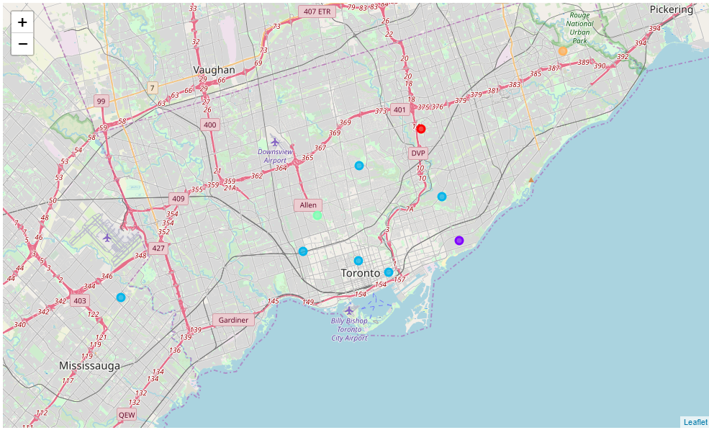
Results (1)

Slide 7
Results (2)
Cluster 1: As we can see in the notebook the first common venue is a park and the next in the row are food places, so we would usually recommend people or small businessperson to go for food target environments for this cluster (North York)
Cluster 2: In the second cluster we can see that the common venues refer more to service firms such as health, electronic devices, Trail, and a mix of food. We would highly recommend probably not to invest in this area because of the high variance in the kind of business here. (East Toronto)
Cluster 3: The biggest cluster of them all, which englobes Downtown Toronto, Queen’s Park, East York, West Toronto, Central Otronto and Mississauga seems to highlight recreational areas, such as parks, pubs, gym, theaters. We would highly recommend entertainment firms to go to this cluster immediately. This all are fairly close to the University of Toronto which makes more sense since more population transits those areas every day.
Cluster 4: York which is our 4th cluster seems like more and sport and eat area, business like sports centers and food would highly function here.
Cluster 5: Finally, Scarborough seems fairly equal to the second cluster, probably this indicates that we should use only 4 clusters for next investigations.

Slide 8
Conclusion
As we noticed the k-means algorithm can be somewhat discrete with the k value. But at least, results give insight about which business could open in different areas. It has a lot of room for improvement, but for now it seems a great approach. Experiments could be done changing some parameters of the k-mean algorithm and a different data set.

