Slide 1
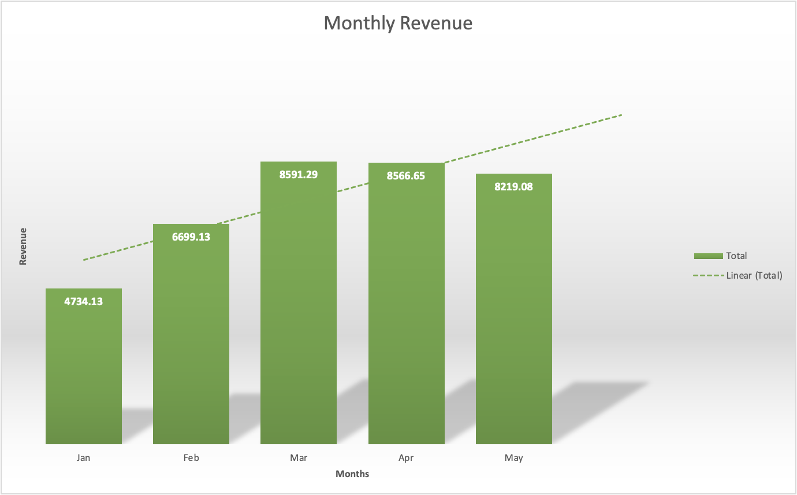
Monthly sales has been growing steadily from Jan to May 2016
Overview
Data shows monthly revenue from Jan to May 2016
There is a linear growing trend in revenue.
Notes:
Goals for today:
- 3 insights from the dataset
- 1. Monthly sales number, 2. Customer loyalty impact, 3. category insight
1. All the data used is cleaned and processed using python and excel.
Assumption: The data is from a clothing store like holister, zara.
Begin presentation
1. Start off by looking at sale trend, to see where we are at in term of sale number.
2. The x axis shows the months from Jan and May, and the y axis shows the revenue, This graph shows the monthly revenue changes from Jan to May
3. It shows that have a steady increase in revenue from Jan to May.
4. The dotted line is a trend line using liner regression.

Slide 2
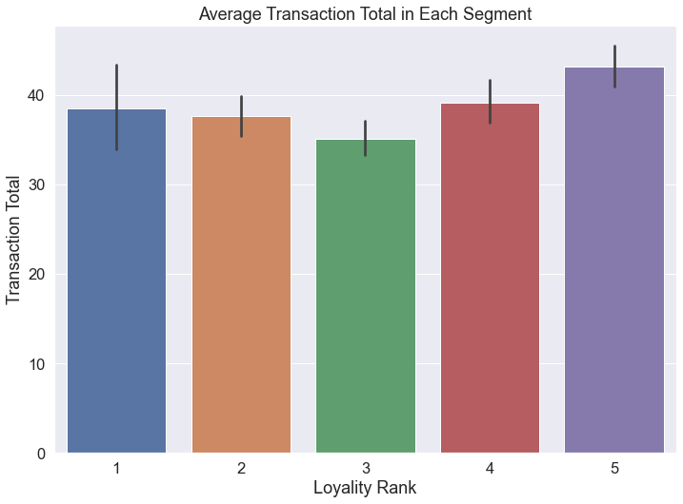
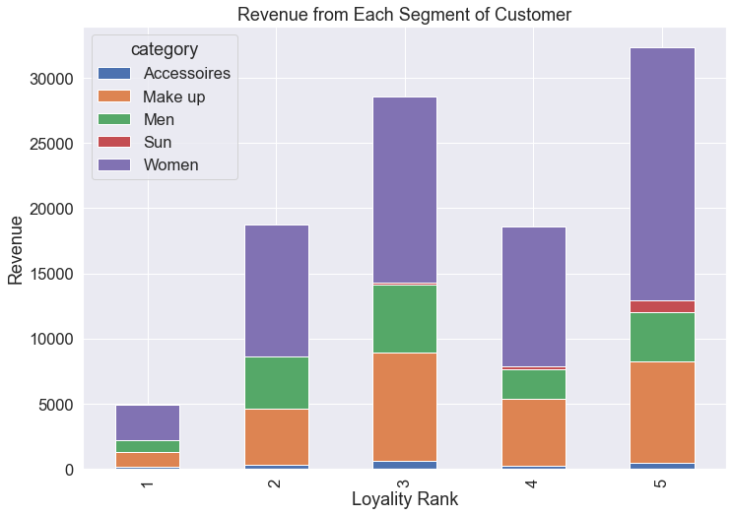
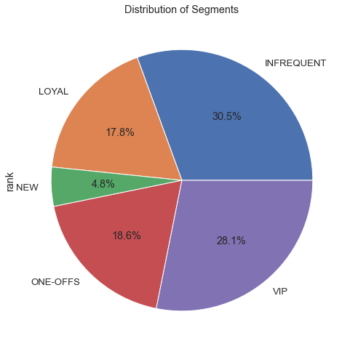
More Revenue are Generated From Loyal Customer Group
Key Points
By looking at revenue from each segment, the more loyal group tends to generate more revenue.
Women and Make-Up products account for most of the revenue in each group, around 80% of the revenue.
A more loyal customer are more likely to spend more in each transaction.
Conclusion
The more loyal the customer ⇒ the more revenue generated.
However, we have more Infrequent Customer than Loyal Customer.
Loyalty marketing program/campaign to target Infrequent Customer to boost revenue.
Notes:
Look at how loyal customer can impact revenue.
Fig 1: x is loyalty group, from 1 to 5, 1 meaning less loyal while 5 is the most loyal. Y is the revenue in each group. Categories are shown using color in each of the bar. It represent the pct of category in a group.
Fig 2: x is loyalty group, y is the average total of a transaction, this shows that average transaction total in each loyalty group. It shows that a more loyal customer is more likely to have a higher transaction total.
Fig 3: This shows the distribution of loyalty group in all of our active customer.

Slide 3
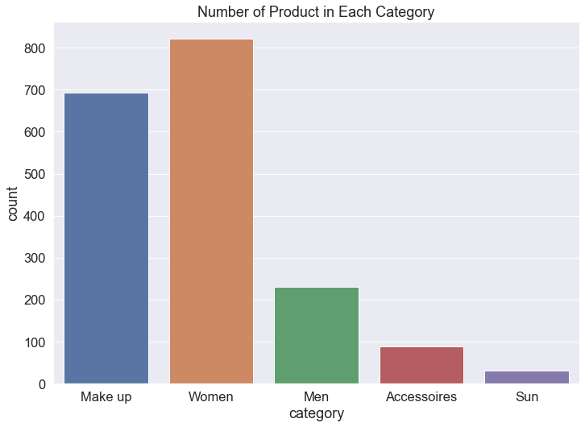
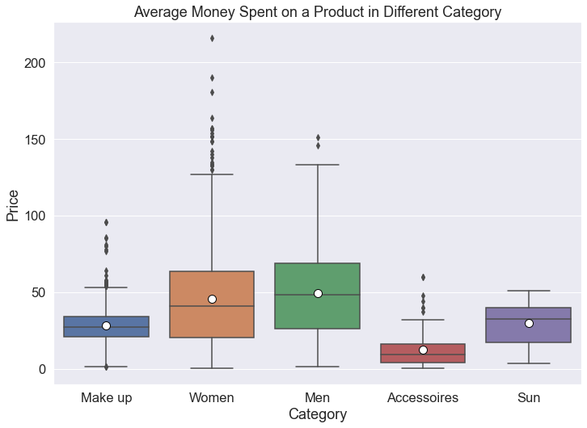
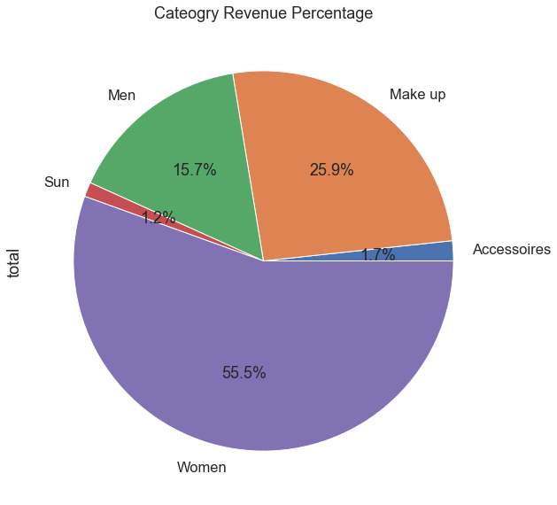
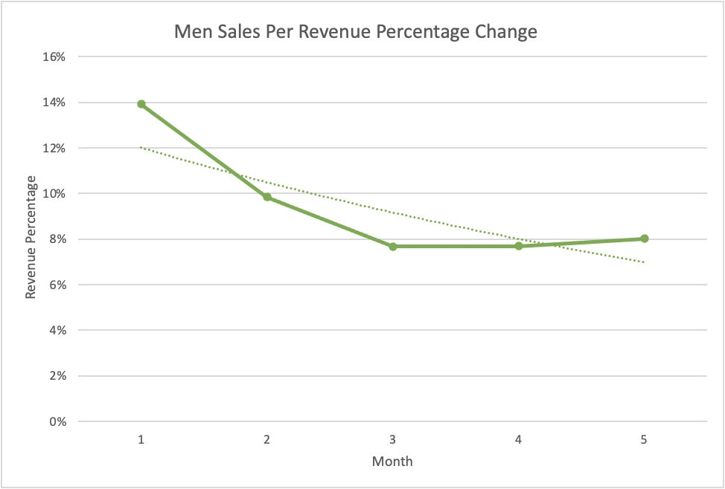
Improve Men Category Sales Performance
Are Men products too expensive?
Data shows that a customer are spending more money on men’s item on average (~$50) compare to any other category
Do we have enough products for men?
We simply do not carry enough men’s item for customers.
Data shows that Men category had been underperforming since Jan.
Notes:
Lastly, data shows that Men category had been underperforming since Jan to May
Fig 1: the x axis is month, and the y axis is the revenue percentage of men category. It shows that even our revenue is raising, but men category has been decreasing in terming percentage in revenue.
Fig 2: It shows that Men category only make up 15% of our overall revenue. Why??
Fig 3: It shows the average transaction total in different category. It shows that shopper are just as willing to buy and spending money on men items.

