Slide 1

Conclusions
Info 498d – Android
Joel Ross
Winter 2016

Slide 2
Project Presentations
https://canvas.uw.edu/courses/1023396/pages/project
Remember the peer evaluation!
https://catalyst.uw.edu/webq/survey/joelross/297254

Slide 3
Releasing Your App
http://developer.android.com/tools/publishing/preparing.html
http://developer.android.com/distribute/tools/launch-checklist.html
https://play.google.com/apps/publish/

Slide 4
Final Thoughts

Slide 5
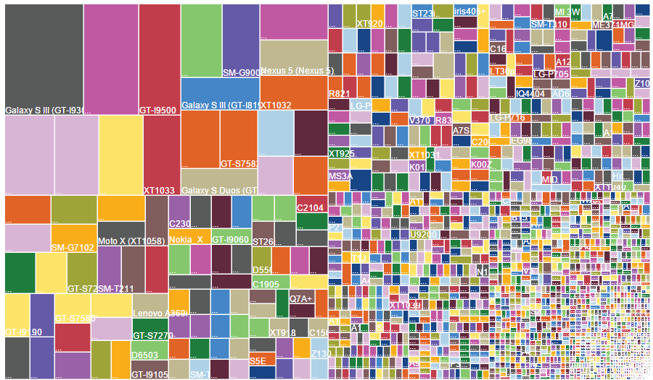
Develop for Flexibility
Android Market Share, August 2014

Slide 6

Develop for Universal Usability
source

Slide 7

Develop New Experiences!

Slide 8
Feedback
What went well?
What could go better?
What did you expected to learn/do but didn't?

Slide 9
Evaluations
CHECK YOUR EMAIL!

Slide 10

Thanks for a great course!

