Slide 1
xv6 bootstrap process
0x100000(1M)
kernel entry
(Start at 0x10000c)
Read from 2nd sector by bootmain
640k
Physical Memory
0x11000(68k)
ELF header
(4k)
0x10000(64k)
0x7e00(31.5k)
bootmain.c
ESP for entry to Bootmain
bootblock
(0.5k)
0x7c00(31k)
bootasm.S
Read from 1st sector by BIOS
BIOS

Slide 2
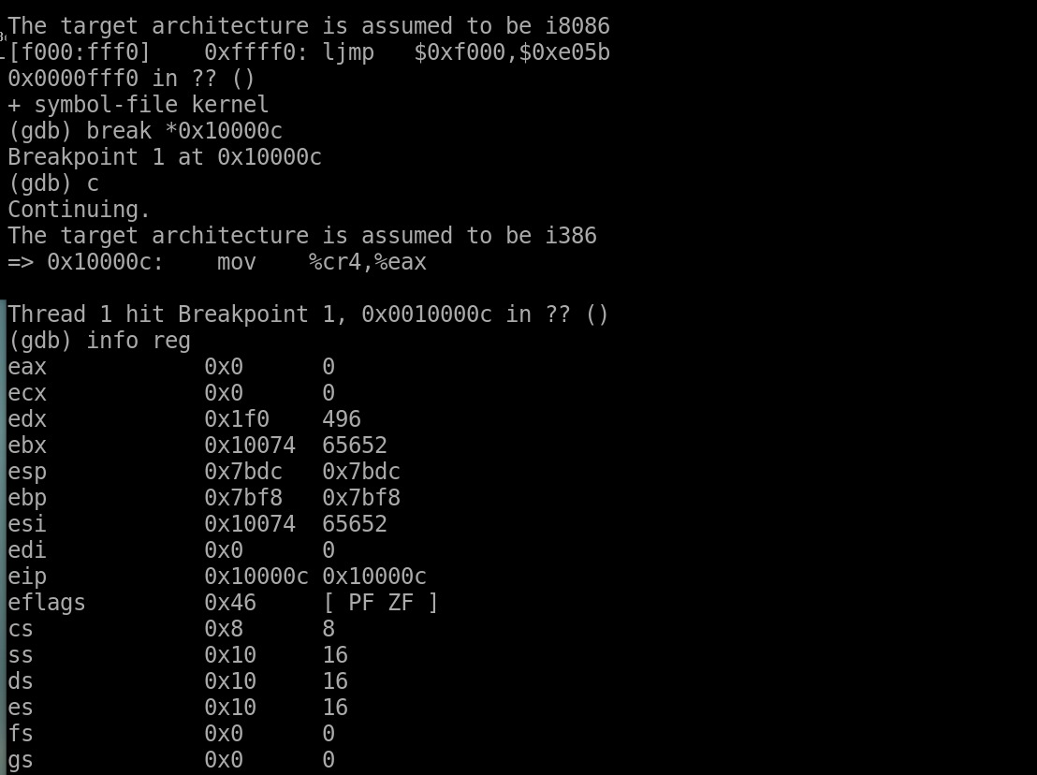
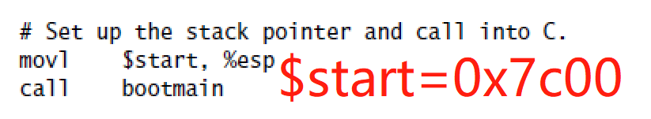
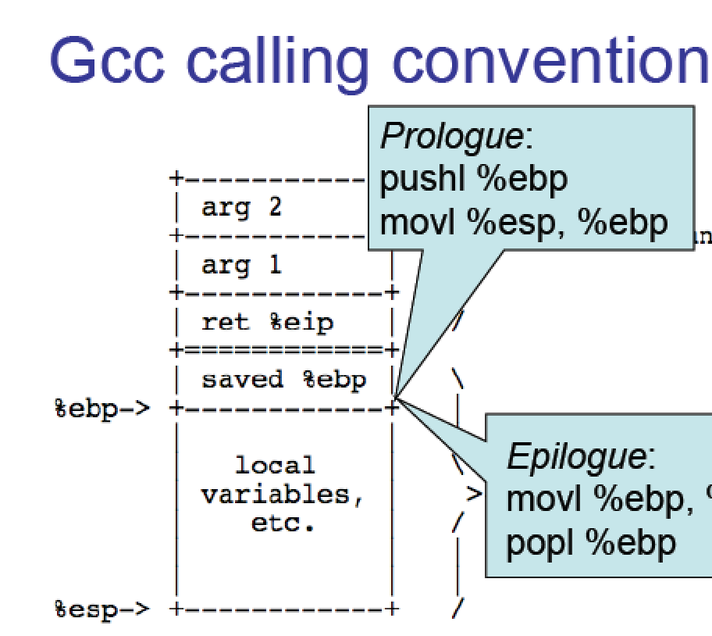

Slide 3
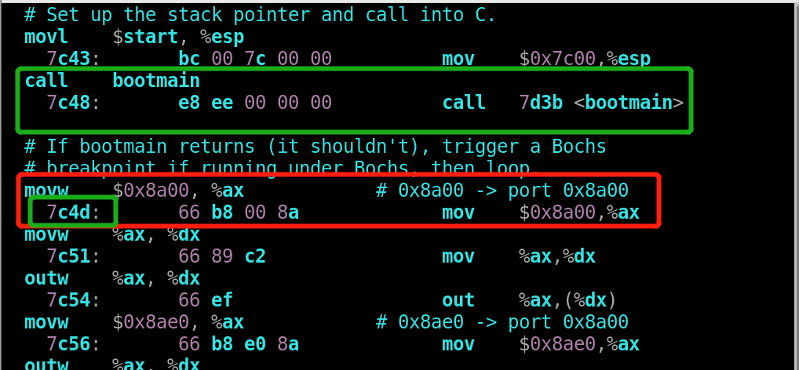
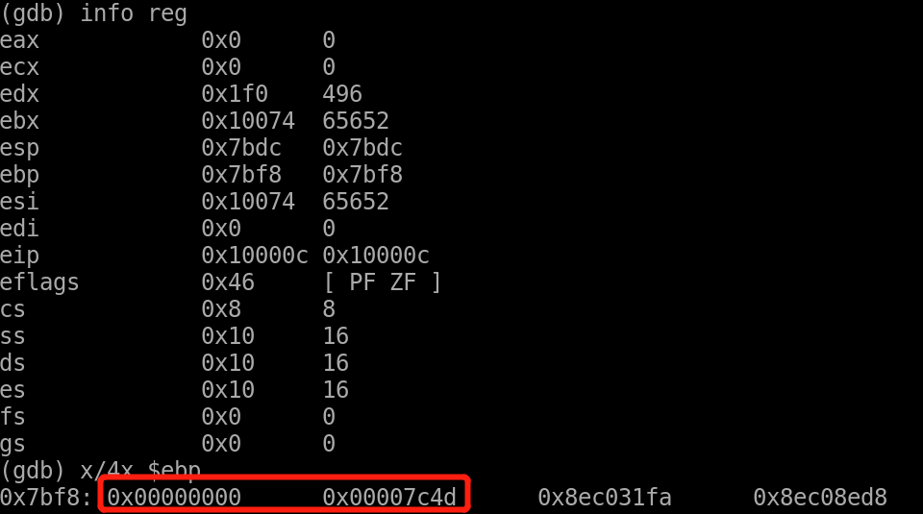
bootblock.asm
break at *0x10000c

Slide 4
Memory management
xv6/memlayout.h
xv6/mmu.h
xv6/vm.c
xv6/kalloc.c
xv6/exec.c

Slide 5
Power on
The concept map of starting procedure on xv6
Start
BIOS
Prepare the hardware and then transfer control to code loaded from the ﬁrst 512-byte sector of the boot disk (memory address 0x7c00).
Jump
Bootasm.S
Switch from 16-bit real mode to 32-bit protected mode.
Bootloader
0x7c00 through 0x7e00 (512 bytes).
Call the C function bootmain.
Bootmain.c
Bootmain’s job is to load and run the kernel.
Call
Entry.S
Physical addresses starting at 0x100000.
Call the kernel’s entry point from ELF header
Find a copy of the kernel executable on the disk starting at the second sector.
ELF header
(the ﬁrst 4096 bytes of the ELF binary from address 0x10000).
Invoke
Main.c
Figure1 The starting procedure of xv6

