Slide 1

Python for Nonprofits
Chris Luedtke, Mentored by Aly Sivji

Slide 2

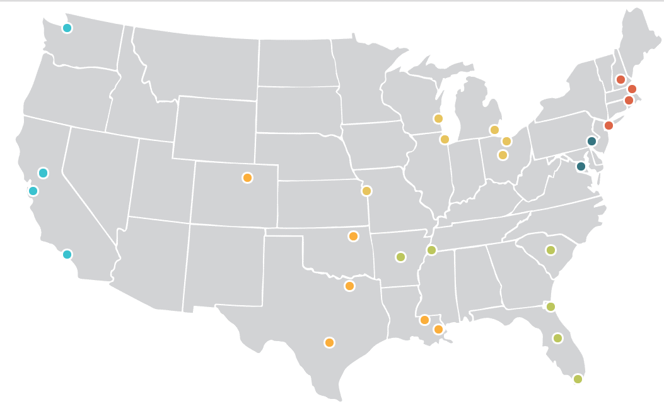
1,500+ AmeriCorps Members yearly
29 city locations
Full time tutors and mentors
Grades 3-9

Slide 3

How I’ve Used Python
Data intake from the field
Data flow to reporting
Data analysis
Web app for machine learning

Slide 4





Software Ecosystem

Slide 5


Data intake from the field
+
x 26 schools
x 250 staff
x 2,000 students
Automated Publishing
Selenium WebDriver

Slide 6
Data flow to reporting
Automated PDF distribution
Powerful Analytics

Slide 7
Data Analysis
How do attributes of tutors and schools relate to our various measurements of success?
Can we combine our disparate metrics into a model of successful program implementation to inform actionable intervention?

Slide 8
Web App

