Slide 1

Double Down on Python
Chris Luedtke, Mentored by Aly Sivji

Slide 2

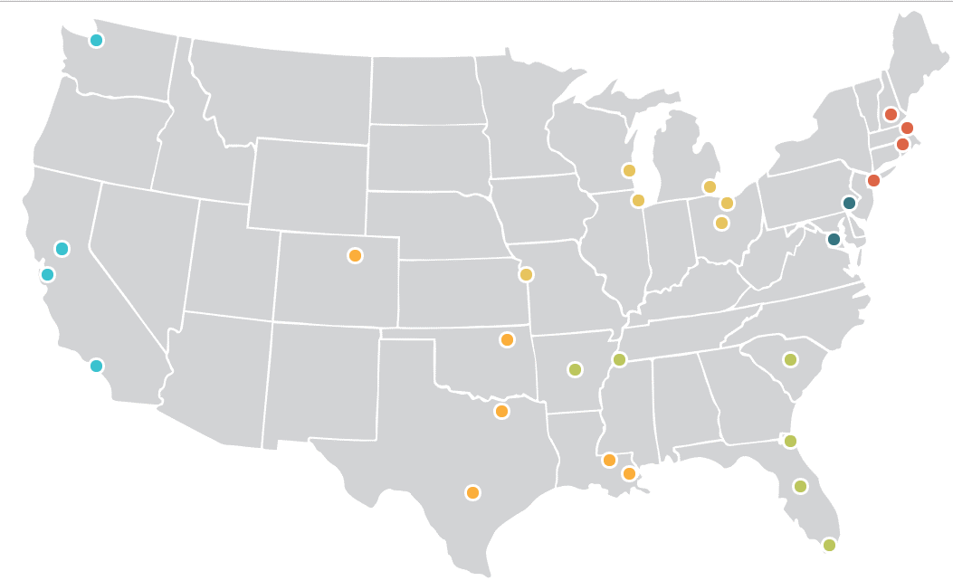
1,500+ AmeriCorps Members yearly
29 city locations
Full time tutors and mentors
Grades 3-9

Slide 3

How I’ve Used Python
Data intake from the field
Data flow to reporting
Data analysis
Web app for machine learning

Slide 4





Software Ecosystem

Slide 5


Data intake from the field
+
x 26 schools
x 250 staff
x 2,000 students
Automated Publishing
Selenium WebDriver

Slide 6
Data flow to reporting
Automated PDF distribution
Powerful Analytics

Slide 7



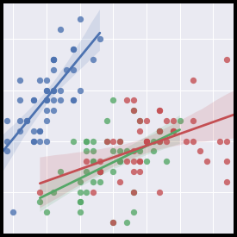


Data Analysis

Slide 8
Data Analysis
Investigative Themes
Which attributes of tutors and schools relate to our many success metrics?
How can we better model program implementation to set realistic expectations and inform actionable intervention

Slide 9
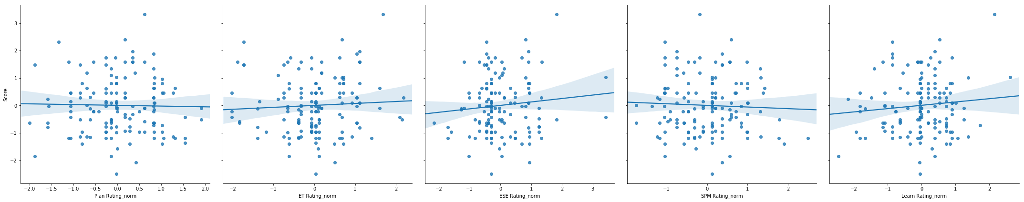
Data Analysis
Tutoring Quality and Student Performance
Planning
Tutoring Strategy
Student Engagement
Progress Monitoring
Implementation of Training

Slide 10
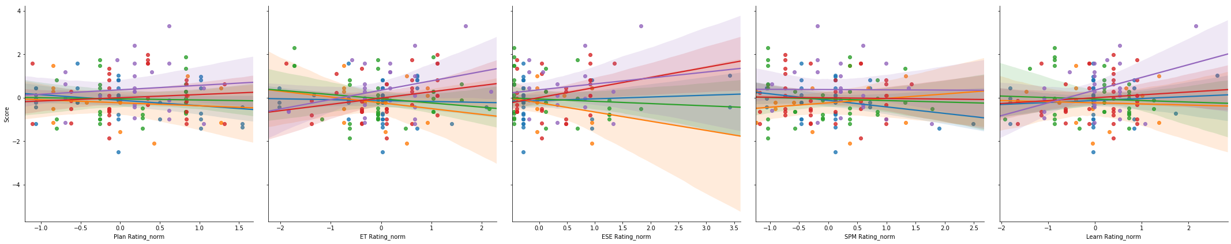
Data Analysis
Tutoring Quality and Student Performance
Planning
Tutoring Strategy
Student Engagement
Progress Monitoring
Implementation of Training

Slide 11
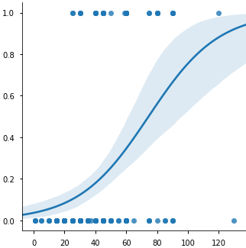
Data Analysis
Commuting Challenge
Challenge Likelihood
One-Way Commute (mins)

Slide 12
Next Steps
Full-year context
Longitudinal data
Direct data from CPS

Slide 13
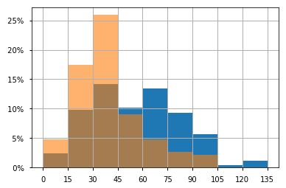


Web App
Placement Algorithm
Place tutors into schools at start of year
Balance for diversity, commuting, language speaking ability
School Year 2017
School Year 2018
One-Way Commute (mins)

Slide 14






Web App

Slide 15
Demo

Slide 16

Thank You ChiPy

