Slide 1



Implementing Python at an AmeriCorps Nonprofit
Chris Luedtke, mentored by Aly Sivji
Notes:
Until 0:09

Slide 2
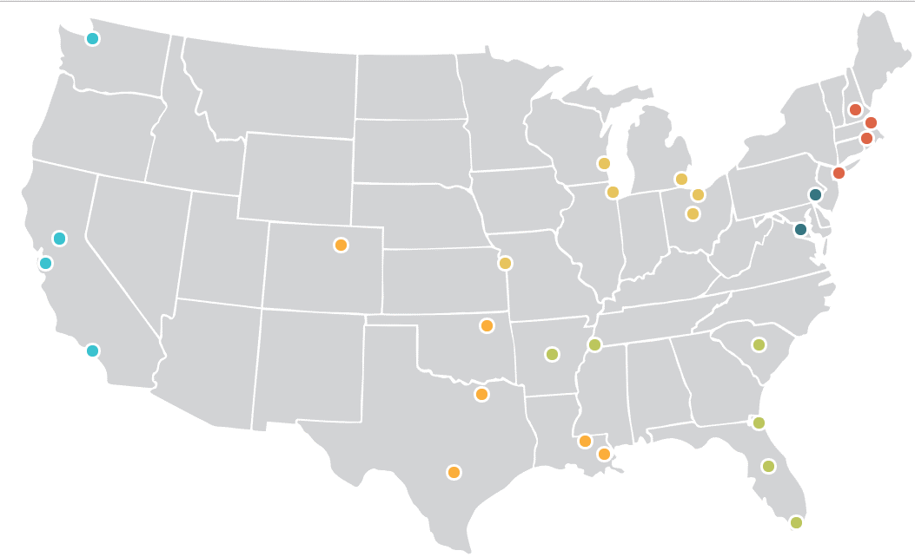
3,000+ AmeriCorps Members yearly
29 city locations
Full time tutors and mentors
Grades 3-9
Notes:
Until 0:36
I’m an analyst at City Year, an educational nonprofit that works toward equitable access to quality education
Each year we enlist thousands of AmeriCorps Members in 29 cities to tutor and mentor students most at risk of dropping out
Each tutor has a cohort of students they are responsible for moving
In my mentorship, I wanted to implement Python where few had done so before
Only a few of our city locations have analyst staff, so properly built data products may multiply across sites and have large organizational impact

Slide 3

How I’ve Used Python
Data intake from the field
Data flow to reporting
Data analysis
Web app machine learning tool
Notes:
Until 00:48

Slide 4




Data intake from the field
+
x 26 schools
x 250 tutors
x 3,000 students
Automated publishing
Selenium WebDriver
Notes:
Until 01:29
Our data are housed in Salesforce, and without Python, uploading data required manually processing and submitting spreadsheets or clicking through interfaces hundreds of times
My first revelation in this mentorship was writing Python scripts to communicate with the Salesforce API
I used Python to update and gather Excel spreadsheets and push them to our database through API commands, requiring just minutes to complete
In cases where database permissions wouldn’t allow edits, I used Selenium to submit repetitive forms in the browser interface

Slide 5

Data flow to reporting
Automated PDF distribution
Powerful Analytics
Notes:
Until 02:00
In terms of reporting, while Excel and Power BI provide continuous data flow and visuals, querying Salesforce through Python allows complete control over publishing and file management
For example, Service Tracker PDFs
Pythonic queries also expose the data to more powerful analytic tools

Slide 6



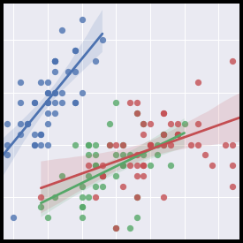


Data Analysis
Notes:
Until 2:12
I also wrote a system of analysis notebooks to gather all our data sources, investigate themes, and visualize uncommon comparisons across datasets.

Slide 7
Data Analysis
Investigative Themes
Which attributes of tutors and schools relate to success metrics like student growth targets and tutor satisfaction?
Can we better model program implementation to set expectations and inform actionable intervention?
Notes:
Until 2:29

Slide 8
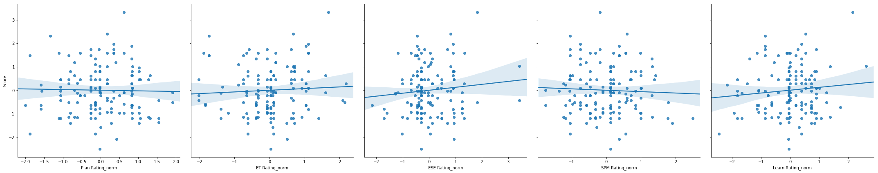
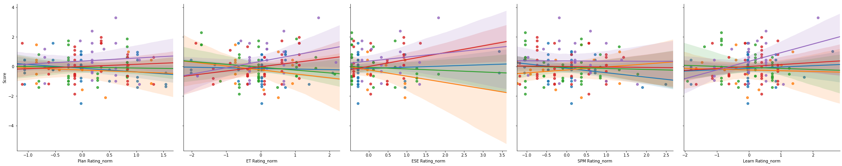
Data Analysis
Tutor’s Student Performance vs. Tutoring Quality
Planning
Tutoring Strategy
Student Engagement
Progress Monitoring
Training Implementation
Notes:
Until 2:54
For example, this analysis of tutor observation scores and tutor’s student performance
Each dot represents a tutor
Low correlation, but when split by coach, some correlations emerge.
This analysis is the start to building analytic tools that enable us to act – for example to provide better training
Keep in mind this is only half a year’s data

Slide 9
Next Steps
Full-year context
Longitudinal data
Direct data from CPS
Notes:
Until 3:25
While I haven’t satisfied my investigation, I know what resources are likely to get me there
With this infrastructure and the intuition I've built for the data, I will quickly incorporate end-of-year data this summer
The context of an entire year will inform which attributes to extract from prior years, adding power to my analysis
Due to our manual processes, data quality challenges the analyses I run, but next year we are implementing a data sharing agreement with CPS

Slide 10
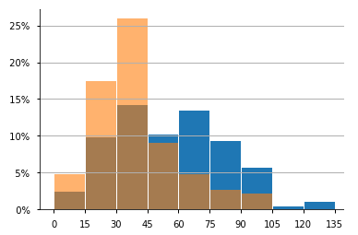


Web App
Placement Algorithm
Place tutors into schools at start of year
Balance for diversity, commuting, language speaking ability
2017
2018
One-Way Commute (mins)
Notes:
Until 4:01
I also built a webapp to serve one of our most impactful data products
In the last year and a half I wrote an R-based algorithm to place tutors into schools based on diversity, commuting, and language speaking ability
Using this tool in Chicago, the average tutor commutes 90 hours fewer than in the previous year
This year only 10% of Chicago’s tutors commute 60 mins or more one way
However, the tool is too technical to implement in cities without analytics staff

Slide 11






Web App
Notes:
Until 4:10
So I built a Django webapp packaged into a docker container and served on azure

Slide 12
Voilà!
Notes:
Until 4:40
Next step is to incorporate a dashboard to communicate the quality of results
I have only scratched the surface of what Python can do – there is so much opportunity for technical folks to support the important work organizations like City Year and AmeriCorps are doing

Slide 13

Thank You ChiPy

