Slide 1

Python in an Educational Nonprofit
Chris Luedtke, Mentored by Aly Sivji

Slide 2

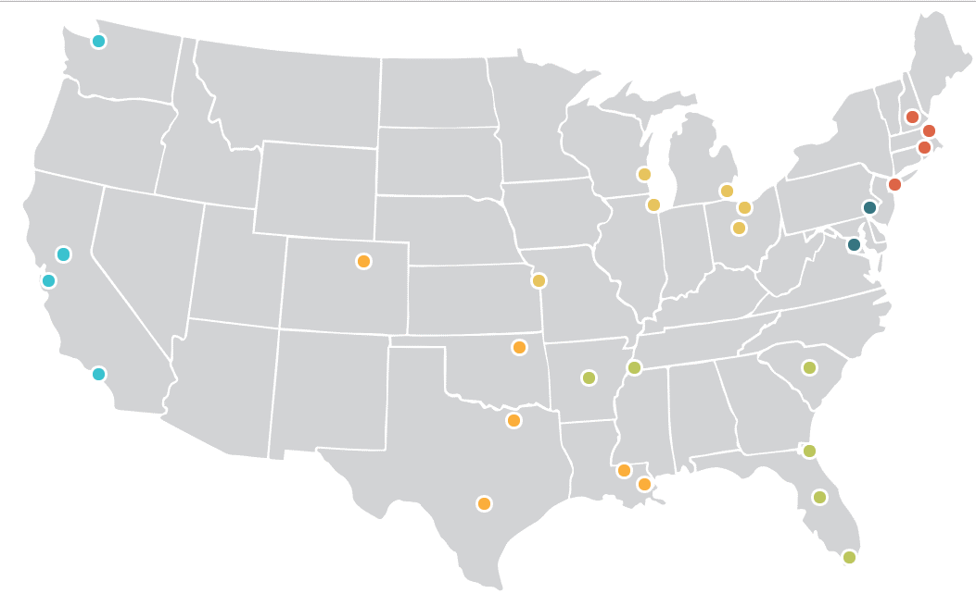
1,500+ AmeriCorps Members yearly
29 city locations
Full time tutors and mentors
Grades 3-9
Notes:
I work as an analyst for City Year, an educational nonprofit which enlists thousands of AmeriCorps Members in 29 cities to tutor and mentor students toward high school graduation
My task at work is to make information available to drive decisions
Since only a few of our city locations have dedicated analysts, there is great potential for properly built data products to multiply across sites and have large organizational impact

Slide 3

How I’ve Used Python
Data intake from the field
Data flow to reporting
Data analysis
Web app for machine learning

Slide 4




Data intake from the field
+
x 26 schools
x 250 staff
x 2,000 students
Automated Publishing
Selenium WebDriver
Notes:
My organization utilizes Salesforce for data warehousing, so my first revelation in this mentorship was writing Python scripts to manipulate our database through Salesforce's API
Writing to our Salesforce database has been an enormous pain-point involving manually processing spreadsheet uploads in the best case, or manually clicking through an interface hundreds of times in the worse case. Also prone to error and limited
I used Python to gather Excel spreadsheets and push them to our database through API commands, requiring mere minutes to complete
Our Salesforce database fields are heavily permissioned down terms of field writing permissions

Slide 5

Data flow to reporting
Automated PDF distribution
Powerful Analytics
Notes:
While Excel and Power BI are sufficient and often powerful tools for continuous data flow and visuals, querying Salesforce through Python allows for complete control over publishing and file management, and exposes the data to more powerful analytic tools.
For example, Service Tracker PDFs

Slide 6



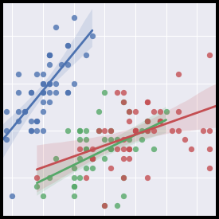
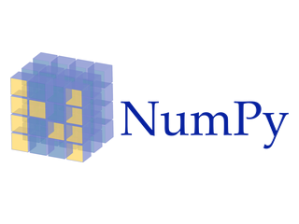

Data Analysis
Notes:
I wrote a system of analysis notebooks to gather all our data sources, investigate themes, and visualize uncommon comparisons across datasets.

Slide 7
Data Analysis
Investigative Themes
Which attributes of tutors and schools relate to success metrics like student growth targets and tutor satisfaction?
Can we better model program implementation to set expectations and inform actionable intervention?

Slide 8
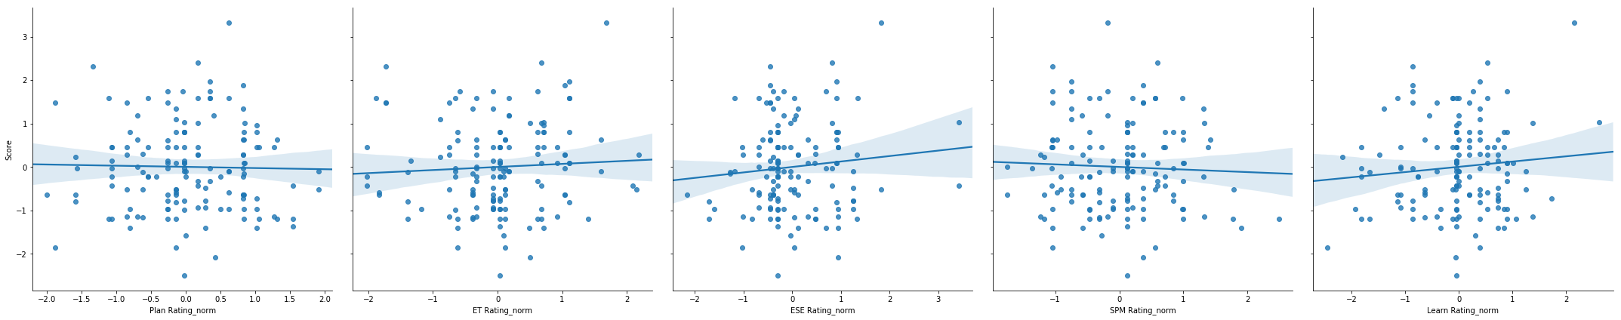
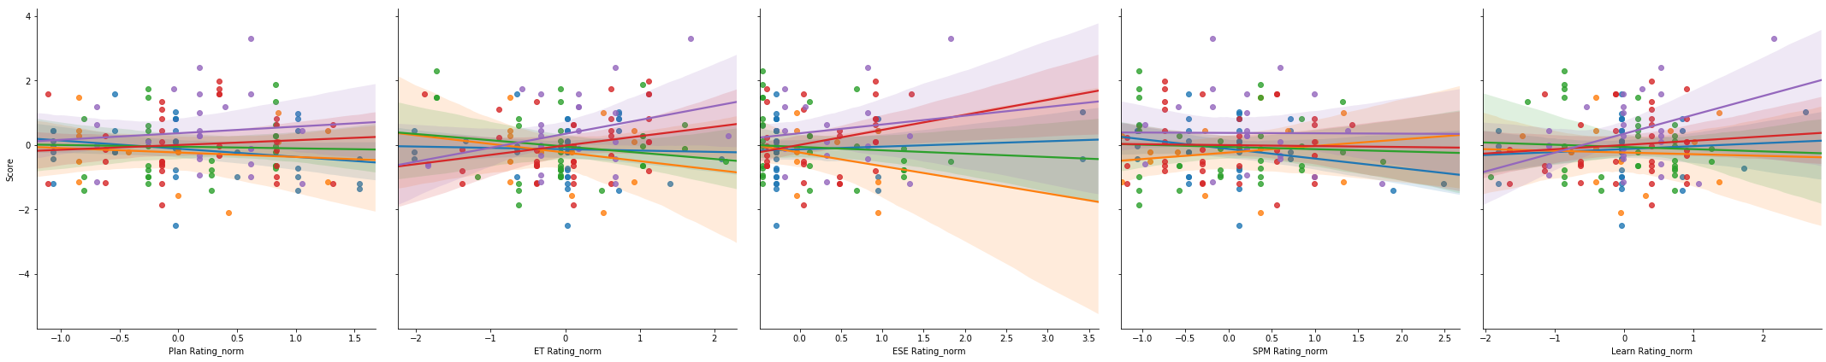
Data Analysis
Observation Scores and the Tutor’s Student Performance
Planning
Tutoring Strategy
Student Engagement
Progress Monitoring
Training Implementation
Notes:
For example, this analysis of tutor observation scores and tutor’s student performance
Each dot represents a tutor
Y axis
X axis
Low correlation, but when split by coach, some correlations emerge
Keep in mind this is only half a year’s data

Slide 9
Next Steps
Full-year context
Longitudinal data
Direct data from CPS
Notes:
While I haven’t satisfied my investigation, I know what resources are likely to get me there
With this infrastructure and the personal intuition I've built for the data, I can quickly incorporate end-of-year data this summer
The context of an entire year of programming will inform which attributes to extract from prior years, adding power to my analysis
Due to our manual processes, data quality is a challenge in my analysis, but next year we are implementing a data sharing agreement with CPS

Slide 10
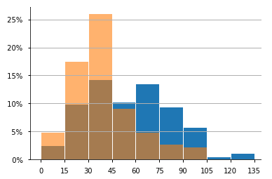

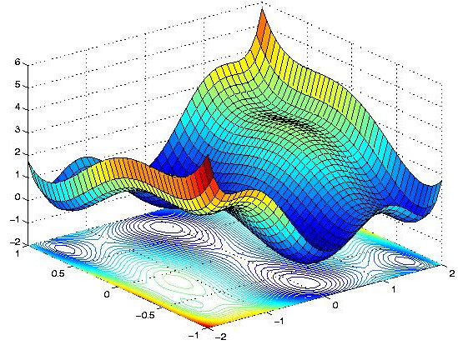
Web App
Placement Algorithm
Place tutors into schools at start of year
Balance for diversity, commuting, language speaking ability
School Year 2017
School Year 2018
One-Way Commute (mins)
Notes:
With the remainder of my mentorship I built a webapp to serve one of our most impactful data products
In the last year and a half I wrote an R-based algorithm to place tutors into schools based on diversity, commuting, and language speaking ability
Without this tool, 30% of tutors commuted 60 mins or more one way. That number is just 10% this year
In other words the average tutor commutes 90 hours less this year because of this tool
However, the tool is too technical to implement in cities without analytics staff

Slide 11
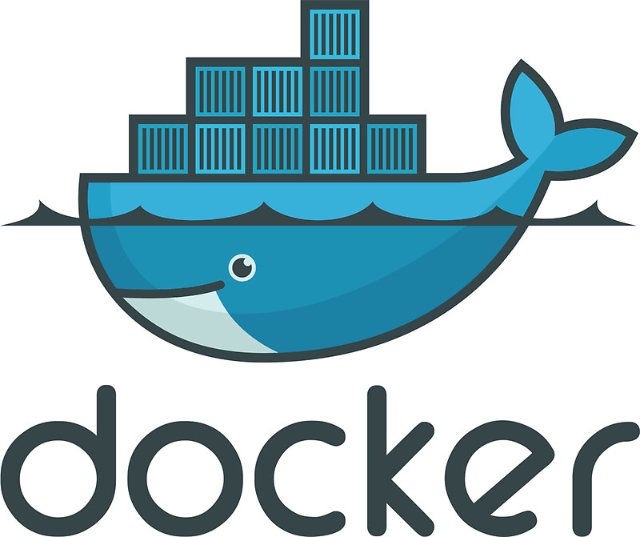





Web App
Notes:
So I built a Django webapp packaged into a docker container and served on azure

Slide 12
Voilà!

Slide 13

Thank You ChiPy

