Slide 1

Python for Nonprofits
Chris Luedtke, Mentored by Aly Sivji

Slide 2

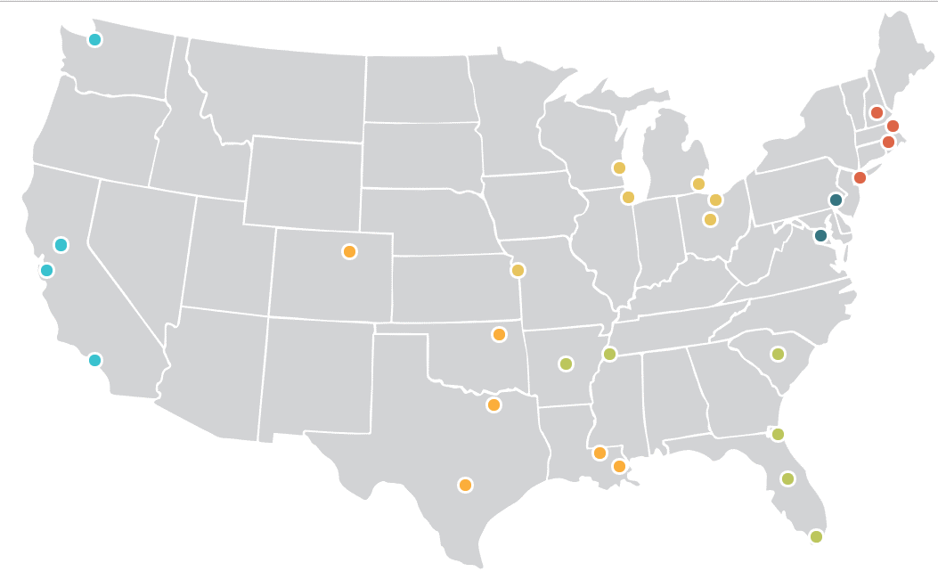
Enlist 1,500+ AmeriCorps Members
Full time tutors and mentors
28 city locations

