Slide 1

IGGI-3
Getting IGGI with it

Slide 2
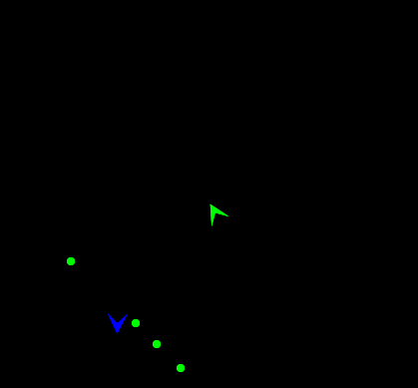
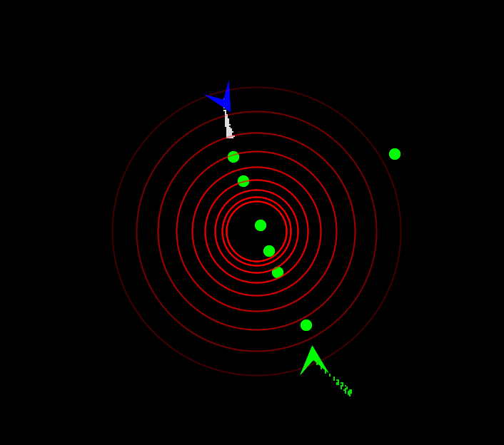
What changes did we make?
Mines as a new kind of missile
Shockwaves to bounce objects about

Slide 3
Mines
Mines are dropped by the Space Ship
Immediately active against enemy Space Ship
Will detonate when enemy Space Ship collides with it
Can be destroyed by Missiles
Each Space Ship has a limited supply, with a cost for each one dropped

Slide 4
Shockwaves
Shockwaves are generated when two objects collide
Space ships
Missiles
Any object within range will be pushed away by the shockwave

