Slide 1
LINUX ON AN FPGA
Chris Major
CSCI460 – Operating Systems
Fall 2019

Slide 2
IMPLEMENT AN OS ONTO AN FPGA
Develop a custom hardware design to support Yocto Linux

Slide 3

WHAT IS AN FPGA?
Field Programmable Gate Array
Create custom digital logic design
Can create Softcore Processors
Image from https://www.coursera.org/learn/intro-fpga-design-embedded-systems

Slide 4
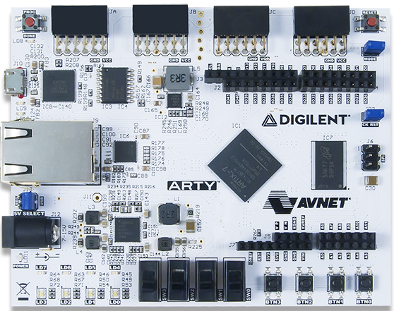
THE DEVELOPMENT BOARD
Artix-7 “Arty” Board
5 V power source
Ethernet support
GPIO for additional functionality
QSPI Flash and DDR3L Memory
Image from https://store.digilentinc.com/arty-a7-artix-7-fpga-development-board-for-makers-and-hobbyists/

Slide 5
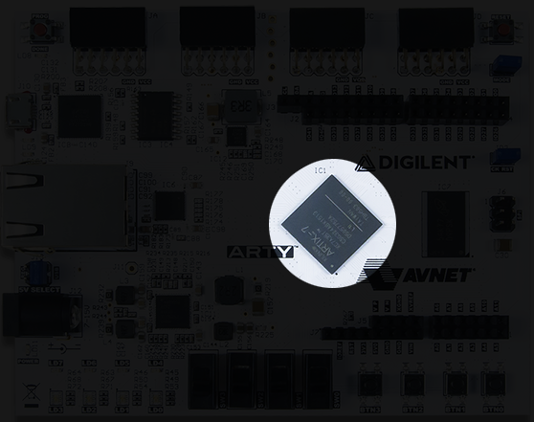
THE DEVELOPMENT BOARD
Uses a Xilinx Artix-7 XC7A35T FPGA chip
Image from https://store.digilentinc.com/arty-a7-artix-7-fpga-development-board-for-makers-and-hobbyists/

Slide 6
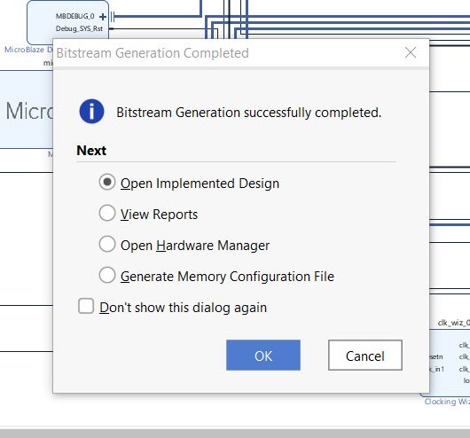
WORKFLOW
Generate design
Bitstream Generation
Test Software
Create Petalinux Project
Configure Petalinux
Build Petalinux Image
Boot
Demo

Slide 7
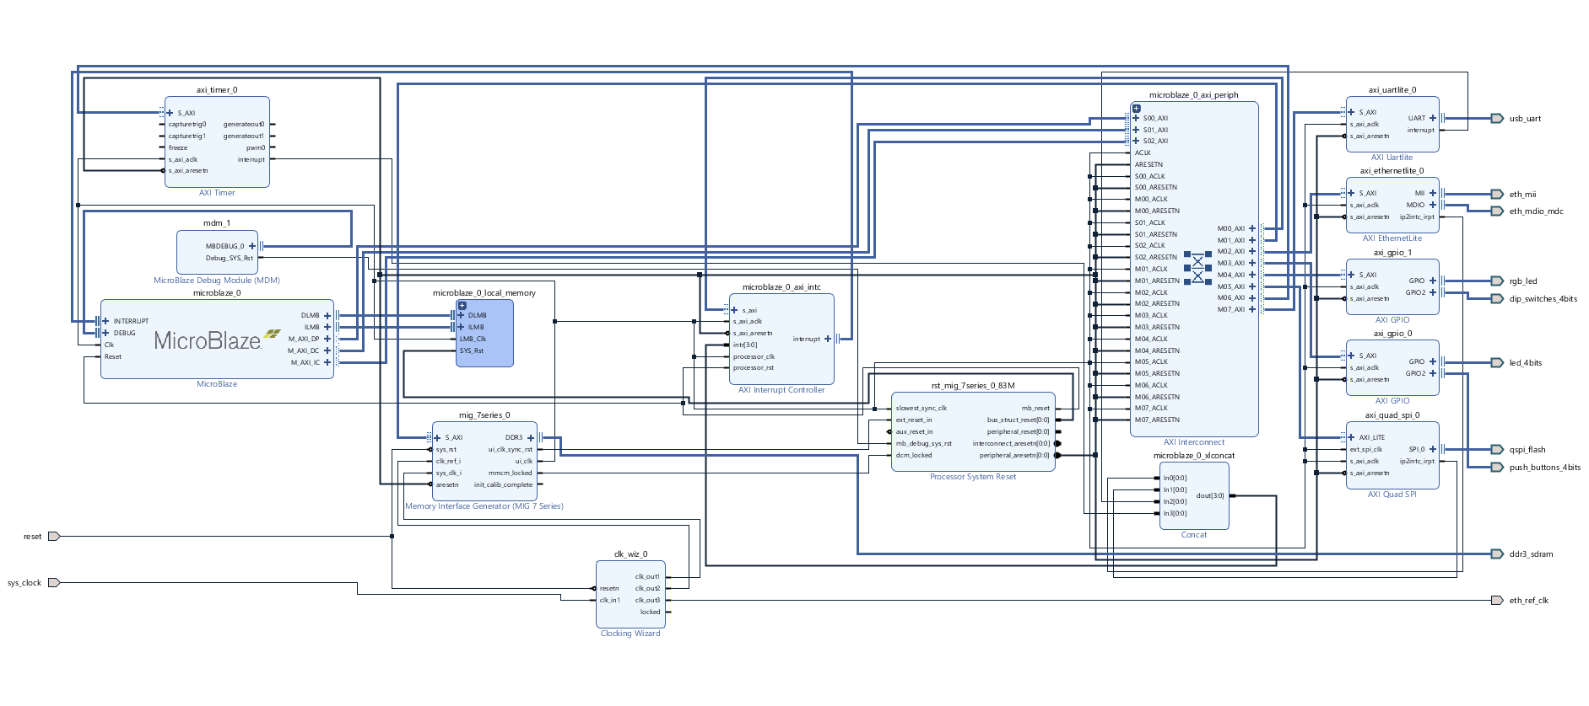
GENERATE DESIGN

Slide 8
BITSTREAM GENERATION

Slide 9
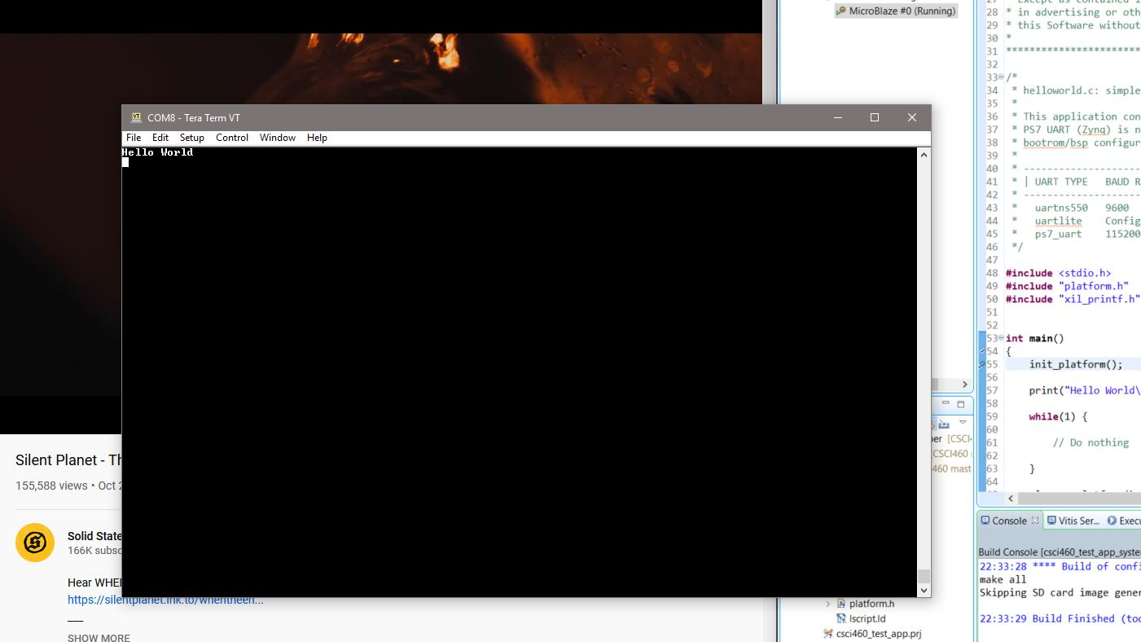
TEST SOFTWARE

Slide 10

CREATE PETALINUX PROJECT

Slide 11
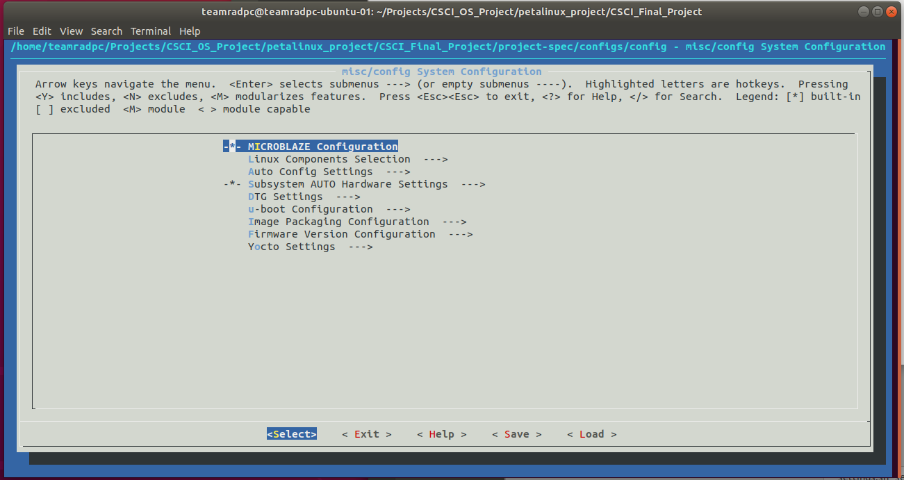
CONFIGURE PETALINUX

Slide 12
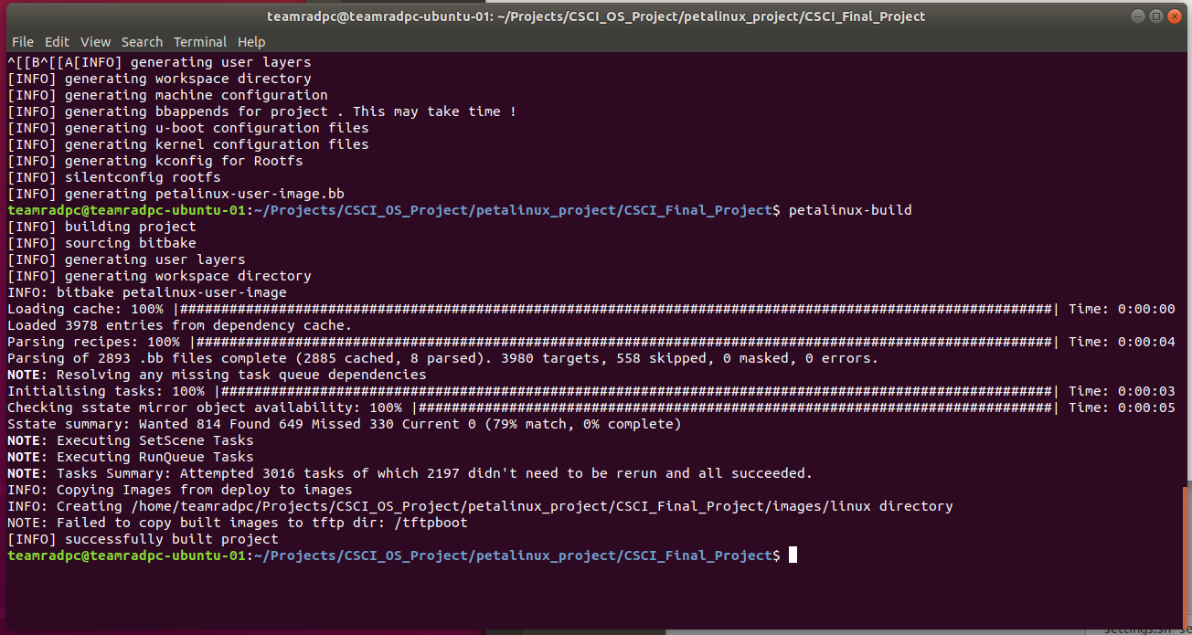
BUILD PETALINUX IMAGE

Slide 13
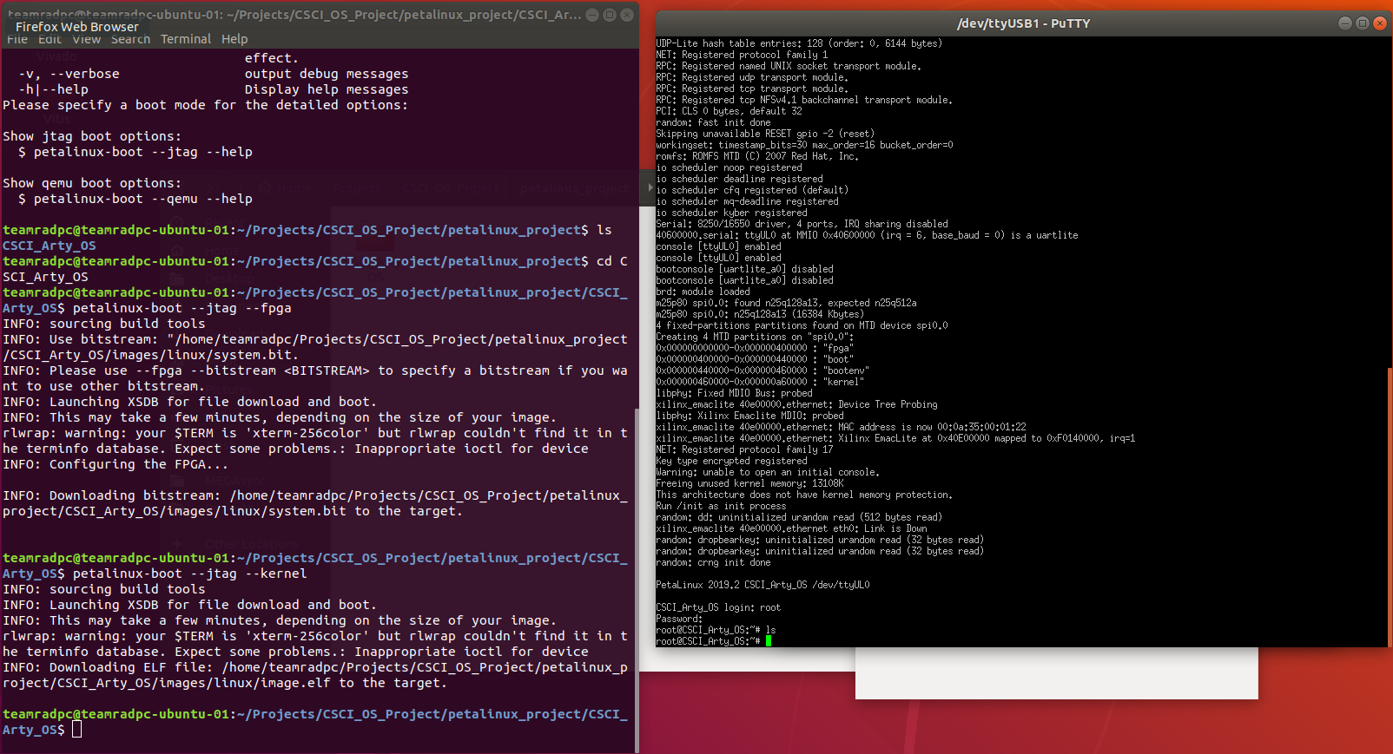
BOOT

Slide 14
DEMO
Stand by for SSH …

Slide 15
SOURCES
https://www.xilinx.com/support/documentation/sw_manuals/xilinx2019_2/ug1144-petalinux-tools-reference-guide.pdf
https://www.xilinx.com/support/documentation/sw_manuals/xilinx2019_2/ug1157-petalinux-tools-command-line-guide.pdf
https://www.yoctoproject.org/
https://reference.digilentinc.com/_media/reference/programmable-logic/arty/arty_rm.pdf
https://reference.digilentinc.com/_media/reference/programmable-logic/basys-3/basys3_rm.pdf?_ga=2.8933622.29982397.1565915174-26851832.1557255277&_gac=1.211996064.1565915174.EAIaIQobChMIg4fPyJCG5AIVGh6tBh38AgkFEAAYASAAEgITxPD_BwE
https://www.youtube.com/watch?v=8oIZxv3fJxs
https://www.youtube.com/watch?v=TR2g6pAKRT0

Slide 16
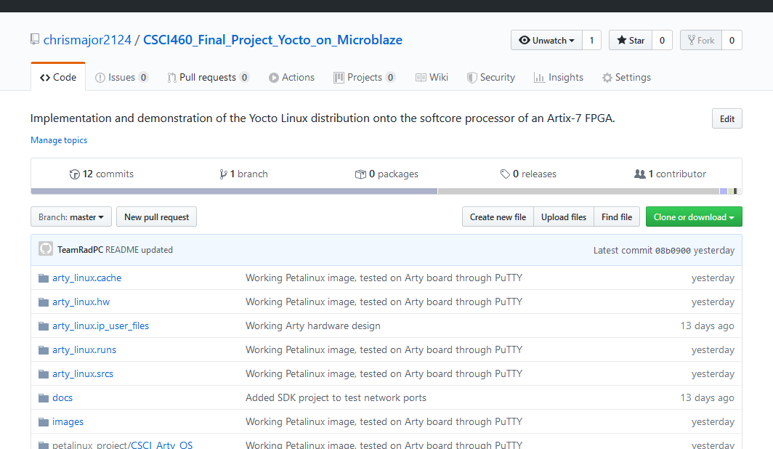
GIT REPO
https://github.com/chrismajor2124/CSCI460_Final_Project_Yocto_on_Microblaze

